Slide 1
Avian reoviral Diseases, Egg Drop syndrome-76 & avian viral nephritis
DR. KAUSHAL KUMAR
Assistant Professor & Head
Department of Veterinary Pathology
Bihar Veterinary College, BASU, Patna

Slide 2
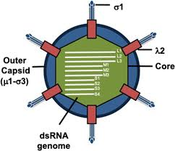
INTRODUCTION-Avian reoviral Diseases
Avian reoviruses has been isolated from
Clinically normal poultry as well as
Diseases such as tenosynovitis, enteritis, hydropericarditis & runting syndrome.
All reoviruses posses a common antigen detectable by AGPT/FAT/CFT
It can affect the gastrointestinal system (such as Rotavirus) and respiratory tract.
It’s dsRNA containing virus ,genomes consists of 8–11 segmented,
Clinically Important diseases caused by them are:
Viral Arthritis
Runting syndrome
Pasty Vent Disease

Slide 3
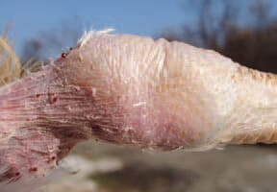
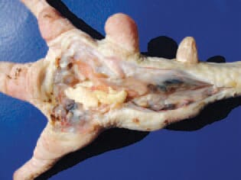
Avian Reoviral Disease-VIRAL ARTHRITS
It affect mainly Broiler Birds
HOST: Chicken of 3-16 Wk. age
Broiler are highly susceptible between 6-7 wk
Layer/breeder are asymptomatic but hatchability decreases
SPREAD: contact/inhalation/ingestion and rarely by eggs
MORTALITY:1-2%; MORBIDITY: up to 50%
SIGN: Symptomless viremia, lameness
Inflammation of tendon and synovial sheaths of leg / foot pads and joints
Swollen hock joint
Ruptured gastrocnemius tendons and synovial sheaths
DIAGNOSIS: virus isolation/AGPT/Neutralisation Test
Swellings affecting primarily in the tarsometatarsal joints
Fibrinous tenosynovitis in foot pad

Slide 4
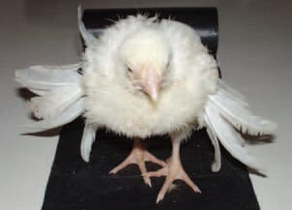
Avian Reoviral Disease-RUNTING SYNDROME Commonly knowns as HALICOPTOR DISEASE
The growing primary wing feathers are abnormally big for chickens with retarded growth, they protrude at various angles, so the disease is termed ..helicopter disease"
HOST:
Poultry chicks are highly susceptible between 1-2 wk.
But may recover at about 4 wk of age
SPREAD: Inhalation/ingestion
MORTALITY:3-4%; MORBIDITY: up to 60%
SIGN:
Poor feathering
Poor shank pigmentation
LESION:
Gall bladder distended with bile and
atrophied bursa of fabricious
Intestine distended with ingesta
DIAGNOSIS: virus isolation/AGPT/Neutralisation Test
Diseases has not been confirmed in India but supposed to be prevalent on the basis of clinical finding.

Slide 5
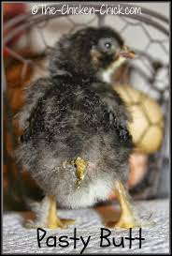
Avian Reoviral Disease-PASTING VENT DISEASE Commonly knowns as REOVIRUS ENTERITIS and CLOACAL PASTING
HOST: Poultry chicks are highly susceptible between 3-4 day old.
SPREAD: Ingestion/Inhalation
MORTALITY:3-5%; MORBIDITY: 10-15%
SIGN:
White pasty excreta sticking around the vent feather, forming a lump.
Poor shank pigmentation.
LESION:
Enteritis and
Distension of cloaca with white pasty excreta.
DIAGNOSIS: Age of the bird & symptoms of pasty vent.

Slide 6
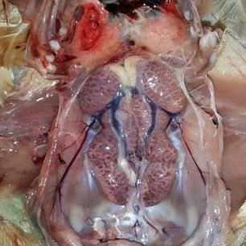
AVIAN VIRAL NEPHRITIS Commonly knowns as BABY CHICK NEPHOPATHY (BCN)
HOST: Poultry chicks up to 4 week old.
ETIOLOGY: Avian nephritis virus-
RNA Virus-Enterovirus of family Picornaviridae
SPREAD: Ingestion/Inhalation
SIGN:
Stunted/poor growth of the bird
Nephropathy-
Swollen kidney
Deposition of urates crystal in kidney
Protein cast in the renal tubules
Nephrocalcinosis
Urate deposition in visceral organs/joints (sometimes)

Slide 7
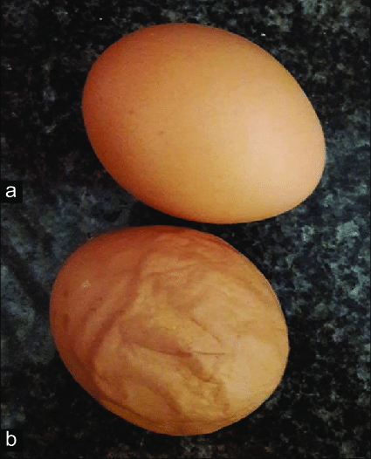
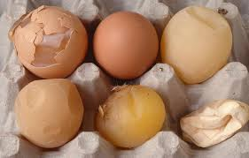
EGG DROP SYNDROME-76 (Reported first time in Netherlands in 1976 by Van Eck)
In India, it was reported since 1980 and characterised by production of pale, soft-shelled, and shell-less eggs by apparently healthy laying hens
ETIOLOGY: Adenovirus BC14
SPREAD: Horizontal as well as vertical transmission
SIGN:
Sudden and variable drop in egg production (35-40%)
Lowest egg production about 9 days post infection.
Deprived Egg Quality-
Depigmentation/ pale
Cracked/Shell less eggs
LESION: Edema of uterine folds with tubular atrophy

Slide 8
THANKS

