Slide 1
BIOCHEMISTY
Course No.-DTC-111, Credit Hours – 2 (1+1)
ENZYME INHIBITION
BINITA RANI
ASSOCIATE PROFESSOR (DAIRY CHEMISTRY)
FACULTY OF DAIRY TECHNOLOGY
S.G.I.D.T., BVC CAMPUS,
P.O.- BVC, DIST.-PATNA-800014

Slide 2
Inhibitors are molecules that => resemble the substrate(s) or product(s) and bind to => active site => thus => they interfere with catalysis => slowing or halting enzymatic reactions.
Many drugs are => reversible enzyme inhibitors.
They have their physiological effect by => decreasing => the activity of a specific enzyme.
For example, aspirin (acetylsalicylate) => inhibits the enzyme that catalyzes the first step in the synthesis of prostaglandins => compounds involved in many processes => including some that produce pain.

Slide 3
Concentration of inhibitor needed => to inhibit enzyme => depends on how tightly inhibitor binds to the enzyme.
Inhibition constant (Ki) is used to describe => how tightly an inhibitor binds to an enzyme.
Types of Inhibitors
There are two broad classes of enzyme inhibitors:
• Irreversible
• Reversible

Slide 4
Irreversible
irreversible inhibitors are those :
that bind covalently with enzyme or
destroy a functional group on an enzyme => that is essential for enzyme’s activity, or
that form => particularly stable noncovalent association.
Formation of a covalent link between => an irreversible inhibitor and an enzyme is => common.
For example => reaction of chymotrypsin with diisopropylfluorophosphate (DIFP) => irreversibly inhibits enzyme by binding with Ser195 in the active-site of chymotrypsin.

Slide 5
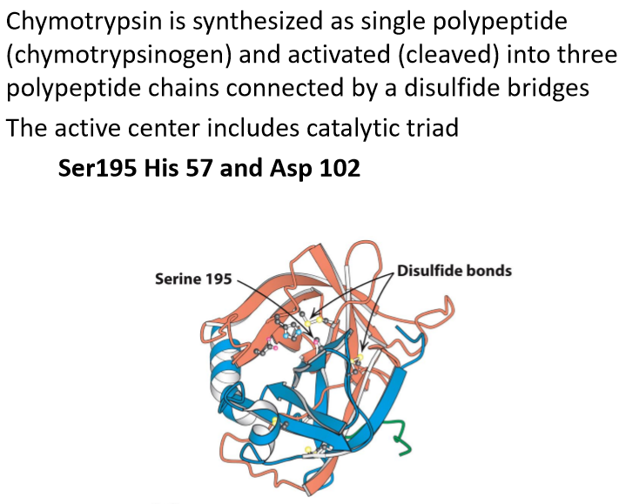
Diisopropylfluorophosphate as irreversible inhibitors of chymotrypsin

Slide 6
Reversible
This type of inhibition involves => equilibrium between enzyme and inhibitor => equilibrium constant (ki) => being the measure of affinity of the inhibitor for the enzyme.
This inhibition is further classified into three categories:
Competitive
Uncompetitive
Noncompetitive.

Slide 7
Competitive Inhibition
Competitive inhibitors bind only to => free enzyme and to the same site as the substrate.
Competitive inhibitors are => molecules that usually look like the substrate but can’t undergo the reaction.
At an infinite concentration of the substrate => competitive inhibitor cannot bind to the enzyme since => substrate concentration is high enough that => there is virtually no free enzyme present.

Slide 8
Since competitive inhibitors have => no effect on the velocity at saturating (Vmax) concentrations of the substrate => intercepts of the double reciprocal plots (1/Vmax) at all the different inhibitor concentrations are => the same.
The lines at different inhibitor concentrations => must all intersect on the y axis at the same 1/Vmax.

Slide 9
At low concentrations of substrate ([S] << Km) => enzyme is predominantly in the E form.
competitive inhibitor can combine with E => so the presence of the inhibitor => decreases => the velocity when => substrate concentration is low.

Slide 10
Competitive Inhibition
Under competitive inhibition
Vmax remains unchanged ; Km increases

Slide 11
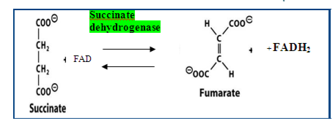
Under competitive inhibition
Vmax remains unchanged ; Km increases
Example :
Malonate is a competitive inhibitor of => succinate dehydrogenase .
The enzyme uses succinate as its substrate but inhibited by malonate => which is structurally similar to succinate and => differs in having => one rather than two methylene groups.

Slide 12
Uncompetitive Inhibition
If inhibitor combines only => with ES (and not E) => inhibitor exerts its effect only at => high concentrations of substrate at which => there is lots of ES around.
This means that the increasing substrate concentration (S) => doesn’t prevent => binding of the inhibitor.

Slide 13
Interestingly Km value is consistently smaller than Km value of the uninhibited reaction => which implies that => S is more effectively bound to the enzyme in the presence of the inhibitor.
The sequence of this type of reaction is

Slide 14
This type of inhibition is often observed for enzymes => that catalyze the reaction between two substrates.
Often an inhibitor that is => competitive against one of the substrates is found to give => uncompetitive inhibition => when the other substrate is varied.
The inhibitor does combine at active site but => does not prevent => binding of one of the substrates (and vice versa).

Slide 15
In this type of inhibition => Vmax as well as Km both are decreased
Uncompetitive Inhibition

Slide 16
Non-competitive Inhibition
Compounds that reversibly bind with either the enzyme or the enzyme substrate complex are designed as => noncompetitive inhibitors and the following reaction describe these events.
Non competitive Inhibition

Slide 17
Noncompetitive inhibition therefore differs from competitive inhibition in that => inhibitor can combine with ES, and S can combine with EI to form => in both instances EIS.
This type of inhibition is not completely reversed by => high substrate concentration => since closed sequence will occur => regardless of the substrate concentration.
Since inhibitor binding site is not identical to nor does it modify the active site directly => Km is not altered but Vmax is decreased.

Slide 18
For example => amino acid alanine noncompetitively inhibits => enzyme pyruvate kinase.
Alanine is one product of => a series of enzyme-catalyzed reactions => first step of which is catalyzed by pyruvate kinase.

Slide 20
THANKS

