Slide 1
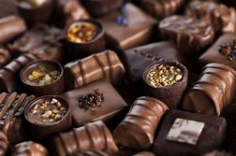
Department : Dairy Technology Course Title : Food Technology I Course No. : DTT -322 Course Teacher: Bipin Kumar Singh
CHOCOLATES

Slide 2
Introduction
Chocolate is a preparation of roasted and ground cacao seeds that is made in the form of a liquid, paste, or in a block, which may also be used as a flavoring ingredient in other foods. The earliest signs of use are associated with Olmec sites suggesting consumption of chocolate beverages, dating from 19 centuries BCE. The majority of Mesoamerican people made chocolate beverages, including the Maya and Aztecs. The word chocolate is derived from the Spanish word chocolate, deriving in turn from the Classical Nahuatl word xocolātl.
Chocolate means a homogeneous product obtained by an adequate process of manufacture from a mixture of one or more of the ingredients, namely, cocoa beans, cocoa nib, cocoa mass, cocoa press cake and cocoa dust (cocoa fines/powder), including fat reduced cocoa powder with or without addition of sugars, cocoa butter, milk solids including milk fat. The chocolates shall not contain any vegetable fat other than cocoa butter.
Types of Chocolate
Plain chocolate
Milk chocolate
Milk covering chocolate
White chocolate
Filled chocolate
Composite chocolate

Slide 3
FSSAI Requirements for Chocolate
Milk chocolates is obtained from one or more of cocoa nib, cocoa mass, cocoa press cake, cocoa powder including low-fat cocoa powder, with sugar and milk solids, including milk fat and cocoa butter.
Milk Covering Chocolate is as defined above, but suitable for covering purposes.
Plain Chocolate is obtained from one or more of cocoa nib, cocoa mass, cocoa press cake, cocoa powder including low fat cocoa powder, with sugar and cocoa butter.
Plain Covering Chocolate is same as that of plain chocolate but suitable for covering purposes.
Blended Chocolate means the blend of milk and plain chocolates in varying proportions.
White chocolate is obtained from cocoa butter, milk solids, including milk fat and sugar.
Filled Chocolates means a product having an external coating of chocolate with a centre clearly distinct through its composition from the external coating, but does not include flour confectionery pastry and biscuit products.
Composite Chocolate means a product containing at least 60.0 % of chocolate by weight and edible wholesome substances such as fruits, nuts.
Packing:Bulk chocolates shall be packed in clean, sound and odour-free containers made of tin-plate, plastic, greaseproof paper, aluminium foil, cellulose film or other suitable flexible packaging materials.

Slide 4
Other Versions of Chocolate Products
Unsweetened chocolate
Dark chocolate
Milk chocolate
Baking chocolate
Couverture

Slide 5
Legislation of Cocoa Products
Most EEC and USA, the name „chocolate‟ may only be used if no other fat is present but cocoa butter. Cocoa butter equivalent fats, up to 5.0% of the total chocolate content may be used in UK, Ireland, Denmark and Sweden.
Formulation for Some Types of Chocolate
Types of chocolate | Cocoa mass,% | Cocoa butter,% | Milk powder,% | Sugar, %
Dark chocolate | 40 | 10 | - | 50
Milk chocolate | 10 | 20 | 15 | 55
Enrobing chocolate | 40 | 15 | - | 45
White chocolat | - | 25 | 25 | 50

Slide 6
Ingredients in Chocolate
Milk solids
Milk crumb
Butter Oil
Cocoa butter
Sugar
Purpose of using sugar
(a) Stabilization of product (b) Reduced bacterial growth and possibility of lipolytic rancidity (c) Uniform flavour to product (d) Balances some of the bitter taste of cocoa

Slide 7
Contd…
Emulsifiers
Lecithin
Advantages (a) Prevents fat bloom. (b) Lowers viscosity of chocolate mass by reducing its surface tension. (c) Fixes the flavour and essential oils into product. (d) Exerts an antioxidant effect.
Sorbitan mono-stearate
Advantages (a) Prevents fat bloom. (b) Forms a layer on starch, sugar and fibre.
Flavourings

Slide 8
Production of Chocolate
Mixing of ingredients
Refining
Conching
Objectives: The objective of conching are as follows:
Conversion of powdery, crumbly refined product into a flowable suspension of sugar, cocoa and milk powder particles in a liquid phase of cocoa butter.
(b) Allows the chocolate mass to be further mixed.
(c) Removes the undesirable flavour while developing the pleasant ones; bitterness is reduced, perhaps allowing other flavour notes to be more pronounced.
(d) Develops a mellow chocolate with a smooth mouthfeel.
(e) Develops the flow properties as well as flavour by coating the new surface with fat.

Slide 9
Contd..
Type of Conches Batch Conches –
(i) Longitudinal conches,
(ii) Rotary (round) conches.
Continuous Conches.
Phases in conching process
Dry phase
Pasty phase
Liquid phase
Effect of conching:In the Conche, the water content of chocolate masse is lowered from ~ 1.6% to 0.6-0.8%. As the moisture is removed, it takes with it many unwanted flavourcomponents. In this way approximately 30% of short chain volatile fatty acids (viz., acetic acid) and up to 50% of low-boiling aldehydes are volatilized. Such removal of volatilized acid component is necessary to give the finished chocolate a full „rounded‟ flavour.
Variables affecting conching
Temperature
Time of conching
Size of particles

Slide 10
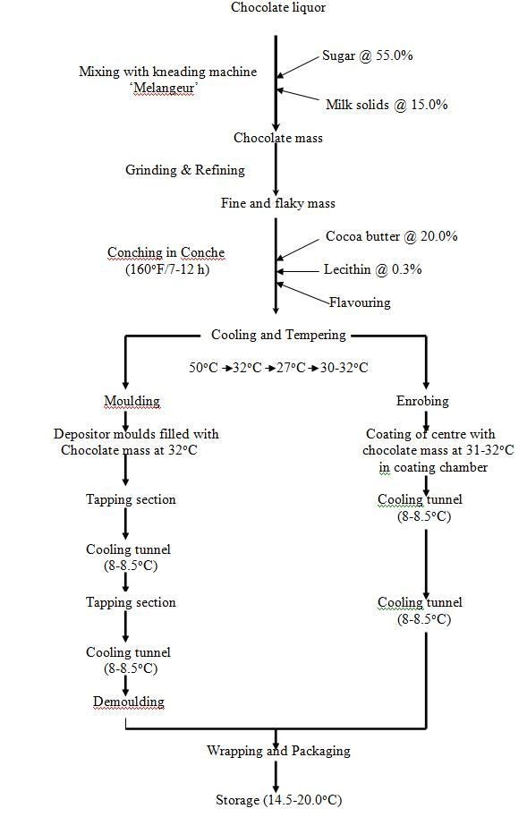
Production of Milk chocolate from cocoa mass

Slide 11
Contd…
Cooling and Tempering
Objectives of cooling and tempering
To develop a sufficient number of seed crystals to encourage the total fat phase to crystallize in a more stable polymorphic form. This in turn, will produce a better overall contraction and a more stable product.Temper is the induced partial pre-crystallizaiton of cocoa butter. Tempering, in general, involves reducing the temperature of the chocolate to induce crystallization of both stable and unstable polymorphs. The temperature is subsequently raised to a point where the unstable polymorphs melt, leaving only polymorphically stable crystals which can then „seed‟ the crystallization of the bulk chocolate in a stable polymorphic form

Slide 12
Contd…
Polymorphism of cocoa fat
Tempering process The tempering steps include the following: 1. Complete melting 2. Cooling to the point of crystallization 3. Crystallization 4. Melting out of unstable crystals
Moulding and Enrobing
Moulding
Enrobing
Cooling
Packaging

Slide 13
Contd…
Storage and shelf life
Sugar and Fat Bloom in chocolates
Sugar bloom:Storage of chocolates in damp conditions
Method to minimize sugar bloom:Maintain an appropriate storage temperature (< 20oC) for chocolate products.
Fat bloom:fat bloom in chocolate is the cocoa butter that has separated toward the surface.
Methods to minimize fat bloom:Maintain an appropriate storage temperature (< 20oC) for chocolate products

Slide 14
Uses of Chocolate
Chocolate can be consumed as such.
Much used as an ingredient on or in other foodstuffs e.g. enrobing of biscuits. Chocolate drops go into biscuits.
Chocolate used in between wafers.
Chocolate is a popular flavour for desserts, ice cram, cakes, etc. In UK, milk chocolate with typical crumb caramel note is predominant

