Slide 1
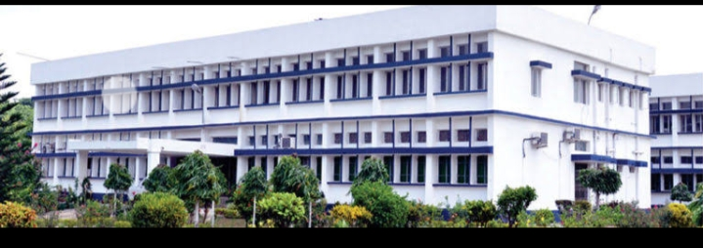
Functional Foods
Department : Dairy Technology Course Title : Food Technology I Course No. : DTT -322 Course Teacher: Bipin Kumar Singh

Slide 2
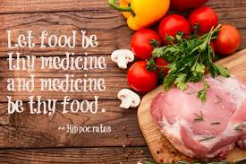
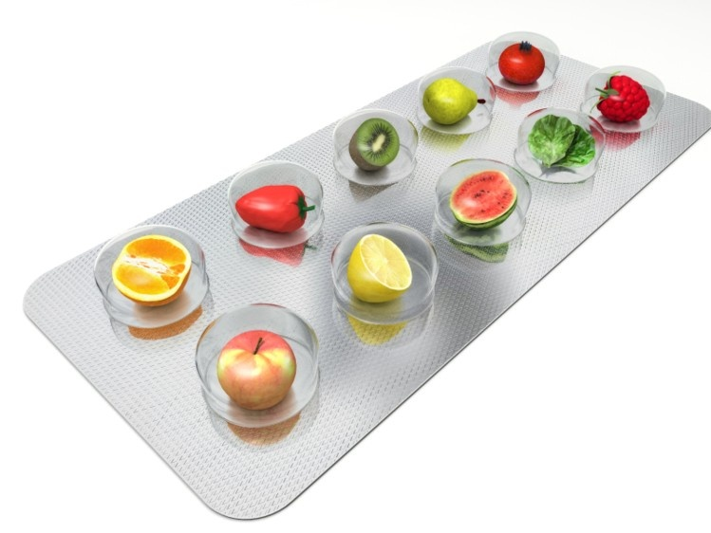
Let Functional foods be thy medicine
Development

Slide 3
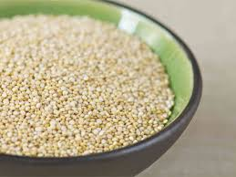
Why Functional Foods?
Change in the understanding of the role of foods in human health promotion
Consumer interest in active food
Well being
Life prolongation
Prevention of initiation, promotion and development of cancer
Cardiovascular diseases
Osteoporosis
Quinoa

Slide 4
Potential targets for functional food development Correlation between diet and disease
Principal Causes of
Death
Cancer
Heart Disease
Pneumonia
Cerebrovascular Diseases (Stroke)
Accidents, Poisoning & Violence
Chronic Obstructive Lung Disease
Diabetes
Urinary Tract Infections
Nephritis, Nephrotic Syndrome & Nephrosis
Diseases Most Affected
by Diet
.Cancer
High Cholesterol
Coronary Heart Diseases
Atherosclerosis
Stroke
Hypertension
Diabetes
Gastrointestinal Disorders
. Osteoporosis

Slide 5
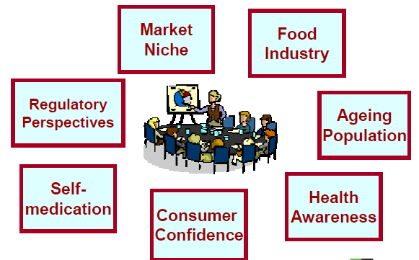
Driving Force for the Nutraceutical/Functional Food Market

Slide 6
Definition
The term functional foods became popular in Japan in mids 1980s. This type of foods is known on the Japanese market as “Foods for specified health use (FOSHU)

Slide 7
Institute of Medicine’s Food and Nutrition Board defined functional foods as
“Any food or food ingredients that may provide a health benefit beyond the traditional nutrients it contains “
To qualify as functional food :
Three conditions
Food (not capsule, tablet or powder) derived from naturally occurring ingredients
Should be consumed as part of daily diet
Regulate a particular body process
Improve biological defense mechanisms
Prevention and recovery of specific disease
Control of mental and physical conditions
Retarding the aging process

Slide 8
New Definition
The Functional Food Center (FFC),Texas defines
“functional food” as natural or processed foods that contains known or unknown biologically-active compounds; which, in defined, effective non-toxic amounts, provide a clinically proven and documented health benefit for the prevention, management, or treatment of chronic disease.
This definition is unique because of its acknowledgement of “bioactive compounds”; or biochemical molecules that improve health through physiological mechanisms.
Also, this definition notes that bioactive compounds must be taken in non-toxic amounts, because bioactive compounds have upper limits before they become dangerous.

Slide 9
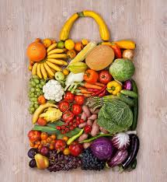
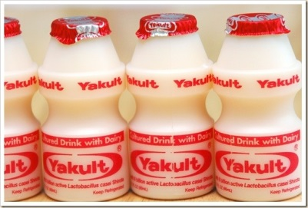
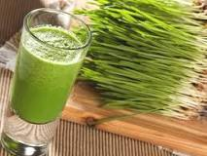
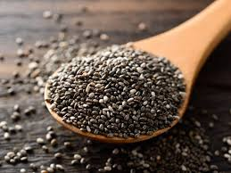

Slide 10
Key Issues in Designing foods
Bioactive components in functional foods
Poor solubility
Sensitive to oxygen, light, temperature
Adversely affect the sensory attributes these foods
Nutrients binds to the food matrix - unavailable

Slide 11
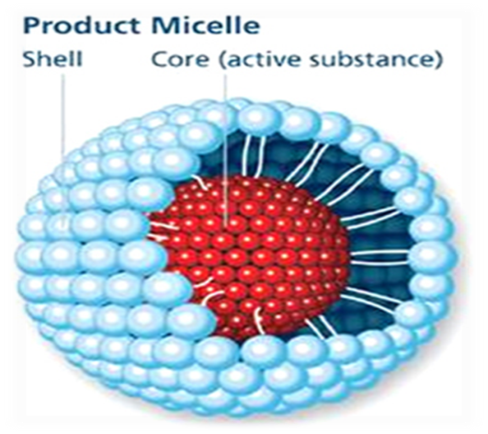
Novel delivery systems for bioactive components in functional foods
Need to design and develop food ingredients with improved
water solubility
thermal stability
oral bioavailability
sensory attributes
shelf life
Physiological performance/biological activities
Nanoencapsulation is currently the second largest area of nanotechnology application in the food sector.
The food encapsulation market size is projected to reach USD 41.74 Billion by 2021, at a CAGR of around 6.0% from 2016.
Rapid progress is being witnessed in the nanoparticles and nanoencapsulation industry of food ingredients and bioactive compounds

Slide 12
Challenges in Development of Functional Foods
The cost of bringing a new product to the market can be significant
Most countries lack a suitable regulatory category for these ‘hybrid’ functional food products, which makes market development much more complicated
In many cases, development of institutional capacity is necessary

Slide 13
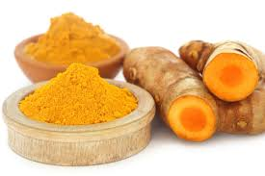
Indian Condition
In India, we have traditional products touted as functional but have little scientific validation
Companies will also have to be sincere and honest in their claims while marketing and communicating with consumers till appropriate regulations for scientific validation are evolved
Processors will need to provide an optimal merger between taste, convenience and health attributes

Slide 14
Proteins and Peptides
(Role in functional foods)
Nutritional Role- Energy & Amino acids
Functional Role- Physicochemical and Sensory
Biological Role- bioactive ingredients for functional or health promoting foods

Slide 15
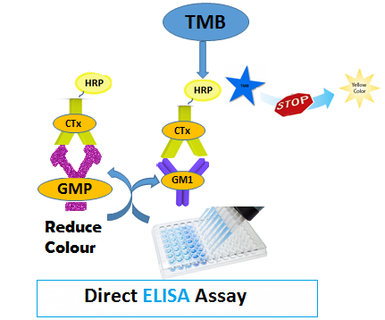
Evaluation of Biological Activity of Glycomacropeptide derived from milk of different species
Source of GMP | Ctx 1 ng binding efficiency | ECEtx 1 ng binding efficiency | Sialic acid (%)
Cow milk | 34.38± 0.88 | 36.30± 1.56 | 7.05±0.49
Goat milk | 83.61± 2.3 | 73.75± 2.8 | 5.70±0.51
Buffalo milk | 114.67± 1.7 | 146.45± 2.1 | 2.48±0.44
E.Coli toxin binding capacity
Cholra toxin binding capacity
Competitive Binding Assay
n = 6; mean ± SD

Slide 16
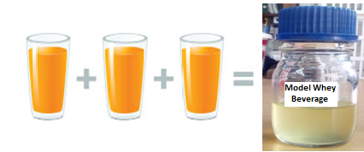
Bioactive Properties of Hydrolysates
Enriched in antioxidant peptides
(VLPVPQK and its derivative)
No cytotoxic effect
Provides cytoprotective effect against H₂O₂-induced oxidative stress in Caco-2 cells
Exhibits immunomodulatory effect
(Phagocytosis & Lymphocyte proliferation)
The technology demonstrated to M/s ITC Ltd., Bangluru
Application
Model Whey Beverage
1 serving (100 ml) of Model Whey Beverage = 3 serving (100ml) of Orange Juice
(In terms of Antioxidant Capacity)

Slide 17
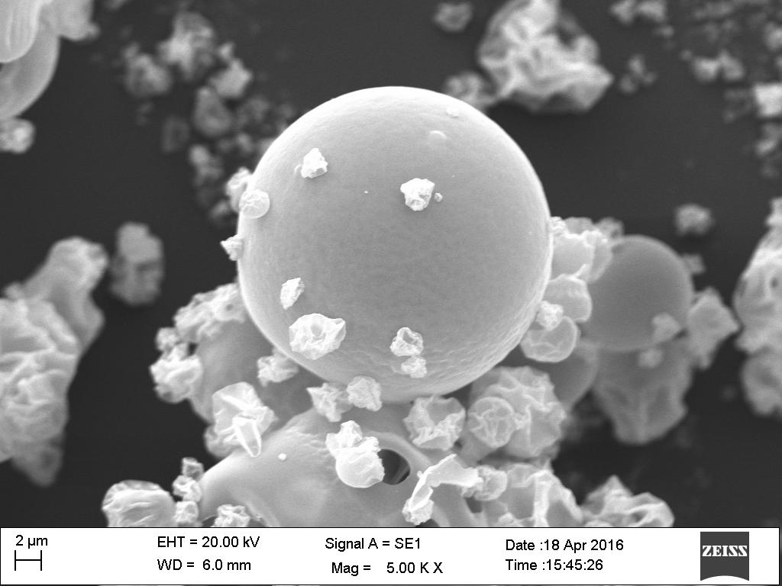
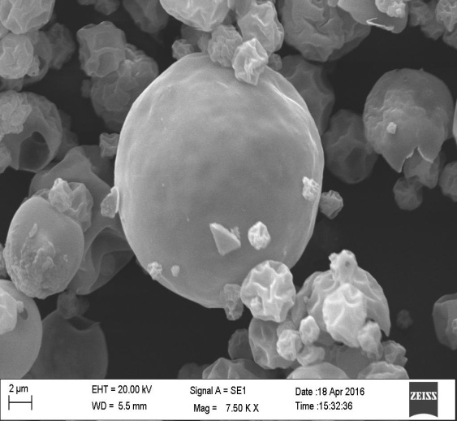
Caseinophosphopeptide- Mineral (Iron/Zinc) Nanocomplexes
LC-MS/MS analysis of cpp- mineral complex confirmed- presence of phosphorylated serine molecule, possible binding site of mineral.
Spray Dried Zinc Peptide and Iron Peptide Complex
Membrane filtration technique was used for separating Caseinophosphopeptide-divalent metal complex aggregates
The method can be scaled up to the commercial level.
CPP-metal complexes showed higher bioavailability in vivo & in vitro assay as compare to their inorganic metal salt.
The nano size CPP-metal complexes remain dispersed and stable at different processing conditions (wide range of pH, temperature & ionic strength).
Patent presentation approved by ITMU, NDRI on Caseinophosphopeptides-divalent metal (Iron/Zinc) nanocomplexes and method of preparation thereof” on 9th Sept,2016.

Slide 18
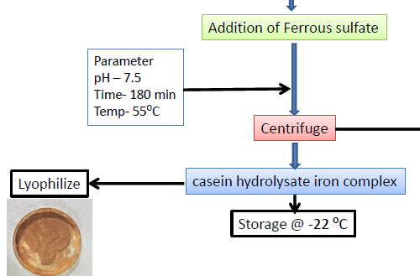
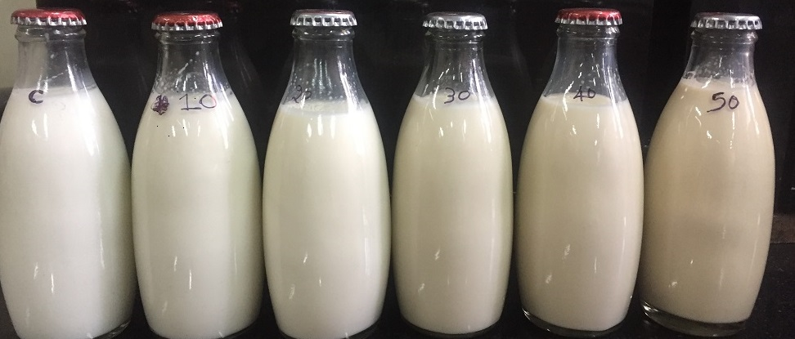
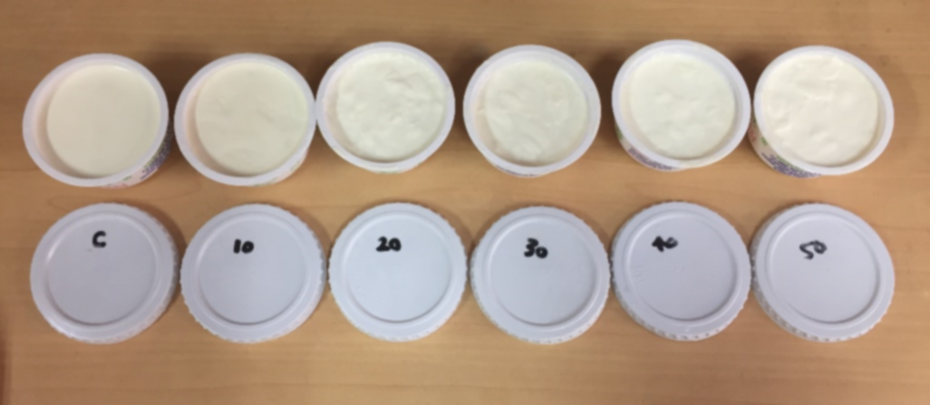
Casein hydrolysates-iron complex fortified milk and yogurt
sensory properties of milk and
Iron fortification using casein hydrolysates-Iron complex in milk and yogurt observed to be an effective strategy to increase the iron, its bioavailability and reduction in fat oxidation without sacrificing the sensory attributes and affecting shelf life of the product
Iron fortified pasteurized milk
Iron fortified yogurt

Slide 19
THANK YOU

