Slide 1
Department of Veterinary Medicine Bihar Veterinary College, Patna – 800 014 (BASU, Patna)
DISEASES OF THE EYE-1
(CONJUNCTIVITIS)
UNIT-2(SYSTEMIC DISEASES)
Dr. Ranveer Kumar Sinha Assistant Professor cum Junior Scientist
E-mail: ranveervet@rediffmail.com

Slide 2
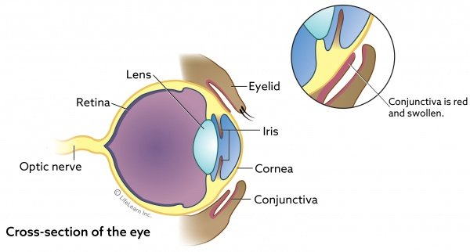

Slide 3
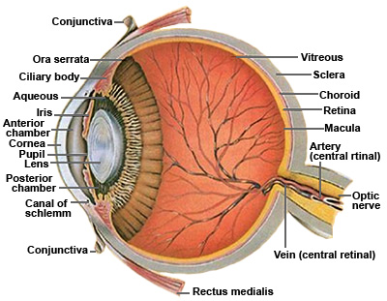

Slide 4
CONJUNCTIVITIS
Definition:-
Inflammation of the conjunctival mucous membrane.
Classification according to aetiological factors:-
Viral conjunctivitis - ICH, CD, IBR
Bacterial conjunctivitis - Staphylococcus, Streptococcus, Mycoplasma, Leptospira bovis, L. pomona etc.
Mycotic conjunctivitis - Aspergillus, Candida etc.

Slide 5
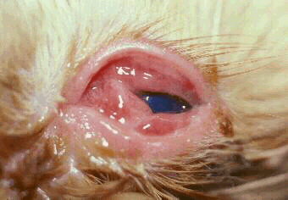
Animal suffered with Conjunctivitis

Slide 6
CONJUNCTIVITIS
Parasitic conjunctivitis - Eye worm like Thelazia spp., Filarid worm, Setaria spp. etc
Traumatic conjunctivitis - Foreign body eg. Awn, Grassblade, Thorn etc.
Chemical conjunctivitis - Tick dips & Corrosive agents etc.
Allergic conjunctivitis - Allergen like pollen, Drugs etc.

Slide 7
CLINICAL FINDING
Hyperaemia of the blood vessel & pain
Ocular discharge:-
serous-mucoid-mucopurulent-purulent
Redness & swelling of mucosa
Epiphora(tear mark) in chronic cases.

Slide 8
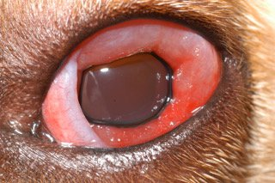
Animal suffered with Conjunctivitis

Slide 9
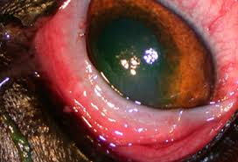
Animal suffered with Conjunctivitis

Slide 10
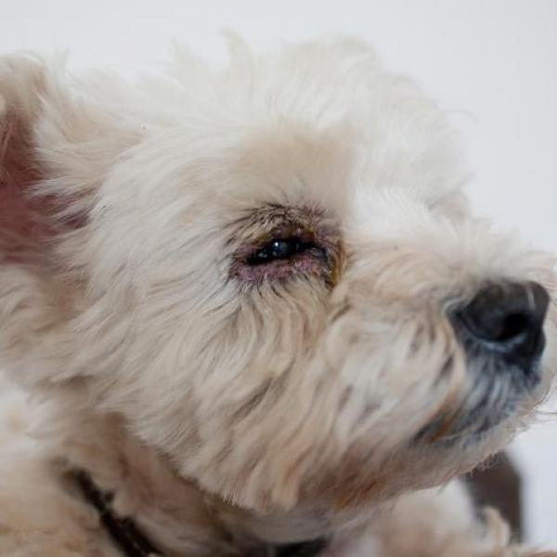
Animal suffered with Epiphora

Slide 11
CLINICAL FINDING
Foreign body or parasite in the eye
In acute cases systemic reaction eg.
Increase in Tem. Pulse & respiration
Sneezing
Profuse serous discharge from both eyes

Slide 12
DIAGNOSIS
Clinical examination.
Ophthalmological exam.
USG exam
Culture exam for organism.
C/S test for selection of antibiotics.

Slide 13
LINE OF TREATMENT
Remove the primary cause
Animal kept away from light & kept in dark place.
NS irrigation for 3-4 times a day.
Antibiotic (solution or ointment)e.g. Chloramphenicol, Gentamycin, Ciprofloxacin, Gatifloxacin, Ofloxacin etc. locally 2-3 times a day for 7-10 days

Slide 14
LINE OF TREATMENT
Antibiotic combination with corticosteroid e.g. Chloramsone(Chloramphenicol+Prednisolone),
Cyprin –D(Ciprofloxacin + Dexamethasone), Betnesol-N(Betamethasone + Neomycin), Pyricort(Gentamicin + Dexamethasone)
In allergic conjunctivitis steroid & antihistaminic preparation
In parasitic conjunctivitis anthelmintic. Mechanical removal of worm using local anaesthetic with fine forcep
Systemic antibiotic in acute cases & according to clinical condition

Slide 15
THANKS YOU !

