Slide 1
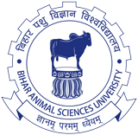
UNIT-IV
Environmental Hygiene
(Credit Hours-3+1)

Slide 2
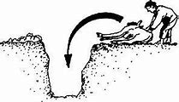
Disposal of carcasses

Slide 3
Disposal of carcasses
Hygienic disposal of dead/fallen animals: social as well as legal obligation
Most important responsibilities of veterinarians: domain of environmental hygiene.
Unsafe disposal of carcasses: serious threat to the health of animals & human communities.
The tissues of dead animals: most conducive conditions for the breeding of flies & insects.
Favors the growth of maggots within a day or two
Many other welfare agencies along with environmental & health organization: safe & quick management/disposal of fallen/dead animals
Some of the agencies relate to transport, tourism, natural resources, zoos & parks, & defense (air) services

Slide 4
Disposal of carcasses
Regulations framed by Governmental/local authorities from time to time
In western countries, the implementation of the regulations is rather strict
For ex: In Scotland the service provided free of charge, In fact, the service paid for the
carcasses of dead, injured/old animals
A number of approaches: TO ensure efficient, environmentally safe & bio-secure disposal of carcasses & fallen animals
Methods of disposal:
1. Traditional method: burial/burning, commonly used in developing countries
2. New technology: In developed countries, economic disposal of carcasses

Slide 5
Preparation of carcass for disposal
Cover the dead/ fallen body with
A cloth or insect repellent
Application of kerosene oil
Prevent spread of disease through flies/insects
Covering of all natural orifices:
Plugged with cotton plugs soaked with a suitable disinfectant
Commonly used disinfectant: Carbolic acid or formalin
The skin of the carcasses should be slashed with a sharp knife Except for cases of anthrax, the so that it cannot be used by unscrupulous traders
Use of personnel protective measures (by wearing secure clothing, boots, gloves, goggles & face masks: to prevent the handlers

Slide 6
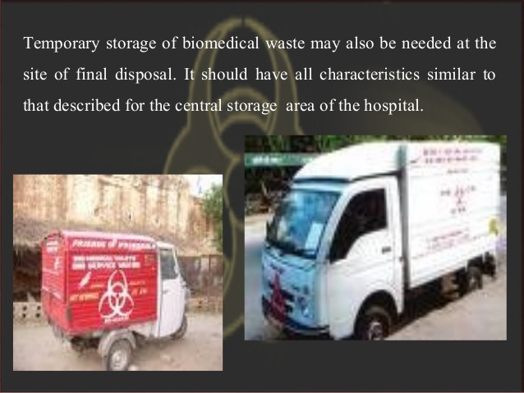
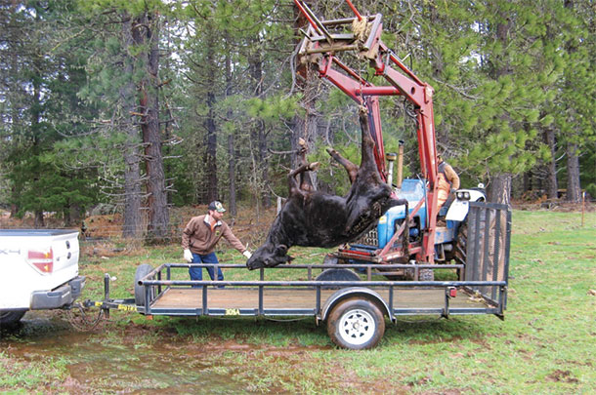
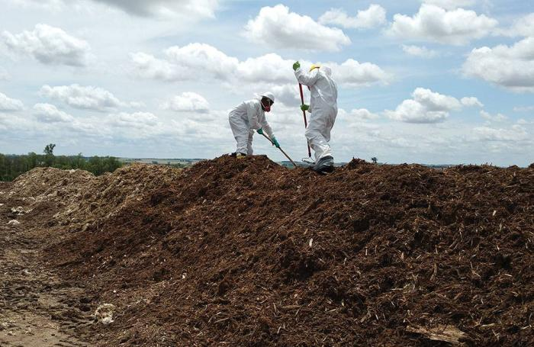
Preparation of carcass for disposal
5. Transport of dead animals:
Desirable to use closed vehicle
Animal should not be dragged under open condition
Imp. part of sanitary practice
6. Site of disposal:
Should be away from:
Source of public water supply (pond, lake, well and river)
From animal/human habitation
Telephone or electric cables lines
Fencing of site:
To prevent access of wild animals & stray dogs to the site

Slide 7
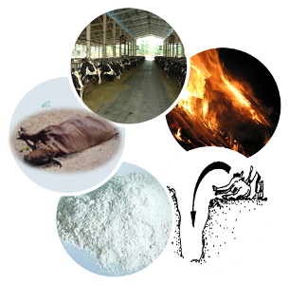
Methods of disposal
Following methods are used for the disposal of carcasses:
Cremation
Burial
Flamegun
Incineration
Rendering
Composting
Fermentation

Slide 8
Cremation
Space required:
Large animals: 1.7 - 2.5 m²space/head
Small animals: 1.25 m2 space/head
Various ways of cremation:
Depends on the number of animals:
Routine cremation: 1 or 2
Emergency/disaster conditions: large number of animals to be disposed

Slide 9
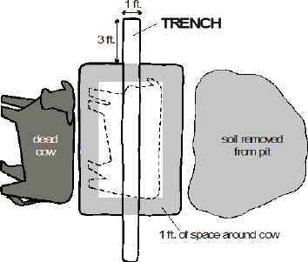
Cremation
Methods of cremation of animals: Three methods
Cross-trench (pit)
Surface burning
Bostock pit method
1. Cross-trench (pit):
Two trenches (2m x 40 cm with 40-45 cm depth) are dug at right angle
The dug soil is heaped at the four right angles so created
Wood, coal, straw, grass & tree branches are used to develop a pyre over the heaps of soil
The carcass soaked in kerosene & paraffin is placed over the pyre & burnt

Slide 10
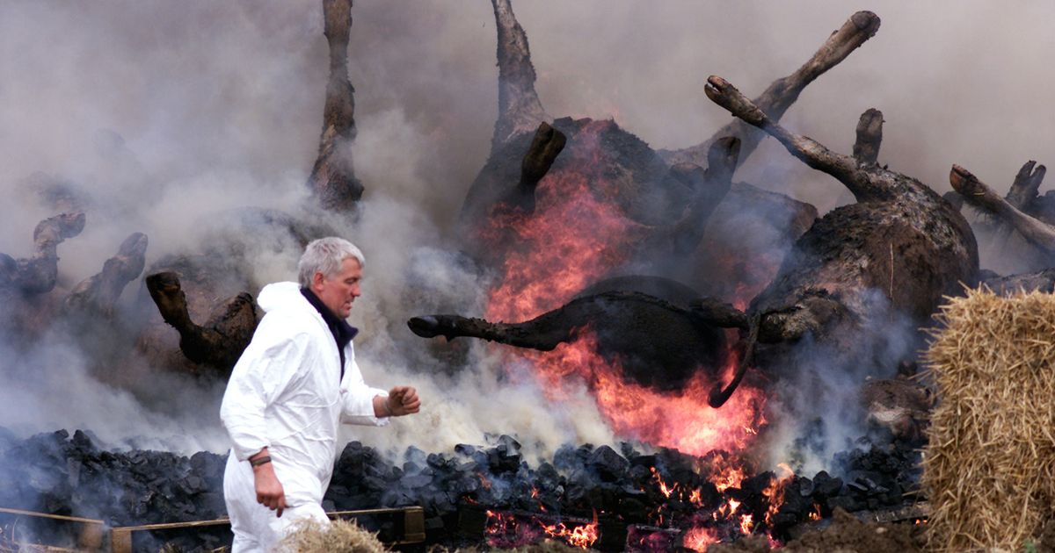
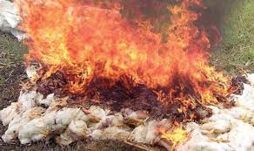
Cremation
2. Surface burning:
Useful for the large number of animals to be cremated
A trench dug: (90 cm x 30 cm with a depth of 40-50 cm)
the length varies with the number of carcasses
Carcasses are arranged in a way that head of a carcass is next to the hind quarter of the other
Small animals (if any, can): used as fillers of spaces in between
The carcasses are covered with kerosene, paraffin, wood & straw & burnt

Slide 11
Cremation
3. Bostock pit method:
An oval pit (2m x 1.2 m with a depth of 1.2m) is dug
A crossed trench (22 cm x 22 cm ) is then dug in its floor
A ventilation trench (1.2 m x 45 cm ) with a depth of 30 cm deeper than the main pits dug at right angle to it
The trench is then connected with a drain pipe with the pit
The pit is filled with straw wood and coal for about 3 quarters of the pit
The carcass is then put after soaking it with kerosene/paraffin and lighted

Slide 12
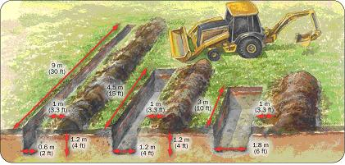
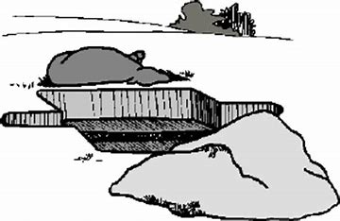
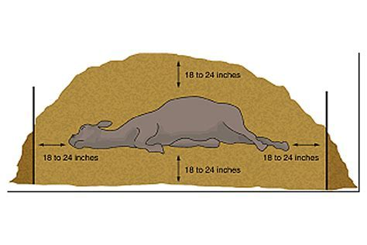
Burial
Surface suitable for burial of a large carcass: 2.4-2.7 m deep
For a horse: 2 -2.5 m²
For cattle: 1.25 -2 m²
For sheep/pig: 0.84 m²
The carcass is lowered on to a thick layer (about 5 cm thick may be sufficient under ordinary circumstances) of quicklime and then covered with sufficient (as required) amount of quicklime and soil.
The soil cover over the carcass: about 1.8 - 2.0 m thick

Slide 13
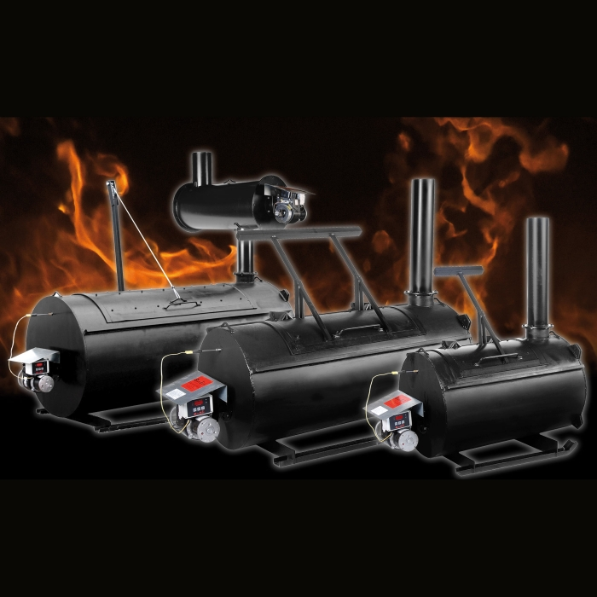
Flamegun
It is an economic & safe method
The carcass is kept on the surface of the earth
Burnt with the help of about 10 flameguns within few hours

Slide 14
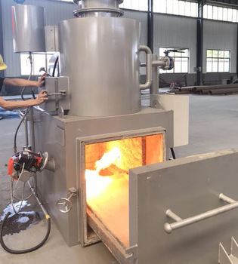
Incineration
The carcass is incinerated in a destructor/incinerator
By using very high temperature: 1300ºC
The carcass can be dismembered into pieces before destruction

Slide 15
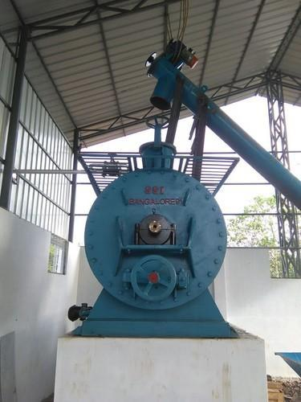
Rendering
The materials/carcasses: from slaughterhouses & other sources
Samples are collected in knackeries for processing
The organs of dead & emergency slaughtered animals are sent to rendering plants
Used to separate fat from the offal/tissues of dead animals
Tallow: fat of sheep/cattle
Lard: fat of pig
Two process:
Wet (autoclaving/steam)
Dry (heat) methods

Slide 16
Rendering
Remaining material used as meat meal & bone meal
Meat meal: rich source of protein, vitamin B & minerals
Bone meal: an important source of calcium & phosphorus
Mixed with animal rations or pet foods
Rendering of raw materials common in France, Germany & Italy
It proves cheaper than burning the carcasses

Slide 17
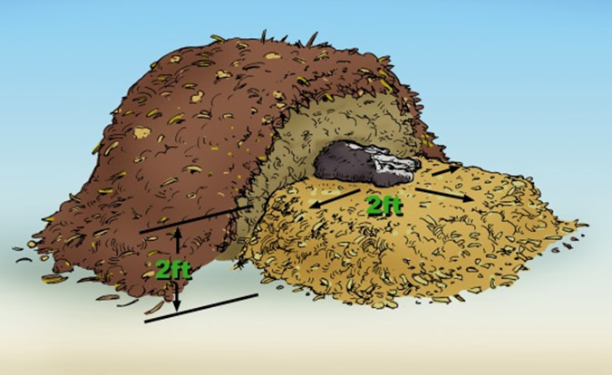
Composting
It is well known & environment friendly practice
The procedure has been described by Casper
Used for the disposal of manure & other animal house wastes
The decomposition process includes
Aerobic bacterial action
Cold, warm & hot decomposition processes
The process used for dead pigs in roofed non insulated silos
The silos: horizontal or tower form
The carcasses are lifted & dumped into the silos
Covered with straw-horse manure mixture as bulking agents & carbon source
Composting: achieved in 6-12 months
The final product is used as fertilizer

Slide 18
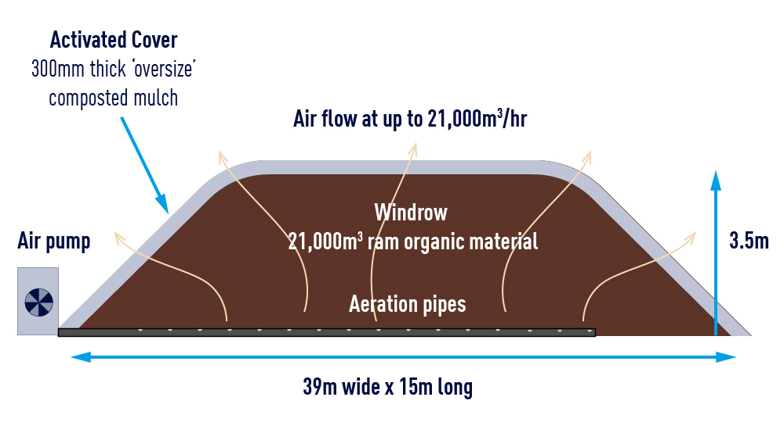
Composting
In the United States: successfully used to dispose of the carcasses
Layering
One part volume of carcass + 2 part volume of litter + 1 part volume of straw in a boxed area
Layering is repeated
In large animals litter can be replaced by manure
Large carcasses: dismembered into pieces before being layered
Birds/small carcasses are used as fillers within the layers
Urea-10-15 pounds of per 1000 pounds of carcass
Bacteria involve is: Bacillus sp. thermogenic at 60-68º/14 days

Slide 19
Fermentation
The bacterial action is carried by Lactobacillus spp. under anaerobic conditions at 32-40ºC
The process is completed within 48 hr
The fermented material can be used as livestock feed
Rumen contents, blood & hydrolyzed feathers can be fermented (ensiled) in 6 weeks under rural conditions
Offal and scrap are ensiled efficiently with the help of 3% formic acid
The fermented product can be used as animal feed

Slide 20
Handling of stray and fallen animals
Stray animals roam freely
Create nuisance for the community in a number of ways including damage to crops
They can be a serious hazard for vehicular traffic especially in congested urban areas
These animals are more likely to be exposed to diseases & environmental toxicities
When old & weak their movements become restricted
The dung & urine excreted: become serious threats to environmental safety
The filth created by such animals helps in the propagation of a variety of insects
Fly breeding (maggots): real threat to community health & environment

Slide 21
The menace of stray animals can be minimized by collecting these animals in what are called cattle pounds which are managed by pound keepers
The activity is regulated by the Cattle Trespass (Amendment) Act, 1921
In U.P., the act was enacted as the Cattle Traspass (Uttar Pradesh Amendment) Act, 1954
There are a number of private organizations that deal with the problem of old and decrepit animals
In recent times, however, some goshalas have begun keeping even healthy cattle for breeding purpose and production
The goshalas are supported by charitable organizations and occasional grants from the Government sources
The activities of the goshalas are regulated by Goshala Acts (Bihar,1950 and U.P.,1964)

Slide 22
There has been a growing awareness about the welfare of animals
The activities concerning animal welfare in India are regulated by Animal Welfare Board of India through the provisions of Prevention of Cruelty to Animals Act, 1960
The Board has its units spread all over the country and is engaged in providing protection to the animals from cruelty, disease and infirmity
Stray animals dying in open areas cause enormous damage to environment
They not only pollute the atmosphere with foul gases/odours but also invite vultures and wild animals to create nuisance
These animals need to be collected immediately and disposed off in an economic and efficient manner as described in carcass disposal methods

