Slide 1
ECTOPIC URETER
Dr. Mithilesh Kumar
Assistant Professor cum Jr. Scientist
Department Surgery and Radiology
Bihar Veterinary College, Patna-800014

Slide 2
Urinary tract is made up of right and left kidney.
Each connect with bladder through right and left ureter.
Ureter does connect properly to bladder
Drains outside the bladder the condition is called ectopic ureter.
It is commonly a result of a duplicated renal collecting system.
Duplex kidney with two ureter.
One drains correctly, duplicated ureter presenting as ectopic

Slide 3
Ureter Connects the Kidney with urinary bladder.
Ectopic ureter is abnormality of ureter.
Ureter does not enter urinary bladder in correct anatomic position.
Cats and dogs are affected by birth.
Causes urinary incontinence
Disruption in normal embryogenesis

Slide 4
Also called wet puppy syndrome
Hereditary problem in golden retriever.
Intermittent or continuous urinary incontinence since birth.
Most dog dogs also display normal voiding of urine.
Dog has had limited exposure to other dogs.
Aggression is common symptoms

Slide 5
Surgery is the treatment in most cases.
Also managed with lasers via cystoscopy,.
Thin light tube inserted into bladder via urethra.

Slide 7
Puppy with ectopic ureters (both right and left). Contrast dye shows the kidneys and ureters. There is no contrast in the bladder indicating the urine bypasses the bladder.

Slide 8
Candidate for Neoureterostomy

Slide 11
candidate for Neoureterocystostomy

Slide 12
PATENT URACHUS

Slide 13
The urachus is a fetal continuation of the bladder taking waste to the allantoic sac.
It should be atrophy shortly after birth and disappear in normal calf
The urachus is a fibrous remnant of allantois
PU Observed in cow calves and also recorded in buffalo calves
Urine dribbles from the umbilicus.
In absence of treatment infection lead to abscess.
Peritonitis and cystitis may develop

Slide 14
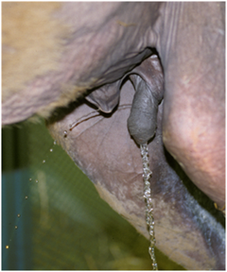
Urination from both the penis and the navel in a foal with a patent urachus.

Slide 15
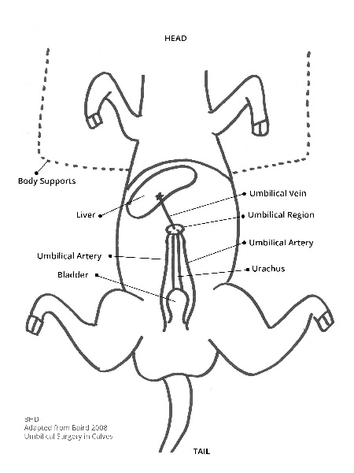

Slide 16
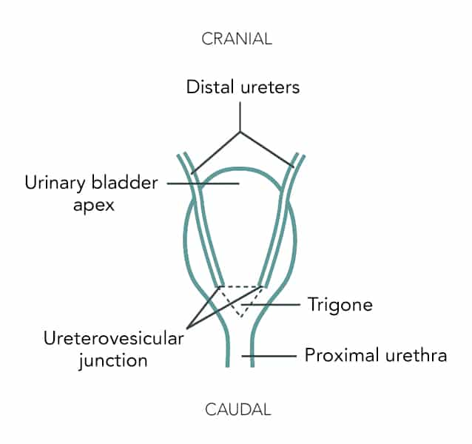

Slide 17
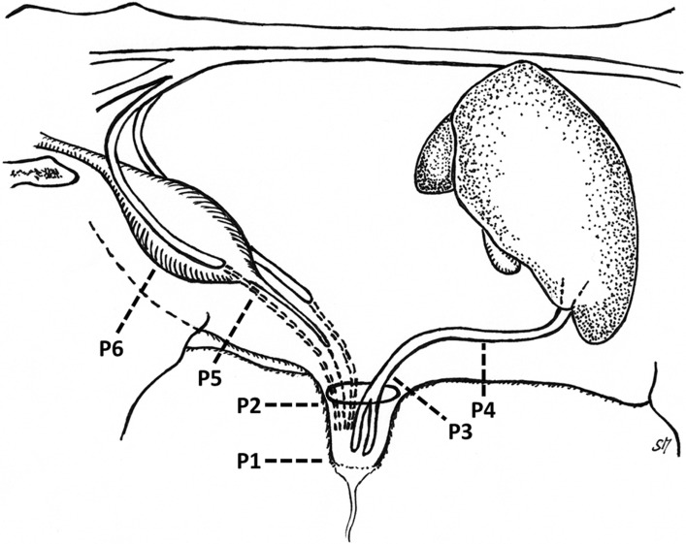

Slide 20
Calf sedated deeply and controlled in dorsal recumbency.
Incision given on umbilicus extended cranially and caudally.
Umbilicus vessels and urachus are doubly ligated proximal to infection
The infected mass is dissected out.
Muscle are closed by overlapping sutures.
Skin closed routinely.

