Slide 1
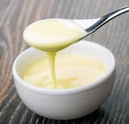
Department : Dairy Technology Course Title : Sensory Evaluation of Dairy Products Course No. : DTT -321 Semester-6th Course Teacher: Bipin Kumar Singh
Sensory Evaluation of Concentrated Milks

Slide 2
INTRODUCTION
A thorough understanding of the sensory attributes of concentrated milk and their routine examination is imperative, not only to assure improvement of the product, but also for ensuring that the product reaches the consumer in good condition.

Slide 3
EVAPORATED MILK
When judging or grading evaporated milk, the judge must keep in mind the desirable qualities and standards for the product. It must be noted that, in addition to meeting the legal chemical requirements for the product high quality evaporated milk must be white to creamy in colour, have a relatively viscous body, be uniformly smooth in texture and possess a mild, pleasant flavour.

Slide 4
Procedure for examination
A routine in examining cans of evaporated milk facilitates judging of the samples. The following steps have been found to be of material aid in going over a lot of samples.

Slide 5
Precaution
Examine the cans for appearance, noticethe upper end of the can for polish; observe the neatness of the label.
Open the can in such a way the both thecan and contents may be examined.
Notice the colour of the milk whichshould be uniformly white to cream colour. Intensity of darkening may be notedfor its degree e.g. none, slight, distinct and pronounced.
Study the body and texture. Smooth,relatively viscous evaporated milk pours like a thin cream without marked splashing. Allowthe can to drain well. Look for any deposit which may be present in the bottomof the can.
Should the milk lack uniformity try todetermine whether the chief factor is fat, protein, salts or foreign material?In case the fat is responsible, the defect will appear at the top of the can asa cream layer or as buttery particles. Defect due to protein will appear asvarious size curds distributed throughout or as different intensities ofgelation.

Slide 6
Contd..
Observe the condition of the container looking for splangling, blackening of the seam and rusting of the container. Splanging appears as clean, bright, dark, overlapping blotches on the surface as though the tin were attacked by acid. •
Determine the colour reaction in coffee. It should be a rich, golden brown colour. Off flavour may be associated with rust formation in the container. ‘
Note the miscibility with coffee. Feathering in hot coffee appears as finely divided, serrated curds shortly after the evaporated milk has been added slowly to the hot coffee.

Slide 7
Defects in evaporated milk
Flavour The flavour defects which may occur inevaporated milk are usually unlike those commonly occurring in fresh milk.Probably the most common flavour defect in evaporated milk is that which seemsto be associated with progressive age darkening or browning of the product.Terms such as slightly acid, 'stale coffee, old, sour 'and strong suggest thenature of the defect. The caramel flavour connotes a pleasant, appetizing tastesensation which is definitely lacking in the defect associated withage-darkening of evaporated milk. This flavour defect is easily detected. The off-flavour is accompanied by only aslight odour suggesting staleness. The underlying taste reaction of the agedarkened evaporated milk is acid.
Body and texture Freshevaporated milk is remarkably free of body and texture defects. However, whenevaporated milk is held for a long period of time or under adverse conditions,the following body and texture defects may be encountered:
Buttery/fat separation :This defect appears as a layer (up to 1 cm or more thick) of heavy cream at thetop of the can. Among the causes of this defect are inadequate homogenization,high storage temperature, long storage period and improper handling while instorage.
Curdy: Curdy evaporated milk may be noted by the presence of many coagulated particlesinterspersed throughout the milk or by a continuous mass of coagulum. It ischiefly associated with the protein rather than the fat. It is a seriouseconomic defect. This condition is due mainly to the abnormally low heatcoagulation point of the end product and could not withstand the sterilizationprocess.

Slide 8
Contd..
Feathering :The feathering of evaporated milk in hot coffee cannot be foretold by macroscopic examination but by actually testing the milk in hot coffee.' It has been postulated that the formation of curd when evaporated milk is added to coffee is due entirely to an excess of viscosity
Gassy :Gassy evaporated milk is rather uncommon. The defect is manifest by bulged cans and sometimes by a hissing sound of escaping air when the can is punctured.
Grainy: A grainy evaporated milk is the one lacking smoothness and uniformity throughout. Such milk seems coarse. It is often associated with an excessively heavy, viscous body. The judge must be are in mind that grainy evaporated milk does not actually contain "grams“ of sediment settled in the container. Neither does such milk contain curds or lumps of butter.

Slide 9
Contd…
Low viscosity :A low viscosity evaporated milk may be noted by its milk like consistency. This defect is discriminated against as it denotes inadequate condensation.
Sediment :The sediment resulting from settling of leukocytes, disintegrated cells, denatured 'protein and foreign material of more or less of a colloidal nature is usually darker in colour than the evaporated milk since this sediment is readily miscible it may be seen only when a can, undisturbed for sometime, is emptied slowly.
Colour In judging evaporated milk two possible colour defects may be encountered, viz. too light in colour and too dark in colour. Too light colour is not it serious defect although it is not desired. The brown discolouration in evaporated milk associated with high sterilization temperature, high storage temperature andage is a serious defect in evaporated milk.

Slide 10
Sweetened condensed milk
Since sweetened condensed milk contains a sufficiently high percentage of sugar for its preservation, the flavour is pronouncedly sweet. Beyond this intense sweetness, the flavour should be clean and pleasant with a slight trace of mild caramel as an aftertaste.

Slide 11
Procedure for examination
A definite routine enables the judge tomake the best use of the available time with the assurance that the examinationis complete when finished.
Appearance of the container should be asbright as new tin as the can has not been subjected to the high heat treatmentof sterilization.
The surface of the product should havethe same intensity of colour as the under layer and should be uniform inconsistency with no indication of lumps, free fat or screen formation.
Colour of the product should be uniformthroughout. Observe if the milk has a greenish white creamy or a brownishcolour.
Viscosity desired is one which isobviously not "thin" but resembling to a marked degree that of mediumto heavy molasses. In grading sweetened condensed milk, the judge must bear inmind that a desirable sweetened condensed milk pours like molasses and, whenpoured, seeks its own level leaving no trace of the folds on the surface.
Flavour should be observed both for thetextural and taste sensations. Register the relative smoothness of the productas a whole and the fineness of the grain by pressing the sample against thepalate with the tongue.

Slide 12
Defects of sweetened condensed milk
Metallic - Prepare 0.5 percent solution of ferrous sulphate in distilled water. Add 1, 4 and 7 ml of the solution to 100 g fresh sweetened condensed milk and mix well to simulate varying degrees of metallic flavour in it.
Rancid -Homogenize 30 percent fat cream obtained from raw milk, allow it to stay at about 37°C for about 1 hour before heating it to nearly 75°C and immediately cooling it to room temperature. Mix the cream with fresh sweetened condensed milk at the rate of 10, 20 and 50 percent to obtain varying degrees of rancidity in the product.
Strong, caramel - Heat, in a boiling water bath, fresh sweetened condensed milk (70 to 80 g) to 85-90°C and leave it covered at about 90°C for 2+, 34 and 44 hours, before cooling to room temperature. This will also give varying degrees of browning in in the product.
Tallowy - Expose fresh sweetened condensed milk, containing approximately 5 mg/kg of ferric or cupric chloride to sunlight to varying periods such as 3, 6 and 9 hours.

Slide 13
Contd..
Sandy, course, mealy - Heat the fresh sample ( about 200 g ) in a beaker at about 70°C for 5 minutes and hold it undisturbed in an incubator at 30°C for 6, 12 and 18 hours to manipulate different degrees of sandiness in the product.
Settled-Heat the sample as mentioned in (e) above and maintain in an incubator at 30°C for 24, 48 and 72 hours.
Thickened - For developing varying degrees of the defect, heat a fresh sample of condensed milk in a water bath to 80°C. As an alternative for developing this defect packed commodities samples of tins can be stored at 37°C for a period varying between 30 to 90 days.

Slide 14
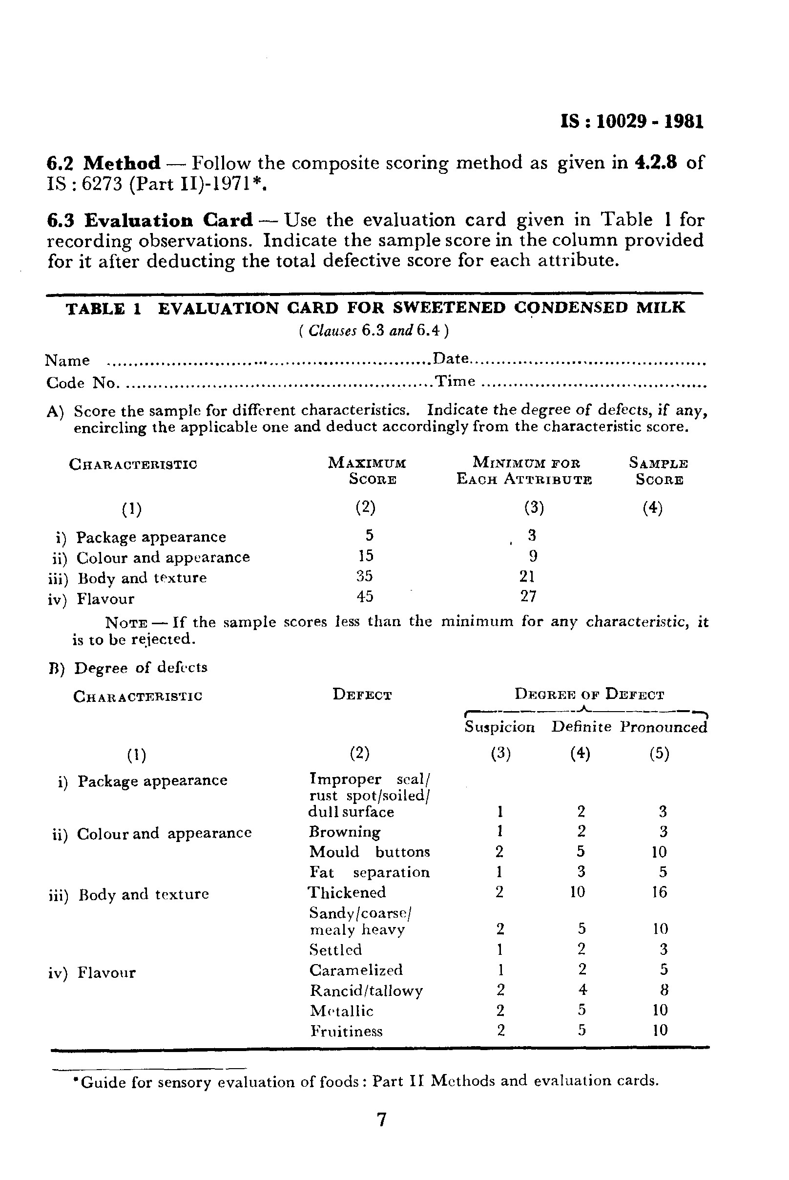
Score card for Sweetened Condensed Milk
EVALUATION CARD FOR SWEETENED CONDENSED MILK ( Clauses 6.3 and 6.4) Name . . . . . . . . . . . . . . . . . . . . . . . . . . . . . . . . . . . . . . . . . . . . . . . . . . . . . . . . . . Date. . . . . . . . . . . . . . . . . . . . . . . . . . . . . . . . . . . . . . . . . . . Code No. . . . . . . . . . . . . . . . . . . . . . . . . . . . . . . . . . . . . . . . . . . . . . . . . . . . ..Time . . . . . . . . . . . . . . . . . ._. . . . . . . . . . . . . . . . . . . . . A) Score the sample for different characteristics. Indicate the degree of defects, if any, encircling the applicable one and deduct accordingly from the characteristic score.

Slide 15
Grading
After computation of data, recorded in Table by the panelists, the following grades should be awarded.
Score | Grades
90 and above | Excellent
80-89 | Good
60-79 | Fair
59 and below | Poor

