Slide 1
FOWL POX

Slide 2
DEFINITION:
Fowlpox is a slow-spreading viral infection of chickens and turkeys characterized by proliferative lesions in the skin and lesions in the upper GI and respiratory tracts.
Also known as contagious epithelioma.
Actively acquired immunity against fowl pox occurs after recovery from naturally occurring infection or vaccination

Slide 3
ETIOLOGY AND EPIDEMIOLOGY
Avipoxvirus
Brick shaped virus, double stranded DNA
Transmitted by contact through abrasions of the skin.
Aerosol transmission by scabs
Humans, Mosquitoes and other biting insects may serve as mechanical vectors.

Slide 4
PATHOGENESIS
Virus enters into the host epithelial cells by endocytosis.
The are released in cytoplasm.
They multiply and form inclusion bodies (Bollinger bodies) which have borrel elementary bodies.
They release epidermal growth factor and causes proliferation of epithelial cells.
Movement of virus occur from cell to cell.
Viremia do occur but no damage to other organs.

Slide 5
CLINICAL SIGNS
Three forms
Cutaneous form ( Dry pox)
• Nodular proliferative skin lesions in non feathered parts – Head, Neck, Legs, Feet
• Papule, vesicles, pustules and then crust/scab within 14 days. Fall off and skin form scars.
• Less mortality.
Diphtheretic form (Wet pox)
• Fibrino-necrotic and proliferative lesion in the mucous membrane of mouth
• Small white nodules in upper respiratory /digestive tract Raised yellow plaques on the mucous membranes.
Mortality as high as 50% .
OCULAR FORM
o Conjunctiva- Discharge/ Blindness
•

Slide 6
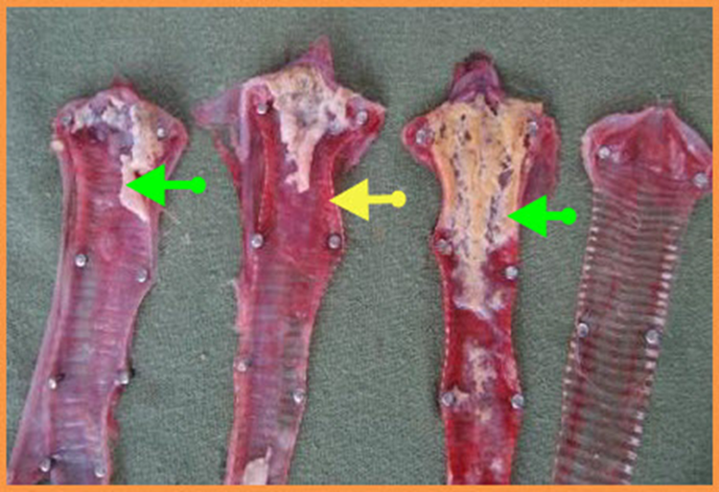
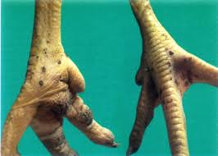

Slide 7
GROSS LESIONS
• Same as signs.

Slide 8
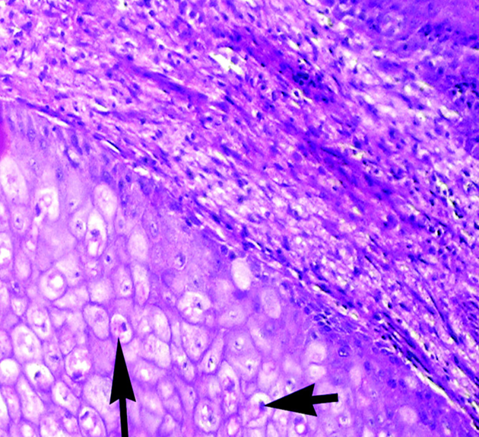
MICROSCOPIC LESIONS
Hyperplasia of epithelium and enlargement of the cells, with associated inflammatory changes
Characteristic eosinophilic cytoplasmic inclusion bodies (Bollinger bodies) with elementary bodies (Borrel bodies).
The inclusion bodies are large.

Slide 9
DIAGNOSIS
o Based on clinical signs (Easy)
o Demonstration of intracytoplasmic eosinophilic inclusions
Laboratory test :
Agar gel precipitation test ( AGPT )
Indirect fluorescent antibody
ELISA (Most sensitive)

Slide 10
Inoculation test

