Slide 1
FATTY CHANGE/HEPATIC LIPIDOSIS
DR. SANJIV KUMAR
ASSTT. PROFESSOR,
DEPTT. OF PATHOLOGY, BVC, PATNA

Slide 2
MECHANISM OF HEPATIC LIPIDOSIS
It is the accumulation of triglycerides or true fats and cholesterol in the cytoplasm of parenchymatous cells. Lipidosis is more common than other conditions.
• Mobilization of free fatty acids from the gut (Chylomicrons) or adipose tissue
• Mitochondrial injury leading to decreases in β-oxidation of fatty acids to ketones etc. (Hypoxia, toxins)
• Decreased apolipoprotein synthesis e.g. CCl4 poisoning and aflatoxicosis
• Failure to form lipoproteins
• Failure to release lipoproteins from hepatocytes

Slide 3
Hepatic lipidosis can occur from one or more mechanisms.
Fatty acid mobilisation from adipose tissue is common in animals following higher energy demand.
Starvation increases triglyceride mobilisation.
Protein malnutrition affects apolipoprotein synthesis.
Chemicals like CCl4 and yellow phosphorous can also induce hepatic steatosis.

Slide 4
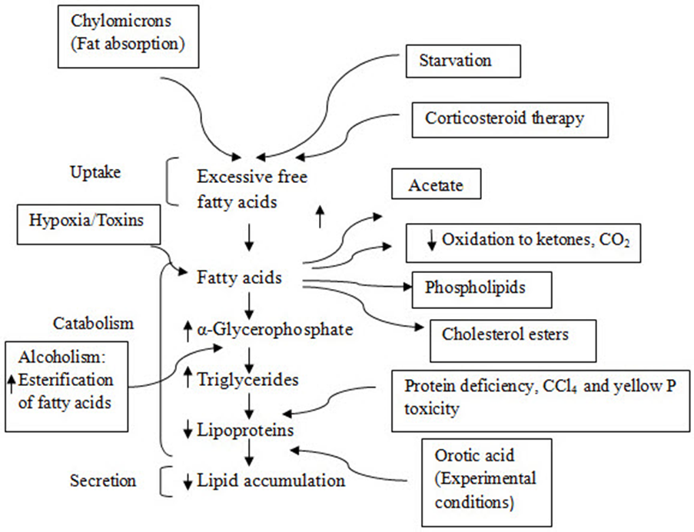
MECHANISM

Slide 5
Grossly :
Enlarged, pale to yellow, soft and friable liver is found in moderate to higher grade fatty changes.
Enlarged with rounded borders.
Upon incision, fat droplets are seen on the blades of knife.
Tissue may float in the fixatives.

Slide 6
Microscopically, hepatocytes show vacuolations which may be small, clear to variable sized and may also form a single large vacuole, pushing the nucleus to a side.
During the processing of fat tissue with xylol clearing, the fat will be dissolved by the xylol and gives vacuolated appearance in the Haematoxylin and eosin stained sections.
Special stans for fats are sudan III, sudan black, scarlech red and Oil Red O. Oil Red O stains fat red and while it is PAS negative, sudan III and sudan black imparts black colour and scarlech red imparts red colour

