Slide 1
Intellectual Property Rights (VPB-321) Animal Biotechnology
Anil Gattani

Slide 2
BASIC FEATURES OF IPRs
DUS (Distinctiveness Uniformity & stability)
NON FUNCTIONAL PROPERTY
PLANT VARIETY
Industrial Design
PATENT
NOVELTY
IP
REPUTATION DUE TO ORIGIN
Geographical Indication
COPYRIGHT
ORIGINALITY (creative work)
Trade Secrets
Trademark
UNLAWFUL ACCESS
DISTINCTIVENESS (indicate trade origin)
Notes:
2

Slide 3
Effective from:-
2 October 2006
Soft copy available at :-
http://www.icar.org.in/miscel/icar-ipmttcguide.pdf
Notes:
3

Slide 4
A PATENT IS A MONOPOLY RIGHT GRANTED
For an invention
By the Government
To the inventor or his/her assignee
For a limited period
Valid within the country of grant
Notes:
4

Slide 5
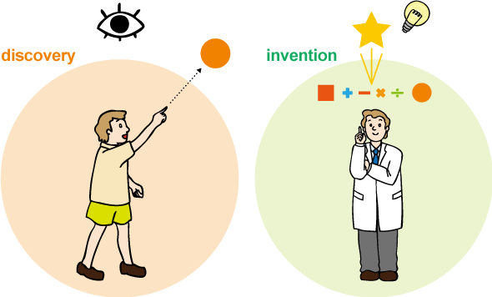
Difference Between Discovery & Invention
Discovery is coming across the things that are already there *Watson & Crick discovered DNA chain | An invention is something which has been created by someone *Thomas Edison invented the light bulb
Notes:
5

Slide 6
WHAT CAN BE PATENTED ?
ALL PROCESSES & PRODUCTS WHICH ARE
NEW
INVOLVING INVENTIVE STEP
CAPABLE OF INDUSTRIAL APPLICATION &
NOT BARRED BY SEC 3 & 4 OF THE PATENTS ACT
PRODUCT MEANS
APPARATUS
DEVICES
MACHINES
CHEMICAL PRODUCTS
DRUG/ FOOD & THEIR COMPOSITIONS
CHEMICAL COMPOSITIONS
BIOLOGICAL PRODUCTS

Slide 7
What is not Patentable
Frivolous, Contrary To Natural Laws
Contrary To Public Order Or Morality, Prejudice To Human, Animal Or Plant Life Or Health Or To The Environment;
Mere Discovery Of Scientific Principle, Abstract Theory, Living Thing Or Non- living Substances
Mere Discovery Of New Form, New Property, New Use Of A Known Process, Machine Or Apparatus (EFFICACY)
Mere Admixture (SYNERGY)
Mere Arrangement, Re-arrangement, Duplication of known devices.
Omitted (Testing Methods)
Method Of Agriculture Or Horticulture
Method Of Treatment.
Plants, Animals, Including Seeds Varieties, Species, Biological Processes.
Exception: Microorganisms
Traditional Knowledge
Literary, Dramatic, Musical Or Artistic Work, Other Aesthetic Work

Slide 8
Patentabilty requirements
Novelty: New characteristics
Inventive step: Non-obviousness, knowledge being not obvious to one skilled in the field
Usefulness/Industrial applicability- invention susceptible to industrial application

Slide 9
“Novel or New”
SHOULD NOT BE
PUBLISHED IN INDIA OR ELSEWHERE
IN PRIOR PUBLIC KNOWLEDGE OR PRIOR PUBLIC USE
CLAIMED BEFORE IN ANY SPECIFICATION IN INDIA

Slide 10
INVENTIVE STEP
“Inventive step” means a feature of an invention that involves technical advance as compared to the existing knowledge or having economic significance or both and that makes the invention not obvious to a person skilled in the art;

Slide 11
INDUSTRIAL APPLICATION
INVENTION IS
CAPABLE OF BEING MADE OR
CAPABLE OF BEING USED IN
AN INDUSTRY

Slide 12
Lifecycle of a patent
Filing of patent application
Formal
Examination
Publication of Application
Search and Substantive Examination
Grant and Publication

Slide 13
Procedure for Registration of Patent
Notes:
13

Slide 14
Trade Mark
A trade mark is any design that can distinguish the goods of one trader from those of another.
It includes words, logos, pictures, or combination of these.
A trademark is used as a marketing tool for product positioning.
The consumer will rely on the labels attached to the product with certain expectation of the quality of said product.
Term: 10 years

Slide 15
To register a trade mark the mark must be distinctive and not contrary to law or morality and not identical to the earlier mark for the same or similar goods
The notion ® may be used for the trademark only if it is federally registered.
In pharmaceutical arena, trade names for certain drug may be registered as a trademark

Slide 16
What Can be a Trademark
A trademark can comprise a name, word, phrase, logo, symbol, design, image, or a combination of these elements & It should be
ORIGINAL
Examples: PRESTIGE, HAWKINS, MAHARAJA

Slide 17
Essential features of a trademark
Trademark which are not registerable
It must be a mark, brand,
Mark that contain or
heading, name, label,
comprises of any matter likely
signature or numerical shape
to hurt the religious
of goods, packaging,or
susceptabilities of any class or
combination of these.
section of the citizens of India.
It must be capable of being
represented graphically.
Mark that comprises of
It must be capable of
or
scandalous or obscene matter.
distinguishing the goods
Mark which has nature as to deceive the public or cause confusion.
services of one person from those of others.
The use must be of a printed or other visual representation of the mark.
Mark prohibited under the
Emblems and Name Act, 1950

Slide 18
Location of Trademark Registry Offices
Delhi
Mumbai
Kolkata
Chennai
Ahmedabad

Slide 19
Well known Trademarks
Coca Cola for soft drink
IBM for computer/ software

Slide 20
Trade names
Furniture, Refrigerators, Storewell, Compactor etc.
Electric items (bulbs, trimmers, sound system etc)

Slide 21
Logo of some well known brands
Logo of iodized salt of Hindustan Lever
Logo of Volkswagen
Logo of Washing Powder of Hindustan Lever

Slide 22
Service mark examples

Slide 23
Designs
Design refers to the 2- or 3- dimensional drawing
delineating features of
Shape
Configuration
Pattern
Ornamentation
Compositions of lines or colors
Applied to any article in 2-d or 3-d or in both
forms, and are judged solely by the eye (shape or surface , patterns, lines or color).
Applied to an article for its manufacturer

Slide 24
Criteria of Design Registration
Novelty: Novelty is judged solely by eye
w.r.t. external appearance of the finished
Article
Absolute Novelty– i.e. Not publicly known or use in India or elsewhere

Slide 25
Term of Design Registration
Term of design registration maximum 15 years subject to renewal every five years
No question of re-registering the registered design >15 years
Classes of goods for design registration- 14 years

Slide 26
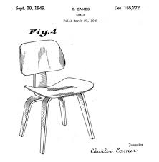
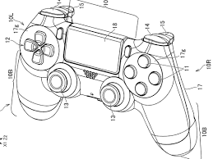
Example of Design
Play Station
Designers chair

Slide 27
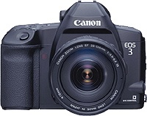
PATENT
TRADEMARK
Auto-Focus Mechanism
Subject Matter of Patent
Brand Name
Subject Matter of Trademark
DESIGNS
External Appearance of Camera
Subject Matter of Design.

Slide 28
Geographical Indication
A geographical indication is a name or sign used on certain products, which corresponds to a specific geographical location or origin (eg. a town, region, or country).
The use of a GI may act as a certification that the product possesses certain qualities, or enjoys a certain reputation, due to its geographical origin.

Slide 29
Who Owns the GI ?
The whole community, which belongs to that
particular region owns the GI
Property of the community, unlike trademark which is a traders property
To exclude unauthorized persons from misusing GI
Quality and reputation owing to a place of origin

Slide 30
Term of GI
Registration of a geographical indication
remains valid for a period of 10 years
Not granted to individuals
It’s a national property (Association, Authority,
Organization)
e.g. Tea Board, Coffee Board, Spice Board
It can be renewed from time to time for
further period of 10 years each

Slide 31
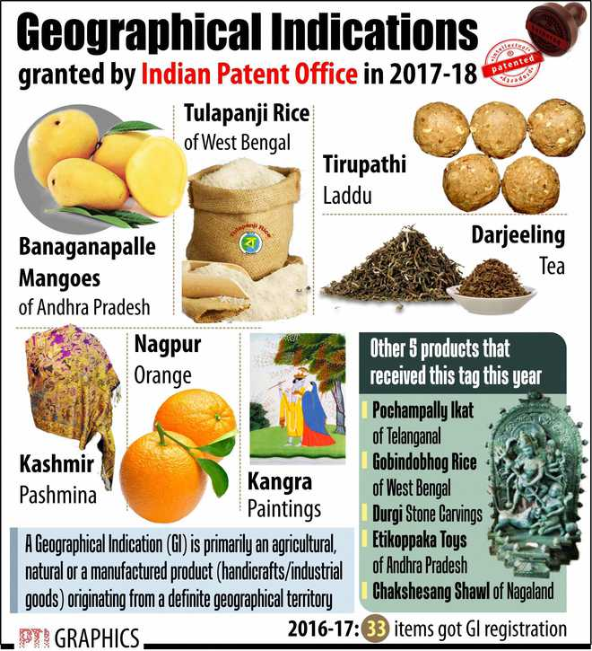
Indian GI

Slide 32
Bihar GI

