Slide 1
INTUSSUSCEPTION AND VULVULUS
Dr Mithilesh Kumar
Assistant Professor cum Jr. Scientist
Veterinary Surgery and Radiology
Bihar Veterinary College,
Patna-14.

Slide 2
Invagination of part of intestine distally
Intussusceptum
Intussuscipiens
Three layer
Entering layer
Middle layer
Ensheathing layer

Slide 3
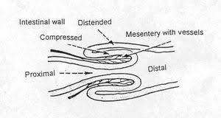

Slide 4
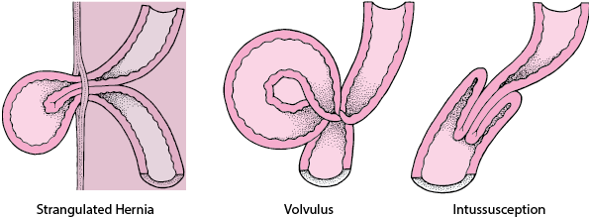
Intestinal strangulation (cutting off of the blood supply to the intestine) usually results from one of three causes.

Slide 5
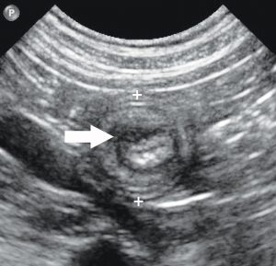
Transverse axis view of the ileocolic junction of a dog diagnosed with an ileocolic intussusception (calipers) with focal muscularis thickening (white arrow).

Slide 6
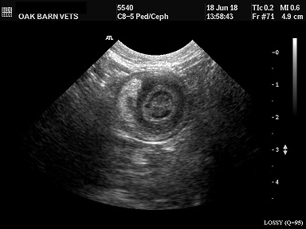

Slide 7
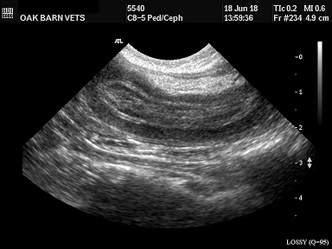
Intussusception observed longitudinally by USG

Slide 8
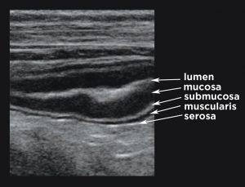
Longitudinal axis view of a segment of jejunum of a normal dog demarcating the different layers of the small intestines.

Slide 9
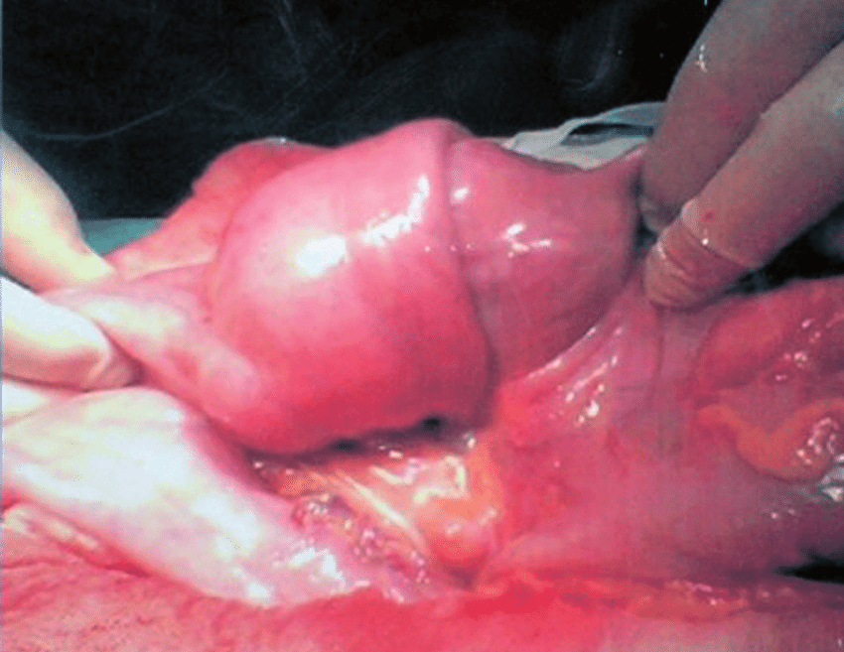

Slide 10
Usually in jejunum and ileum rarely in colon
CAUSE
Vigorous bowel movement
Abscess or polyp

Slide 11
CLINICAL SIGNS
Anorexia
Colic
Depression
Feces gradually decrease.

Slide 12
Rectal temperature and respiration rate normal
Pulse rate accelerated
Rectum-Empty and contains blood tinged mucus
Rectally palpated sausage shaped mass
Rt flank laparotomy

Slide 13
TREATMENT
Rt flank laparotomy
Invaginated segment of the intestine located and resected
Anastomosis of healthy ends of intestine
Fluid therapy
Antibiotics

Slide 15
Volvulus
Axial rotation of the mesentery and attached small intestine
Found in cattle and dog
Whole or part of mesentery rotated.
Distal jejunum and proximal ileum are prone.
Rolling the animal.

Slide 16
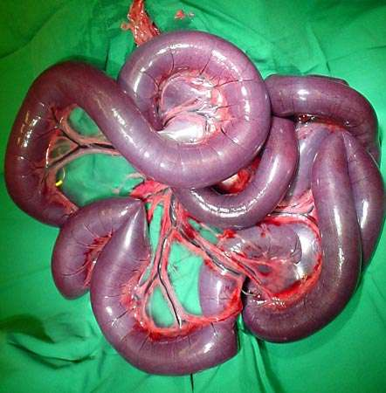
Volvulus -Mesenteric volvulus from a German Shepherd Dog.

Slide 17
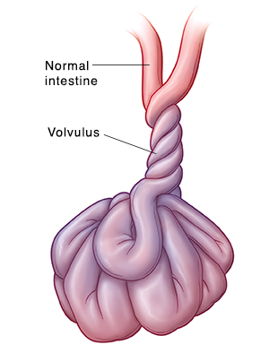

Slide 18
Rt flank laparotomy
Palpation, location and direction of rotation detached and corrected
The segment of intestine exteriorized and decompressed for correction
Antibiotics
Fluid therapy.

Slide 19
PARALYTIC ILEUS
Function obstruction in the flow of ingesta simulates mechanical obstruction
Restoration of motility of intestine
Calcium solution, neostigmine, saline purgative and rumen cud transplants,

