Slide 1
VSR Unit-5: Surgical Affections of Male Reproductive System-II
Dr. Ramesh Tiwary
Assistant Professor
Deptt. of Veterinary Surgery and Radiology

Slide 2
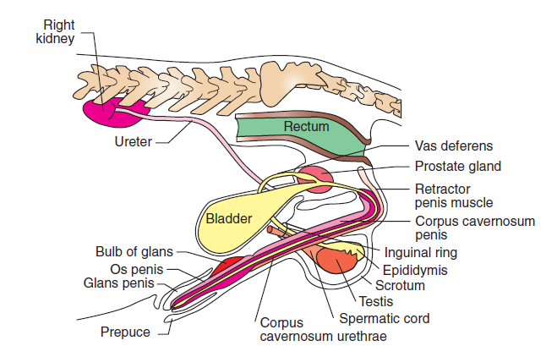
Male Genital System

Slide 3
Benign Prostatic Hyperplasia (BPH)
Spontaneous enlargement of the prostate gland in dogs as they age.
Both hypertrophy and hyperplasia occur with diffuse glandular proliferation
Hyperplasia affects dogs as young as 1 year of age and peaks at 5 to 6 years
Prevalence: 50% in all adult dogs by 4 to 5 years of age.
95% of the male dogs affected by 9 years of age.

Slide 4
Clinical Signs
Hindquarter Weakness.
Ribbon like stool due to partial occlusion of lumen of large bowel
Bloody urethral discharge,
Hemospermia, infertility
Decreased libido, reluctance to breed
Perineal hernia (concurrent condition)

Slide 5
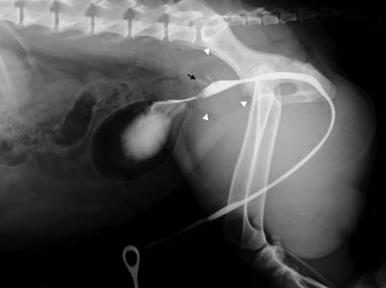
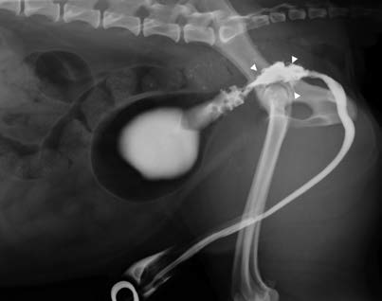
BPH/PN

Slide 6
Medicinal Treatment
Finasteride
Testosterone- 5 alfa reductase- Dihydrotestosterone
Finasteride 5-mg tablet per dog/day for 1 to 50 kg
Significantly decreases dihydrotestosterone (58%)
Finasteride reduces prostate diameter (20%) and volume (43%)
Not adversely affect the serum testosterone, libido, semen quality, and fertility.

Slide 7
Surgical Treatment
Castration is the best treatment for benign prostatic hyperplasia
Involution of the gland begins within days of surgery
50% size decrease in in 3 weeks
70% reduction in size is expected by 9 weeks.

Slide 8
FNAC

Slide 9
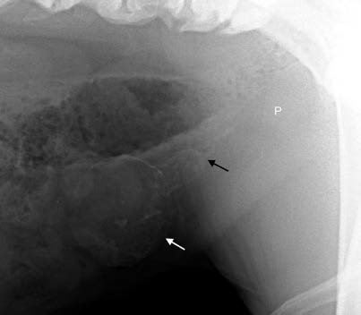
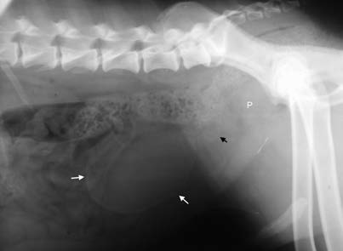
Paraprostatic cyst

Slide 10
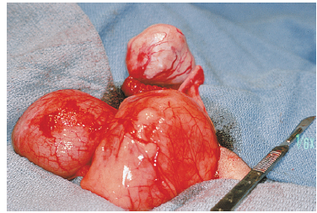
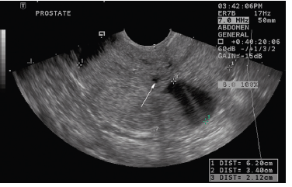
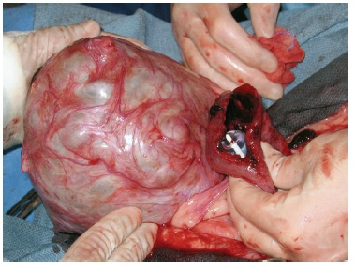
Prostatic Cyst

Slide 11
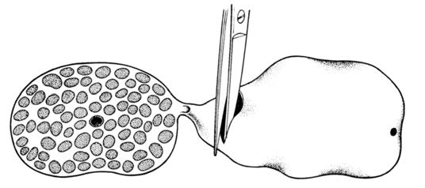
Omentalization of cyst
Omentum- physiologic drain

Slide 12
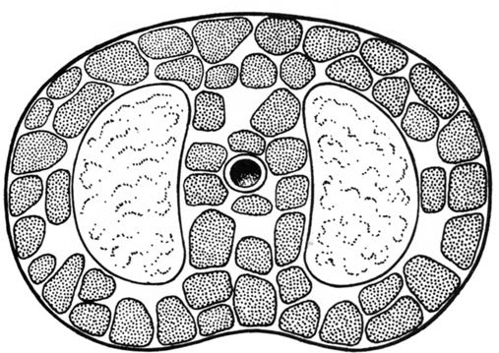
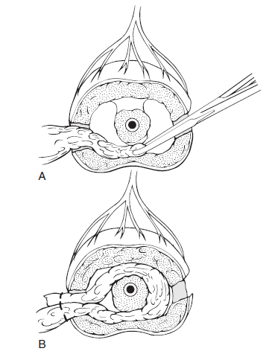
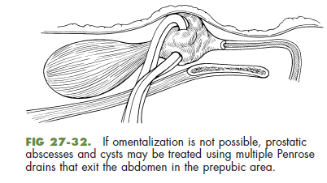
Omentalization of Prostatic Abscess

Slide 13
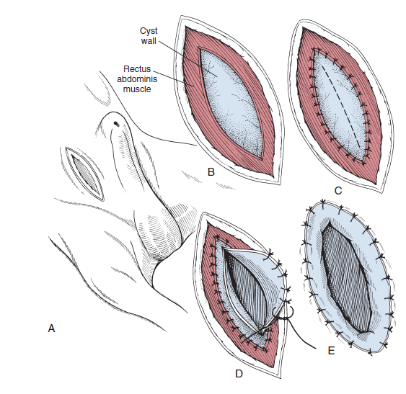
Masupialization of P.Cyst/Abscess

Slide 14
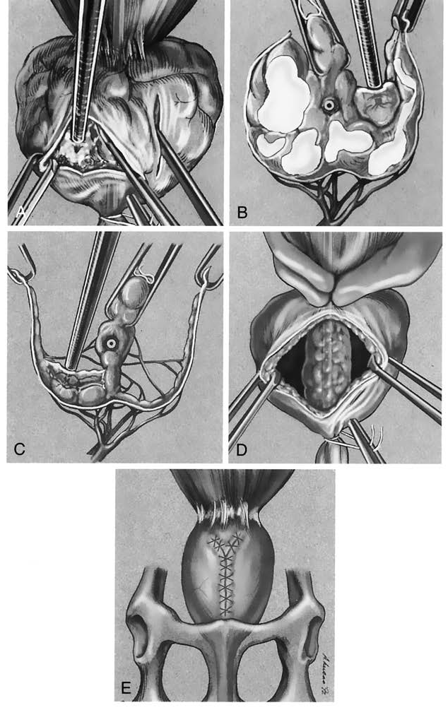
Partial Prostatectomy
Partial prostatectomy procedure for treatment of prostatic cysts and abscesses

Slide 15
Excisional prostatectomy is used to treat cancer
Treatment is usually palliative
Transitional and prostatic carcinomas usually grow slowly.
Neither medical therapy nor radiation treatment provides significant benefits in patients with prostatic cancer.

Slide 16
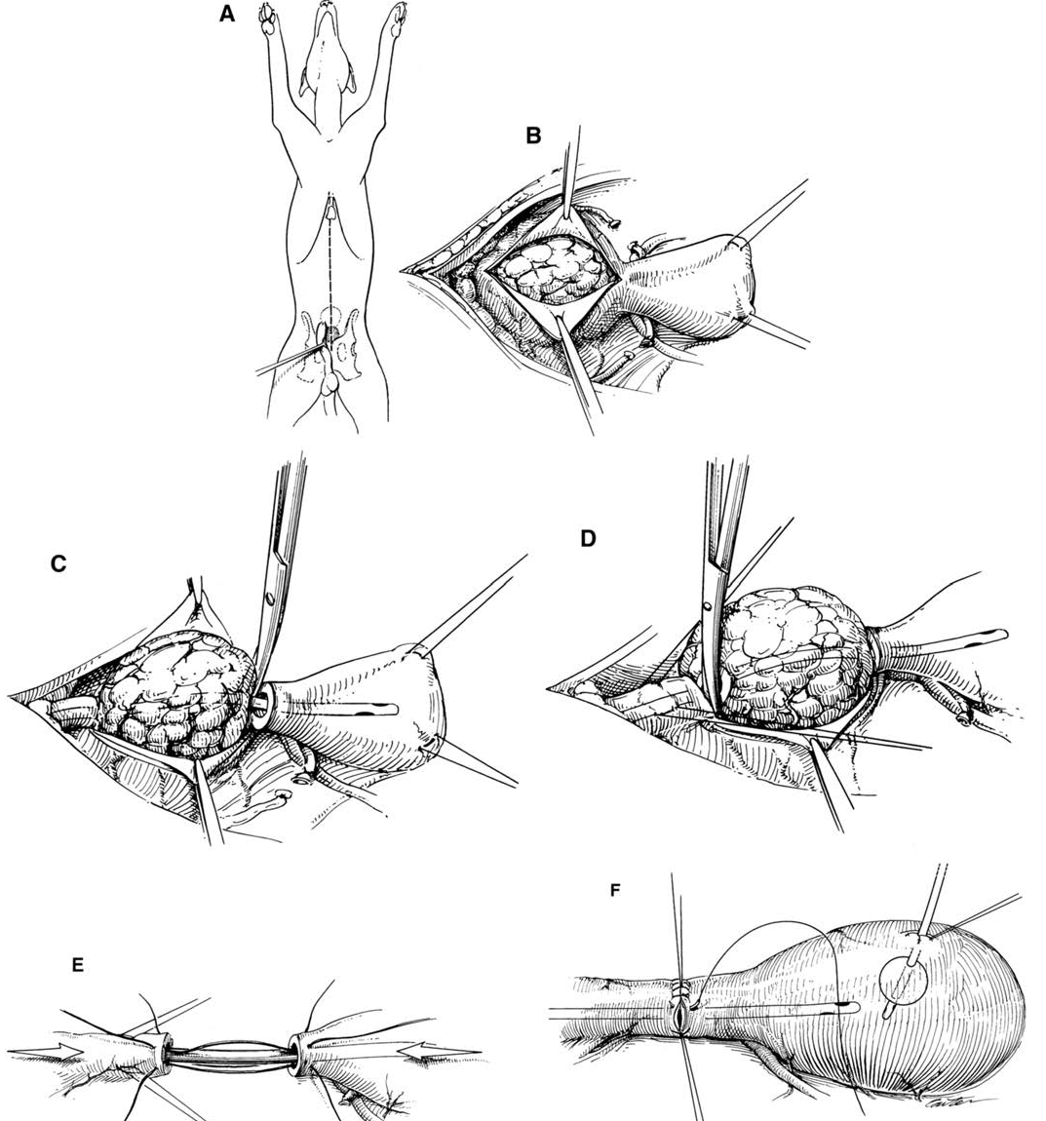
Prostatectomy

Slide 17
BACTERIAL PROSTATITIS
Intermittent hematuria and dysuria or bacterial UTI
Clinical abnormalities pain, fever, and lethargy
Pain during rectal palpation
Common organism is Escherichia coli, followed by staphylococci and streptococci
In septic dogs, without C/S start treatment with a combination of clindamycin and enrofloxacin

