Slide 1
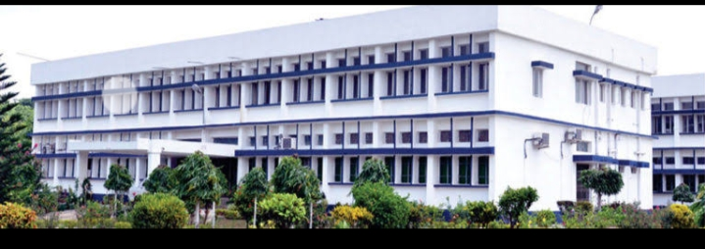
PHYTOCHEMICALS IN RELATION TO HUMAN HEALTH
Department : Dairy Technology Course Title : Food Technology I Course No. : DTT -322 Course Teacher: Bipin Kumar Singh

Slide 2
Phytochemical
Consumption of fruits and vegetables has since long been associated with lesser incidences of certain diseases like cataract, scurvy, cancer and CVD in populations consuming them. The disease prevention ability of fruits and vegetables is mainly attributed to the photochemical present in minor quantities.
“Photochemical”- consisted of two words “Phyto” and “Chemicals”.”Phyto” from Greek word for plants, denoting their plant origins and it refers to the chemicals which are present in plant. These photochemical are secreted or developed as a part of the plants own defence mechanism against environmental insult and fortunately beneficial to human beings. These photochemical are very effective anti-oxidants thus checks free radical mediated degenerative diseases like cancer, CHD etc.

Slide 3
Photochemical with Proven Health Benefits
Phytoestrogens
Organosulphur compounds
Glucosinolate
Carotenoids and flavonoids
Lycopene and cancer prevention
Flavanoids
Phytosterols
Other Phytochemicals

Slide 4
Phytoestrogens
Phytoestrogens are a broad group of plant-derived compounds that structurally mimics endogenous 17 betaestradiol. Two major phytoestrogens, which are of great importance from nutritional and healt perspectives, include lignans (Flaxseed) and isoflavones (soy bean).
Isoflavones are flavonoids compounds and major flavonoids that have been identified in soybeans are genistein, daidzein and glycitein. These compounds exist naturally in soy bean in several glycoside forms, but it is the aglycone form that is biologically active.

Slide 5
Organosulphur compounds
These compounds are also called as “Promise of Garlic”. Garlic and other alliums are popular recipe seasoning, but these also have long been promoted as a medicinal agent. Garlic and other alliums – onions, chives, leeks and scallions contain allylic sulphides.

Slide 6
Glucosinolate
About 100 glucosinolate have been identified in more than 450 plant species including 16 higher plant families, marine sponges and red algae. Cruciferous vegetables comprising of cauliflower, broccoli, radish, horseradish, cabbage, Brussels sprout contain relatively high content of glucosinolate, a poten anticarcinogen. Glucosinolate (GS) are a group of glycosides stored within cell vacuoles of all cruciferous vegetables.

Slide 7
Carotenoids
Carotenoids are major pigments in majority of fruits and vegetables, algae, certain fungi and bacteria. Carotenoids are plant pigments with 40 carbon atoms per molecule (tetraterpenoids). They are a widely distributed group of more than 750 naturally occurring fat-soluble pigments that are synthesized by higher plants as well as some algae and photosynthetic bacteria. They are responsible for characteristic deep red, yellow or orange colour of foods including tomato, carrots, citrus fruits, egg yolk, cow milk, liver, lobster and salmon.

Slide 8
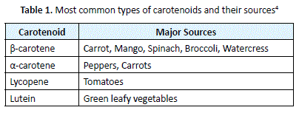

Slide 9
flavonoids
Flavonoids are polyphenolic compounds and were originally regarded as nutritionally inert, are implicated in anticarcinogenic properties. A great deal of attention has been directed to the polyphenolic constituents of tea, particularly green tea. Catechins are the predominant and most significant of all tea polyphenols. The four major green tea catechins are epigallocatechin-3-gallate, epigallocatechin, epicatechin-3-gallate and epicatechin.

Slide 10
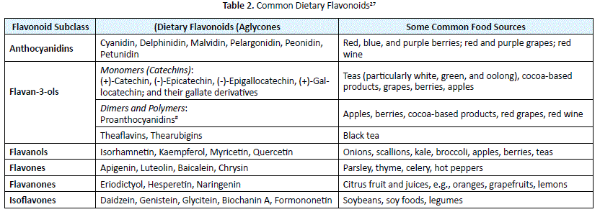

Slide 11
Contd...
Sources and Toxicity: National Health and Nutrition Examination survey (NHANES) reported an estimated intake of 200 to 250 mg/ day of flavonoids among US adults. It was also observed that widely consumed flavonoid is Flavan-3oles which accounts for 80% of flavonoid intake while the least consumed flavonoids were isoflavones and flavones . Flavonoids are found mostly in the fruits, especially citrus fruits, and vegetables, tea, red wine and legumes

Slide 12
Phytosterols
Phytosterols affect cholesterol absorption and lipoprotein metabolism. High intakes of phytosterols will lower cholesterol absorption and LDL concentrations in blood. In the intestine, these phytosterols will eject cholesterol from mixed micelles, which can decrease cholesterol absorption resulting in low levels of cholesterol in the blood

Slide 13
Contd..
Safety and Toxicities of Phytosterols: Phytosterols are generally recognized as safe substances (GRAS) based on available scientific evidence22.The recommended intakes of phytosterols are usually 3g/day[22,23].However, people with phytosterolemia genetically were told to avoid any food supplements with phytosterol in order to reduce the risk of having premature atherosclerosis

Slide 14
Contd...
Disease Prevention: Plant sterols help to prevent some diseases like cardiovascular disease [25]. Clinical trials found that the consumption of phytosterols in the average of 2 g/day decreased the concentrations of serum LDL cholesterol by 9-14%[19].The reduction in LDL cholesterol could reduce the risk of coronary heart disease (CHD) by 20% [19]. In other words, abalanced diet of plant sterol foods, which is rich in fiber, vegetables, whole grains, fruit, and low in saturated fat, is also important in reducing CHD risk

