Slide 1
Parathyroid Hormone
Dr Pramod Kumar
Asstt. Professor
Department of Veterinary Physiology
Bihar Veterinary College, Patna

Slide 2
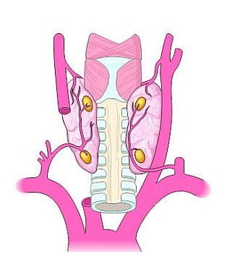
Functional Anatomy of Parathyroid Glands
Two pairs of small endocrine glands situated beyond the thyroid gland
size as of a split pea

Slide 3
Histological structure
Parenchyma of gland and arranged in cords.
Types of cells:
Chief cells - principal cells, more numerous and secrete PTH or parathormone.
Oxyphil cells - larger than chief cells and appears at puberty and their function is still not clear.

Slide 4
Structure, Synthesis and Secretion
Structure - single chain polypeptide containing 84 amino acids and having MW 9500.
Synthesis- precursor molecule called prepro-PTH, contains 115 amino acids.
Secretion - released from chief cells by exocytosis in response to decrease in plasma-ionized calcium concentration.

Slide 6
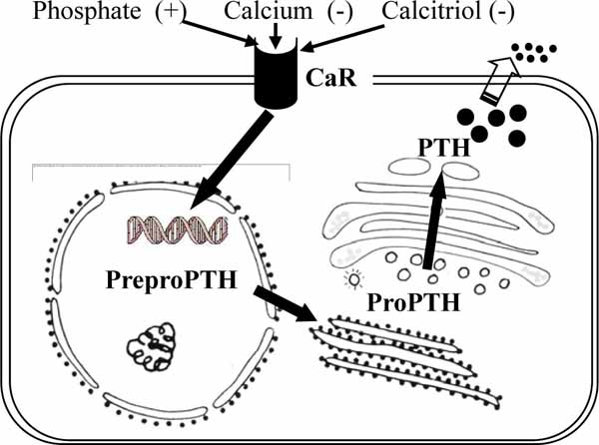
Secretion

Slide 7
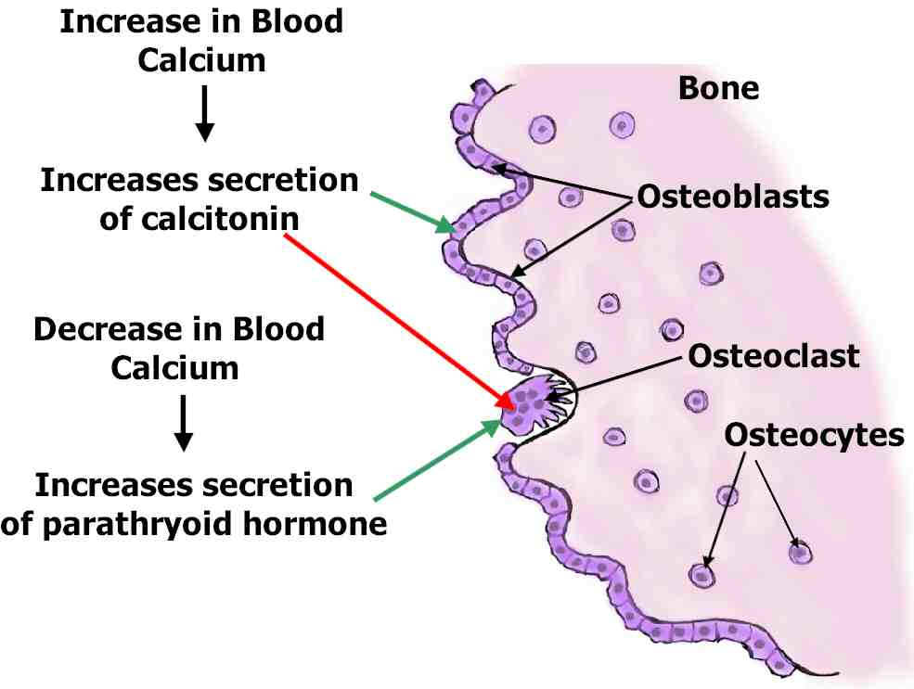
Endocrine system

Slide 9
Regulation
Role of plasma-ionized calcium.
Role of serum Mg concentration.
Role of plasma phosphate concentration.
Role of vitamin 1,25(OH)2D3.

Slide 10
Plasma level is about l30 pg/mL
Half-life in plasma is 5–8 min
Degradation occurs rapidly in the peripheral tissues
PTH is predominantly split in the liver.

Slide 11
Mechanism of action
Actions on bone - stimulates calcium and phosphate reabsorption from the bones
Rapid phase of demineralization: osteocytic osteolysis In this process, the calcium is transferred from the bone canalicular fluid into the osteocytes and then into the ECF. Phosphate is not mobilized along with ca.
Slow phase of demineralization: stimulates the formation of new osteoclasts from the osteoprogenitor initiate process of bone resorption
Ca and phosphate are released from bone and transferred to the ECF.

Slide 12
Actions on kidney:
Increase in calcium reabsorption from the ascending limb and the distal tubules which helps to prevent hypocalcaemia.
Inhibition of phosphate reabsorption in the proximal tubule, produces phosphaturia and hypophosphataemia.
Stimulation of reabsorption of Mg²⁺ by the renal tubules.
Stimulation of synthesis of 1,25- dihydroxy-cholecalcifrol.

Slide 13
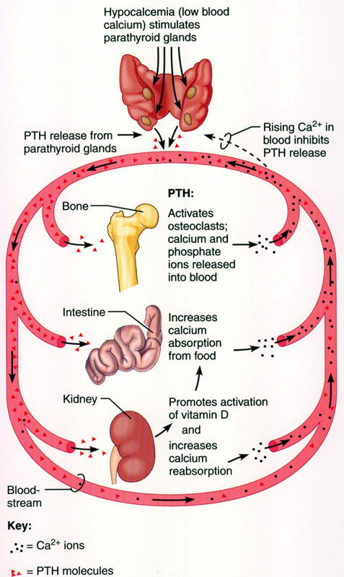
Actions on intestines
Enhances Ca and phosphate absorption from intestine by ↑ing synthesis of 1,25-dihydroxy-cholecalciferol in the kidney

Slide 14
Hyperparathyroidism
Primary hyperparathyroidism: occurs due to excessive secretion by single autonomous parathyroid adenoma.
Clinicobiochemical features:
Hypercalcaemia may produce muscle weakness, lethargy and constipation.
Ca stimulate release of gastrin to occur hyperchlorhydria and peptic ulceration.
Hypercalcaemia cause hypertension, cardiac arrhythmias and ECG changes

Slide 15
Secondary hyperparathyroidism:
Excessive secretion occur to persistent hypocalcaemia causes continued stimulation of parathyroid gland.
Aetiology: typically seen in slowly developing renal failure.
Clinicobiochemical features: Bone pains, fractures and deformity may result. Alkaline phosphatase and osteocalcin levels are elevated.

Slide 16
Hypercalcaemia can be divided into two groups:
Conditions associated with hypercalcaemia and raised PTH levels
Conditions associated with hypercalcaemia and low or undetectable PTH levels are:
Hypercalcaemia of malignancy
Multiple myeloma
Familial hypercalcaemia
Hyperthyroidism

Slide 17
Hypo-parathyroidism refers to a clinical condition characterized by low level of plasma calcium either due to deficient production of PTH or its unresponsiveness.
It can be classified into two main groups:
True hypoparathyroidism - deficient production due to heritable or acquired causes.
Post-operative hypoparathyroidism - most common cause is due to damage to glands or their blood supply

Slide 18
Pseudohypoparathyroidism - congenital condition in which PTH production is normal but target tissues are resistant to its effects.
Defect may lie in parathyroid receptors or there may be post-receptor defect.
Clinical and biochemical features are similar to hypoparathyroidism but PTH levels are elevated

Slide 19
Tetany
It refers to a clinical condition resulting from increased neuromuscular excitability.
Causes of tetany include:
Hypocalcaemia – Extracellular Ca plays an important role in membrane integrity and excitability.
Hypomagnesaemia - causes tetany because Mg ions are associated with neuromuscular irritability.
Alkalosis reduces ionic Ca and can produce tetany.

