Slide 1
Department of Veterinary Medicine Bihar Veterinary College, Patna – 800 014 (Bihar Animal Sciences University, Patna)
PARAKERATOSIS
(Zinc Deficiency)
Dr. Ranveer Kumar Sinha Assistant Professor cum Junior Scientist

Slide 2
INTRODUCTION
Skin, hair & wool are rich in Zn content
Def. of Zn produces:-
1. Retarted growth:- reduced appetite & poor food utilization
2. Skeletal disorders:-
Disturbed bone growth & remain fragile.
Deformity due to decreased osteoblastic activity.
Also produces stiffness of joint & lesions around the hoofs.

Slide 3
INTRODUCTION
3. Abnormal keratogenesis:
Produces rough, dry, scaly hair coats & alopecia.
Parakeratosis in pig(imperfect keratinisation of epithelial cell)
Alopecia & general dermatitis around the head & neck is observed in cattle.
4. Reproductive disorder: Delay in sexual maturity due to Zn def. Bull & cow remain infertile.

Slide 4
ETIOLOGY
Parakeratosis is a zinc-responsive dermatosis usually observed in 2- to 4-month-old swine. The deficiency is usually caused by feeding
Excessive calcium; excessive phytic acid (sometimes present in soybean protein) or a low concentration of essential fatty acids.
Enteric pathogens or changes in intestinal flora can adversely influence zinc absorption.

Slide 5
PATHOGENESIS
Zn is component of certain enzyme like carbonic anhydrase required for removal of Co2.
Alkaline phosphatase required for phosphorylation, concerning lipid metabolism & lactic dehydrogenase for the interconversion of pyruvic acid & lactic acid

Slide 6
SYMPTOMS/SIGNS
Skin lesions and reduced growth rate.
Reddened macules and papules on the ventrolateral abdomen and medial surface of the thighs
The lesions are slowly covered by thick, roughened scales and crusts.
More obvious lesions soon become apparent on the lower legs and on the dorsum.
Lesions sometimes can be seen around the eyes, ears, snout and tail and eventually may become generalized.
Skin are hyperkeratotic and there may be fissuring of the epidermis with secondary infection of the fissures.

Slide 7
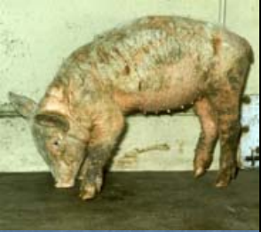

Slide 8
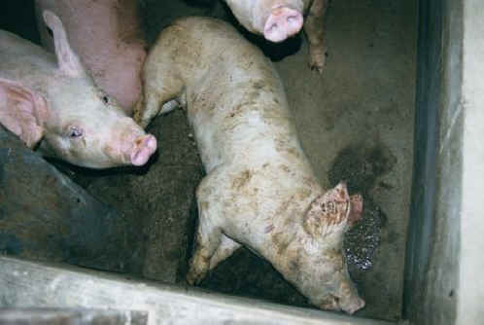

Slide 9
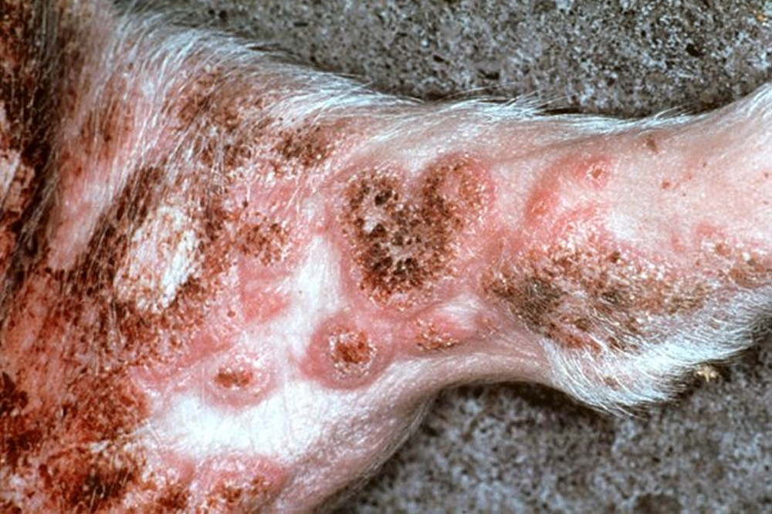

Slide 10
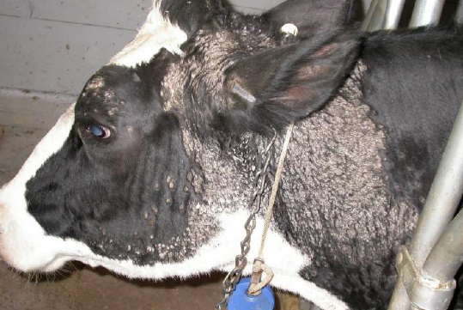

Slide 11
DIAGNOSIS
Clinical finding
History of diet
Estimation of Zn level(N.20-120 mg/dl)
Reduced alkaline phosphatase & Carbonic anhydrase level in serum

Slide 12
DIFFERENTIAL DIAGNOSIS
Differentiated from sarcoptic mange
Parakeratosis is non pruritic whereas sarcoptic mange is pruritic.
Pigs with Parakeratosis will recover if excessive calcium is removed from the ration and it is properly supplemented with zinc.

Slide 13
TREATMENT
Ruminant:-2 gm Zinc sulphate orally for a week
Pig:- 2-4mg/kg b.wt.orally
Dog:-100-200 mg Zinc sulphate

Slide 14
THANK YOU
FOR
LISTENING

