Slide 1
Preservation of eggs LPT- 321 (Meat Science)
By-
Dr. SUSHMA KUMARI
Asst. Prof., Dept. of LPT, BVC
BIHAR ANIMAL SCIENCES UNIVERSITY

Slide 2
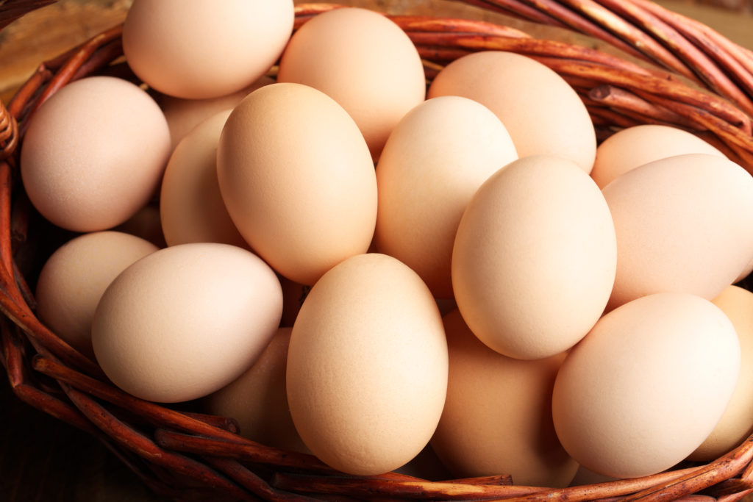
Preservation of Eggs

Slide 3
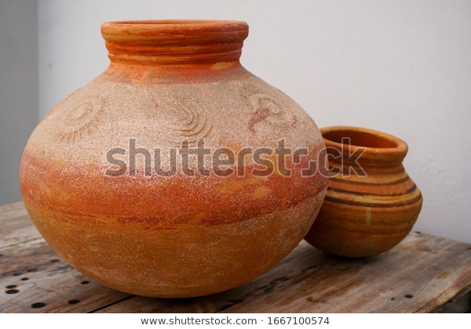
Methods of Egg Preservation

Slide 4
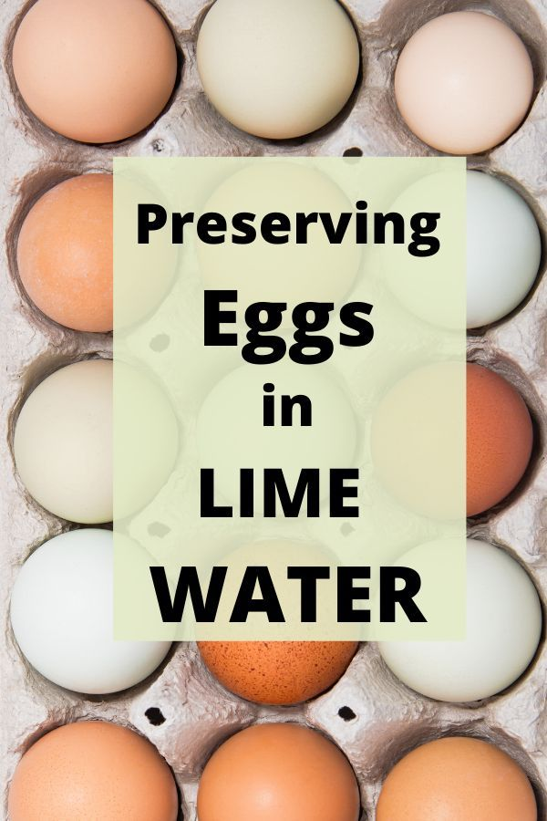

Slide 5
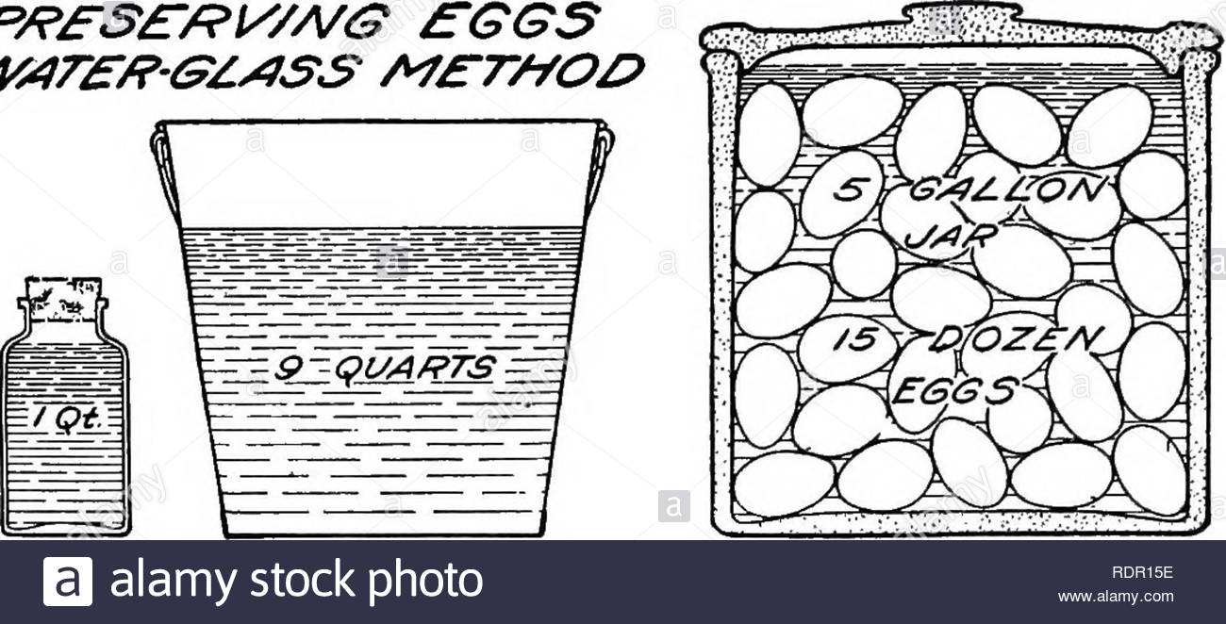
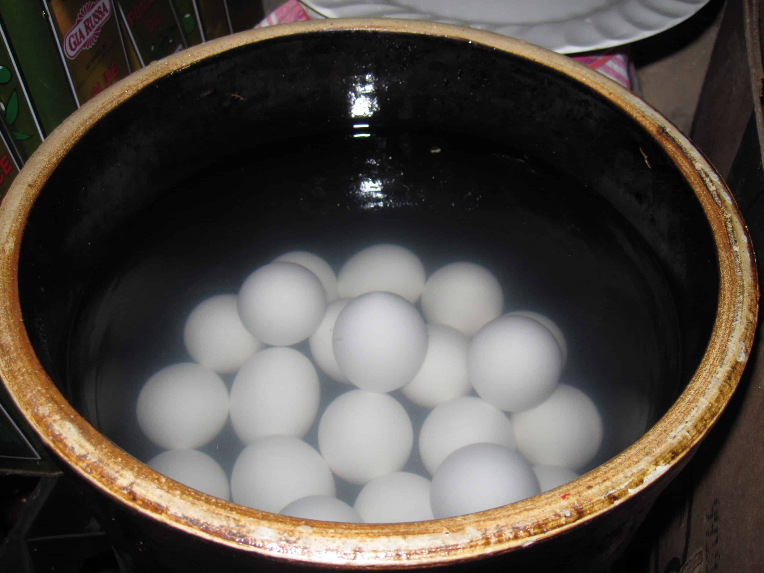
Water glass method
A 10% solution of sodium silicate is prepared in hot water and allowed to cool.
The cooled solution is poured into a jar containing the eggs till they are immersed completely.
The jar is covered and kept in a cool place where the temperature should not exceed above 70ºF.
Eggs preserved by this method are usually punctured before boiling to avoid the breakage of shell while boiling and it also helps for easy peeling of shell.

Slide 6
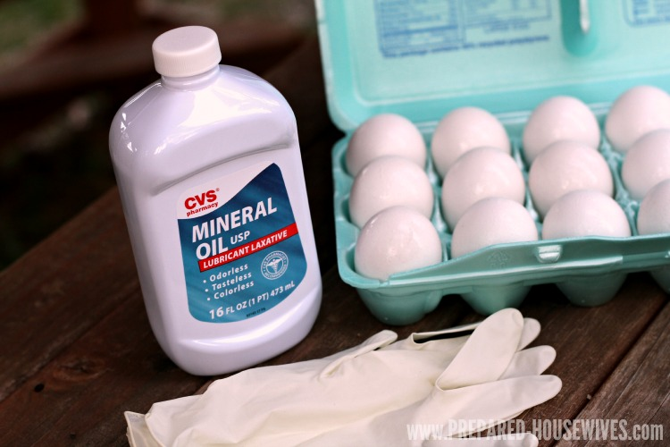
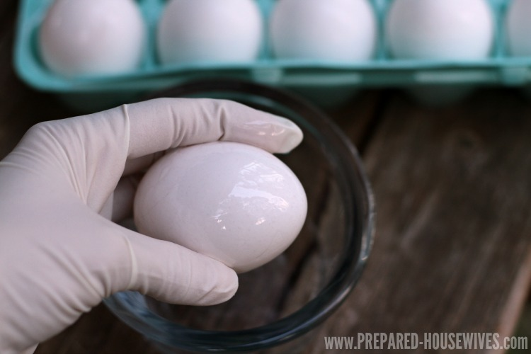

Slide 7
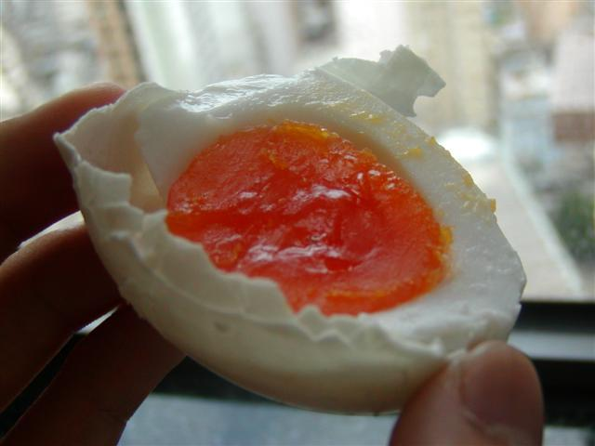

Slide 8
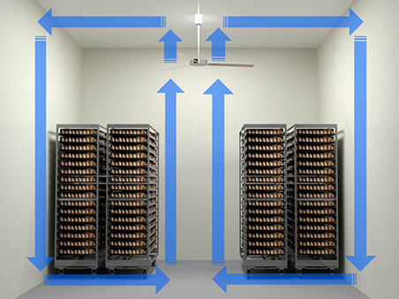
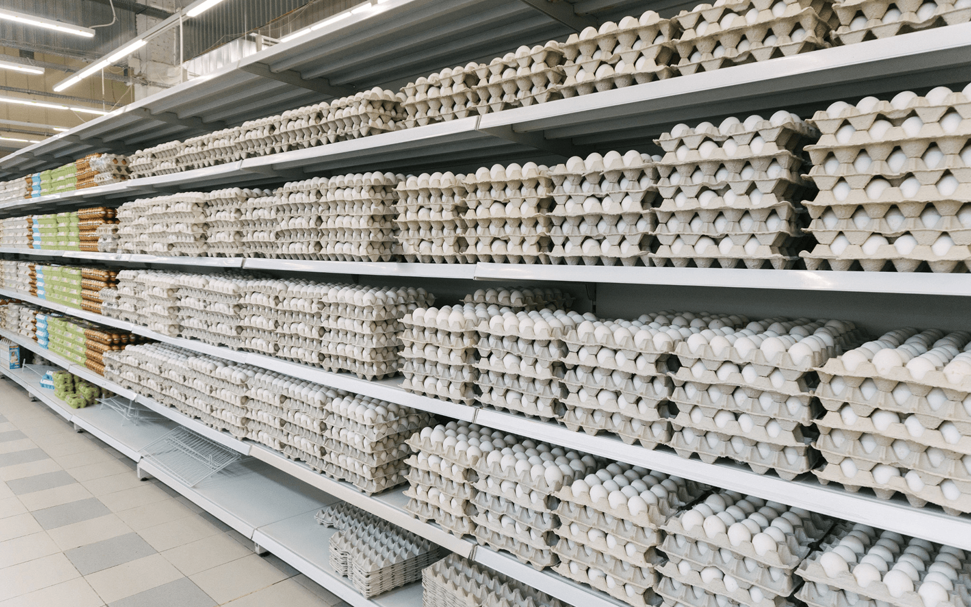

Slide 9
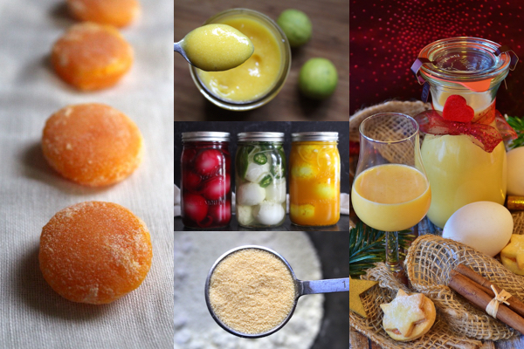
Preservation of eggs without shell

Slide 10
Thanks

