Slide 1
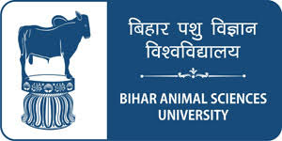
Preservation of meat and poultry
Dr. R. K. Jaiswal
Asstt. Prof.-cum-Jr. Scientist
Dept. of Livestock Products Technology
Bihar Veterinary College
Bihar Animal Sciences University
Patna-800014 (Bihar)

Slide 2
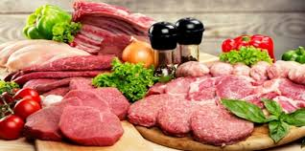
Principles of Preservation of Meat
Practiced since time immemorial
Times of plenty to tide over scarcity
Primary purpose: prevent spoilage
Accomplished through unfavourable immediate micro-environment
Initiated by drying meat

Slide 3
Methods of Preservation of Meat
Moisture Control
Temperature Control
Direct Microbial Inhibition
Drying
Intermediate Moisture Foods
Freeze Drying or Lyophilisation
Salting
Curing and smoking
Freezing
Preservation by High Temperature
Canning
Retort Processing
Irradiation
Antibiotics
Chemicals
Preservation by Low Temperature
Chilling

Slide 4
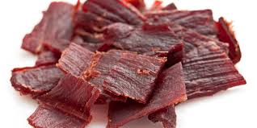
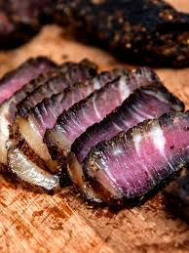
Drying
At present drying plays only a minor role in preservation of meat on a commercial scale.
Product | Country of Origin
Jerkey | South America
Pemmican | North America
Biltong | South Africa
Charque | Uruguay and Brazil
Odka | Somalia and other East African countries
Qwanta | Ethiopia and other East African countries
Kilishi | Nigeria and some of the West African countries
Pastrima | Turkey, Egypt and Armenia

Slide 5
Freeze drying or Lyophilization
Process of removing water from frozen foods
Removal of water is accomplished by sublimation, i.e., the water in the frozen meat evaporates without melting of ice.
Frozen meat is subjected to controlled vacuum and temperature conditions.
Food product must be in comminuted form and packaging must be completely moisture.
Preserve beef, pork, chicken, shellfish, whole steaks and chops.
Expensive to preserve meat (high moisture) by lyophilization.
Advantages are shrinkage and distortion of shape are very minimal, and retention of flavour and nutrition is excellent.

Slide 6
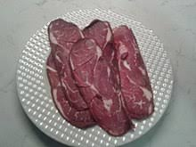
Intermediate moisture meat products
Sundried meat had meager dehydration capacity resulting in poor juiciness and texture.
Later studies revealed that meat products with 20-50% moisture had moderate juiciness and texture on rehydration.
Such products were resistant to bacteriological spoilage and could be held without refrigeration. Referred as IMM.
Stability is due to reduced availability of water to the microorganisms (water activity: 0.6 to 0.85) .
Special significance where refrigeration facilities are not always available.
Helpful for Defense expeditions and stress situations

Slide 7
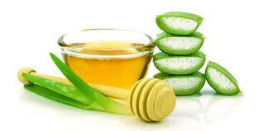
Humectants
Various additives employed for lowering the water activity of foods are known as humectants.
Some of the most commonly used humectants are:
Glycerol
Propylene glycol
Sodium chloride
Polyhydric alcohols (e.g. sorbitol)
Sugars (e.g. sucrose, dextrose, corn syrup etc)
Low molecular weight compounds and easily soluble in water.
Chemically inert and do not modify normal sensory qualities.

Slide 8
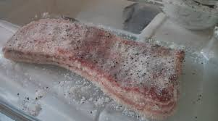
Salting
Very ancient method of preservation
Process of applying dry salt on the surface of meat and rubbing it to extend the shelf life of meat.
When dry salt is applied, salt dissolves in the meat fluid near the surface and further withdraws fluid from the meat.
It then passes slowly inward, dissolves throughout the meat substance .
Thus salt has no harmful effects on the bacteria.
Higher concentration of salt gives greater preservative action.
Principle involved in applying salt is dehydration and germicidal.

Slide 9
Curing
Addition of salt, sugar and nitrate or nitrite to the meat, which results in conversion of the meat pigments into the characteristic cured meat pigments imparting the characteristic cured meat colour and production of characteristic meat flavour.
The process of meat curing is currently valued as a means of imparting organoleptic qualities to the cured products, though it originally was introduced as a means of preserving meat.
Due to the advent of efficient and widespread refrigeration the need for preserving meat by curing alone has reduced.

Slide 10
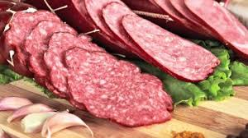
Curing Ingredients
Sodium chloride
Sodium or potassium nitrate
Sodium nitrite
Monosodium glutamate
Sugar
Acetic acid
Vinegar
Spices

Slide 11
Salt
Acts by dehydration and alteration of osmotic pressure so that it inhibits bacterial growth and subsequent spoilage.
Ionizes to yield the chlorine, which is harmful to the organisms.
Sensitizes the cells against CO₂.
Interferes with the proteolytic enzyme action.
Effectiveness of sodium chloride varies directly with its concentration and storage temperature.
Acceptable level of salts in hams has been reported to be about 3% and about 2% for bacon.

Slide 12
Sugar
Sugar softens the products by counteracting the harsh and hardening effects of salt.
It interacts with amino groups of the proteins and upon cooking, forms browning of the products, which enhances the flavour of the cured meats.
Sugar substitutes have been used in bacon cures to prevent excessive browning during cooking.
It acts as a preservative by dehydration.

Slide 13
Nitrates and Nitrites
Nitrates and nitrites bring about the desired pink colour development – nitrosyl hemochromogen.
Nitrate raise the oxidation-reduction potential and therefore are more favourable to aerobic than anaerobic organisms.
Inhibit the growth of food poisoning and spoilage organisms.
Effective in preventing the growth of Clostridium botulinum organism.
Retards development of rancidity.
Nitrate or nitrite alone or in combination of both shall not be more than 200 ppm in finished products as it is toxic.

Slide 14
Development of cured pink colour
NaNO₃ → NaNO₂ → HONO → NO
Sodium nitrate Sodium nitrite Nitrous acid Nitric oxide
Myoglobin +Nitric oxide→Nitric oxide myoglobin →Nitrosyl hemochromogen
(purplish red) (red) (pink in colour)
Nitrosamine
The reaction of nitrous acid with secondary amides produces nitrosamine.
It is demonstrated that nitrosamine are carcinogenic compounds.
They have been isolated from cured meats in a few instances.
Work is now underway to determine the factor that controls their formation, but the final answer is not available.

Slide 15
Different methods of curing
Dry curing (dry salt cure, Conventional dry cure)
Curing with liquid
Combination curing (Thermal or hot cures)
Curing with liquid
Injection curing
Artery pumping
Stitch pumping (Pump pickling)
Machine pumping (Multiple needles pumping)

Slide 16
Phosphates
Alkaline phosphates are used to increase the water binding capacity and thereby the yield of the finished product.
Decrease the amount of shrinkage in smoked products when cooked.
To reduce the degree of purge or cook-out in canned product.
Legal limits for added residual phosphates are set at 0.5% in the finished products.
Approved phosphates are
Sodium tripolyphosphate
Sodium hexa metaphosphate
Sodium acid pyrophosphate
Disodium phosphate

Slide 17
Ascorbic Acid/ Ascorbates
Causes reduction of metmyoglobin to myoglobin, thereby accelerating the rate of curing.
React with nitrites to increase the yield of nitric oxide from nitrous acid.
Excess ascorbate acts as antioxidant, thereby stabilising both colour and flavour.
Antioxidant properties of ascorbate not only prevent development of rancidity but also prevent fading of colour of sliced meats upon exposure to light.

Slide 18
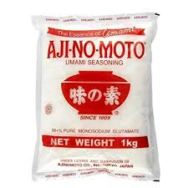
Monosodium glutamate (MSG)
It has been used in a number of products to enhance the flavour.
Related with umami flavour (fifth taste).
There is little advantage of its use in cured meat products.
Added at 0.1% level.
Causes Chinese Restaurant Syndrome (CRS)

Slide 19
Smoking
Smoking is done in addition to curing.
Cured products are placed in airtight smoke house with heat and smoke simultaneously applied.
Hard wood logs and saw dusts are used to generate smoke.
Kind of wood varies from country to country depending upon the availability and practice.
Smoking gives the products a characteristic colour and flavour.
Smoking process extends for 3 days at a temperature of 85°F (29.5°C).
It retards fat oxidation.
Reduction of water content as well as the deposition of components has bacteriostatic effects.

Slide 20
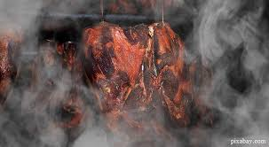
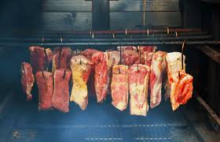
Purpose of Smoking
Improved shelf life
Development of desirable organoleptic characteristics such as flavour and colour .
Protection of fat from oxidation.
Creation of newer product.

Slide 21
Composition of smoke
Phenols – act as antioxidant, have bacteriostatic effect, contribute to smoky flavour and aroma, responsible for surface sheen.
Aldehydes – contribute colour and have bactericidal effect.
Alcohols – have bactericidal effect.
Organic acids – have antimicrobial effect and accelerate cure reaction.
Cabonyls – contribute to smoky colour and browning.
Hydrocarbons – contribute to undesirable compounds such as benzopyrene and effect colour and flavour.
Gases such as carbon dioxide, carbon monoxide, oxygen, nitrous oxide etc. - contribute to formation of undesirable compounds such as nitrosamines, also contribute to colour.

Slide 22
Types of fuel used
Most commercial smoking operations have been using sawdust, which is easier to utilize and gives a greater volume of smoke.
Hard woods have been reported to be the best for smoking e.g. sawdust of hickory, maple, oak , cherry and pecan
However, liquid smoke has been produced satisfactorily from both hard and softwood with excellent results.
Methods of Smoking
1. Natural air circulation
2. Air-conditioned smoke house
3. Continuous smoke house

Slide 23
Liquid smoke
Does not contain any carcinogenic or harmful substance.
Less time is required in preparation of product.
Minimum variation occurs in different batches because composition of liquid smoke is constant.
Easy to apply.
No air pollution occurs in the processing premises as it does not require installation of smoke generator or smoke oven.

Slide 24
Application of liquid smoke
It is generally spread on the product just before cooking.
Smoke solutions are diluted with water or frequently with vinegar or citric acid.
Composition of liquid smoke
20 – 30 parts of liquid smoke
5 parts citric acid or vinegar
65 - 70 parts of water
Citric acid or vinegar is used to enhance the skin formation on skinless frankfurters.

Slide 25
Chilling/Refrigeration
Most widely used method for short term storage of meat.
Slows down microbial growth and enzymatic as well as chemical reactions.
Storage of fresh meat is done at refrigeration temperature of 2-5°C.
Refrigeration of meat begins with chilling of animal carcasses and continues till ultimate use.
Relative humidity kept at 90%.
Carcasses are first held in chill coolers (15°C) to remove their body heat and then passed on to holding coolers (5°C).
Pork and poultry start with a comparatively high microbial load.

Slide 26
Refrigerated storage life of meat is influenced by species of origin, initial microbial load, packaging, temperature and humidity.
Favours growth of psychrophillic organisms causing spoilage .
Fresh meat has shelf life of 5-7 days at refrigerated temperature of 4±1°C.
Processed meat products are also stored under refrigeration till these are finally consumed.
These meat products are less perishable as compared to fresh meat.

Slide 27
Physical changes in chilled meat
Shrinkage: loss of weight occurs as a result of evaporation of water from meat surface; carcass cut into quarters dissipate water vapour rapidly and continuously and retail joints even more so.
Sweating: Denotes condensation of water vapour on meat brought from a cold store into ordinary room temperature.
Loss of bloom: Bloom is defined as the colour and general appearance of the carcass surface when viewed through the semitransparent layer of connective tissue, muscle and fat, which form the carcass surface.

Slide 28
Cold shortening
Undesirable change associated with quick chilling
Noticed when pre-rigor muscles, were subjected to a temperature of below 10°C, in which the meat is very tough due to extreme contraction.
Thus a pH of above 6.2 and presence of ATP is a pre-requisite for cold shortening to occur.
Occurs due to the inability of the sarcoplasmic reticulum to sequester Ca⁺⁺ at low temperatures (0°C-5°C) and a decreased binding ability of mitochondria to bind Ca⁺⁺.
Prevented by the use of electrical stimulation, which advances the onset of rigor, tender-stretch method of suspending carcasses and by ageing.

Slide 29
Freezing
Freezing is a method of choice for the long term preservation of meat.
It stops the microbial growth and retards the action of enzymes.
It has the advantage of retaining most of the nutritive value of meat during storage, although a very little loss of nutrients does occur in the drip during thawing process.
Since drip is not possible in cooked meat products, proper freezing conditions result in retention of most of the nutritional and sensory properties.

Slide 30
It is utmost important to wrap fresh meat in suitable packaging film before freezing, otherwise meat undergoes freezer burn.
Freezer Burn: Abnormal condition occurs due to progressive surface dehydration resulting in the concentration of meat pigments on the surface.
This discolouration in frozen meat due to sublimations of ice crystals, is irreversible condition.
On cooking, freezer burn meat is quite tough and lack juiciness.

Slide 31
Slow Freezing Vs. Quick Freezing

Slide 32
Types of freezing

Slide 33
Types of freezer
1. Plate type freezers: meat is placed in trays which remain direct contact with metal freezer plates. A temperature of -10°C or so is achieved.
2. Blast type freezers: used in large meat plants. Such freezers render fast freezing of meat products due to rapid air movement. A temperature range of -10 to -30°C is generally achieved.

Slide 34
Undesirable changes in freezer storage of meat
Freezer burn
Freezer burn is an extension of surface desiccation associated with freezing.
It occurs on the outer surface of imported frozen offals, like kidneys livers.
Freezer burn is attributed to loss of moisture from the outer tissues; it may be seen where a carcass is stored close to opening of a cold air duct.
The meat or offals have a brown withered discolouration.
Storage temperature influences both the rate of desiccation and the development of freezer burn. This can be prevented by using suitable packaging.

Slide 35
Bone darkening
Bone darkening is a condition, which develops when young poultry is frozen and thawed.
Organoleptic properties of the muscle are not affected, but the brown to black appearance of the long bones and the surrounding muscles results from leaching of haemoglobin out of the bone marrow.
Subsequent oxidation of the red haemoglobin to methaemoglobin produces the dark colour.
Bone darkening is a problem only in young birds for two reasons.
First, more haemoglobin is present in the bone marrow of young, rapidly growing birds.
Secondly, incomplete calcification of the bones allows the haemoglobin to escape from the marrow cavity.

Slide 36
Thaw rigor
When prerigor meat is frozen, a severe type of rigor mortis ensues during thawing.
The shortening so produced may be 60 to 80% of the original length of the unrestrained muscle.
Although shortening is less in a muscle attached to skeleton, the condition results in tough meat and heavy drip losses.

Slide 37
Canning
Process of preservation achieved by thermal sterilisation of a product held in hermetically sealed containers.
Preserves the sensory attributes such as appearance, flavour and texture of the meat products to a large extent.
Canned meat products have a shelf life of atleast 2 years at ambient temperature.
Canning has been in vogue for about 200 years now, since the French Biochemist, Nicholas Appert, in 1809
In 1810, an English man, Peter Durrand, conceived and patented the idea of using tin cans instead of glass containers.
Boston and Thomas Kensette began using tins as cans in 1819 in New York.

Slide 38
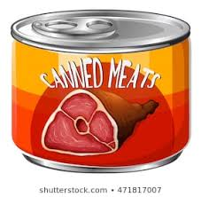
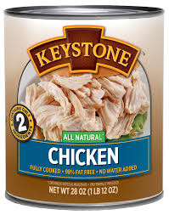
Steps in canning
Preparation of meat and gravy
Precooking
Filling
Exhausting
Seaming
Retorting or thermal processing
Cooling
Storage

Slide 39
Aseptic Canning
The food is sterilized at 120°C for 6 sec to 6 min, depending on the food, before it enters a sterilized can, which is then closed with a sterilized lid.
This method is said to improve the flavour and the vitamin content.
Retort Processing
Flexible pouches made from laminates of thermoplastic and aluminium foil are used
Not withstand the high internal pressure developed during processing
Sterilized in media (water or steam and air) capable of providing an external pressure sufficient to balance the internal one.

Slide 40
Radiation preservation of meat
1. Ionising radiations: high speed electrons, X-rays, gamma particles (cobalt 60, cesium 137).
Capable of killing microorganism on meat without significantly raising the temperature (cold sterilisation).
Amount of radiation energy absorbed by meat is expressed in rads (or) gray which is equal to 100 rads.
A mega rad is a million rads or 10,000 Gray or 10 kGy.
A dosage of about 4.5 megarads or 45 kGy is considered to be capable of sterilising products to a state where they can be stored without refrigerated storage.

Slide 41
Radiation preservation may be classified as Radappertisation, Radurization and Radicidation in the decreasing order of dosage.
Radappertisation, which brings about sterility in meat, involves the application of radiation in the range 0f 20 -30 kGy (radiation sterilisation).
It is oftern associated with development of unpleasant odours, flavors and off colours (Wet Dog Hair odour).
Beef is particularly liable to such changes while pork and poultry less so.

Slide 42
Radurization (radiation pasteurisation): uses doses less than that required for sterilisation, typically in the range 1- 10 kGy, as this dosage is sufficient to kill many spoilage organisms and thus can extend shelf life of meat under refrigeration significantly.
Radicidation is a process in which doses less than 1kGy are employed to increase shelf life, prevent sprouting in vegetables and for rendering pork free of Trichinella spiralis.
2. Non-ionizing radiation
Microwave and infrared rays have wavelength greater than visible lights are capable of generation of heat in the irradiated object and thus impart preservative effect.
Ultra violet rays when absorbed by micro-organisms is lethal to them and thus germicidal.

Slide 43
Chemical preservation
There are many chemicals, which prevent microbial growth in foods and act as preservatives.
Several organic acids have been Generally Recognized As Safe (GRAS) for use as chemical preservatives.
Apart from nitrate, nitrite, sorbic, acid and tetracyclines.
U.K. preservatives in food regulations act , 1962 lists only seven, namely sulphur-di-oxide, propionic acid, benzoic acid, methyl-p-hydroxy-benzoate, ethyl-p-hydroxy-benzoate, diphenyl, O-phenylphenol and copper carbonate,
Of these seven, only sulphur di-oxide is permitted in meat preservation up to 450 ppm being in sausage and sausage meat.

Slide 44
Preservation by use of antibiotics
The antibiotics when used in the required concentration impart no flavour or odour to the meat and do not discolour the product, while most of them are considered relatively harmless to humans.
Broad-spectrum antibiotics such as Chlortetracycline, Oxytetracycline and Chloramphenicol are commonly used.
Infusion of beef carcasses with tetracycline antibiotics seems to have improved their keeping quality and retarded internal spoilage.
However, preservation of foods using antibiotics has been banned in many countries due to public health concern.

