Slide 1
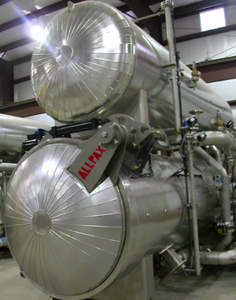
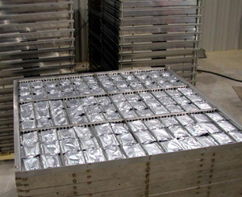
Retort Pouch Processing
Subject: Fish Canning Technology
Date of Lecture: 08.06.2020
By
Dr. Abhishek Thakur
(Assistant Professor)
College of Fisheries, Kishanganj
BASU, Patna

Slide 2
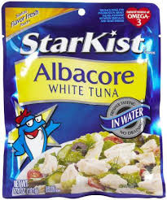
Retort Pouch Processing
A retort pouch “a flexible package in which prepared food is hermetically sealed for long-term unrefrigerated storage.”
(1977,Webster)

Slide 3
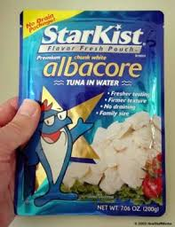
Steps involved in Retort Pouch Processing
Pouch Making
Filling
Deaeration/Exhausting
Sealing
Seal Cooling
Traying
Retorting
Rinsing
Drying
Outer Packaging/Over Wrapping
Bulk Packaging

Slide 4
Pouch Making
A retort pouch can be defined as “a container made of 2, 3 or 4-ply material which, when fully sealed, will act as a hermatically sealed container that can be heat processed at similar temperature & pressure as for metal containers.
The material used in retort pouch must also provide superior barrier properties for long shelf, seal integrity, toughness & puncture resistance.

Slide 5
Pouch Making
Pouches configuration:
3-ply pouch is the commonest _ a sandwich of thin gauge aluminium between thermoplastic films.
Sl. No. | Ply | Configuration
1 | 2 – ply | 12μm nylon or PES/70μm polyolefin
2 | 3-ply | 12μm PES/ 12μm Al foil/70μm polyolefin
3 | 4-ply | 12μm PES/ 12μm Al foil/12μm PES/70μm polyolefin

Slide 6
Pouch Making
Outer ply (PES) provides barrier properties mechanical strength.
Al-layer protects the material against the gas, light & water & ensure adequate shelf life of the contents.
Inner polyolefin layer (PP) provides best heat-sealing medium.
Inner & outer layers are laminated using a thermosetting adhesive (PES-isocyanate).

Slide 7
Pouch Making

Slide 8
Pouch Making

Slide 9
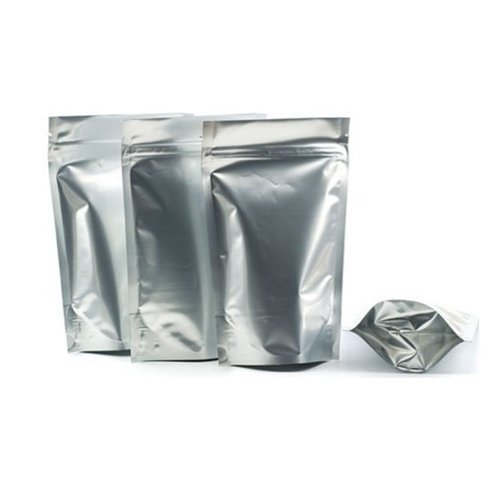
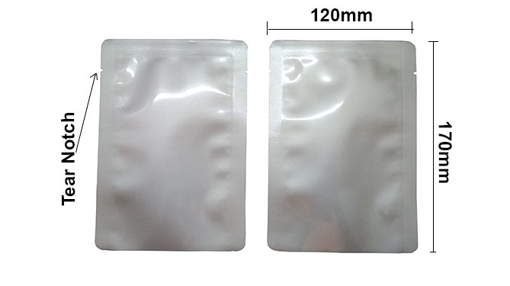
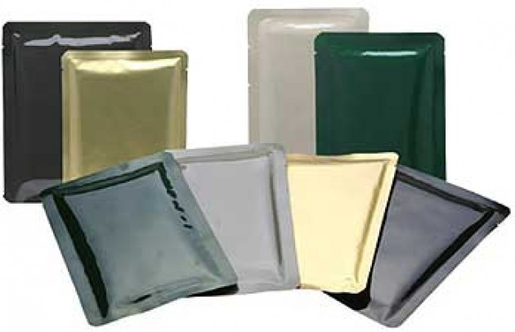
Pouch Making
Design: Flat rectangular shape with four fin seals about 1 cm wide.
The pouches are manufactured by hot bar sealing & impulse sealing.
Corner of the pouches are rounded to avoid damage to adjacent packs.
Tear notch for ease of opening.

Slide 10
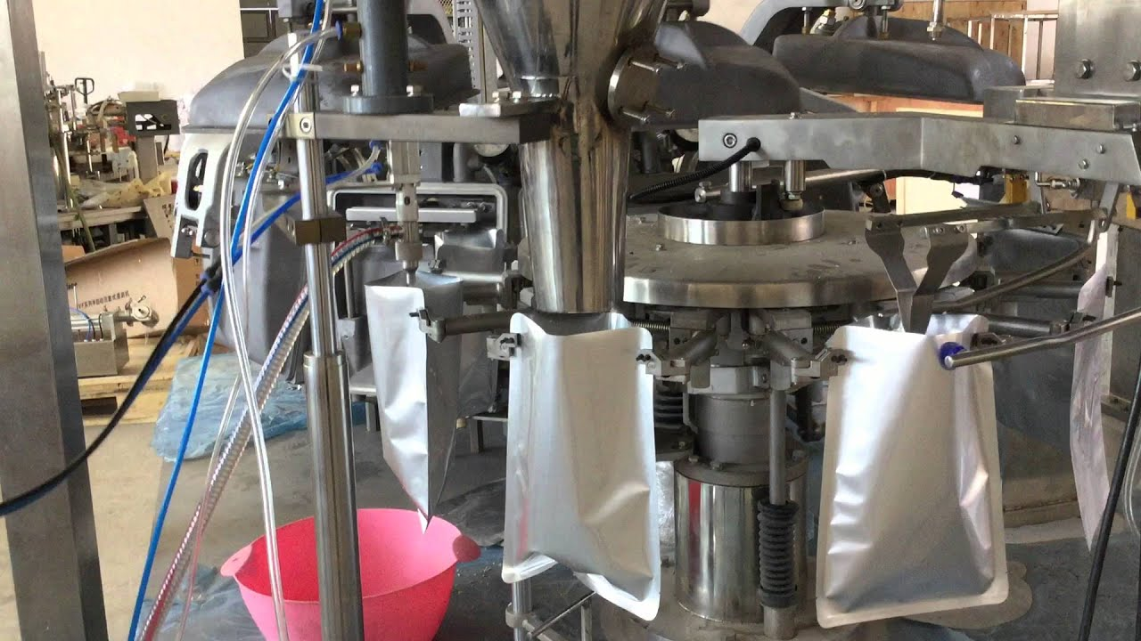
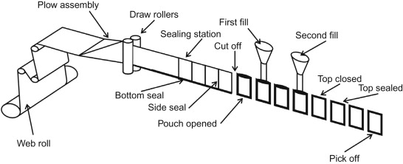
Filling
Process of filling can be done either of the using
Hand Filling
Machine Filling.

Slide 11
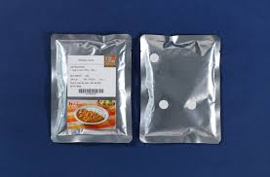
Deaeration/Exhausting
It can be done by using Vacuum Sealing machine or by injecting steam & seal quickly or to make the pack hot or to spout out head space air by pushing both sides of the pouch to make food level high.

Slide 12
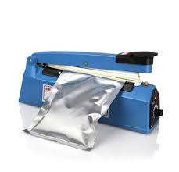
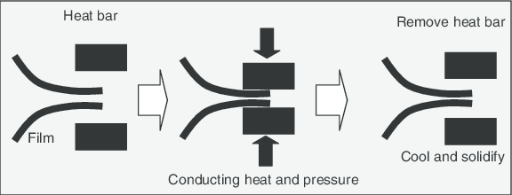
Sealing
Hot Bar Sealing
Impulse Sealing

Slide 13
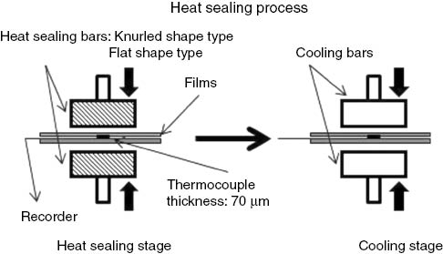
Sealing
Impulse Sealing

Slide 14
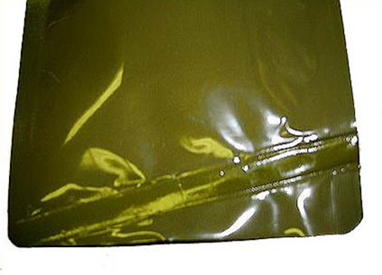
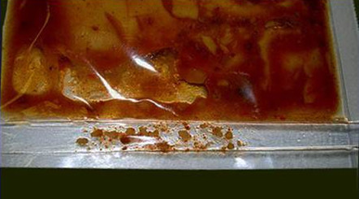
Seal Cooling
It can be done by pressing the sealed part of the pouch in a water cooled press.

Slide 15
Traying
Filled & Sealed packs should be laid flat on the retort tray.

Slide 16
Retorting
Heat sterilization of the filled & sealed pouch is done in the retorts using steam air mixture.
A slight difference in internal pressure (even 0.1kg/cm²) can result in brusting of pouches.
Proper pressure & temperature during retorting required to be maintain.

Slide 17
Retorting
Still Retorts
Agitating type Retorts
Continuous Retorts
Hydrostatic Retorts
Overpressure Retorts etc.

Slide 18
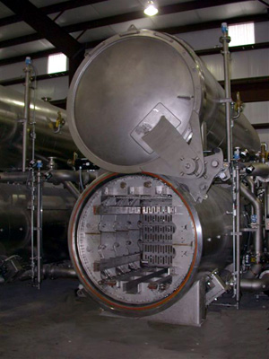
Retorting
Overpressure Retorts:
Used for flexible pouches.
Here Pouches are held in water heated with steam & provide with an overpressure of air to prevent extensive distension of the pouches.
Air Steam Retort:
Air twice denser than steam (Stratified below steam)

Slide 19
De-traying

Slide 20
Rinsing
Rinsing is done by using chlorinated water having chlorine @10ppm level.

Slide 21
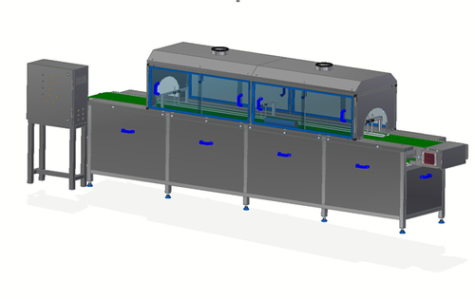
Drying
Pouches coming out from rinsing equipment will be wet.
Needs to be dried before cartoning.
Certain types of air knives are used to remove bulk of the water.

Slide 22
Outer Packaging/Over Warping
The purpose of using an outer packaging/cartons is to prevent damages to the pouch while handling during storage, transportation, distribution and retail sail in shop.

Slide 23
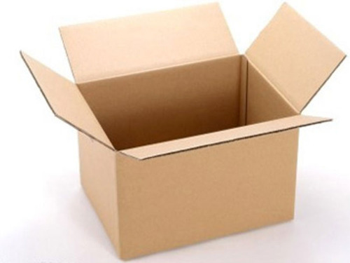
Bulk Packaging
Pouches are usually packed in horizontal position.
Packed in master carton for transport and sale.

Slide 25
Advantages of pouches compared to Metal cans
Can be produced any shape and size.
High surface to volume ratio and thin cross section.
Rapid heat penetration compared to convectional metal cans.
Heating is uniform.
30-40% reduction in processing time.
Less damage to texture of meats.
Offers Saving in terms of weight (84 % less) and space (85% less) compared to metal cans.
Easy opening.
Easily destroyable.
Boil in bag advantage.
Little Storage space.

Slide 26
Disadvantages
Not robust like metal cans.
Vulnerable to damage_ needs overwrapping.
Expensive
Processing line speed of a retort pouch is slow i.e. 30 pouch /min. and Canning 300-400 or above cans/min.
retort pouch processing line is Retortable pouched are susceptible to rodents and insects

Slide 27
Thank You

