Slide 1
DEPARTMENT OF ANIMAL NUTRITION
BIHAR VETERINARY COLLEGE, PATNA-14
COURSE NO. ANN-608
RESEARCH TECHNIQUES IN ANIMAL NUTRITION
DR. SANJAY KUMAR
ASSISTANT PROFESSOR

Slide 3
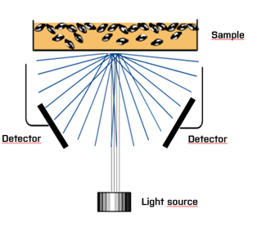
Transmittance/Reflectance
Light source
Detector
Detector
Light source
ITEC169A
ITEC168A
Transmittance (NIT)
Reflectance (NIR)
Notes:
This picture illustrates the difference between transmittance and reflectance.
It is important to point out that with transmittance in the NIR range it is possible to penetrate up to 30 mm of the sample and the entire path length of the sample is integrated into the spectral measurement. With reflectance only 0.1-1 mm of the surface will be penetrated which will create problems for non-homogenous samples.

Slide 4
Monochromators
Are normally pre-dispersive ( split the light before the sample)
Scan a large range
System II, XDS, DS 2500 , Infratec 1241/Nova, Foodscan
Both reflectance and transmittance
Well working system used for many years
The odd ones are Infraxact and XDS PA that both are post dispersive monochromators. Similar to DDA systems.

Slide 5
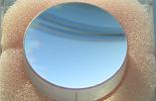
Pre dispersive Monochromator transmittance
Exit slit – one wavelength at the time
Rotating Holographic grating
Detector
Long pass filter
Entrance slit
Lamp

Slide 6
Pre dispersive Monochromator Reflectance
Exit slit – one wavelength at the time
Detector
Rotating Holographic grating
Long pass filter
Entrence slit
Lamp

Slide 7
DDA spectrometer Post dispersive
Detector array
Fixed Holographic grating
Lamp
ProFoss
Infratec SOFIA

Slide 8
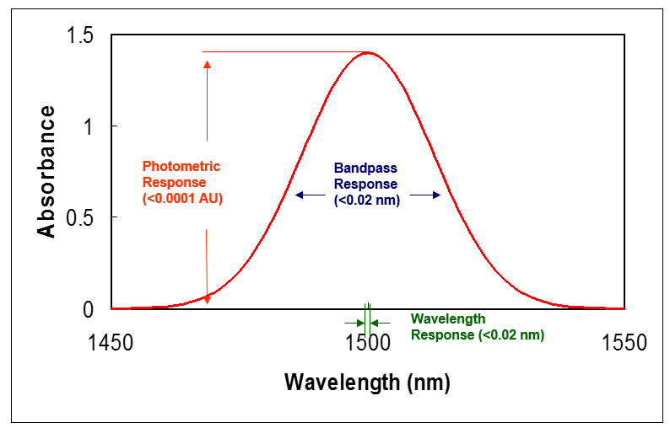
Factory standardization means better Transferability between instruments
This means that instruments are identical and no standardization is required.
Notes:
Key to transferability is to build instrument that gives the same spectra and does it every time, everywhere.

Slide 9
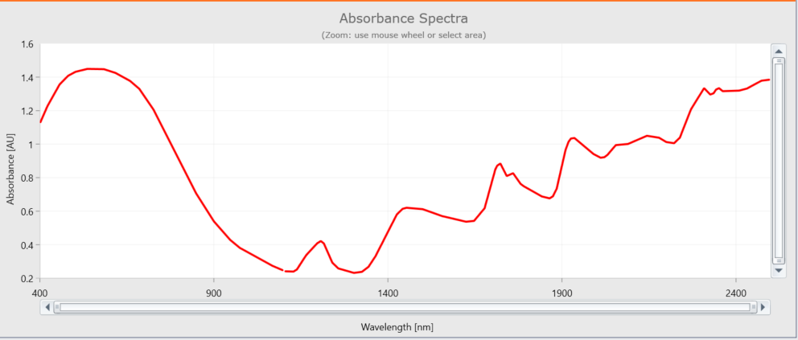
Dedicated Training
DS 2500 spectra
Cattle feed Spectra
Notes:
Dark in the visible range , so high absorbance there

Slide 10
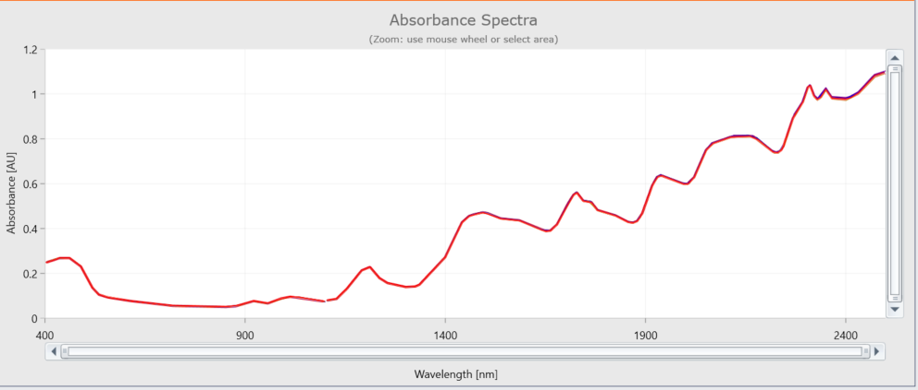
Dedicated Training
DS 2500 spectra
Milk powder
Notes:
White sample , so low absorbance

Slide 11
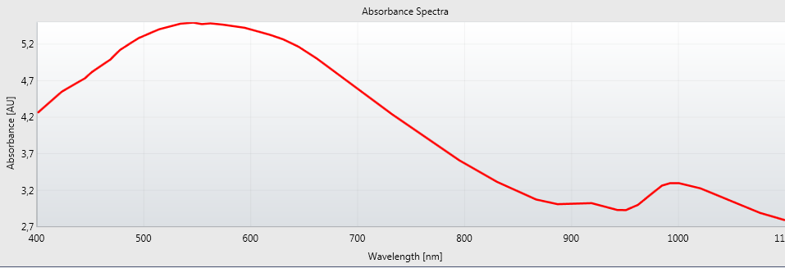
Dedicated Training
Infratec spectra
Notes:
This is a typical Infratec spectra , only a small part is used and it will always look the same.
Wheat in this case.
Explain the curve, it is actually black ( non transperent ) up to 7-800 nm.
The curve is just because the limitation of the instrumentis like that. Lower at the lower wavelengths, in reality does the slope just continue higher and higher to the left.

Slide 12
Lamberth Beers laW
A= Concentration * Pathlength* Constant
A= absorbans at λ
Pathlength = optical path through the sample
Constant= absorbtivity at λ
Normall rewritten as:
Concentration =A*Pathlength*Constant
Notes:
So pathlength is important, changes will directly influence the result.
Even though ANN calibrations can handle it quite well.
Packing of a material is also important as it in brings in more sample in the path similar to increasing the pathlength.
Important , there is a limit too performance based on the spectrometer, not the calibration.

Slide 13
Near-Infrared Spectroscopy
Absorptivity
Pathlength
Band Overlapping
Diffuse Reflectance
Penetration Depth
700nm
1100nm
1800nm
2500nm

Slide 14
Molecular Vibrations
A match between natural vibration and EM energy vibrations.
Energy is absorbed, increase in vibrational amplitude
= a peak response
No match,
No absorbance
No peak

Slide 15
Near Infrared Absorptions
Notes:
C-H is an indication of fat/oil , O-H is indication of water/ moisture/ alcohol , N-H is indication of protein ( aminoacids).

