Slide 1
Stress Physiology
Dr Pramod Kumar
Department of Veterinary Physiology
Bihar Veterinary College, Patna

Slide 2
Stress
Any event which an individual finds difficult to cope with is called a stressor.
The stress may be physical, psychological or socio-culture.
Animals have to endure many stressors in their natural environments. For eg, food shortages, survivability from predator or parasites, conflicts with group members, fluctuations in food and water availability and temperature.

Slide 3
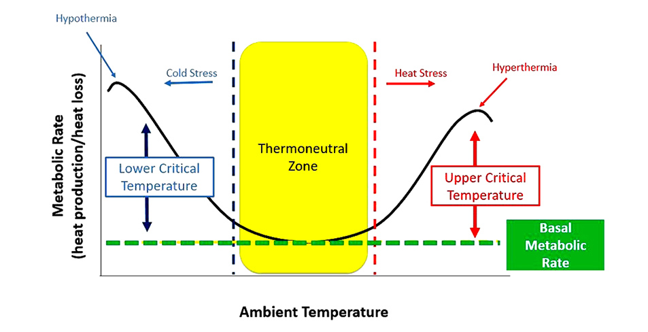
Stress

Slide 4
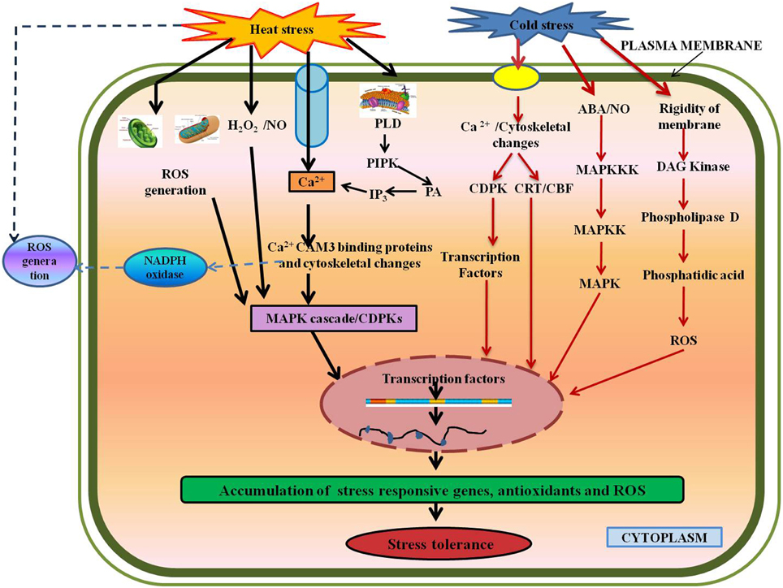

Slide 5
Stress = Nervous system + endocrine system to prepare the body for a challenge.
Physiological response - The fight-or-flight sympathetic nervous system response works to keep alive, like release of endorphins, dopamine and other neurotransmitters
Autonomic nervous system :
Effects via PSNS (Trophotropic response) are inhibition, slowing and restorative functions
Effects of neural activation via SNS (ergotropic response) are generalized arousal.

Slide 6
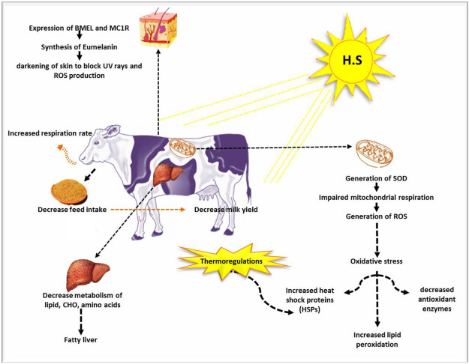

Slide 7
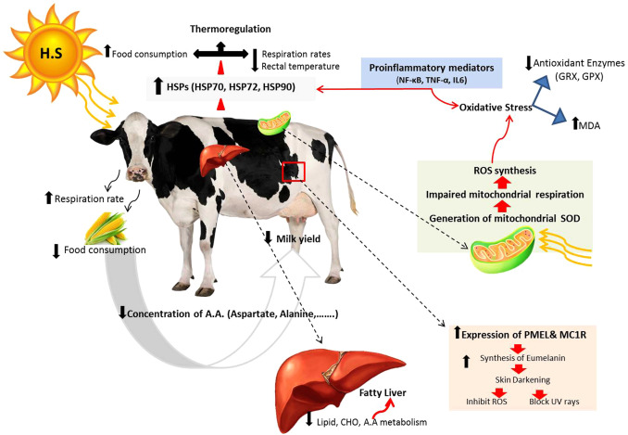

Slide 8
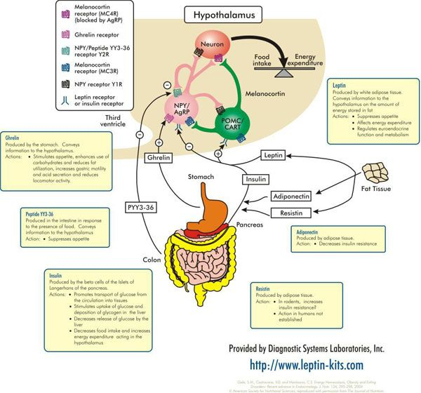

Slide 9
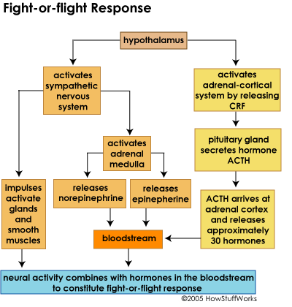
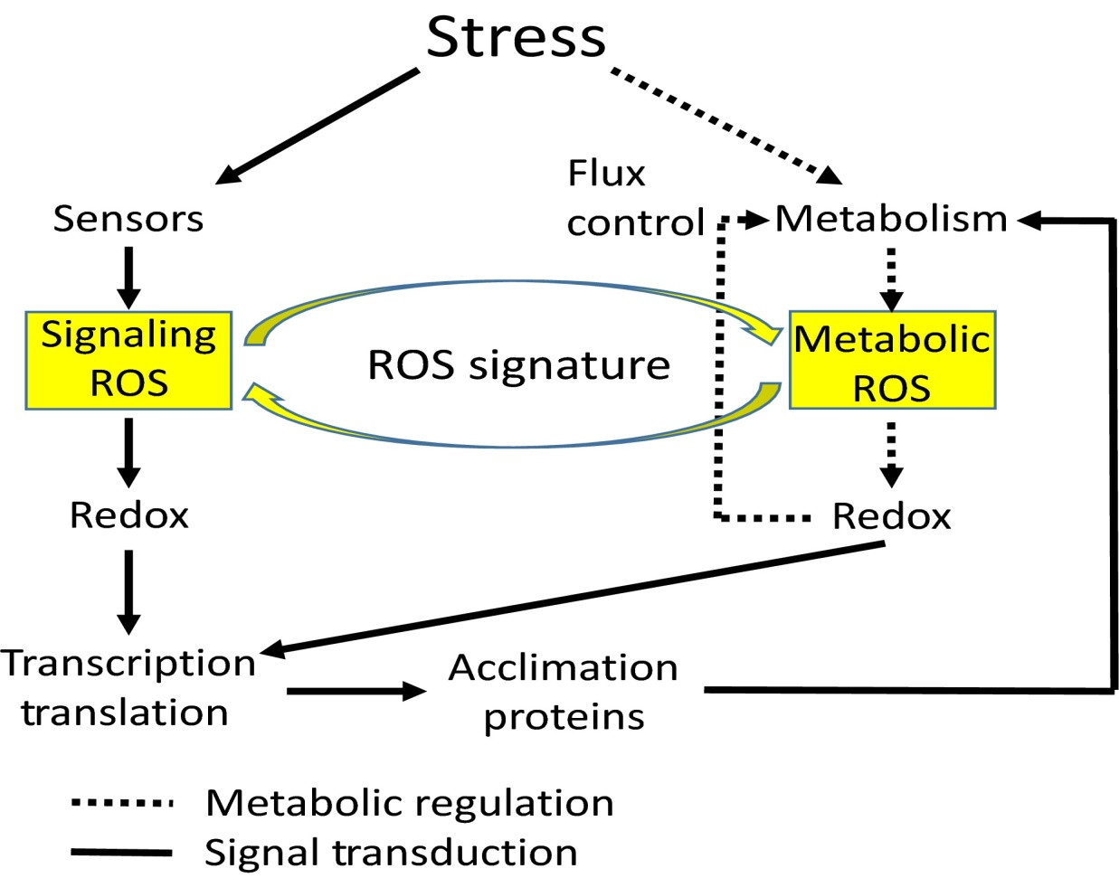

Slide 10
Adrenocorticotropic Hormone, Corticotropin Releasing Hormone and Glucocorticoid increases energy and reduce inflammation, histamines and immunity at ACTH axis
General Adaptation Syndrome was proposed by Hans Seyle (1956 ) as an integrative model for the stress response. It is tri- phasic phenomenon which involves alarm, resistance and exhaustion phase
Epinephrine effects heart rate and stroke volume: acts on blood and resources to non-essentials like guts, reproductive, skin, heart, brain, lungs, skeletal muscle

Slide 11
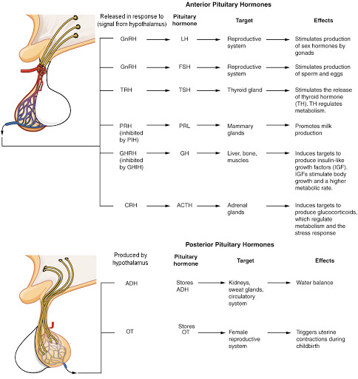

Slide 12
Other effects: release stored nutrients from liver and fat into blood stream send WBCs to battle stations in skin during injury
Oxytocin —released during stress and makes us seek out social connections
Stress – released less cortisol and more oxytocin (vasodilation) and repairs damaged cardiac muscle from stress, combats inflammation

Slide 14
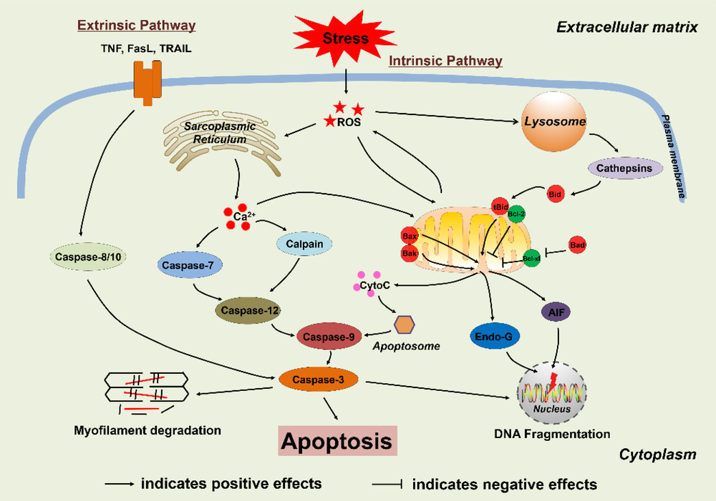

Slide 15
