Slide 1
VSR Unit-5: Surgical Affections of Male Reproductive System-I
Dr. Ramesh Tiwary
Assistant Professor
Deptt. of Veterinary Surgery and Radiology

Slide 2
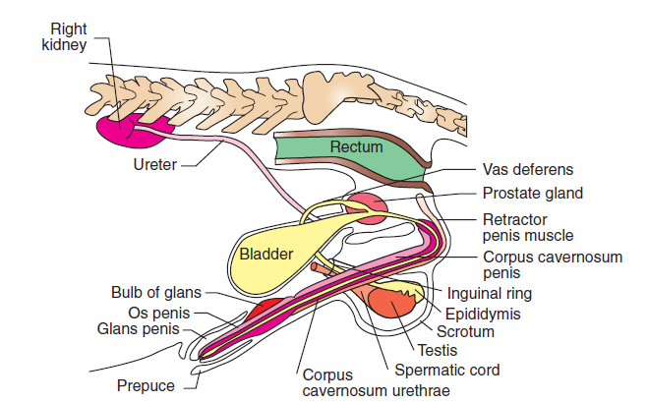
Male Genital System

Slide 3
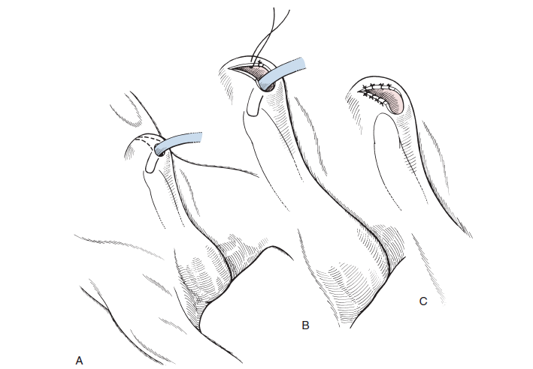
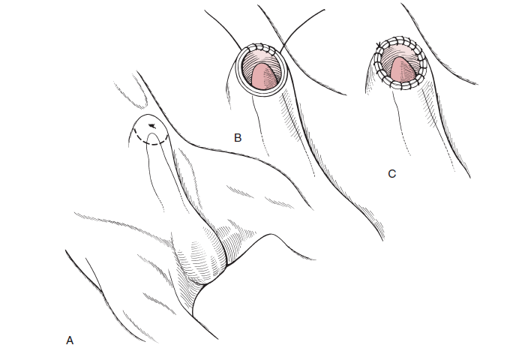
Phimosis
Inability of the penis to protrude from pepuce or sheath

Slide 4
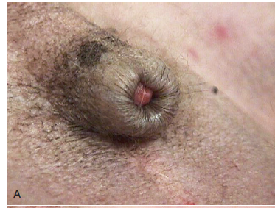
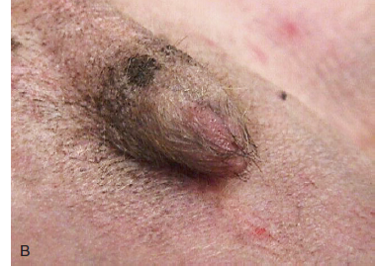
Paraphimosis
Inability to retract the penis into the pepuce or sheath

Slide 5
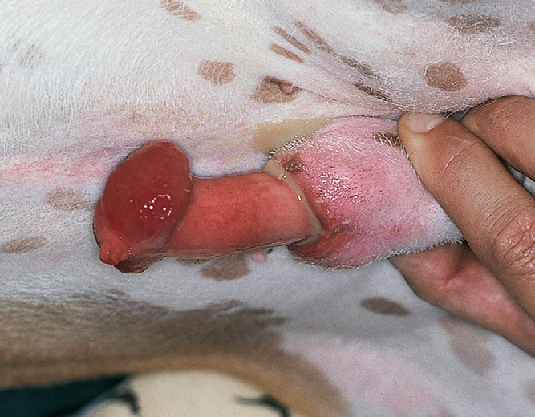
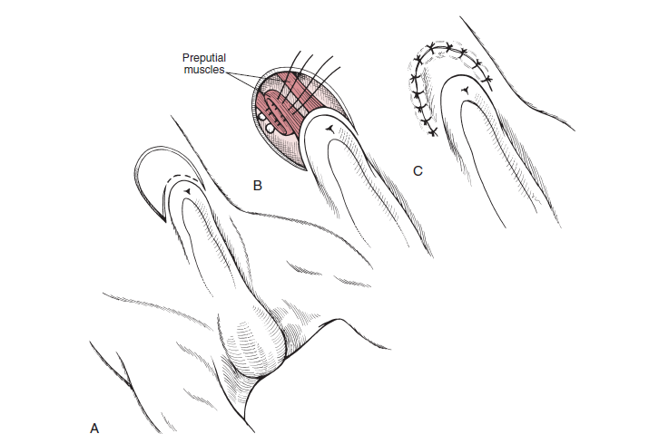
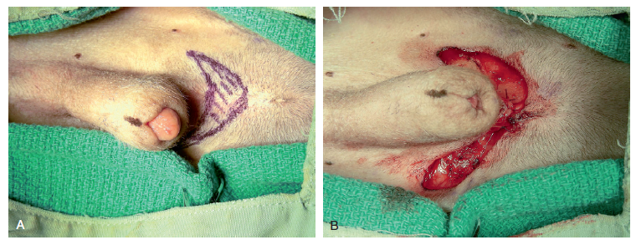
Prepucial Lengthening

Slide 6
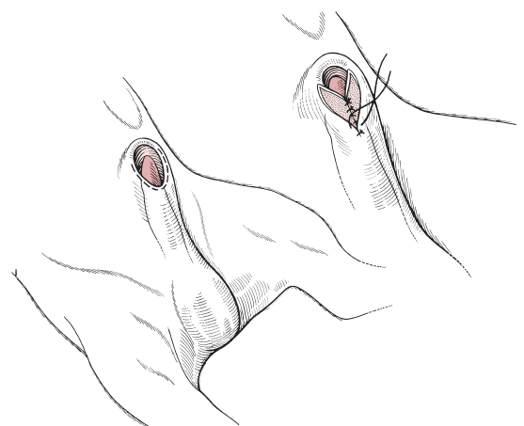
Hypospadias
Developmental anomaly the urethra opens ventral and caudal to the normal orifice
Preputialreconstruction
When incompletely formed preputial orifice and hypospadias at the glans.

Slide 7
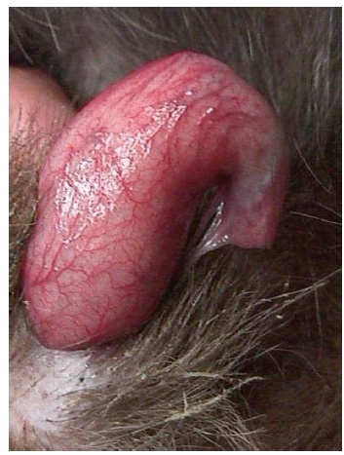
Pesrsistant Frenulum
Congenital thin fibrous band that deviates the penis ventrally

Slide 8
Priapism is persistent erection of the penis without sexual excitement
Phallopexy :procedure to create a permanent adhesion between the penile shaft and preputial mucosa.

Slide 9
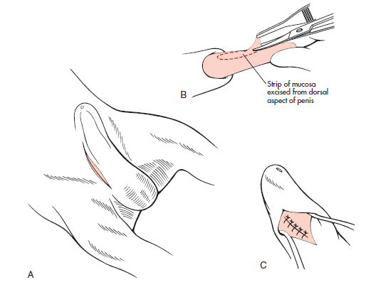
Phallopexy
Procedure to create a permanent adhesion between the penile shaft and preputial mucosa.
Prevents complete exteriorization of the glans, eliminating the risk of recurrent paraphimosis and penile trauma

