Slide 1
SURGICAL AFFECTION OF TAIL AND DOCKING UNIT-5 REGIONAL SURGERY -2
Dr Mithilesh Kumar
Assistant Professor cum Jr. Scientist
Veterinary Surgery and Radiology
Bihar Veterinary College,
Patna-14.

Slide 2
Tail is composed of vertebrae, muscle, fascia and skin.
The no. of coccygeal vertebrae varies in species
Middle coccygeal artery and lateral coccygeal vein located
A paralysed tail is abnormally flexible.

Slide 3
TRAUMATIC INJURIES:-
Open wound occurs as a result of trauma.
The wound should be treated on general principles.
The coccygeal vertebrae may get fractured or dislocated.
Injuries near the sacrococcygeal joint may cause paralysis

Slide 4
Tail should be amputed in complete paralysis.
Found in all species but more in buffaloes.
Exact aetiology not known but multiple fracture.
The lesion is due to some form of trauma
Other fracture include concrete floor, close confinement, hot season and large body weight.

Slide 5
Predispose to greater risk of trauma and infection.
Thickening and fissuring of the epidermis.
Secondary bacterial infection produce necrosis
Microbiological examination show mixed infection.
In mild cases dry necrosis and loss of hair to the tip.

Slide 6
In severe cases complication like arthritis, multiple abscessation and gangrene cause toxaemia and death.
TREATMENT:-
Affected part cleaned with antiseptic creams are used
Parenteral administration of antibiotic.
In severe cases amputation required.

Slide 7
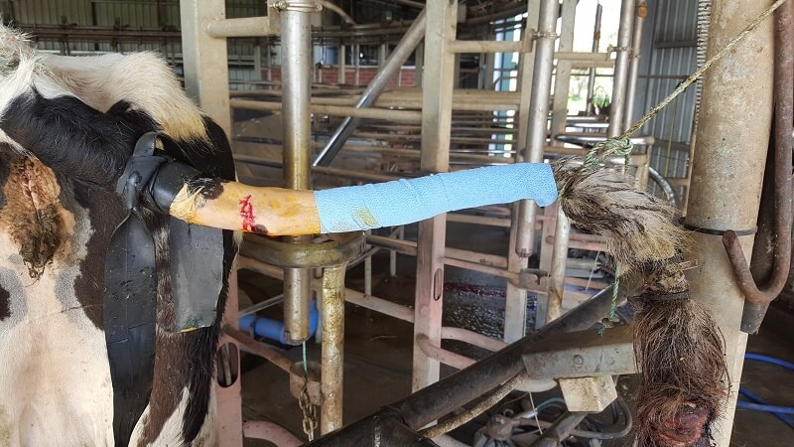
Amputation of tail by tourniquet

Slide 8
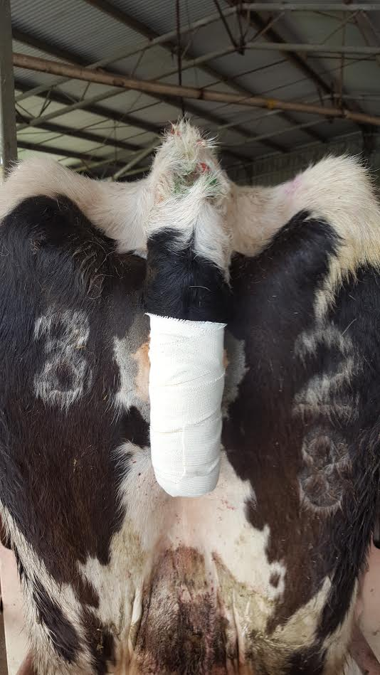
Bandage applied after amputation

Slide 9
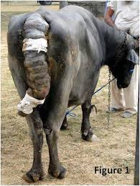
Gangrenous tail

Slide 10
AMPUTATION OF TAIL :
Indication:-
Irreparable injuries of tail like fracture, necrosis or gangrene, paralysis
Improve appearance in dog.
Tourniquet applied at base of tail.
The exact point of disarticulation is determined by palpation.

Slide 11
Aseptic preparation of area.
Semi-circular incision is given on dorsal or ventral surface of tail.
The incision placed distal coccygeal joint to be disarticulated.
Tourniquet may be loosened to identify the vessels.
Tail is disarticulated by transection.
Haemostasis checked by loosening tourniquet.
Simple interrupted and horizontal mattress.

Slide 12
DOCKING OF TAIL

