Slide 1
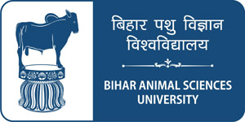
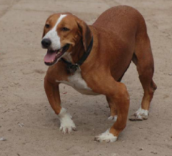
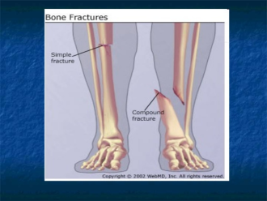
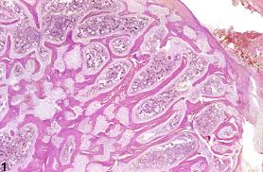
Pathological Changes Affecting to Musculoskeletal System
Dr Deepak Kumar
Assistant professor
Department of Veterinary Pathology
Bihar Veterinary College, Patna
Bihar Animal Sciences University, Patna - 14

Slide 2
Pathological Changes Affecting Musculoskeletal System

Slide 3
Pathological Changes Affecting Musculoskeletal System

Slide 5
Anomalies & abnormalities in the Skeletal system
Abrachia – Absence of both fore limbs.
Amelia – Absence of limbs.
Apodia – Absence of posterior limbs.
Micromelia – All parts of limbs are present but are smaller size.
Perodactyly – Absence of some of the toes.
Adactylism – Absence of all the toes in limb.
Brachydactylism – Abnormal shortening of toes.

Slide 6
Anomalies & abnormalities in the Skeletal system
Polydactylism – More number of digits, seen in horse & pig.
Syndactylism – Fusion of toes, seen in cattle & pigs.
Prognathism – Having a long jaw- pig-mouth in horse.
Brachygnthism – Having a short jaw- parrot-mouth in horse.
Kyphosis – Abnormal curvature & dorsal prominence of spine hump-back. This is rare in animals.
Scoliosis – Abnormal lateral curvature of the spinal column.
Torticollis – Wry neck – twisting of the neck

Slide 15
Osteoporosis
There is decreased serum Estrogen And increased osteoclast activity in menopausal women with osteoporosis
Copper deficiency in dog, Mg deficiency in pig & Zinc deficiency in fowls causes osteoporosis

Slide 17
Osteopetrosis
In this condition, bones are dense & fracture like a piece of chalk
It is rear hereditary disorder

Slide 19
Fractures

