Slide 1
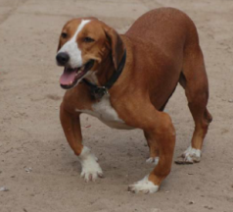
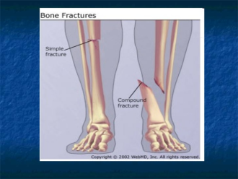
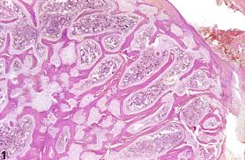
Pathological Changes Affecting to Musculoskeletal System
Dr Deepak Kumar
Assistant professor
Department of Veterinary Pathology
Bihar Veterinary College, Patna
Bihar Animal Sciences University, Patna - 14

Slide 2
Pathological Changes Affecting Musculoskeletal System
Joints ( Articulation ) serves as union of between bone and are necessary for mechanical role of bone.

Slide 14
Pathology of Muscle
Atrophy of Muscles
1. Senility : in old age there is gradual atrophy all muscles, but cattle & swine are slaughtered young and so atrophy is not seen in them.
The animals is not able to metabolise available nutriments in old age.
The muscle cell are not able to assimilate the nutrients & so catabolism exceeds anabolism.

Slide 15
Atrophy of Muscles
Disuse – this is seen in fracture of bones when the parts are immobilized for long time & muscle therefore are not utilized.
Starvation – sufficient food not available to make up for the catabolism that takes place.
Atrophy of wasting disease, cachexia & malnutrition- T.B, J. D
Denervation – when a nerve is injured or severed, the muscles supplied by it becomes paralised & atrophied

Slide 16
Atrophy of Muscles
Pressure – the cause of pressure may be tumors, abscesses, cysts producing ischemia locally & interfering with movement will couse atrophy.

Slide 17
Myosistis
Inflammation of the muscle is called myositis
Couse – 1. Trauma 2. By direct extension from lesions of neighbouring arthritis, osteitis. 3. in Pyemia, hematogenously 4. by parasites infection
Acute myositis - BQ
Suppurative myositis – Strangales & Glanders.
Chronic myositis – Actnomycosis & Actnobacillosis. ( Sulphur granules appears)
Parasitic myositis – Toxoplasma, Trichnella spiralisa – is found in man, pig

Slide 18
Myosistis
Cysticercus ( Measles)
C. Cellulosae – the bladder worm of T. solium, a tape worm of man, infectes the muscles of pig.
C. Bovis – is the itermediate host of tape worm t. seginanata of man, found in the muscle of cattle.

Slide 19
Disease of unknown origin
Eosinophilic myositits –
Cattle & Sheep – large number of eosinophils, histiocytes, plasma cell & lymphocytes are found between the muscle fibers & in tissue spaces.through extensive degeneration of the mucles may not be notised, in some place necrosis & invesion of muscle fibres by eosinophilic are observed & those area are notisced yellowish green.
Dog – the eye bulge out, resulting in keratitis & corneal ulceration in German shepherds & Alsations breed.
blood picture reveals high eosinophilic count upto as much as 90 %.

Slide 20
White muscle disease ( stiff-lamb disease)
This is essentially a coagulative necrosis of the muscle due to various causes –
The clinically is classified in to three main types –
1. the stiff types – difficulty in rising & walking, while walking, the gait is stiff in lames & calf
2. The Respiratory form – diaphragm & intercostals muscle are affected & respitary distress developed.
3. The Cardiac form – in animals with cardiac involment alone, sudden death occurs without any symptoms. Clinically SGOT level will more than 300 unit

Slide 21
Causes –
- Vitamin E deficiency - is an antioxidant & its absence, oxidation in the muscle is increased to 400 times the normal & so degeneration & necrosis occur.
Deficiency of Se – necrosis of muscles developed
Vit B deficiency – thiamine deficiency produce cardiac necrosis.

Slide 22
AZOTURIA
AZOTURIA ( Equine myoglobinurea,Monday –morning sickness, paralytic hemoglobinuria)
is a syndrome that damages the muscle tissue in horses. It is usually due to overfeeding a horse carbohydrates and appears to have a genetic

