Slide 1
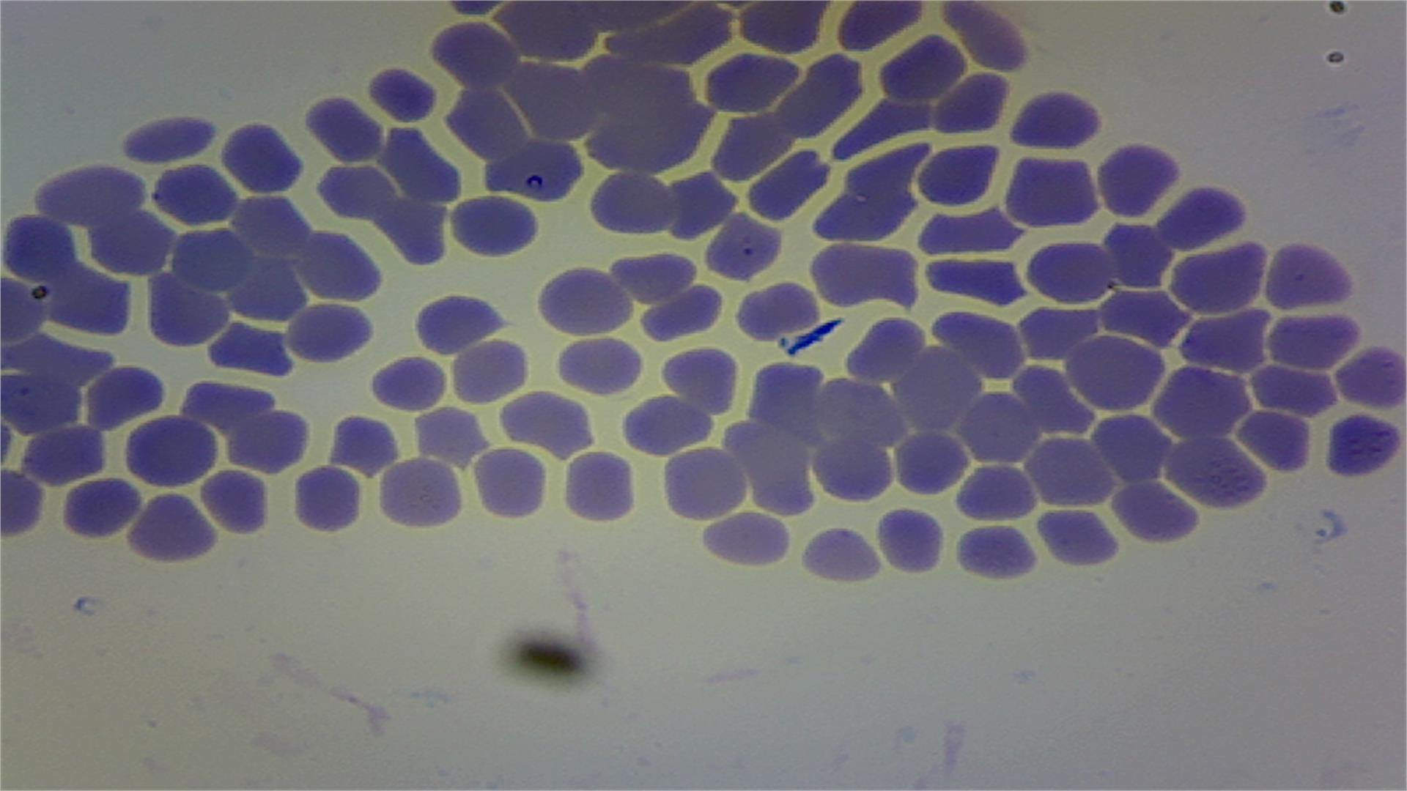
Theileriosis
Dr. Pallav Shekhar
Department of Veterinary Medicine
Bihar Veterinary College
(Bihar Animal Sciences University, Patna)
Unit 6

Slide 2
INRTODUCTION
Bovine theileriosis is a tick born haemoprotozoan disease
It causes huge economic losses due to high incidence, mortality, weight losses, abortion and reduced milk yield
It is characterized by fever, anemia along with respiratory and digestive disorders

Slide 3
Intro………
Tropical theileriosis/Mediterranean coast fever: caused by Theileria annulata
In India it is known as tropical theileriosis
In other countries it is known as Egyptian or Mediterranean fever
East coast fever caused: Caused by Theileria parva
Theileria parva is present eastern central and south African countries.
It is transmitted by rhipicephalous appendiculatus

Slide 4
Etiology:
The causative agent, Theileria annulata, is found to be widely distributed in both Tropical and sub-tropical region
Transmission
The tick for transmitting causative agent Theileria annulata belongs to genus Hyalomma anatolicum anatolicum (Three host tick)
These are mostly two/three host ticks, preferring hot and humid climate for completion of their life cycle
Tick positive for infective stages of Theileria annulata acts as constant source of infection to susceptible animals

Slide 5
Epidemiology
Tropical and sub tropical countries.
Host: Cattle, buffaloes, sheep, goats, camels
All ages of cattle
Cross bred cattle highly susceptible
Summer and Rainy season
Stress
Young ones more susceptible
Infection reported in 2-3 days old calf.

Slide 6
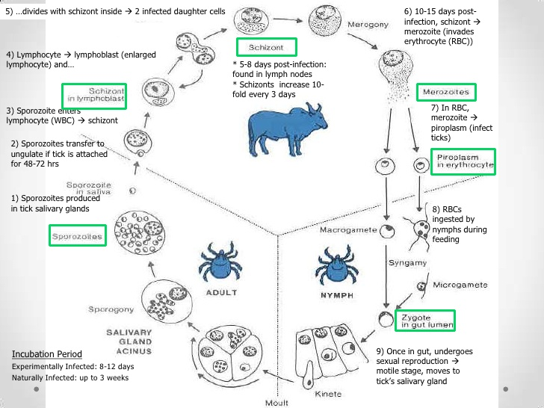

Slide 7
Pathogenesis
Sporozoites
Microschizonts
In lymphocytes
Kochs blue body
Micromerozoites
RBC
(Piroplasmosis)

Slide 8
Clinical Signs
Body temperature higher.
anemia,
jaundice,
and heart failure.
Lymph nodes are commonly enlarged and there may be episodes of blood from the nose, difficulty breathing and weight loss.[
Other signs, but not present in all cases are :
Blood-tinged diarrhea, or with obvious blood clots.
Bruxism(grinding of teeth) can be seen
Circular raised patches of hair all over the body
Haemorrhages in the ocular and vaginal mucous membranes
A degree of anaemia
Diarrhea with blood clots in a calf
Diagnosis

Slide 9
Diagnosis
Thin blood smears from each samples had prepared and fixed in methanol for 5 min and stained with Geimsa stain(1:10)for 40 min.
Blood smear were examined for piroplasm in intra-erythrocytic form of Theileria spp under 100x objective magnification.
The presence of even a single piroplasms had recorded as positive for Theileria spp.
Similarly, the lymph-node aspirates examination for macroschizonts (Koch Blue bodies)

Slide 10
Fig; Showing Theileria spp in blood slide

Slide 11
Treatment
Oxytetracycline
Buparvaquonene @2.5mg per kh body weight
Blood transfusion

