Slide 1
TRACE ELEMENTS
Dr Pramod Kumar
Asstt. Professor
Department of Vety. Physiology

Slide 2
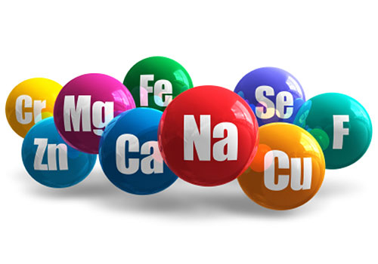
INTRODUCTION
The trace elements serve a variety of functions including catalytic, structural and regulatory activities in which they interact with macromolecules such as enzymes, pro-hormones, pre-secretory granules and biological membranes.

Slide 3
Essential trace elements are required for optimum metabolic function in an animal`s body.
Iron
Zinc
Copper
Manganese
Iodine
Chromium
Selenium
Molybdenum
cobalt

Slide 4
Characterization on metabolic activities
Anions
Cations
Maintains homeostasis by different pathways.
Anions absorbed easily and homeostasis is mediated by renal excretion.
Cations need specific pathways for absorption and their homeostasis is effected by gastrointestinal and biliary secretion.

Slide 5
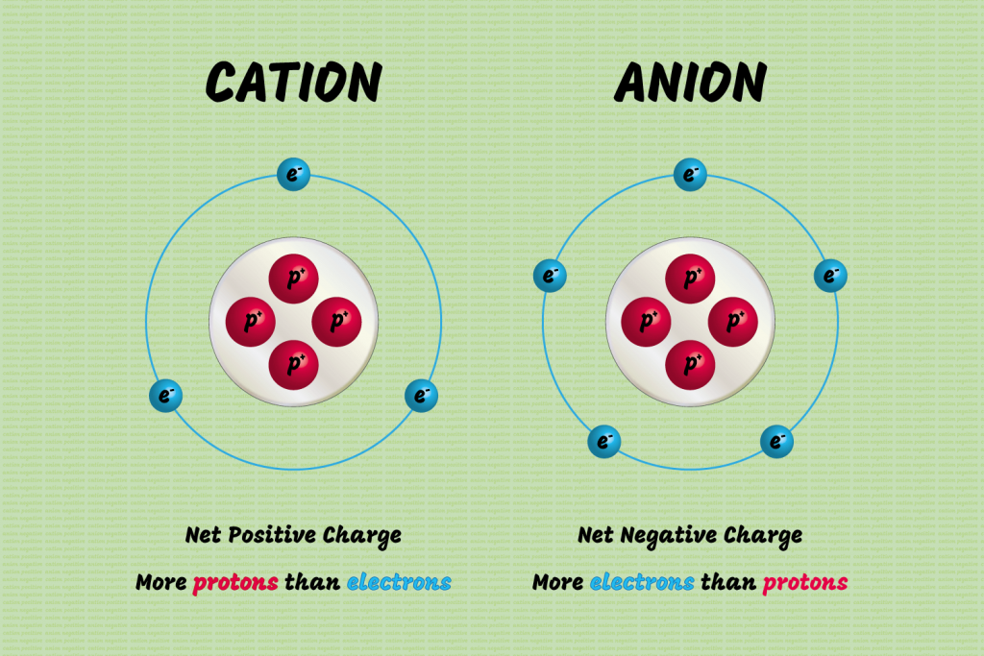
Anions - negatively charged ion or electrolytes.
Extracellular anions are chloride, bicarbonate, phosphate, sulfate, protein and organic acids.
Intracellular anions are chloride, bicarbonate, phosphate and protein.
Cations - positively charged ion or electrolyte.
Extracellular cations are sodium, potassium, calcium and magnesium.
Intracellular cations are potassium, magnesium.

Slide 6
Minerals - inorganic regulators needed for different functions inside the body.
Regulates:
• provision of energy
• protoplasmic activities
• body fluid balance
• acid-base balance
• structural units of bones, teeth, haemoglobin and thyroxin

Slide 7
Physiological functions
growth and development
functioning of the body; iodine in thyroxin, zinc in insulin, Cobalt in Vitamin B12, sulphur in thiamine and iron in hemoglobin.
In tissue protein, cell bodies and muscles - responsible for their proper functioning.

Slide 8
Metabolic regulation
Metalloenzymes such as the cytochrome enzymes facilitate ATP production
Zinc and copper acts as natural antioxidant enzymes
Influence to the osmotic pressure of body fluids as Na and K salts
maintenance of acid base balance by preventing accumulation of too much acid or alkali.

Slide 9
Classification of Minerals
Macrominerals
@ 100mg/day
Microminerals
@ less than 100mg/day
Ca, K and Na maintain the heart beat rhythm.
Ca maintains normal response to nerve stimulus
Ca is responsible for clot formation.

Slide 10
Sodium
Regulates ATP-dependent channels with potassium for the transmission of nerve impulses in the brain.
Blood level controlled by aldosterone, ANP and ADH.
Excessive sodium can cause hypernatraemia
Low sodium levels can cause hyponatraemia

Slide 11
Potassium
major intracellular cation
key circulating electrolyte
Regulates ATP-dependent channels along with sodium in a 3:2 ratio to maintain the difference in K content between ECF and ICF
Maintains osmotic pressure
Maintains water balance

Slide 12
Contd..
Maintains acid-base balance
Acts as co-factor for several glycolytic enzymes
Transmit nerve impulses
Maintains activity and synthesis of nuclear and proteins
Hyperkalameia - increase serum K in the plasma
Hypokalameia - decrease serum K level in the plasma

Slide 13
Chlorine
regulate water balance (osmotic pressure and acid base)
nerve impulse conduction
hydrochloric acid formation in the stomach
Change in plasma level might cause abnormal metabolism of Na⁺ & Cl⁻ lead to hyperchloraemia or hypochloremia

Slide 14
Calcium
Intracellular calcium:
muscle contraction
releases hormones (neuro-transmitter/modulators)
activation of some enzyme
enter in glycogen metabolism
cell division

Slide 15
Contd…
Extracellular calcium:
maintain ECF calcium concentration
bone mineralization
blood coagulation
membrane excitability
muscle contraction

Slide 16
Phosphorous
synthesis of nucleic acids
synthesis of ATP
maintenance of pH balance
act as major buffer system (phosphoric acid)
part of DNA and RNA and necessary for growth
Activates many enzymes and vitamins B
ATP uses three phosphate groups

Slide 17
Magnesium
active in many enzyme systems
resides half the body’s magnesium in the bones
rest is in muscles and soft tissues
1 % in the extracellular fluid
calcium, bone magnesium may serve as a reservoir to ensure normal blood concentrations.
necessary for energy metabolism
catalyst in the reaction to form ATP compound
permit the use of glucose
involved in the synthesis of protein, fat and nucleic acids
Involved in cells membrane transport systems.

Slide 18
Calcium and magnesium is involved in muscle contraction and blood clotting
calcium promotes whereas magnesium inhibits
interaction between the two mineral helps to regulate blood pressure and lung function
supports the normal functioning of the immune system

Slide 19
Chromium
It is needed in small amount for certain biological function
control of glucose metabolism
lipid metabolism
acts as cofactor for increasing glucose utilization
transport amino acids into cells
lower cholesterol level

Slide 20
Manganese
involved in protein and fat metabolism
promotes healthy nervous system
necessary for digestive function, bone growth, and immune function
necessary for the proper function of SOD

Slide 21
Copper
involved in the formation of red bloods cells
involve in oxidation reduction reactions
involved in the proper processing of collagen for production of skin, bone, and connective tissue

Slide 22
Iodine
required for the synthesis of T3 and T4
deficiency leads to cretinism and goiter
Cretinism;- deficiency during pregnancy lead to neonatal hypothyrodism characterized by mental retardation, dwarfism and retarded development
Goiter characterized by enlargement of thyroid gland and impairment of thyroxin production

Slide 23
Iron
synthesisze haemoglobin, myoglobin, chytochromes, catalase and peroxidase
stored in the body as ferritin or haemosiderin
Ferritin is iron storage compound in liver, spleen and bone
The protein compound of ferritin is apoferritin
Deficiency leads to result in hypochromic microcytic anaemia

Slide 24
Selenium
constituent of glutathione peroxidase
protects the cell membrane against oxidative damage by H2O2
prevents lipid oxidation and protect cell against superoxide free radicals

Slide 25
Zinc
acts as co-factor for enzymes
involved in variety of biochemical processes
interacts with insulin to ensure proper function
regulates blood glucose levels
promotes wound healing
regulates immune function
serves as co-factor for numerous antioxidant enzymes
necessary for protein synthesis
processing of collagen

Slide 26
Sulfur
consists essential amino acids for skin, hair, nails, liver and pancreas
primary function in amino acid metabolism
modified complex carbohydrates present in proteins and lipids
amino acid methionine is the source
cofactors or regulators of enzyme function

