Slide 1
UNITIII
Hormonal Regulation of carbohydrate metabolism

Slide 2
Hypoglycemia in Neonatal Piglets
Hypoglycemia is a common cause of death in neonatal piglets
Glycogen reserves are soon depleted if piglets losses its heat or fail to ingest an adequate amount of milk
Signs of hypoglycaemia include loss of condition, weak vocalization, faltering gait, cold skin, and recumbency. These are rapidly followed by paddling, frothing at the mouth, coma, and death if intervention does not occur

Slide 3
Hormonal Regulation of carbohydrate metabolism
Alice Skoumalová

Slide 4
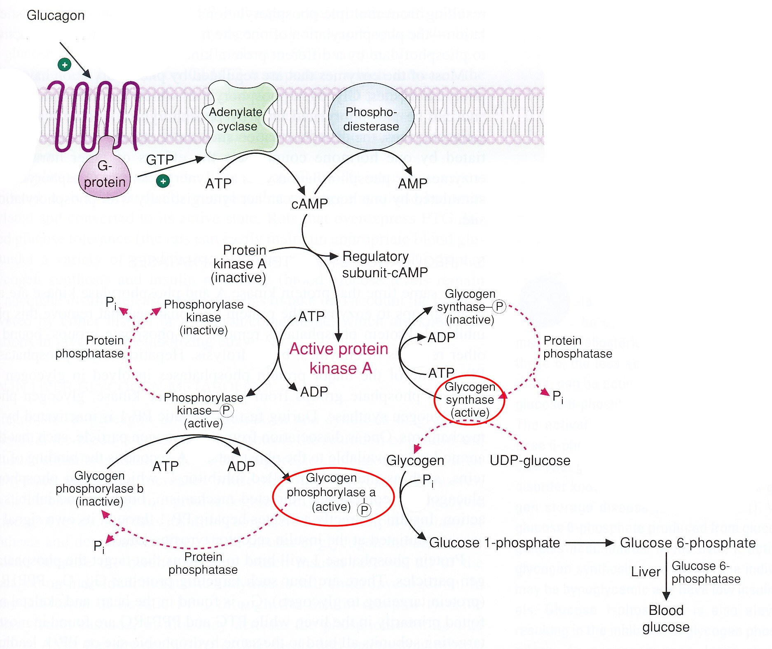
Regulation of glycogenolysis in the liver by glucagon:
cAMP → protein kinase A:
1. inactivates glycogen synthase
2. activates glycogen phosphorylase

Slide 5
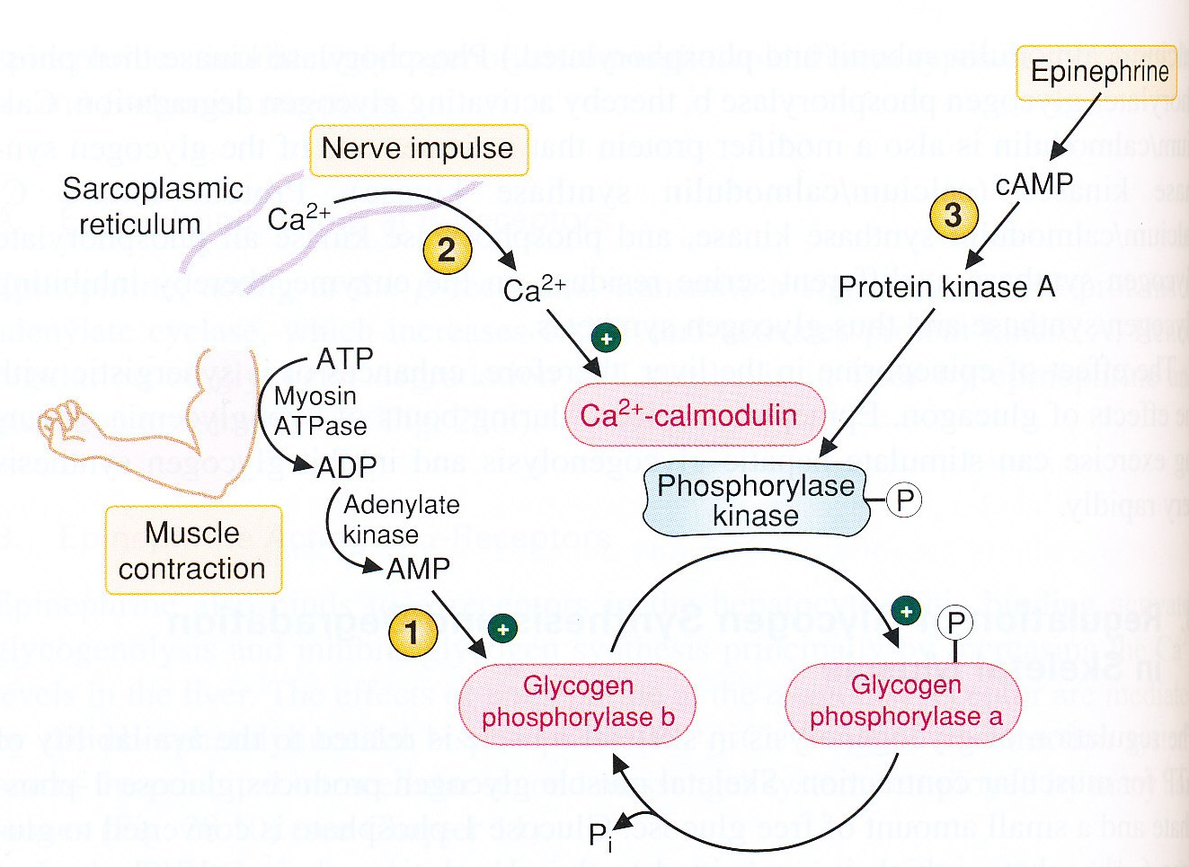
Regulation of glycogenolysis in muscle:

Slide 6
Regulation of liver and muscle glycogen metabolism:
State | Regulators | Response
Liver
Fasting | Glucagon ↑, Insulin ↓ cAMP ↑ | Glycogen degradation ↑ Glycogen synthesis ↓
Carbohydrate meal | Glu ↑, Glucagon ↓, Insulin ↑ cAMP ↓ | Glycogen degradation ↓ Glycogen synthesis ↑
Exercise and stress | Adrenalin ↑ cAMP ↑, Ca²⁺-calmodulin ↑ | Glycogen degradation ↑ Glycogen synthesis ↓
Muscle
Fasting (rest) | Insulin ↓ | Glycogen synthesis ↓ Glucose transport ↓
Carbohydrate meal (rest) | Insulin ↑ | Glycogen synthesis ↑ Glucose transport ↑
Exercise | Epinephrine ↑ AMP ↑, Ca²⁺-calmodulin ↑, cAMP ↑ | Glycogen synthesis ↓ Glycogen degradation ↑ Glycolysis ↑

Slide 7
Glucose homeostasis:
maintenance of blood glucose levels near 80 to 100 mg/dL (4,4-5,6 mmol/l)
insulin and glucagon (regulate fuel mobilization and storage)
Hypoglycemia prevention:
release of glucose from the large glycogen stores in the liver (glycogenolysis)
synthesis of glucose from lactate, glycerol, and amino acids in liver (gluconeogenesis)
release of fatty acids from adipose tissue (lipolysis)
Hyperglycemia prevention:
conversion of glucose to glycogen (glycogen synthesis)
conversion of glucose to triacylglycerols in liver and adipose tissue (lipogenesis)

Slide 8
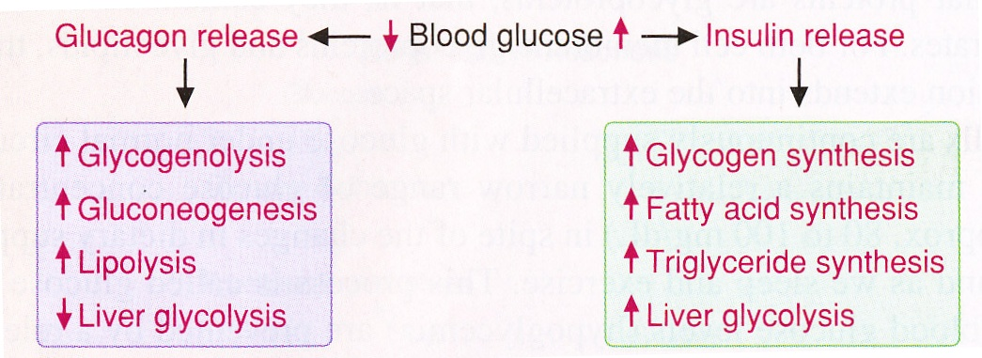
Pathways regulated by the release of:
glucagon (in response to a lowering of blood glucose levels)
insulin (in response to an elevation of blood glucose levels)

Slide 9
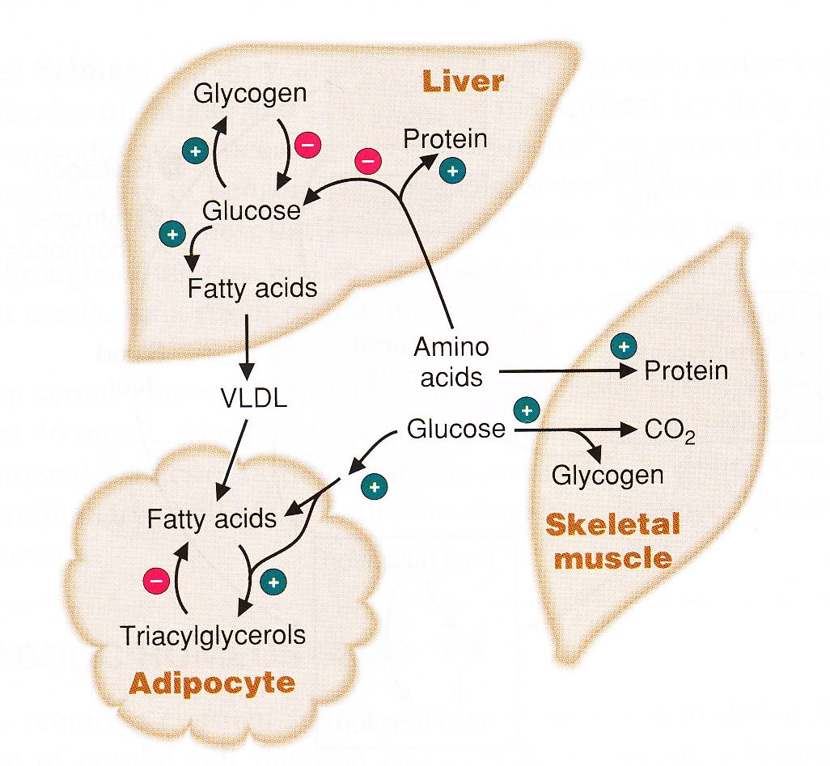
Major sites of insulin action on fuel metabolism:
The storage of nutriens
glucose transport into muscle and adipose tissue
glucose storage as glycogen (liver, muscle)
conversion of glucose to TG (liver) and their storage (adipose tissue)
protein synthesis (liver, muscle)
inhibition of fuel mobilization

Slide 10
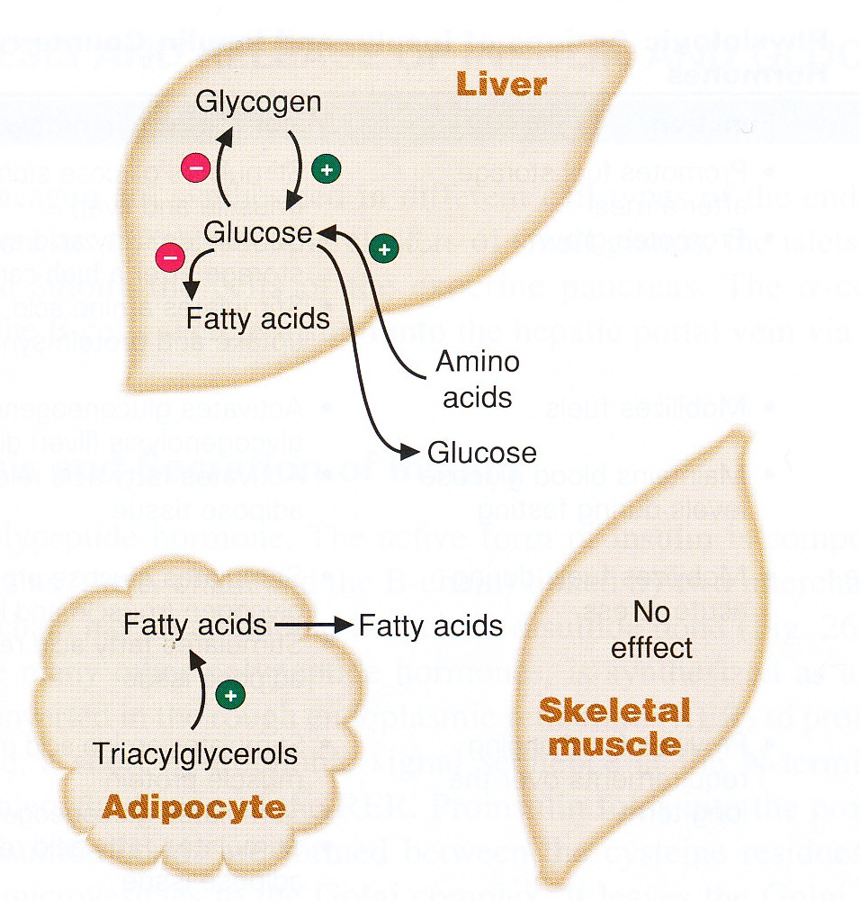
Major sites of glucagone action on fuel metabolism:
Mobilization of energy stores
release of glucose from liver glycogen
stimulating gluconeogenesis from lactate, glycerol, and amino acids (liver)
mobilizing fatty acids (adipose tissue)

Slide 11
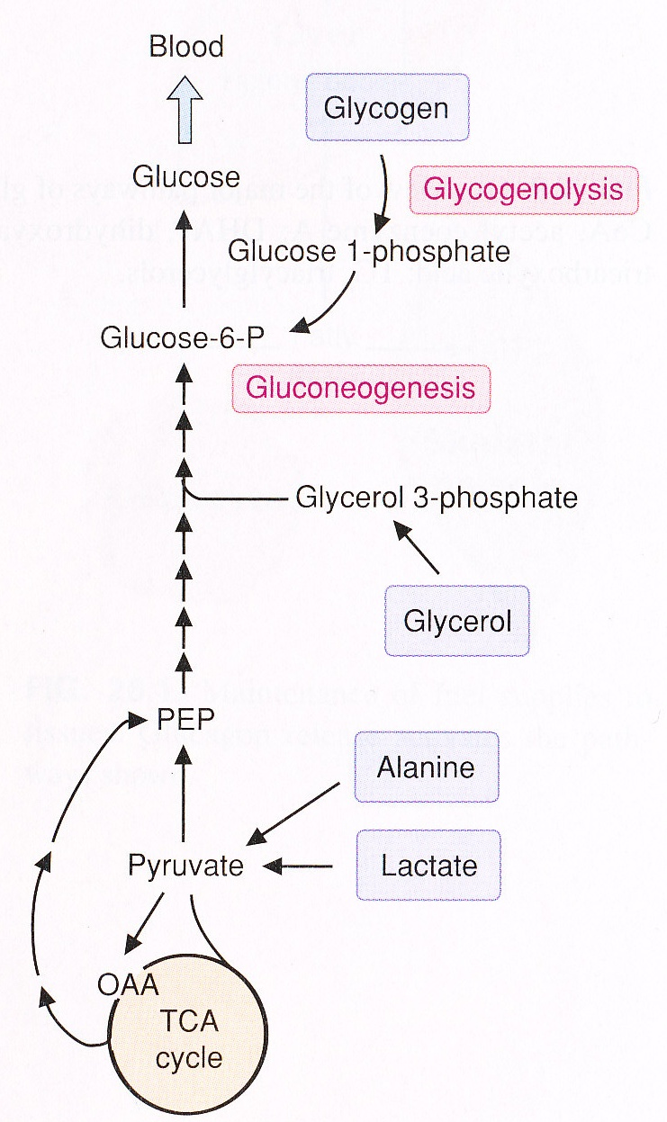
Production of blood glucose
Glycogenolysis
2 hours after a meal
the primary source of blood glucose during the first few hours of fasting
Gluconeogenesis
after consumption of the liver glycogen
lactate (muscle, erythrocytes), amino acids (muscle), glycerol (adipose tissue)

Slide 12
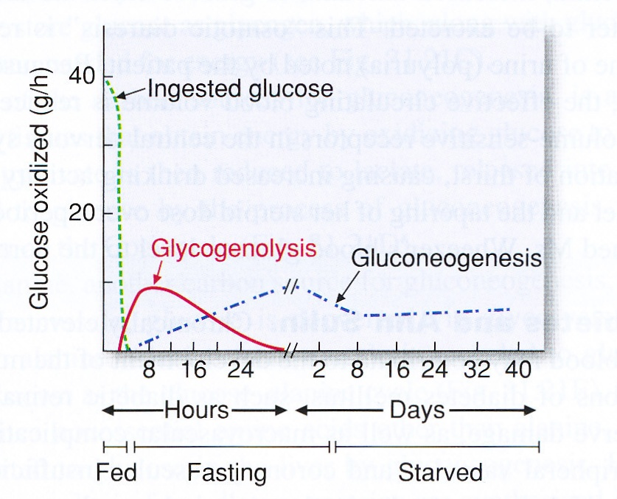
Sources of blood glucose in fed, fasting, and starved states:

Slide 13
Blood glucose levels at various stages of fasting:
Stage of fasting | Glucose (mg/dL) | Glucose (mM/L)
Normal level | 80-100 | 4,4-5,6
Fasting (12 h) | 80 | 4,4
Starvation (3 d) | 70 | 3,9
Starvation (5-6 wk) | 65 | 3,6

