Slide 1
UNITIII
LIVER FUNCTION TESTS

Slide 2
Each organ of the body has to perform its biochemical functions
Possible only when the cells of the organ are intact in structure and function
Any abnormality in the tissue caused by exogenous or endogenous factors will seriously impair the organ function which influences the health of the organism
Upon damage of tissue cellular content (specially enzymes) will be released in to serum and increases its level
SGPT, SGOT, Amylase, Lipase etc

Slide 3
Some organ synthesizes biomolecules for serum
Any functional abnormalities decreases serum level of that biomolecule
Total protein, albumin, globulin
Deficiency of any substrate or cofactor for synthesis pathway also leads to decreases serum level of biomolecule eg: HB
Organ also perform execratory function, any abnormalities in tissue leads to increase serum level of biomolecule
Bilirubin, Creatinine, Urea

Slide 4
LIVER FUNCTION TESTS
Detect presence of liver disease
Distinguish among different types of liver disease
Gauge the extent of known liver damage
Follow the response of treatment
Do not suggest a specific diagnosis

Slide 5
Functions of Liver
Metabolic function
Execratory function
Protective function and detoxification
Haematological function
Storage function

Slide 6
Tests for excretory function
bile pigments
bile salt
bromosulphthalein

Slide 7
Tests for excretory function
Bile pigments
Bile salt
Bromosulphthalein

Slide 8
Tests for Biosynthetic function
Serum Albumin
Serum Globulins
Prothrombin time

Slide 9
Tests for detoxification capacity
Hippuric acid synthesis

Slide 10
Tests for metabolic capacity
Galactose tolerance

Slide 11
Tests based on serum enzymes derived from liver
ALT (alanine transaminase)
AST (aspartate transaminase)
ALP (Alkaline phosphatase)
5- nucleotidase
Gama- glutamyltranspeptidase (GGT)

Slide 12
Serum Bilirubin
Bilirubin is a bile pigment, and is the excretory end product of heme degradation
Conjugated in liver by glycosylation
Excreted in bile
Conjugated bilirubin : water soluble , so excreted by kidneys
Unconjugated bilirubin : insoluble in water , bound to albumin in blood

Slide 13
Normal serum contains unconjugated bilirubin(80%) and conjugated bilirubin(20%)
Horse: 1-2 mg/dl
Cattle: 0.01-0.5 mg/dl
Dog : 0.06-0.12 mg/dl

Slide 14
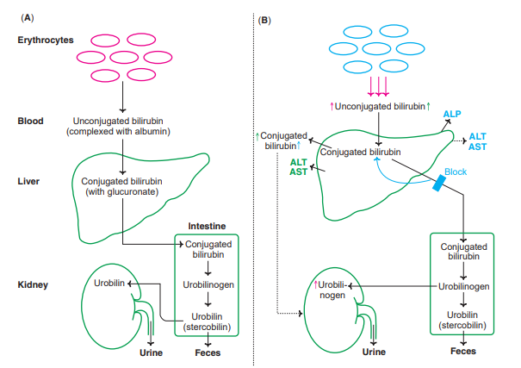

Slide 15
Test for serum bilirubin
Van Den Bergh method- specific reaction to identify the increase in serum bilirubin (above the reference level)
Bilirubin reacts with diazo reagent to produce coloured azo pigment . At pH 5 – pigment purple
Conjugated bilirubin gives purple color within 30 sec. this is referred as direct positive van den Bergh reaction
Unconjugated bilirubin gives van den Bergh reaction within 30 min. after addition of methanol this is referred as indirect positive

Slide 16
Serum Bilirubin
If serum contain both conjugated and unconjugated bilirubin then purple color produced immidiataly (direct positive) which further intesified by addition of alcohal (indirect Positive)- Biphesic reaction
Indirect Positive- hemolytic jaundice
Direct positive- obstructive jaundice
Biphesic- hepatic jaundice

Slide 17
Unconj Conj
In water | insoluble | soluble
In alcohol | soluble | soluble
normal | 0.2-0.9mg/dl | 0.1-0.4mg/dl
In bile | Absent | Present
In urine | Always absent | Normally absent
Absorption gut | Absorbed | Not absorbed
Diffusion into tissues | Diffuses – yellow colour | Doesn’t diffuse
Van den bergh | Indirect + | Direct +

Slide 18
Bilirubin in urine
Conjugated bilirubin , being water soluble is excreated in urine
Unconjugated bilirubin , being water insoluble is not excreated in urine

Slide 19
Bromosulphalein test
Bromosulphalein is a dye use to assess the excretory function of liver
Non toxic dye excreted through bile within 45 min.
Any impairment in liver increase retention time

Slide 20
Serum Albumin
Synthesize by liver
Normal : 3.5 – 5 g/dl
Long half life :18 -20 days
Because of slow turnover S.Albumin not a good indicator of acute/mild hepatic dysfunction
Good indicator for chronic hepatic dysfunction
Hypoalbuminemia – chronic hepatic dysfunction
cirrhosis
Ascites
protein malnutrition,

Slide 21
Serum Globulins
Increased stimulation peripheral Reticulo-endothelial system when shunting of antigens past liver & impaired clearance by kupffer cells
Gamma globulins – B lymphocytes
Alpha , beta globulins – hepatocytes
Increased gamma globulins – CLD

Slide 22
Gamma globulins
IgG – Auto immune hepatitis
IgM – Primary biliary cirrhosis
Ig A – Alcoholic liver dissorders

Slide 23
Prothrombin Time
A decrease in the concentration of plasma clotting factors is found in the impairment of liver function
Prothrombin time prolonged in patients with liver damage
Half-lives of clotting factors are relatively short (5-72 hrs.), therefore, changes in prothrombin time occur quickly

Slide 24
Hippuric acid synthesis
The liver is the major site for the metabolism of xenobiotics (detoxification)
Measurement of hippuric acid synthesis is an ideal test for assessing the detoxification function of liver
Hippuric acid is produced in the liver when benzoic acid combines with glycine
sodium benzoate is orally given animal after emptying the bladder
Urine collections are made for estimation of hippuric acid excreted in urine

Slide 25
Galactose tolerance
Glactose exclusively metabolized by liver
Liver function is assessed by utilization of glactose
Glactose is given I/V and blood is collected at 10 min interval for next 2 hours
Glactose is marked elevated in hapatocellular damage (infective jaundice, cirrhosis)

