Slide 1
Systemic histology and ultrastructure VAN-607 TOPIC- HISTOLOGY OF FEMALE GENITAL TRACT
Dr. SANJAY KUMAR BHARTI
HEAD,VETERINARY ANATOMY

Slide 2
SYSTEMIC HISTOLOGY AND ULTRASTRUCTURE- VAN-607 TOPIC- HISTOLOGY OF FEMALE GENITAL ORGANS
Female Genital Organs Contains following organs 1.-One Pair Gonads 2.- Tubular Organs
A.- OVARY.
B.- FALLOPIAN TUBE OR OVIDUCT.
C.- UTERINE TUBE .
D.- VAGINA.
E.- URETHRA
E.- VULVA, VESTIBULE & CLITORIS
F.- Accessory sex glands-.

Slide 3
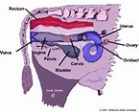
Gross Position of Female Genital organs-cow

Slide 5
HISTOLOGY OF UTERUS

Slide 6
HISTOLOGY OF UTERUS CONTI..

Slide 7
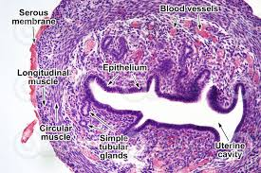
HISTOLOGY OF UTERUS CONTI..

Slide 8
HISTOLOGY OF UTERUS CONTI..

Slide 9
HISTOLOGY OF UTERUS CONTI..

Slide 10
HISTOLOGY OF CERVIX

Slide 11
HISTOLOGY OF VAGINA

Slide 12
HISTOLOGY OF VAGINA CONTI…

Slide 13
HISTOLOGY OF VAGINA CONTI…

Slide 14
HISTOLOGY OF VULVA

Slide 15
HISTOLOGY OF EXTERNAL GENITALIA

