Slide 1
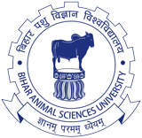
UNIT-IV
Environmental Hygiene
(Credit Hours-3+1)

Slide 2
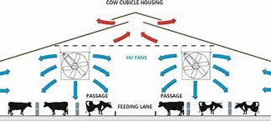
Ventilation in animal houses

Slide 3
VENTILATION
Ventilation in animal houses is required:
Removing stale air &
To replace it by fresh air
Ventilation should be appropriate:
Very little ventilation or too much of it is injurious to the health of animals & their attendants
In improperly ventilated animal houses:
The stagnant air becomes warmer & more humid
Condensation of water on the surface
Bedding & floors makes them wet
Animals become uncomfortable
Leads to concentration of animals at places (uneven distribution of animals)
Accumulation of excreta & expired air in pockets

Slide 4
VENTILATION
High humidity:
Lead to concentration of dust, particulate matter, ammonia, other gases
Pathogenic microorganisms carried by animal facilitating exacerbation of respiratory & enteric diseases, mastitis & other illnesses
High humidity with low temperature (during the winter months): favourable for the spread of various infections
Gases from slurry pits or channels beneath the animals also expose the animals to intoxication
In over ventilated animal houses:
Accompanying draughts: during the winter months & cold climate of the hills
Wasting of much of the valuable heat: many deaths due to chilling & lowering of the animals’ resistance to pathogens
Particularly so in case of new born & unprotected stock which becomes vulnerable to various diseases and deaths

Slide 5
VENTILATION
Open ventilation of cattle yard
Less problems & ample air flow promotes good growth of the coat
Prevents accumulation of animal waste products in air
Requirements for fattening piggery or brooder house for chicks are different
While planning ventilation, main stress is given for avoiding draughts at ground level and open side of the yard to face towards the south
The modern concept of ventilation aims
The replacement of vitiated air by supplying fresh outdoor air
Controlled in regards to its humidity, temperature & purity to provide a thermal environment that is comfortable & free from risk of infection

Slide 6
STANDARDS OF VENTILATION
The standards of ventilation: based on the efficiency of ventilation in removing odour & obnoxious gases
The gases generated:
Carbon dioxide,
Ammonia,
Hydrogen sulphide,
Methane,
Carbon monoxide &
Fumigation gases like formaldehyde, etc.
The Threshold limit values (TLV) for animals are lower than that for man & deserve utmost attention

Slide 7
STANDARDS OF VENTILATION
Three standards are considered for ventilation:
Cubic space:
The amount of carbon dioxide produced during respiration does not exceed more than 2 parts in 10,000 parts of air
This would depend on the type, age, & number of livestock housed therein
Air change:
It is more important than cubic space requirement
The cooling power of the air is to be maintained satisfactorily
The number of air changes/hour: dividing the total hourly air supply to the house by the cubic capacity of the house
Floor space:
The floor space per animal is more important than the cubic space
Heights in excess of 3 meters are ineffective from the point of view of ventilation as the products of respiration tend to accumulate at the lower levels

Slide 8
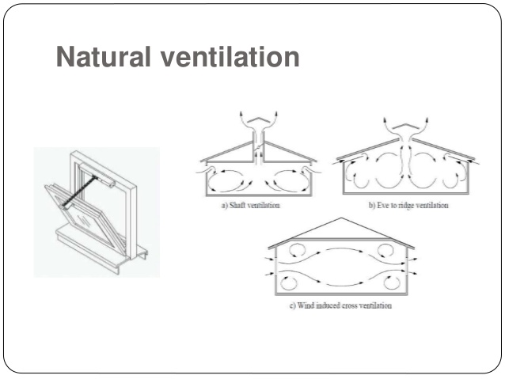
TYPES OF VENTILATION
Types of ventilation: two
Natural
Mechanical
Natural ventilation:
Simplest system of ventilation
Depends on three forces:
Wind
Diffusion
Inequality of temperature

Slide 9
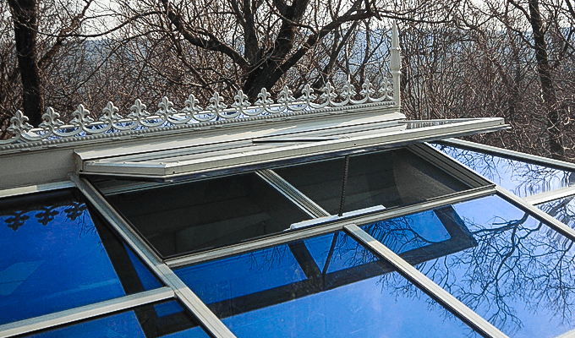
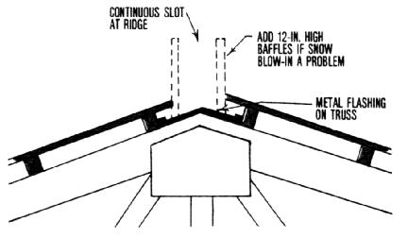
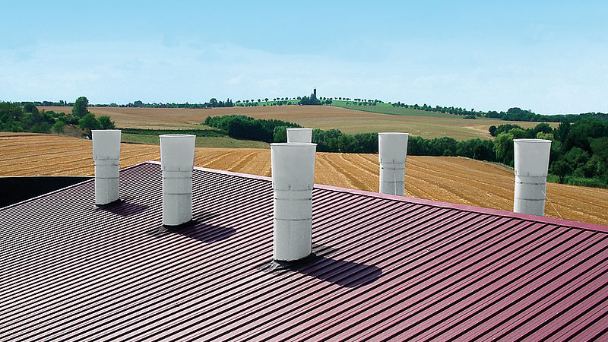
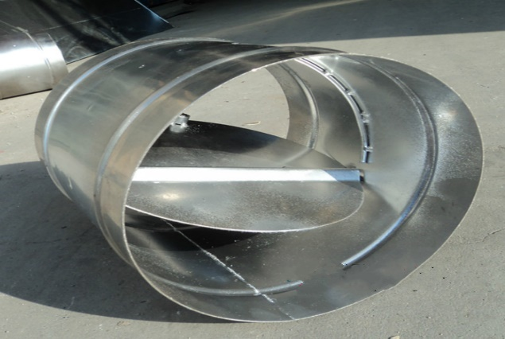
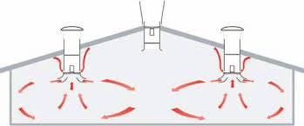
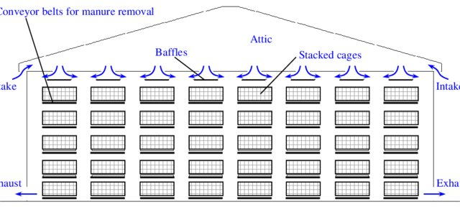
NATURAL VENTILATION
Broadly three types of natural ventilation are in use:
A fixed open ridge
with a protective cap: sufficient in climatic housing for cattle
A simple chimney type
Satisfactory for a limited area of controlled outlet ventilation
The throat can be controlled by a butter- fly value or hinged flap
Hopper- type windows
Fitted with gussets to prevent direct draughts serving as principal inlets
Small baffled openings left open during cold or windy weather

Slide 10
NATURAL VENTILATION
Automatic control of natural ventilation: achieved by
Regulating the open area with the help of automatic thermostatic means
Linking the thermostat to a motor which progressively open or closes the ventilation flaps, inlets/outlets according to the temperature
Breathing roof & upside down roof ventilation also provide good top ventilation
Extraction of air form a limited number of ridge fans
Entry of air through baffled inlets around the wall are the conventional methods for ventilating a livestock building

Slide 11
MECHANICAL VENTILATION
Mechanical or artificial ventilation can be effected by four means:
Exhaust ventilation: Air is extracted to the outside from the inside by an exhaust fan operated electrically
Plenum ventilation: Fresh air is blown into the room by centrifugal fans so as to create a positive pressure & replace the vitiated air proportionate
Balanced ventilation: This is a combination of exhaust & plenum system of ventilation
Air conditioning:
It is the simultaneous control of all factors affecting both physical & chemical conditions of atmosphere within a structure
These factors affecting both physical & humidity, air movement, distribution, dust bacteria, odour & toxic gases
Most of these affect the health & comfort of animals

Slide 12
MECHANICAL VENTILATION
A number of alternatives are also being developed as per need
Cross & end to end ventilation:
Animal house size: 12 m X 30 m
By fixing a number of fans in one of the side walls (opposite to the side wall providing air entry)
Ventilation of wide span building (14-22 m)
By diffusing the incoming air by means of a filter of glass- fibre or hessian
Peg board/slotted hard-board as ‘diffusing’ agents: prevent the clogging of the fine glass-fibre filters

