Slide 1
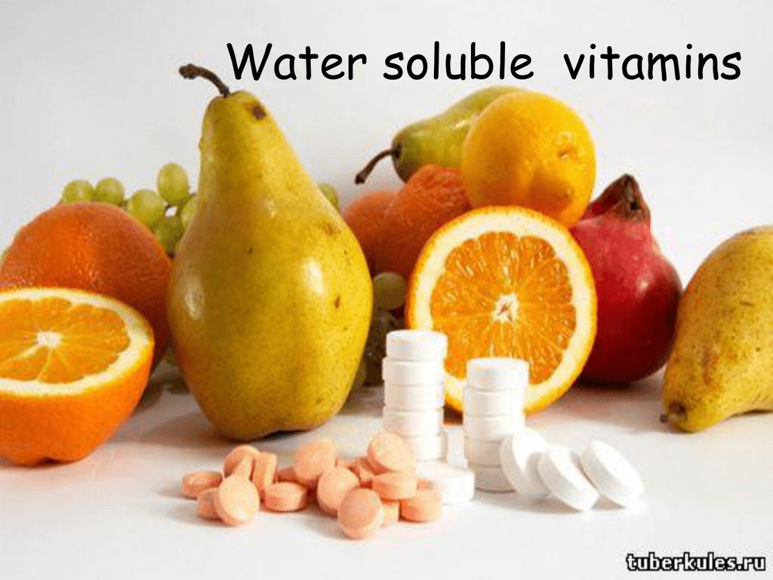
Dr Pramod Kumar
Asstt. Professor
Department of Vety. Physiology
Bihar Veterinary College, Patna

Slide 2
Introduction
Vitamins are organic compounds required in the diet in small amounts to perform specific biologic functions for normal maintenance of optimum growth and health.
The word Vitamin comes from the Greek word “VITAMINE” which means ‘Vital for Life.’

Slide 3
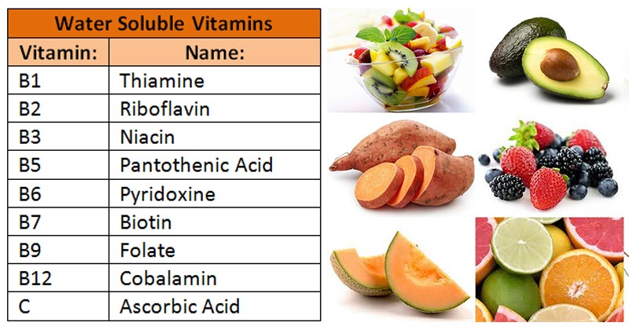

Slide 4
General Properties
Heterogeneous group of compounds and they differ chemically from each other.
soluble in water.
Excreted in the urine and are non-toxic to the body.
Not stored in large quantities (except B₁₂) being continuously supplied in the diet.
These vitamins form coenzymes (active form of vitamin) that help to participate in a variety of biochemical reactions.

Slide 5
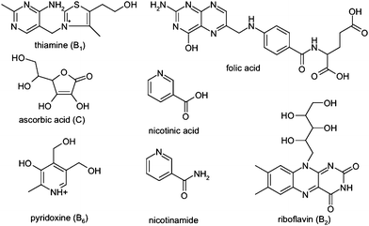
Structure of water soluble vitamins

Slide 6
Thiamine (Vitamin B₁)
contains a pyrimidine and a thiazole ring.
active form is the coenzyme Thiamine Pyrophosphate (TPP).
activation occurs mainly in liver.
TPP is involved with the energy releasing reactions of carbohydrate metabolism.
Deficiency cause & Manifestations: Inadequate Diet, Pregnancy and lactation, Beri-beri
I. Wet BB: Edema and weak heart muscles
II. Dry BB: Degeneration of peripheral nerves and weak muscles.
III. Infantile BB: Affects infants.

Slide 7
Riboflavin (Vitamin B₂)
Structure: Isoalloxazine ring attached to Ribitol.
Stable to heat but sensitive to light (photosensitive).
Active Coenzymes: Flavin adenine dinucleotide = Flavin mononucleotide + AMP forms in intestine and liver.
Biochemical Functions: isoalloxazine ring serves as an acceptor of two hydrogen atoms. The coenzymes participate in many oxidation reduction reactions and in the Electron Transport Chain.
Deficiency cause & Manifestation: Phototherapy, Pregnancy and Lactation
Glossitis, Dermatitis & Cheilosis

Slide 8
Niacin (nicotinic acid/B₃)
Pyridine derivative - amide form is known as Niacinamide or Nicotinamide
Structure - Synthesized endogenously from Tryptophan
Two active coenzymes: Formed in the Liver NAD+ and NADP+
Biochemical Functions - Coenzymes NAD+ (NADH) and NADP+ (NADPH) are involved in oxidation–reduction reactions in carbohydrate, lipid and protein metabolisms.
Deficiency causes & Manifestation: Inadequate Diet, Pregnancy and Lactation & Vitamin B6 deficiency:
Pellagra is characterized 3 D’s (Dermatitis, Diarrhea and Dementia)

Slide 9
Pyridoxine (Vitamin B₆)
Vitamin B₆ represent three compounds pyridoxine, pyridoxal and pyridoxamine.
Structure - pyridine derivatives and active Coenzyme is Pyridoxal Phosphate (PLP), synthesized in the intestine from all the three forms.
Biochemical Functions - These are closely associated with the metabolism of Amino acids.
Deficiency cause & Manifestation: Antituberculous drug, Oral Contraceptive Pills
Neurological, Dermatological and Hematological manifestations.

Slide 10
Vitamin C (Ascorbic Acid)
Structure - resembles a carbohydrate (hexose). Heat sensitive and destroyed by cooking. Does not have any active coenzyme form but acts as a strong reducing agent.
Biochemical Functions: required for hydroxylation of proline and lysine. These are essential for the collagen cross-linking and the strength of the fibre.
Antioxidant Role: acts as an antioxidant preventing tissue injury due to oxidative damage by free radicals: Fights infection, Reduces risk of cancer and coronary artery disease.

Slide 11
Immunological Function: enhances the synthesis of Immunoglobulins and increases the phagocytic functions of leukocytes.
Deficiency Manifestations: Hemorrhages under the skin, bone fragility, joint pain, Poor wound healing, frequent infections, Spongy and bleeding gums, loosened teeth. Deficiency is manifested as Scurvy

Slide 12
Cobalamin (Vitamin B₁₂)
Structure - Cobalamin contains a corrin ring with four pyrolle rings and COBALT at the centre.
Two active coenzyme: Deoxadenosyl & Methylcobalamin
Absorption and Storage: Absorption requires a glycoprotein known as intrinsic factor produced in the stomach in presence of HCL and stored in the liver in the form of Deoxyadenosyl Cobalamin.
Biochemical Functions: Synthesis of Methionine from Homocysteine • Thus B₁₂ deficiency results in decreased THF that leads to reduced nucleotide and DNA synthesis. Vitamin B₁₂ is deficient abnormal fatty acids incorporated into cell membrane
Deficiency cause & Manifestations: Vitamin B₁₂ is mainly present in animal diet, Decreased absorption due to Gastrectomy and malabsorption diseases, Pernicious Anemia, Pregnancy and lactation
Megaloblastic Anemia and Nervous Manifestation

Slide 13
