Slide 1
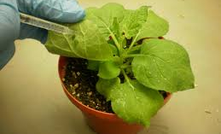
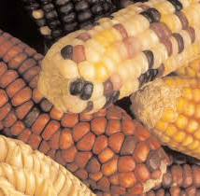
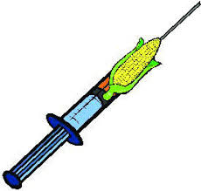
Biopharming
Anil Gattani

Slide 2
Bioreactor
Genes transferred into animal with a view to obtain a large-scale production of protein encoded by these genes in milk, urine, blood of such animal
These animals are bioreactor and approach is called molecular farming or gene farming

Slide 3
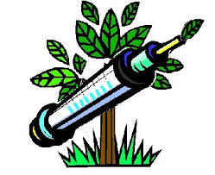
Definition
Biopharming is the production and use of transgenic plants and animals genetically engineered to produce pharmaceutical substances for use in humans or animals.
products belong to different categories
Plant Made Pharmaceuticals (PMPs) of protein origin, such as recombinant therapeutic proteins, enzymes, growth factors and vaccines
Animal Biopharming
Plant Biopharming

Slide 4
History
Year | Achievement
1982 | 1st transgenic drug (Insulin) in E.coli
1990 | 1st plant derive protein (Serum albumin)
1998 | 1st Animal derive transgenic protein in mice milk (tissue Plasminogen activator)
2006 | 1st plant derive vaccine Ranikhet disease vaccine using Tobacco
2009 | 1st animal made pharmaceutical using goat

Slide 5
Methodology
Suitable
Vector
Gene of interest
Electric Shock
Plant or Animal
Extracted products or
Direct consumption
Biochemical and
Clinical Tests
Protein Expression in
Harvest

Slide 6
Animal Biopharming
A GE animal to make a certain pharmaceutical protein in its Milk, Urine, Blood, Sperm, Eggs
E.g.
Lipase (Sheep, Rabbits)
Growth Hormone (Goats)
Factor VIII (Cattle)
Process

Slide 7
Pros and Cons
Pros
Can scale up & Cost reduction- (20-50 $ /g)
Complex protein processing
Very high expression levels
Cons
Viral contamination
Long time scales
Little regulatory experience

Slide 8
Plant Biopharming
Enables a plant to make a certain pharmaceutical molecules for non-food, feed or fiber applications
Plant-made antibodies (plantibodies)
Plant- made vaccines (edible vaccines)
Plant-made therapeutic proteins and intermediates

Slide 9
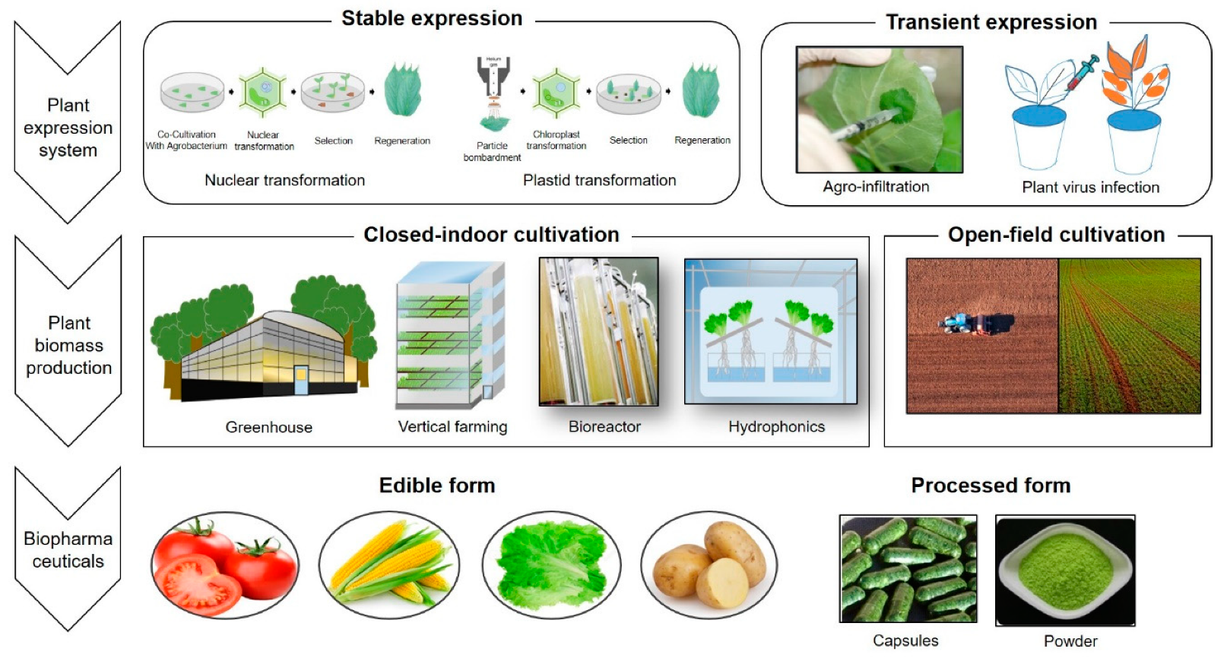
Plant Biopharming

Slide 10
Plantibodies
Plantibodies - monoclonal antibodies produced in plants
Plants used include tobacco, corn, potatoes, soy, alfalfa, and rice
Free from potential contamination of mammalian viruses
Examples: cancer, dental caries, herpes simplex virus, respiratory syncytial virus

Slide 11
Plant made Antibodies

Slide 12
Plant made Edible vaccine
Hepatitis virus B surface antigen - tobacco / potato / lettuce
Newcastle virus disease - tobacco
Cholera - Rice

Slide 13
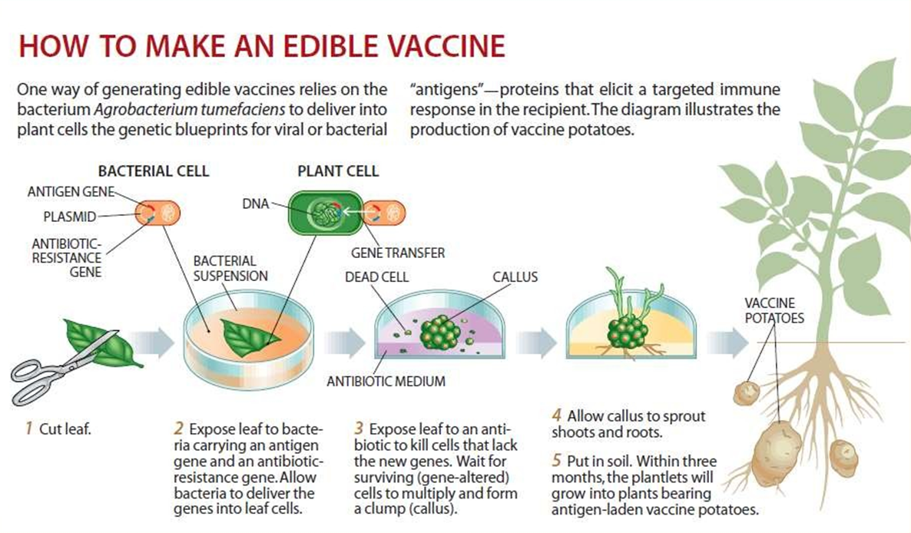
Process of Edible vaccine

Slide 14
Plant made therapeutic proteins
Human serum albumin - potato and tobacco
Human GH produced - tobacco chloroplast.
Human Lactoferine - Potato

Slide 15
Criteria to select a plant
should be easily engineered
should be capable of production of high levels of proteins
Appropriate technique should be available to extract the proteins from plant tissues
Ideally the host plant should be non-food crop or the food crop should be completely sterile to avoid cross-pollination with near by field crops

Slide 16
Strategies of biopharming
1. Plant gene expression strategies
Transient transformation
adv. – quick and easy production
disadv. – small amount of product, processing pblms
Stable transformation
adv. – use for producing large quantities of protein, stability and storage
disadv – gene flow - outcrossing w/native species
Chloroplast transformation
adv. – reduce gene flow through pollen
disadv. – protein not stable for long periods of time therefore complications w/extraction/processing times

Slide 17
Strategies of biopharming
2. Location of transgene expression
Protein quantity and preservation
Whole plant
adv. - an obtain large amts of protein
disadv. - problems w/preservation
Exa mples - tobacco, alfalfa, duckweed
Target specific tissues (e.g. seed, root)
adv. - high amts of protein in seed/root, long-term storage capability.
examples: soy, corn, rice, barley

Slide 18
Strategies of biopharming
3. Selection of plant species and characteristics
Mode of reproduction – self/outcrossing
Yield, harvest, production, processing

Slide 19
Pros and Cons
Pros
Easy scale up & Cost reduction- (10-20$ /g)
Stability – Storage
Safety – free from animal viruses
Shorter development Cycles
Cons
Environment contamination
Food supply contamination
Health safety concerns – allergens, field chemicals

Slide 20
Need of Biopharming
Many pharmaceutical drugs have been produced in sterile fermenters by mammalian cells or using genetically engineered microorganisms. As the construction of huge fermentation plants incurs huge capital cost, the production costs also very high
Another method of production of biopharmaceuticals is to extract it from animal and human tissues such as insulin from pig and cow pancreas or blood proteins from human blood. But these procedures carry the risk of transmitting infectious diseases to humans
As there is advance in the techniques of manipulating the plant genome over the past several years, plants can be used to produce a wide range of important proteins
Eukaroytic production system so proper folding of proteins

Slide 21
Need of biopharming
Expression System | Production Quality | Contam- ination Risk | Scale-up Capacity | Storage Ability | Time effort For the process | Ethical Issues | Production Cost
Bacteria | Low | Endotoxins | High | Medium | Low | Low | Low
Yeast | Medium | Low | High | Medium | Medium | Low | Medium
Mammalian Cell Cultures | Very High | Virus, Oncogenes | Very Low | Difficult | High | Exist | High
Plant Cell Cultures | High | Low | Medium | Medium | Medium | Low | Medium
Transgenic Animals | Very High | Virus, Oncogenes | Low | Difficult | High | Very High | High
Transgenic Plants | High | Low | High | Easy | High | Exist | Low

Slide 22
Need of Biopharming

Slide 23
Risk of Biopharming
Pollen from plants engineered to produce pharmaceuticals may fertilize nearby food or feed crops of the same species. If this occurs, the pharmaceutical may be produced in seed of the neighbouring crop, with potentially negative effects on human or animal consumers of the seed
The introduced gene or its product may have negative effects on the natural environment
Farm workers may be exposed to unhealthy levels of a biopharmaceutical by absorbing products from leaves through their skin, inhaling pollen, or breathing in dust at harvest
Unexpected toxins or residues of pesticides used on the crop may contaminate the final drug product

Slide 24
Safeguards for biopharming
Physical differences
e.g. “purple” maize, GFP
Easily detectable by addition of 'reporter genes‘
e.g. PCR markers
Use chloroplast expression system
will help increase yield
will eliminate potential gene flow via pollen
Use completely closed facilities or greenhouses
Complete disclosure of DNA sequences

Slide 25
Safeguards for biopharming: Physical method
Remove male flowers of GM plant
Use Isolated fields
Use Barrier crops

Slide 26
Industrial products
Avidin by Sigma
transgenic corn
traditionally isolated from chicken egg whites
GUS (β-glycuronidase) by Sigma
transgenic corn
traditionally isolated from bacterial sources (E.Coli)
Trypsin by Sigma
transgenic corn
traditionally isolated from bovine pancreas
first large-scale transgenic plant product

