Slide 1
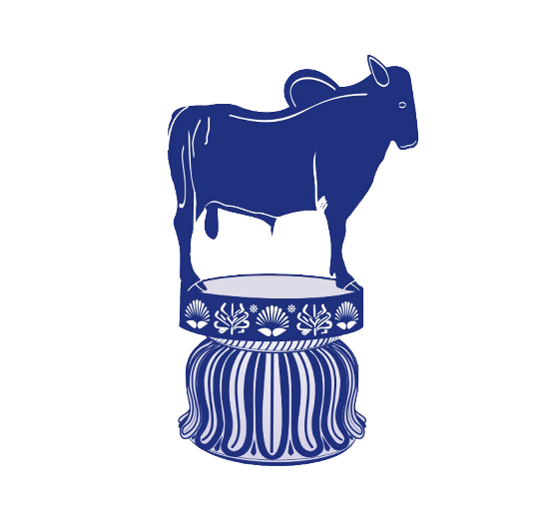
General information of Horse and its Management
Presented by
Dr. Ravikant Nirala
Assistant Professor
Livestock Production Management
Bihar Veterinary College, Patna - 14

Slide 2
Position in Animal kingdom
Kingdom: Animalia
Phylum: Chordata
Class: Mammalia
Order: Perissodactyla
Family: Equidae
Genus: Equus
Species: Equus caballus
Equus asinus

Slide 3
Common terminology associated with Swine
Species: Equus
Adult male: Stallion
Adult male breeder: Stud
Adult female: Mare
Young born male/ female : Foal
Young male upto 3 yrs: Colt
Young female upto 3 yrs: Filly
Gestation period: 336 days
Age of Maturity: 15-24 months
Breeding life 18 years
Estrous length: 21 days + 5days
Estrous Period: 4 to 6 days
Normal temp.: 99.5-101.3 F
Male: Female= 1:30-40
RR: 8-16
HR: 32-44
Av. Productive life: 20-25 yrs

Slide 4
Castrated male: Gelding
Castrated female: Spayed
Female with offspring: Suckling
Young weaned male/ female :
weanling
Act of Parturition: foaling
Act of mating: Covering
Sound: Neigh
Meat of Swine: kinophagia
Volume of Semen: 75 -150 ml
Sperm count: 150 million/CC
Best breeding season: Early spring
First heat after Partuirition: 4-14 d

Slide 5
Milk composition
C : 6.1 %
P : 2.7 %
F : 1.6 %
M : 0.51 %
Water: 90 %

Slide 6
Terminology in Equine Production
Mare: A mature female horse of four years of age and given birth of a foal.
Stallion: A mature uncastrated male horse of four years of age.
Gelding: A castrated male horse of all ages.
Colt: A young uncastrated male horse.
Filly: A young female horse under 3-4 years of age. After foaling………. mare.

Slide 7
Foal: A young horse of either sex under the age of one year such as Colt foal and Filly foal.
Foaling: The act of giving birth by mare.
Foal at foot: A suckling foal running with its dam/mare.
Covering: Mating in horses.
Broodmare: A mare that is used for horse breeding.

Slide 8
Stud: An establishment where pedigreed stallion being kept for breeding.
Stud Book: A list of horses of a particular breed whose parents are known.
Hand: A measurement of the height of a horse. One hand is equal to 4 inches. The measurement is usually taken from the ground to the withers.
Pony: A horse breed that typically measures shorter than 14.2 hands (58 inches, 147 cm). it is used in sport of polo.
Horses: Individual animals of breeds that typically measure over 14.2 hands (148 cm, 58.27 in) of height without shoes and over 14.2½ h (149 cm, 58.66 in) (just) with shoes. Cut off height: 14 hands

Slide 9
Jack: An uncastrated male donkey or ass.
Jennet/Jenny: A female donkey.
Jockey: The rider of a horse in horse racing.
Mule: Hybrid offspring of a male donkey and a horse mare. Almost always sterile. Mules are noted for their sure-footedness.
Hinny: The sterile hybrid offsprings of horse stallion and female donkey.
Zebroid: Hybrid offspring of a zebra crossed on another equine.

Slide 10
Neigh: A sound made by a horse.
Stable: A building in which horses are kept.
Grooming: Cleaning horses for hygienic, practical or esthetic reasons.
Doping: Illegal use of medicines to improve a horse's performance in racing/showing or to harm an animal to perform poorly by an opponent.
Farrier: A professional hoof care specialist who does hoof trimming and horse shoeing.

Slide 11
Horses
Family: Equidae Scientific name: Equus caballus
Odd-toed ungulate mammal.
Important role in transportation, agriculture, sports and warfare.
Light riding horses: 14.0-16.0 hands weighing 386-540 kg. Ex. Arabians, Morgans, Quarter Horses.
Larger riding horses: 15.2-17 hands weighing 540-680 kg. Ex. Thoroughbreds, American Saddlebreds, Warmbloods.
Heavy/draft horses: 16.0-18.0 hands weighing 680-900 kg. Ex. Clydesdale, Belgian, Percheron and Shire.

Slide 12
Pony
Shorter than 14.2 hands (58 inches, 147 cm).
Ponies often exhibit thicker manes, tails and overall coat.
Proportionally shorter legs, wider barrels, heavier bone, shorter and thicker necks and short heads with broad foreheads.
Calmer temperaments than horses and high level of equine intelligence.

Slide 13
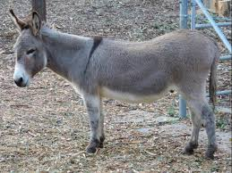
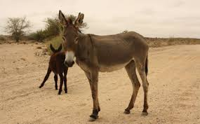
Donkey
Donkeys' ears are much longer in proportion to their size.
Straighter necks and back due to lack of true wither.
Coarse mane and tail.
Smaller and rounder hooves with more upright pasterns.
Characteristic brassy bray sound.
Colors from gray shades of gray-dun to brown, black, light-faced roan.
Sizes: 36" and under (Miniature Mediterranean), 36.01-48" (Standard), 48.01" to 56" (Large Standard).

Slide 14
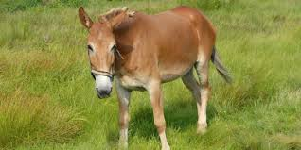
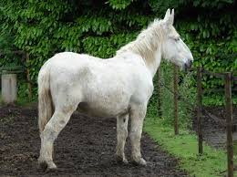
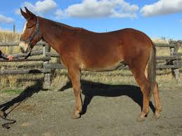
Mule
Body of a horse with the extremities of a donkey.
Grow taller than both parents due to hybrid vigour.
Stronger than horses.
Long ears, short thin mane, tail with shorter hairs.
Legs like the donkey with small and upright hooves.
Stubbornness and bad-tempered but highly intelligent.

Slide 15
Thanks

