Slide 1

BIHAR ANIMAL SCIENCES UNIVERSITY, PATNA, BIHAR
Bihar Veterinary College, Patna
SIRE EVALUATION
Speaker: Ramesh Kumar Singh
Assistant Professor cum Jr. Scientist
Division of Animal Genetics and Breeding
Bihar Veterinary College, Patna

Slide 2
SIRE EVALUATION
A sire’s production transmitting ability can be estimated by mathematical means and expressed as a single figure known as Sire Index
The result of progeny testing is expressed as the index of the genetic worth of the sire or sire index.
It is used in ranking of sires of progeny testing as per their genetic worth so as to select the best sires.
The breeding value / genetic worth refers to the average genetic effect of the genes passed on by the individual to its offspring and is estimated to know whether the individual is genetically superior to other individuals or not for the trait concerned.

Slide 3
Biasness in sire evaluation
The genetic biasness is created by genetic differences among herds and due to the differences in genetic merit (production level) of the mates of the sire.
The major environmental biases are introduced by the different environmental conditions (feeding, management, climatic factors etc.)

Slide 4
SIMPLE DAUGHTER AVERAGE INDEX
This index is a simplest method to evaluate a bull by his daughter’s production alone in single herd under same environment (Edward, 1932).
It provide sound basis of evaluation.
This method does not take into account differential production level or probable contributions of the dams or mates of sires or dams of daughters. It leads to bias in evaluation or ranking of sires.
S_{I} = D_{i}
where, D_{ij} = Average yield of j^{th} daughters of the i^{th} sire

Slide 5
EQUIPARENT / INTERMEDIATE / MOUNT HOPE INDEX/ YAPP’S INDEX
This index is based on the principle that the two parents contribute equally to the genetic make up of the progeny.
Equiparent index makes adjustment for the different production level of dams.
However, it overcorrects the production level of mates allotted to different sires.
It overestimates the breeding value of a sire mated to set of dams inferior to the herd average and underestimates if dams superior to the herd average.
S_{I} = 2D – M
where,
D = average yield of daughters of the sire;
M = average yield of dams mated to the sire

Slide 6

Contemporary daughter average index
The herd mate or contemporary comparisons reduce the environmental variation due to herd, year and season.
The records of the daughter of a sire are compared with the daughter of all other sires in the same herd calved in the same month or $±$ 2 months.
The sire index proposed by Sunderasan et al. (1965) is:
I = H + $\frac{n}{n+k}$ (D – C_{D})
Where, n = no. of daughter; K = constant based on sire error variance

Slide 7
Corrected contemporary daughter average index
The following 2 sire indices as an extension of the contemporary daughter average indices have been proposed.
These indices besides adjusting the number of progeny and period to period variation also adjust for the differences in production level of dams allotted to different sires.
These indices are:
The second index was proposed by Sunderasan et al. (1965) and known as Dairy Search Index.

Slide 8

Least square constants
The sire constants are obtained by least squares techniques which adjust the data for all the environmental effects including the non-orthogonality in data.
These sire constants are used in getting the sire index as
I = $\frac{{2nh}^{2}}{{4+\left(n−I\right)h}^{2}}$ (S_{i})
Where, S_{i} is the sire constant for i^{th} sire

Slide 9
Maximum likelihood method and REML
The maximum likelihood (chance) method estimates the parameters by maximizing the logarithm of the likelihood function.
The likelihood function is the likelihood of simultaneous occurrence of observation and is generally the product of the density function of the observations (variables).
However, the ML estimates are biased because no account is taken of the degree of freedom in estimating the variance components.
The ML method was improved by a method known as restricted maximum likelihood (REML) which takes care of the bias in estimates as well as avoids negative estimates of components of variance (Searle et al. 1992).

Slide 10
Best linear unbiased prediction method (BLUP)
The BLUP method of estimation was developed by Henderson (1949, 1973).
This method is more powerful than the conventional selection index approach.
This provides directly comparable estimates of the average breeding value of groups of animals born in different years.
It takes into account the complications of non-random mating, sires from more than one herd, environmental trends over time, herd differences for B. V. of dams and bias due to selection.
Thus BLUP takes account of the fixed effects such as herd-year-season and it is applicable when mixed models are used.

Slide 11
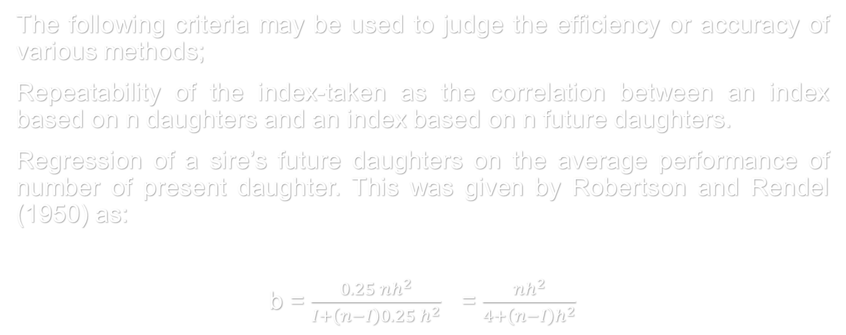
Efficiency of sire indices
The following criteria may be used to judge the efficiency or accuracy of various methods;
Repeatability of the index-taken as the correlation between an index based on n daughters and an index based on n future daughters.
Regression of a sire’s future daughters on the average performance of number of present daughter. This was given by Robertson and Rendel (1950) as:
b = $\frac{{0.25 nh}^{2}}{{I+\left(n−I\right)0.25 h}^{2}}$ = $\frac{{nh}^{2}}{{4+\left(n−I\right)h}^{2}}$

Slide 12
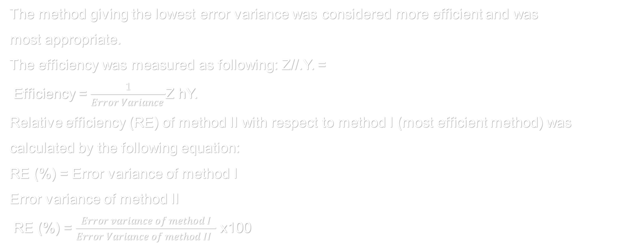
Error variance or within sire variance
The method giving the lowest error variance was considered more efficient and was
most appropriate.
The efficiency was measured as following: Z//.Y. =
Efficiency = $\frac{1}{Error Variance }$Z hY.
Relative efficiency (RE) of method II with respect to method I (most efficient method) was
calculated by the following equation:
RE (%) = Error variance of method I
Error variance of method II
RE (%) = $\frac{Error variance of method I}{Error Variance of method II }$ x100

Slide 13

Coefficient of determination (R²)
Coefficient of determination (R²) of fitting the model:
R² (%) = $\frac{S.S. of fitting the model}{T.S.S.}x 100$

Slide 14

Rank correlation
The correlations between the rankings of the sires based on their breeding values estimated by the above methods were tested by using Spearman’s rank correlation (spearman, 1904):
r(s) = 1 - $\frac{{6 \sum{d}}_{i}^{2}}{n (n^{2 }−1)}$
Where, r = Rank correlation coefficient
n = Number of sires under evaluation
d_{i} = Difference of rank between paired items under two methods
The significance of rank correlation was tested by t-test with n-2 degree of freedom as given below:
t = r $\sqrt{\frac{(n−2)}{{(1−r}^{2})}}$

Slide 15
THANKS

