Slide 1
Wool Part 1 (A part of Unit II- 3rd Prof. Year)
Dr. Gargi Mahapatra
Asst. Prof. cum Jnr. Sc.
Dept. of Livestock Products Technology
Bihar Veterinary College
BASU, Patna.

Slide 2
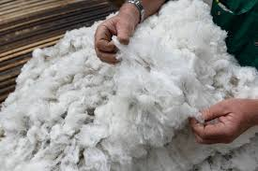
Wool
Wool is a natural fibre of animal origin which is hygroscopic in nature, is crimpled, elastic and grows in clusters. It’s a fibre of cylindrical structure and basically protein in nature. Structurally it consists of a cortex and cuticle, it is devoid of a medulla.

Slide 3
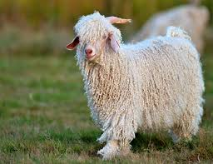
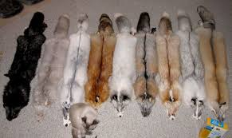
Allied Fibres
Mohair
Fur/ Hair
Natural fibre obtained from Angoora goats. Has approx. 25-45 microns diameter and is both resilient and durable. It is notable for its high lustre and sheen, mohair has scales as wool but the scales are not fully developed, hence it doesn’t felt like wool. Like wool mohair has no medulla
A synonym for non-human hair. The term is sometimes used to refer to the body hair of animal as a complete coat, also known as pelage. Structurally it is similar to hair and it consists of cuticle, cortex and medulla.

Slide 4
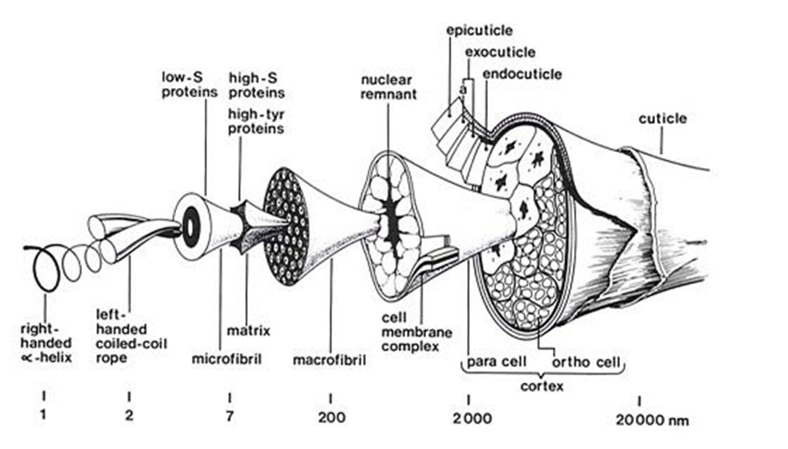
Physical Structure of Wool
A protein fibre made up of keratin. It contains sulphur containing amino acid, cysteine.

Slide 5
Physical Structure of Wool… cont.
Cuticle: Outer most protective layer of scales. The scales overlap each other like tiles, exposed edges faced outwards. It has a waxy coating which makes it resistant to water and water based stains.
Cortex: Internal cells of the fibre, contributes 90% of the fibre. Cortex contains corticular cells and cell membrane complex. Contains two types of cells
ortho-corticle cells
para-corticle cells
Cell Membrane Complex: It contains proteins and waxy lipids which runs through out the whole fibre. The molecules in this region has fairly weak intermolecular bonds which breaks downs easily when exposed to harsh handling and strong chemicals.

Slide 6
Physical Structure of Wool… cont.
Macro-fibrils: Long rod like filaments present inside the cortical cells.
Matrix: It is a continuous phase having micro-fibrils embedded in it. It consists of sulphur containing proteins. The matrix is the region responsible for wool’s fire resistance and anti-static property.
Micro-fibrils: They are the basic supporting system of the wool fibre. It gives strength and flexibility to the fibre. They contain pairs of twisted molecular chains.
Helical coil: It is the smallest part of the fiber. It consists of twisted molecular(protein) chains that are coiled in helical shape. This structure is stiffened by hydrogen and di-sulphide bonds. These bonds link each coil of the helix helping to prevent stretching,

Slide 7
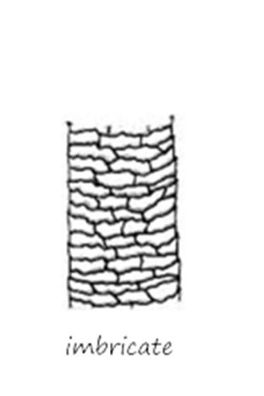
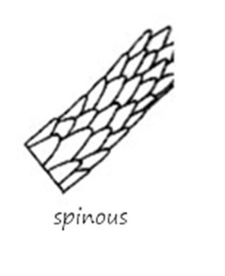
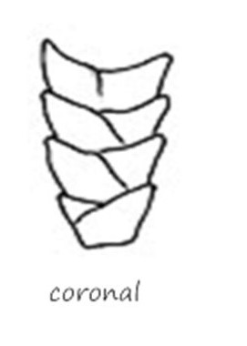
Cuticular Patterns
Coronal Corona-Reticulate Reticulate
Each scale forms Ring around the fibre is made Scales arranged in
a complete ring from more than 1 scale. The an irregular network
around the fibre. lateral and axial band overlap above the fibre
Top portion of 1 top of 1 scale overlaps the bottom surface.
scale overlaps portion of the next.
bottom portion of
the next.

Slide 8
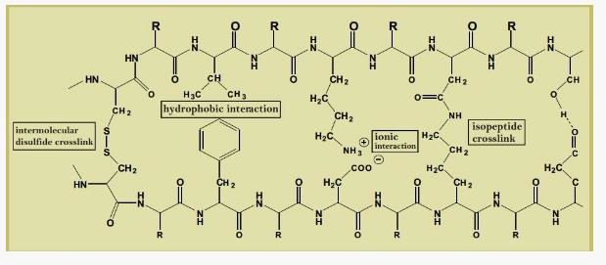
Chemical Structure of Wool
Long chains of keratin roughly lie parallel to the long axis of the fiber.
Long keratin molecules linked together in 3 different ways
Cysteine links
Ionic links
Hydrogen bonds

Slide 9
Properties of Wool
Physical Properties
Chemical Properties
Cylindrical in structure.
Devoid of medulla.
Shows curliness/ crimpiness (2-12/cm)
Durable.
Elastic, stretches up-to 30% of its normal length.
Hygroscopic, absorbs 18-50% of its own weight.
Light weight; Water-proof, Non- inflammable and light weighted.
Wool burns slowly and forms a porous brittle mass of carbon.
Gives up moisture when heated up to 100-150°C.
When heated to a temp. of 130°C, keratin readily decomposes to ammonia.
Insoluble in water.
Continuous boiling of wool causes breakage of its macromolecules, causing decomposition.
Wool softens on soaking in cold water

Slide 10
Properties of Wool contd..
Physical Properties
Chemical Properties
Transmits UV rays.
Strong, stronger than steel of the same diameter.
Can be felted or matted easily.
Shrinks when subjected to wash in warm water containing mild soap.
Wool fiber has projections which help in adherence.
Specific gravity- 1.304 & Refractive index varies between 1.553-5.00.
Exposed to cold water wool fiber diameter is seen to increase.
No harm occurs to wool, when exposed to cold or boiling solutions of mineral acids.
Colour of wool becomes light yellow on treating with nitric acid, this colour reaction is useful in identifying animal fibre.
Slow dissolution of wool occurs in concentrated mineral acids.
Wool is sensitive to alkalis. Complete destruction and dissolution of wool occurs when boiled with 5% solution of caustic soda.

Slide 11
wool Quality
Parametres
Fibre-fineness
Fibre length and Staple length
Moisture Content
Crimp Frequency
Medullation Percentage
Scouring Yield
Burr Content
Colour
Lustre

Slide 12
Moisture content and Moisture Regain
Moisture = Mass of absorbed water in specimen X 100
Regain % Mass of dry specimen
Moisture = Mass of absorbed water in specimen X 100
Content % Mass of undried specimen

Slide 13
Length
Expressed in centimetres.
Determines spinnability of the fibre
Fibre Length- Length of the fibre in straightened condition.
Staple - Length of the fibre in relaxed condition
Length (with crimps)
Crimp – Number of crimps per unit length of the frequency fibre

Slide 14
Medullation Percentage
Volume occupied by medulla in a fibre.
Expressed in percentage (%).
Varies from 5%-89%-99%
Medullated fibres are of lower density. They are stiff and less elastic.
Evaluated using- Projection microscope, Lanometre and Dichlorobenzene.

Slide 15
Scouring Yield
The process of cleaning of wool is called scouring.
Scouring detergent @ 0.3-0.6% is added to water at 45°C.
Scouring is practiced by dipping the wool in bowls containing scouring solution and the process should be repeated at least twice.

Slide 16
Burr Content
Amount of vegetable content present in a fleece is known as burr content.
It is estimated by dissolving wool in NaOH solution.
Types
Low Burr 3%
Medium Burr 5%
Heavy Burr >5%
The process of removal of burr is known as Carbonization.

Slide 17
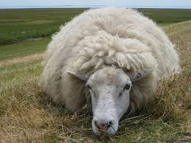
Thank You

