Slide 1
BLUE TONGUE
8th Semester Dr. Anil Kumar
Asst. Professor
Dept. of VCC

Slide 2
Bluetongue (catarrhal fever of sheep and sore muzzle)
A viral disease of sheep, and occasionally cattle and goats, transmitted by insect vectors.
It is characterized by catarrhal stomatitis, rhinitis, enteritis, and lameness.
Etiology:
Bluetongue virus is an arthropod-borne RNA orbivirus in the Family Reoviridae.
Bluetongue is endemic in India
The disease has increased manifold in our country in sheep, cattle and buffaloes.
BT is most severe in sheep, whereas In cattle, the infection is usually not much noticeable
Spread :
Bluetongue is transmitted by biting insects of the genus Culicoides.

Slide 3
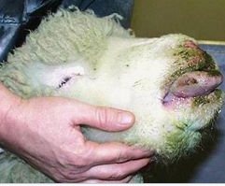
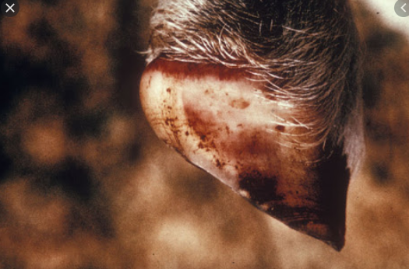
Mechanical transmission
In utero
Infection has been transmitted by insemination from an infected bull, since the virus is present in the semen.
Pathogenesis: Following infection
viral replication initially occur in haematopoietic cells
This results in viraemia and subsequent replication in
endothelial cells throughout the body
Endothelial cells become swollen and later become necrotic, causing oedema, haemorrhage, thrombosis, and infarction
Source: Image from Internet

Slide 4
Clinical signs:
Bluetongue disease has two different manifestations—reproductive problems and vasculitis of several organ systems.
A spiked fever often leads to depression, anorexia, and rapid weight loss.
Affected animals may develop edema of the lips, tongue, throat, ears, and brisket.
Other signs include excessive salivation and hyperemia or cyanosis of the oral mucosa, including the tongue (hence the name bluetongue).
Affected sheep often produce profuse serous nasal discharge that soon becomes mucopurulent and produces crusts and excoriations around the nose and muzzle.
Oral lesions progress to petechial hemorrhages, erosions, and ulcers.
Pulmonary edema is often severe and pneumonia may develop.

Slide 5
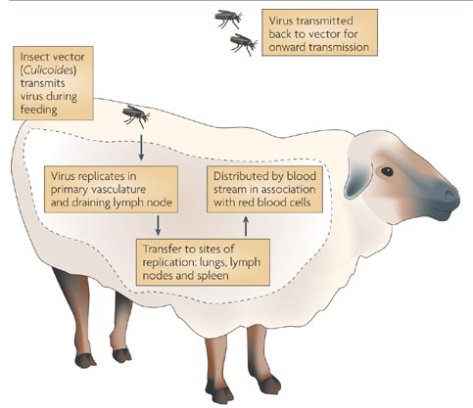
Source: Nature Review Microbiology

Slide 6
stiffness or lameness because of muscular changes and laminitis.
Cyanosis or hemorrhagic changes of the skin of the coronet can extend into the horny tissue.
A definite ridge in the horn of the hoof may be present for many months after recovery.
The reproductive or teratogenic form of the disease varies greatly with strain, host, and environmental factors.
Teratogenic effects include abortions, stillbirths, and weak, live “dummy lambs.” Congenital defects may include hydranencephaly.
Diagnosis:
clinical signs.
Viral isolation from blood obtained during the viremic, febrile state is the most definitive means of diagnosis.

Slide 7
Serologic evaluation, the two types of viral antigen groups called P7 and P2. The former (P7) is found in all bluetongueviruses, and the latter (P2) determines the serotype.
complement fixation, agar gel immuno-diffusion (AGID), or one of several ELISA tests.
Polymerase chain reaction– (PCR-) based tests.
Clinicopathologic signs LIKE leukopenia during the early febrile stage of the disease and an increase in serum CK corresponding to the latter phase of muscle stiffness and lameness.
Treatment:
Broad-spectrum antimicrobials (oxytetracycline 5 mg/kg IM SID to BID) are often used to treat secondary pneumonia and dermatitis.
NSAIDs (flunixin meglumine 1.1 to 2 mg/kg IV) may be recommended.

Slide 8
Animals should be kept on soft bedding with good footing.
Due to reluctance of animals to eat, they should give a gruel of alfalfa pellets by stomach tube or encouraged to eat soft feeds and green grass.
Prevention:
Control of Culicoides vector.
Modified live vaccines based on local strains and serotypes are available in some parts of the world.
The vaccine should be administered at least 2 weeks before breeding season to prevent teratogenic effects.
Pregnant animals cannot be vaccinated with modified live vaccines.
Sheep that have recovered from an attack of bluetongue are solidly resistant for months to infection by the same viral strain.

