Slide 1
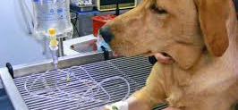
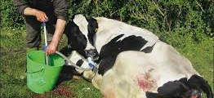
Biochemical basis of Fluid Therapy
Anil Gattani

Slide 2
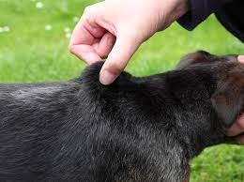
Indication of Fluid therapy
instituted for the following conditions
Dehydration- loss of skin elasticity, dry buccal mucosa and tongue, and sunken eyeballs
Acid–base disturbances - vomiting, diarrhea, abnormal respiratory pattern, and CNS abnormality
Electrolyte imbalances- Blood gas and urine analyses
Nutritional problems
Loss of body fluids- burn, haemorrhage,

Slide 3
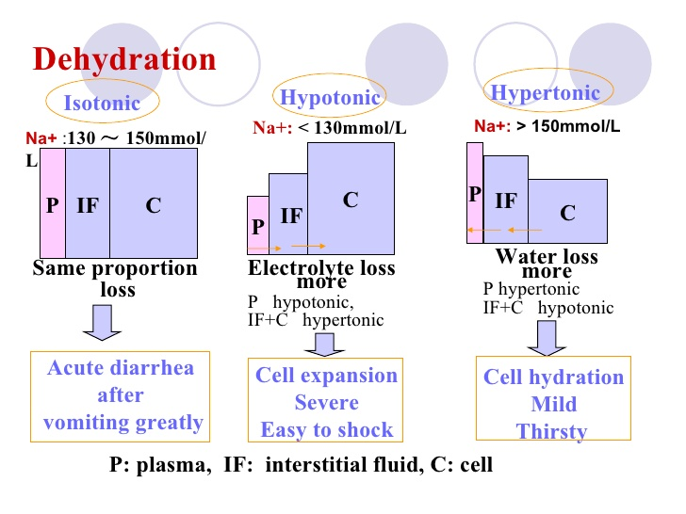
Dehydration
Hypertonic dehydration- loss of pure water or hypotonic fluid
Isotonic dehydration - loss of isotonic body fluids (in acute case),
Hypotonic dehydration - loss of a hypertonic fluid or loss of isotonic fluid with water replacement

Slide 4
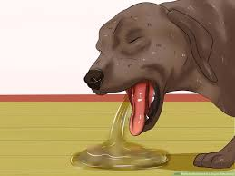
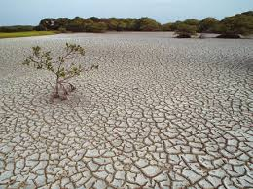
Causes of dehydaration
Decreases in water intake –
Lack of water source, Disorders and pain of the buccal cavity and pharynx, CNS disturbances
Increases in body fluid excretion
Polyuria, Profuse sweating, Vomiting/diarrhea, Respiratory loss

Slide 5
Role of electrolytes on hydration states and acid–base balance
↑ [Na⁺] in ECF → water retention
↑ [K⁺] in plasma→↑[K⁺],↓[H⁺] in urine → Acidemia
↓ [K⁺] in plasma→↓[K⁺],↑[H⁺] in urine → Alkalemia

Slide 6
Role of carbohydrate metabolism on hydration states and acid–base balance
↓ Carbohydrate utilization → Hyperglycemia → Glucosuria→ Polyuria → Dehydration
↓ Carbohydrate utilization →↑ Gluconeogenesis → Ketoacidosis
↑ Carbohydrate intake (grain overload) in herbivores →↑ Lactic acid production → Acidosis

Slide 7
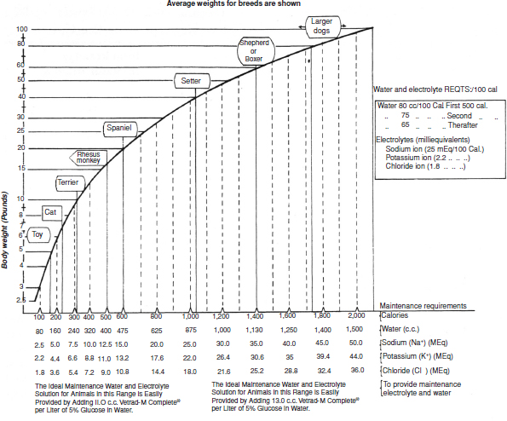
Water replacement
Amount of fluid therapy = body water maintenance + replacement of the deficit + ongoing loss
Maintenance water= 50–75 mL/kg/day (Average 65)
Ongoing loss- vomiting, diarrhoea, etc

Slide 8
replacement of the deficit
Replacement volume (L) = %dehydration × body weight (kg)
4% dehydration- No replacement
6% - decreased skin turgor, dull haircoat and dry mucous membranes
8-10% - skin lacks pliability, Dry mucous membranes and tongue, Soft eyeballs that are sunken into the orbit, Cold extremities, Capillary refill time >3 seconds
12 %- All the signs seen with 8–10%, Circulatory collapse (shock)

Slide 9
composition of replacement fluid
similar to the volume of fluid lost
E.g. if loss of the electrolyte-rich GI fluid, then fluid should contain Na⁺, K⁺, Ca²⁺, Cl⁻, and ${HCO}_{3}^{−}$(or indirect alkalinizing agents)
In pure loss of water- 5% dextrose (glucose in water) or 2.5% dextrose and 0.45% NaCl over 24–72 hours

Slide 10
Other factors
Dehydration affects young animals much faster than adult
Old animals with chronic diseases require more water than younger
Physical and weather conditions may affect the requirement
Drugs will alter requirements, particularly diuretics and mineralocorticoids

Slide 11
Calculation of mOsm/L from mM
For electrolyte solutions
Since NaCl dissociates into two particles, Na⁺ and Cl⁻, 1 mmol/L (1 mmolar or 1 mM) of NaCl solution yields 2 mOsm/L
1mmol of NaCl contains 58.5 mg
For nonelectrolyte solutions
glucose does not dissociate, 1 mM of glucose solution yields 1 mOsm/L

