Slide 1
INTRODUCTION TO CEREAL GRAINS, LEGUMES AND OILSEEDS, STRUCTURE AND COMPOSITION OF CEREAL GRAINS, LEGUMES AND OILSEEDS

Slide 2
Introduction
Cereal grains are the fruit of plants belonging to the grass family (Gramineae).
Cereals are plants which yield edible grains and includes rice, wheat, corn, barley, and oats.
Cereal grains provide the world with majority of its food calories and about half of its protein.
They are also good source of micronutrients such as calcium, iron and vitamins of group B.
Asia, America, and Europe produce more than 80 percent of the world’s cereal grains.
Cereals are easy to store because of low moisture content, easy to handle and providing variety to the diet.

Slide 3
The principle cereal grains grown in India are
wheat
rice
corn
barley
sorghum

Slide 4
Structure of Cereal grains
Cereal grains are a ‘dry’ fruit called caryopsis.
The caryopsis fruit has a thin, dry wall which is fused together with the seed coat.
The seed portion of cereals consists of numerous components which basically include three parts: a seed coat or testa (bran), storage organ or nutritive reserve for the seed (endosperm), and a miniature plant or germ.
The fruit tissue consists of a layer of epidermis and several thin inner layers a few cells thick.
The aleurone layer which is just below the seed coat, is only a few cells thick, but is rich in oil, minerals, protein and vitamins.

Slide 5
Starch and protein are located in the endosperm which represents the bulk of the grain and is sometimes the only part of the cereal consumed.
Starch is arranged in the form of sub-cellular structures called granules that are embedded in a matrix of protein.
The developing endosperm contains protein bodies which become a continuous phase as the grain matures.
There is generally a gradient of more protein and less starch per cell from the outer to the inner region of the endosperm.

Slide 6
Reserve proteins in the endosperm are in the form of smaller ‘protein bodies’ that range in size from 2-6 µm that become disordered and adhere to the starch granules in the mature grain of species like wheat.
Cereal grains are also an important source of several other nutrients such as protein, calcium, iron, vitamin B complex and dietary fiber.
Cereal grains contain 10-14% moisture, 58-72% carbohydrate, 8-13% protein, 2-5% fat and 2-11% indigestible fiber.
They also provide about 300-350 kcal/100 g of grains.
Cereals are deficient in vitamins A, D, B12 and C

Slide 7
Wheat
Scientific name – Triticum aestivum
Wheat is the earliest field crop used for human food processing.
The precise origin of the wheat cultivation is unclear, but it is thought that man has been cultivating and processing the wheat for at least 12,000 – 17,000 years.

Slide 9
Composition of Wheat
Composition
Moisture(%) | 11
Carbohydrate(%) | 69
Protein(%) | 13
Fat(%) | 2
Fiber(%) | 3
Ash(%) | 2
Calorific value(kcal./100gm.) | 340

Slide 10
Rice
Scientific name – Oryza sativa
Rice crop originated in Asia and has been a staple food there since the Ice Age in the North.
Actual rice grains and husk have been excavated in India that were more than 4500 years old.
According to a general consensus, domestication occurred at three places – India, Indonesia and China – thereby giving rise to three races of rice – Indica, Javonica and Sinica (also known as Japonica), respectively.

Slide 11
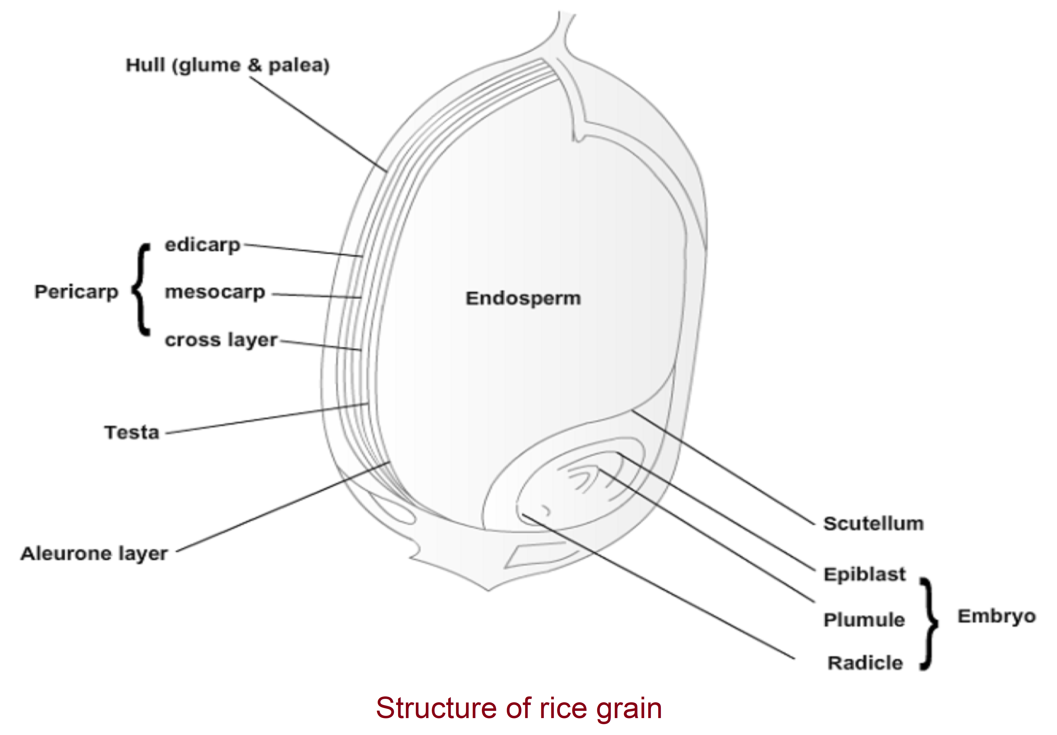

Slide 12
Composition of Rice
Composition
Moisture(%) | 11
Carbohydrate(%) | 65
Protein(%) | 8
Fat(%) | 2
Fiber(%) | 9
Ash(%) | 5
Calorific value(kcal./100gm.) | 310

Slide 13
Corn
Scientific name – Zea mays
Corn or Maize is native to the America.
Archeological evidence suggests that corn was domesticated and grown as early as 5000 B.C. in Mexico.

Slide 14
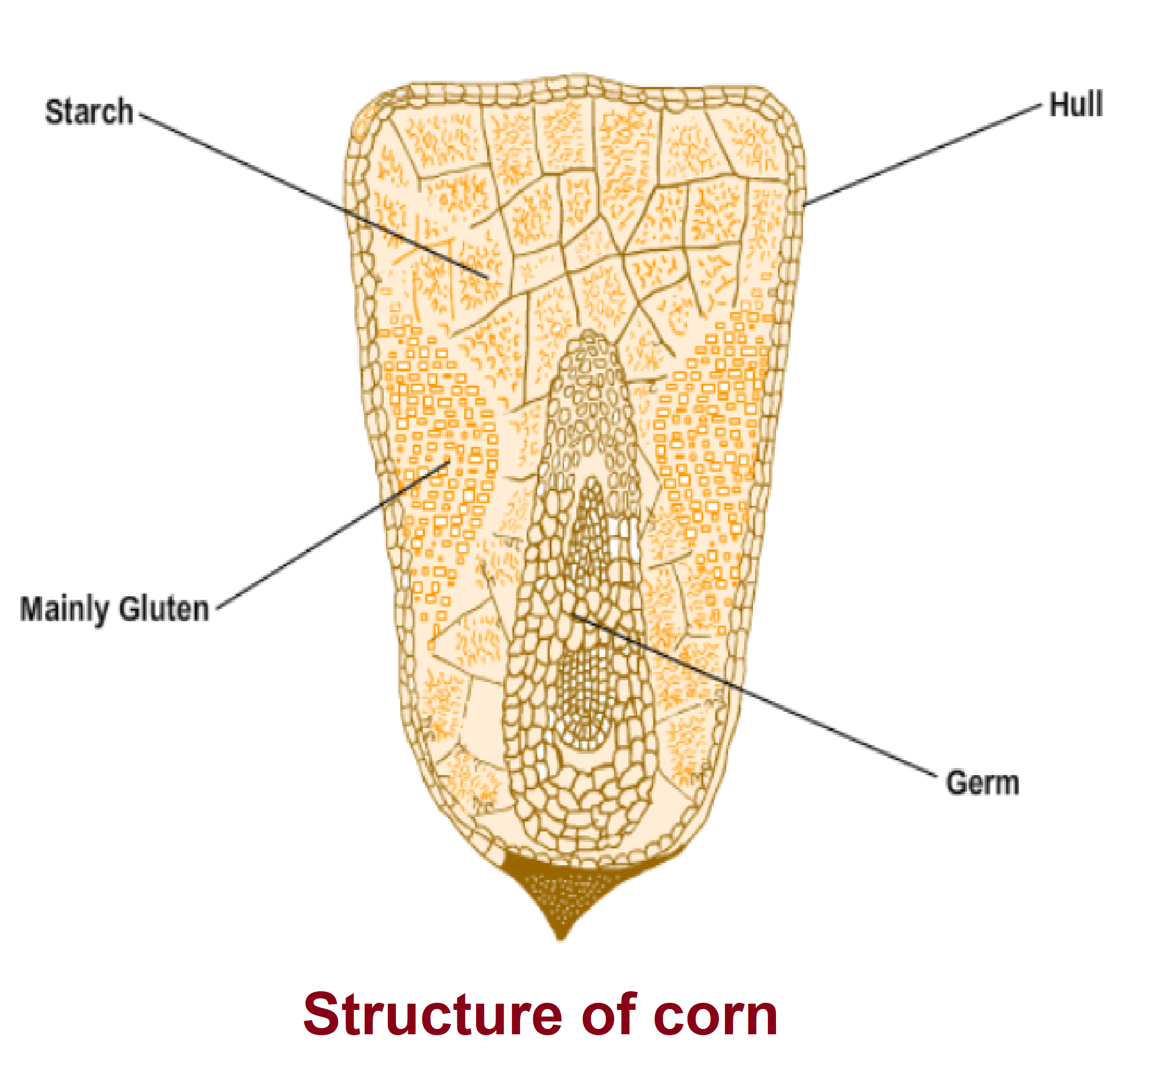

Slide 15
Composition of Corn
Composition
Moisture(%) | 11
Carbohydrate(%) | 72
Protein(%) | 10
Fat(%) | 4
Fiber(%) | 2
Ash(%) | 1
Calorific value(kcal./100gm.) | 352

Slide 16
Barley
Scientific name - Hardeum vulgare
Barley is among the most ancient of the cereal crops.
The original area of cultivation was in the Fertile Crescent of the Middle East, in present day Lebanon, Iran, Iraq, and Turkey.
Barley played an important role in ancient Greek culture as a staple bread–making grain, as well as an important food for athletes.
Gladiators were known as hordearii, which means “eaters of barley”.
Barley is often referred to as the “king of grains”.

Slide 17
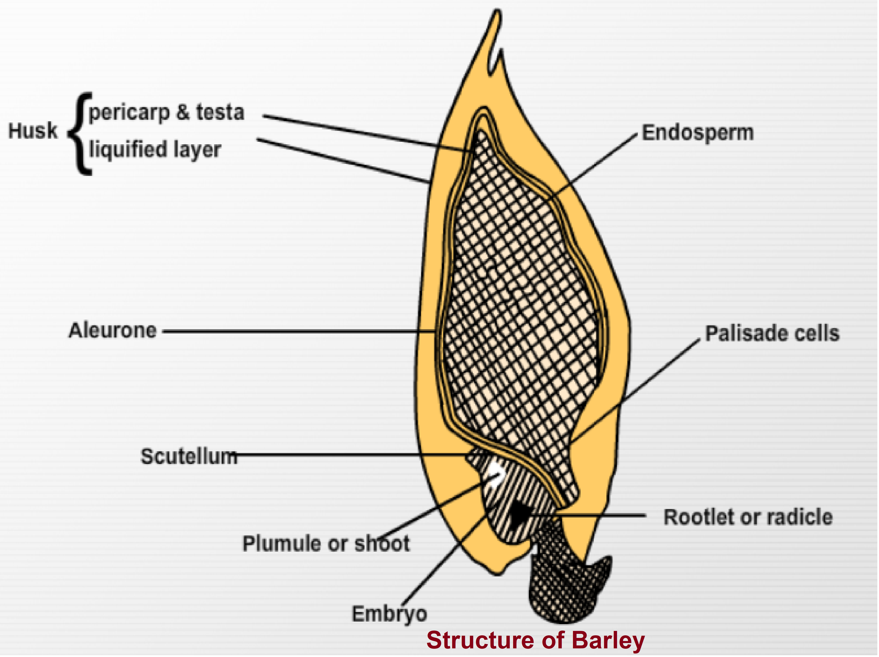

Slide 18
Composition of Barley
Composition
Moisture(%) | 14
Carbohydrate(%) | 63
Protein(%) | 12
Fat(%) | 2
Fiber(%) | 6
Ash(%) | 3
Calorific value(kcal./100gm.) | 320

Slide 19
Structure of Legumes
The term ‘pulses’ is limited to crops harvested solely for dry grain, thereby excluding crops harvested green for food mainly as vegetables (peas, beans, etc.), crops used mainly for oil extraction (e.g. soybean and groundnut) and leguminous crops for sowing purpose (e.g. seeds of clover and alfalfa).
A legume is a plant in the family Fabaceae (or Leguminosae), or a fruit of these specific plants.
A legume fruit is a simple dry fruit that develops from a simple carpel and usually dehisces (opens along a seam) on two sides.
A common name for this type of fruit is a pod. Well-known legumes include peas, beans, lentils, black gram, green gram, soy and groundnut.

Slide 20
Pulses all have a similar structure, but differ in color, shape, size, and thickness of the seed coat.
Mature seeds have three major components: the seed coat, the cotyledons, and the embryo.
The seed coat or hull accounts for 7–15% of the whole seed mass.
Cotyledons are about 85% of the seed mass, and the embryo constitutes the remaining 1–4%. The external structures of the seed are the testa (i.e., seed coat), hilum, micropyle, and raphe. The testa is the outer most part of the seed and covers almost all of the seed surface.
The hilum is an oval scar on the seed coat where the seed was attached to the stalk.
The micropyle is a small opening in the seed coat next to the hilum. The raphe is a ridge on the side of the hilum opposite the micropyle.
When the seed coat is removed from grain, the remaining part is the embryonic structure.
The embryonic structure consists of two cotyledons (or seed leaves) and a short axis above and below them. The two cotyledons are not physically attached to each other except at the axis and a weak protection provided by the seed coat.
Thus the seed is unusually vulnerable to breakage. The outermost layer of the seed coat is the cuticle, and it can be smooth or rough. Both the micropyle and hilum have been related to the permeability of the testa and to water absorption.

Slide 21
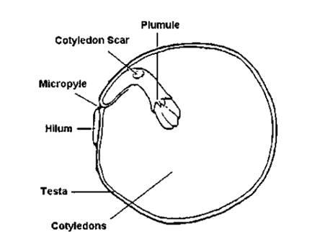
Structure of pulse

Slide 22
Composition of Pulses
Pulses contain carbohydrates, mainly starches (55-65 percent of the total weight); proteins, including essential amino acids (18-25 percent, and much higher than cereals); and fat (1 - 4 percent). The remainder consists of moisture, fiber, minerals and vitamins.

Slide 23
Proximate composition of pulses (Per 100 g edible portion)

Slide 24
Structure of Oilseeds
Oil seeds are mainly used for extraction of edible oil.
Oilseeds crops grown in India are groundnut, rapseed, mustard, soybean, sunflower, sesame, castor, safflower, niger and linseed.
Oilseeds are made up of three basic parts: the seed coat, the embryo, and one or more food storage structures.
The seed contains two pieces of cotyledons that function as food reserve structures.
The seed coat is marked with a hilum or seed scar. The basic function of the coat is to protect the embryo from fungi and bacterial infection.
Unlike seeds of grass family (e.g. wheat, rice, etc.), where oil is concentrated in a germ that lies along the side of the endosperm, the entire hull of oilseeds is the germ.
It typically consists of a rootlet (hypocotyl) and two cotyledons leaves that are pushed above the soil and unfold during the germination.
Oil in oilseed is distributed in spheresomes throughout the germ cells.
Recovery of oil from oilseeds is facilitated by rupturing the cell walls by heat and pressure during flaking, and by optional extrusion, followed by pressing or solvent extraction.
Waxes from the pericarp (hull), which protect the seed against drying are often also solubilized by the sovent or oil.

Slide 25
Structure of oilseed

Slide 26
Proximate composition of whole oilseeds (%)

Slide 27
THANK YOU

