Slide 1
Diseases of skin
By- Dr sonam bhatt
Assistant professor
Vmd
Basu patna

Slide 2
INTRODUCTION
Largest organ of the body
Provides a protective barrier against the environment, regulates temperature,
3 major layers: the epidermis or outermost layer, the dermis or middle layer, and subcutis or innermost layer
Other - skin appendages (such as hair and claws) & subcutaneous muscles & fat

Slide 3
Skin lesions
Primary lesion- directly reflected on the skin & are independent in origin
Secondary lesion –may owe their origin from the course of primary lesions or from some remote areas other than skin. Ex: FMD, RP
Primary lesion: 2 types; Localised & generalized

Slide 4
Primary skin lesions
Macule (macula spot):circumscribed flat top having difference of color from surrounding
Not elevated above skin surface
Macular lesion extending over more than one centimeter in diameter is patch
Produced by vasodilation; less pigmentation or hyperpigmentation

Slide 5
Papule (pimple): solid elevation over the skin around or less than one centimeter in diameter.
Size may vary pin head to pea
Pink or red in color
Swelling is caused by cellular infiltrations, metabolic products, allergic response or hyperplasia
May originate from follicle or non-follicle
Follicular papule: result of bacterial, fungal & parasitic infection
Non- follicular : allergic in origin
Elevated flat topped papules are known as lichenoid

Slide 6
Plaque: solid elevation with flat top having the diameter of more than a centimeter
Observe in acute allergic condition
Lesions are predominantly noticed over neck, thorax & referred as vegetation
Nodule (tubercle): solid circumscribed mass extending into dermis is nodule
Larger papule greater than one cm are considered as nodules
Appear as a result of inflammatory or neoplastic reactions
Larger lesion is known as node
Hypoderma bovis produces nodular lesion in cattle

Slide 7
Vesicle(bulla): small fluid filled elevation of the superficial epithelium of the skin
Fluid consists of serum & lymph which accumulate between epidermal or dermal layers
Large vesicle is known as bulla
Soft in character & fragile in nature
Mostly observed as a result of viral infection, contact irritants or auto-allergy
Ex- pox lesion
Superficial thin walled vesicle with surrounded erythema is known as impetigo

Slide 8
Pustule: vesicles filled with pus
May result due to inflammation
May be considered as superficial minute abscess
May originate from bacterial infection or a vesicle of pox lesion may turn into pustules due to secondary bacterial infection
Wheal (urticaria, hive): circumscribed semisolid elevated round or flat topped lesions
Due to allergic reaction
Insect bites, stings or allergen may induce wheal

Slide 9
Secondary skin lesions
Scale(squame, flake): excessive accumulation of discarded keratinous debris over the skin surface
Remains as bran like deposition over the skin
It is the discharge of sebaceous & sweat glands which are dried up. This dried up materials form thin layers & fall of which is known as dandruff or pityriasis
Ex- ectoparasitic or mycotic infection, nutritional deficiency

Slide 10
Crust (scab) – dried discharge of exudate on the skin
Ex – sheep scab, dermatophyllosis, ringworm crust
Crust which result from slough due to burn is known as eschar
Erosion : loss of superficial layer of the skin without any breach of the basement membrane.
Healing tendency
Ulcer : breach in the continuity of epidermis
Less healing tendency to heal
May result due to break down of vesicles or pustules

Slide 11
Excoriation – superficial erosion of the skin
Occurs due to pruritis
Mechanical damage by scratching is responsible for excoriation
Ex- Sarcoptes scabies
Scar : it is formed by the proliferation of fibrous tissue in an area replacing healed up lesions
it is devoid of hairs & atrophic
Scar is formed following traumatic damage, ulceration, surgical intervention & cauterisation

Slide 12
Lichenification: thickening & hardening of tissues
Results due to chronic inflammatory process
May develop following self-inflicted trauma or ectoparasitism
Lichenification manifested with manifested hyperplastic changes of stratum spinosum is known as acanthosis
Fissure (crack, rhagade): spilt of the skin
Elasticity of the skin is lost in this condition
Chap: small fissure extending to the subcutaneous layer
Pigmentation

Slide 13
Other histological lesions :
Parakeratosis- imperfect keratinisation of corneal layer
Seen in pigs due to deficiency of skin
Hyperkeratosis : excessive thickening of stratum corneum
Occur due to inflammation, dietary deficiency or traumatisation
Acne : inflammation of hair follicle

Slide 14
Pruritis ( Itching)
Sensation that gives rise to the desire of scratching
Peripheral or central in origin
Peripheral pruritis:
Many ectoparasite eg sarcoptes, notoedres, ticks etc may produce irritation of epidermis & resultant itching
Deep seated lesions do not produce itching
Mainly observed in muco- cutaneous junction (plenty of pain receptors )

Slide 15
Central pruritis: stimulation of itching centre in the medula may initiate scratching reflexes
Depends on structural configuration as observed in pseudo rabies in pig or scrapie in sheep
Diseases like hepatitis, diabetes mellitus, nervous form of ketosis may produce itching in animals

Slide 16
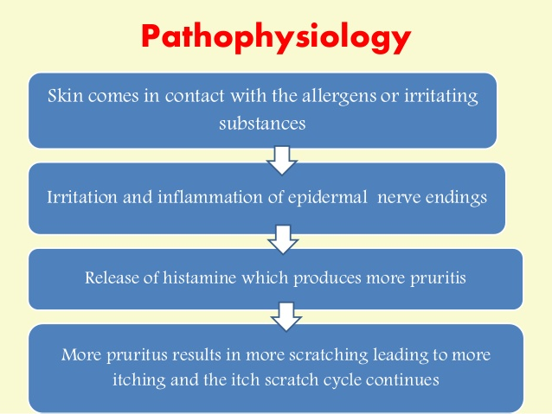
Pathogenesis

Slide 17
Management of pruritus
In peripheral origin, skin scrapings should be examined for ectoparasites & appropriate acarisidal treatment should be extended
Central origin can be controlled by sedative
Application of soothing agents
Use of antihistaminics or corticosteroids
Regulation of diet. Addition of essential fatty acids in the diet

