Slide 1
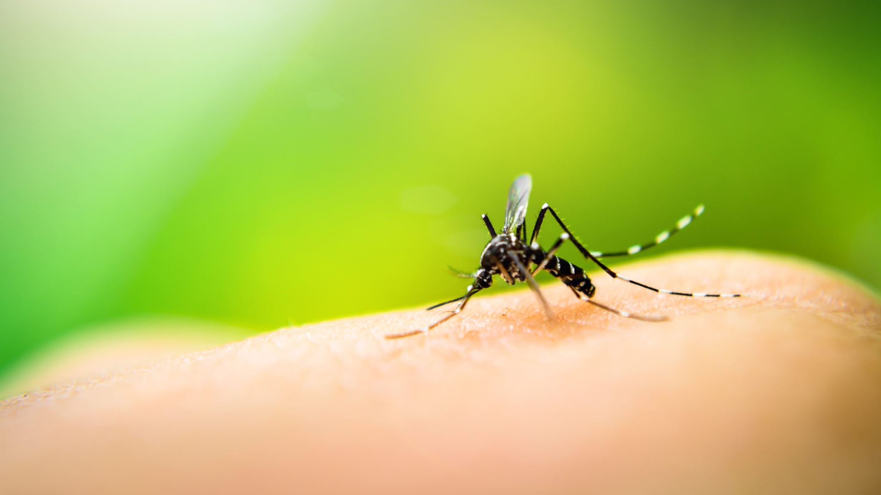
Diseases of skin
VMD-421
By- Dr Sonam Bhatt
Assistant Professor
VMD
Basu patna

Slide 2
Dermatitis
Inflammation of dermis & epidermis including blood vessels & lymphatics
May result due to infectious & non-infectious causes

Slide 3
Non-infectious Causes
Physical- trauma, injury, laceration, sunburn, ingestion of photodynamic plants
Chemical – irritants (acid or alkali), corrosive agents
Allergic – allergens
Nutritional

Slide 4
Infectious Causes
Bacterial- Streptococcus, Staphylococcus; Spherophorus necrophorus (foot rot or pododermatitis )
Viral- pox, contagious ecthyma of sheep & goat; systemic viral diseases (FMD, CD etc)
Protozoan- topical form of Leishmania
Metazoan parasite- cutaneous larva migrans, cutaneous myiasis, humpsore etc
Acarodermatitis- Sarcoptes, Demodex
Fungal

Slide 5
Clinical findings
Varies with the nature of causative agents
In viral infection- signs of viremia & systemic reactions
Bacterial infection- pyoderma
Acaro- dermatitis – seborrhoic condition
Zinc deficiency – parakeratosis
Vitamin A deficiency – hyperkeratosis
Allergic dermatoses- itching & edema

Slide 6
Diagnosis
History of diet & environment
Clinical signs (cutaneous manifestations )
Examination of skin scrapings for parasites
Examination of skin swab for bacterial isolates
Cutaneous biopsy
Examination of blood for leucocyte & eosinophil count. Leucocytosis indicates bacterial infection; leucopenia – viral infection; eosinophilia – allergic reaction

Slide 7
Line of Treatment
Primary cause should be ruled out & appropriate measures should be adopted to eliminate them
Bacterial dermatitis- local & systemic antibiotic therapy
Allergic dermatitis – antihistaminics
Mycotic dermatitis – antifungal
Corticosteroids
Supportive therapy

Slide 8
Acarodermatitis
Caused by acari and mites
Scabies: caused by Sarcoptes scabie in all domestic animals
Mode of infection – direct close contact, spread of disease may occur from one species to other species of animals
Predisposing factors – malnutrition & debility; secondary skin lesions; internal worm burden

Slide 9
Clinical signs – lesions are distributed in head, neck & forelimb
Lesions shows intense itching ; excoriation & oozing of serum & blood…. Invaded by super-imposed bacteria leading to a condition known as pyoderma
Lesions may be covered with scales & crusts
Skin become thickened & form folds
In chronic case –animal become emaciated

Slide 10
Diagnosis – history & clinical signs
Examination of skin scraping
Line of treatment – Ivermectin @ 200-400 microgram/kg BW, SC
Broad spectrum antibiotic – severe cases
Supportive therapy

Slide 11
Demodectic Mange (Red mange)
Mite live in the hair follicle & sebaceous gland
Etiology – Demodex canis ; D. bovis; D.cati etc
Predisposing factors – young age group; short haired breeds of dog; malnutrition ; certain systemic disease (distemper) ; endoparasitic burden etc
Clinical signs – localised or generalised in dog
4 forms – squamous form; squamo-papular form ; pustular ; atypical form

Slide 12
Clinical pathology – skin scrapings & pus shold be examined & digested with KOH. Minimum 3-5 different sites should be selected for examination
Diagnosis – clinico-pathological examination
Line of treatment –
Clipping of hairs
Debridement & cleaning of crusts, scale & debris
Antiseptic solution should be applied ( Povidone iodine; benzyl peroxide)
Application of acaricides – Amitraz @ 5-6ml/litre is used
Corticosteroids should never be used

Slide 13
Photosensitization (slough sickness; grass poisoning)
Condition where an animal show marked sensitivity to sunlight following ingestion of photodynamic substances
Commonly observed in cattle but may occur in sheep, goat & horses
Photosensitive chemicals are usually ingested but in some cases exposure may be by contact
Three types of photosensitization occur: primary, secondary or hepatogenous, and aberrant

Slide 14
Primary photosensitization - plant pigments or drugs such as phenothiazine, sulfonamides, or tetracyclines
Secondary photosensitization- more common in large animals
Specifically related to the plant pigment phylloerythrin
Phylloerythrin, a porphyrin compound, is a degradation product of chlorophyll released by rumen microbial digestion. Liver disease or injury, which prevents normal conjugation of phylloerythrin and excretion through the biliary system, predisposes to photosensitization
The only example of aberrant photosensitization is congenital porphyria of cattle

Slide 15
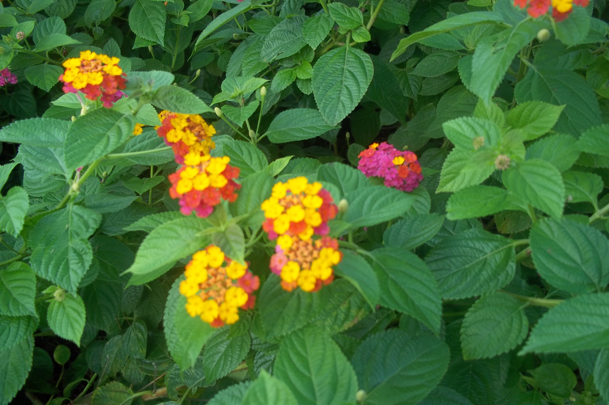
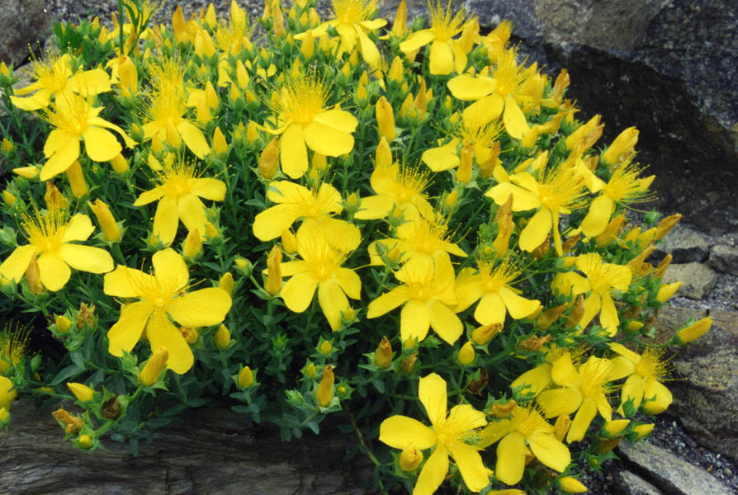
Photo sensitizing plants:
Primary photosensitizers- Ammi majus; Brassica; Hypericum; Ricinus; Trifolium
Secondary photosensitizers( hepatic effect)- Lantana camara; Senecio

Slide 16
Pathogenesis –
Photosensitive chemical is deposited in the skin and is activated by absorbed sunlight
Activated pigments convert local amino acids and proteins to vasoactive substances
Increase the permeability of capillaries leading to fluid and plasma protein losses and eventually local tissue necrosis

Slide 17
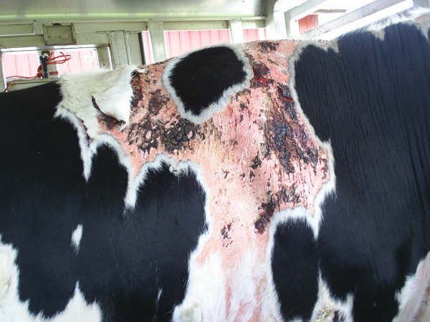
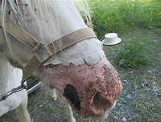
Clinical findings –
Photosensitization can occur within hours to days after sun exposure & produces lesions of the face, vulva, & coronary bands
Lesions are most likely to occur on white-haired or thinly haired areas. Initially, edema of the lips, corneas, eyelids, nasal planum, face, vulva, or coronary bands occurs
Facial edema, nostril constriction, & swollen lips potentially lead to difficulty breathing
With secondary photosensitization, icterus is also common. Necrosis & gangrene may occur

Slide 18
Diagnosis-
History & clinical findings with liver function test
Plasma phylloerythrin level above 10mg/dl is suggestive of retention

Slide 19
Line of treatment-
Change of diet & housing are necessary to check the disease
Avoid exposure to sun rays
Avoid further exposure to chemical /plants
Local treatment with astringent lotions may be done
Predisolone @ 1mg/kg orally or parenterally for 10days along with topical application
Course of antihistaminic are to be given for 3-5days
Course of liver extract parenterally with fluid therapy
Antibiotics
NSAID

