Slide 1
Bovine Ephemeral Fever
VMD-422
By – Dr. Sonam Bhatt
Assistant Professor
VMD
BASU PATNA

Slide 2
Synonyms
Bovine Epizootic Fever
Three-Day Sickness
Three Day Fever
Three-Day Stiff sickness
Dragon Boat Disease

Slide 3
Introduction
Economically important arboviral disease
Affects cattle and water buffalo
Widespread in tropical and semitropical areas of the Eastern Hemisphere

Slide 4
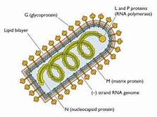
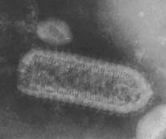
Etiology
Arthropod-borne rhabdovirus ------type species of the genus Ephemerovirus

Slide 5
Epidemiology
Occurrence: Enzootic in the tropical areas of Africa, in most of Asia, the Middle East, the East Indies, & in much of Australia, with extensions into the subtropics & some temperate regions
Source of Infection: Affected animal & biological vectors (hematophagous biting insects)
Method of Transmission: Transmitted by arthropods; genera of mosquitoes, & from a number of Culicoides species (biting midges); Windborne transmission

Slide 6
Environment Risk Factors
Summer months
outbreaks are clustered & relatively short lived
Animal Risk Factors
Only cattle are known to be naturally affected
All age groups of cattle are susceptible
Calves less than 3 to 6 months old are not affected by the natural disease

Slide 7
Pathogenesis
Virus multiplication probably occurs primarily within the vascular system
Virus alters cellular biology in cattle to enhance virus entry and replication
After an incubation period of 2 to 10 days, there is a biphasic fever with peaks 12 to 24 hours apart
Fever lasts 2 days, and increased respiratory rate, dyspnea, muscle trembling, limb stiffness, & pain are characteristic at this time

Slide 8
There is generalized inflammation with vasculitis and thrombosis, serofibrinous inflammation in serous & synovial cavities, and increased endothelial permeability at the same sites
Virus can be detected in circulating neutrophils and plasma, the serosal & synovial fluids
Mesothelial cells of synovial membrane & epicardium, & in neutrophils in the fluids
Clinical signs are thought caused by the expression of mediators of inflammation coupled with a secondary hypocalcemia

Slide 9
Clinical signs
Calves are least affected, with those less than 3 to 6 months of age showing no clinical signs
Overweight cows, high-producing cows, & bulls are affected the most
In most cases, the disease is acute. After an incubation period of 2 to 4 days, sometimes as long as 10 days, there is a sudden onset of fever (40.5°–41° C [105°–106° F]), which may be biphasic or have morning remissions
Anorexia and a sharp fall in milk yield occur

Slide 10
.There is severe constipation in some animals & diarrhea in others
Respiratory & cardiac rates are increased, and stringy nasal & watery ocular discharges are evident
Animals shake their heads constantly, and muscle shivering & weakness are observed
Muscular signs become more evident on the second day, with severe stiffness, clonic muscle movements, and weakness in one or more limbs

Slide 11
A posture similar to that of acute laminitis, with all four feet bunched under the body, is often adopted
On about the third day, the animal begins eating and ruminating, and the febrile reaction disappears, but lameness and weakness may persist for 2 to 3 more days
A common name of “3-day sickness” is applied because animals typically progress through onset of disease to severe illness & recovery within 3 days

Slide 12
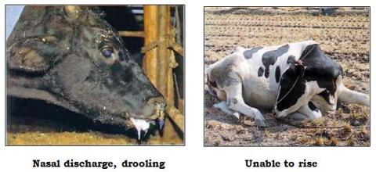
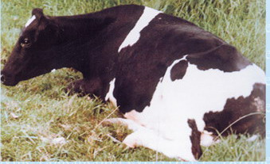
Some animals remain standing during the acute stages, but the majority go down and assume a position reminiscent of parturient paresis, associated with hypocalcemia, with the hindlegs sticking out and the head turned into the flank.

Slide 13
Clinical pathology
Marked leukocytosis with a relative increase in neutrophils occurs during the acute stage of the disease
Plasma fibrinogen levels are elevated for about 7 days, and there is a marked increase in creatine kinase activity
Hypocalcemia
Available serologic tests include a complement fixation test, serum neutralization, fluorescent antibody test, agar gel immunodiffusion (AGID) test, & a blocking ELISA, which is reported to be simple & the preferred test

Slide 14
Available serologic tests include
a complement fixation test, serum neutralization,
fluorescent antibody test, agar gel
immunodiffusion (AGID) test, and a blocking
ELISA, which is reported to be simple
and the preferred test

Slide 15
Necropsy findings
Serofibrinous polyserositis
Pulmonary emphysema & fibrinous bronchiolitis are standard findings, & subcutaneous emphysema along the dorsum may be observed
Characteristic microscopic findings consist of a mild vasculitis of small vessels, with perivascular neutrophils & edema fluid plus intravascular fibrin thrombi

Slide 16
Differential diagnosis
Botulism
Parturient paresis
Pneumonia
Traumatic reticulitis

Slide 17
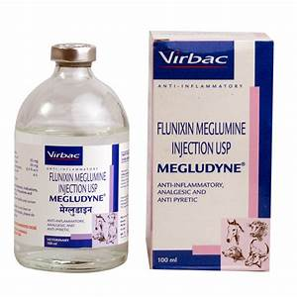
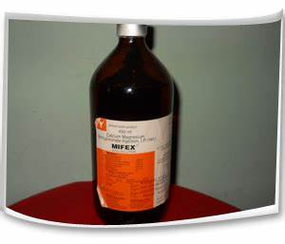
Treatment
Palliative treatment with nonsteroidal antiinflammatory drugs such as IV or IM flunixin meglumine (2.2 mg/kg/d), or IM ketoprofen (3 mg/kg/d)
Parenteral treatment with calcium borogluconate should be given to cows that show signs of hypocalcemia

Slide 18
Control
Restriction of movement from infected areas is practiced, but vaccination is the only effective method of control
Vaccines prepared from attenuated tissue culture virus or in mouse brain and adjuvanted in Freund’s incomplete or Quil A adjuvants are commercially available in Australia, Japan, Taiwan, and South Africa
Two vaccinations are required and are effective in preventing disease in natural outbreaks for periods up to 12 months

