Slide 1
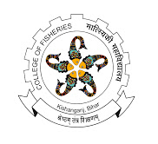
History and development of fishing gears
Subject: Fishing Gear Technology
Date of Lecture: 14.07.2020
By
Dr. Abhishek Thakur
(Assistant Professor)
College of Fisheries, Kishanganj
BASU, Patna

Slide 2
History and development of fishing gears
Fishing is the art of catching fish and other aquatic animals.
In olden days fishing was not having much importance as there was no demand for fish.
Earlier fishing was restricted to a particular community but it is not so now.
In order to meet the increased demand, fishing is now carried out industrially.

Slide 3
History and development of fishing gears
Fishing technology not only concerns fishing gear, fishing methods and vessels but also concern Biological and Environmental factors.
Fishing technology has developed continuously by utilizing improved and larger fishing vessels, more sophisticated fishing equipment and preservation techniques.

Slide 4
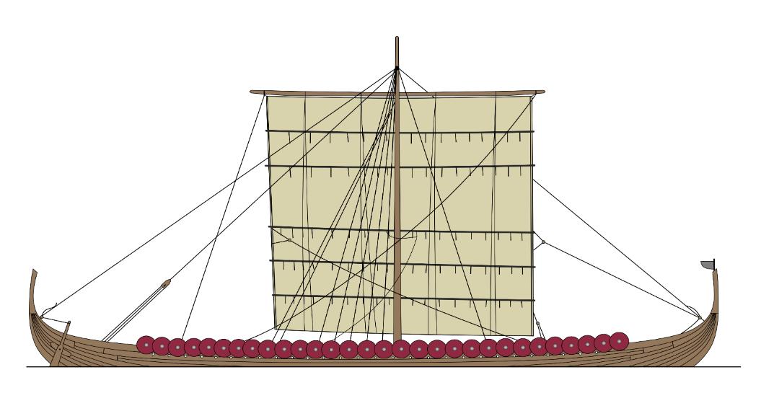
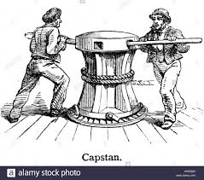
History and development of fishing gears
Mechanization started in the fishing industry during the second half of the nineteenth century with the use of steam driven capstans.
Steam power was successfully used in towing a trawl for the first time in 1877.
Steam gradually replaced manual and sail propulsion. This was later superseded by the internal combustion engines.

Slide 5
History and development of fishing gears
Today, the diesel engine is universally favored for larger vessels and petrol/kerosene driven outboards for small boat operations.
Development of electrical and hydraulic power systems led to complete mechanization of fishing which use larger nets and lines, or more pots and traps.

Slide 6
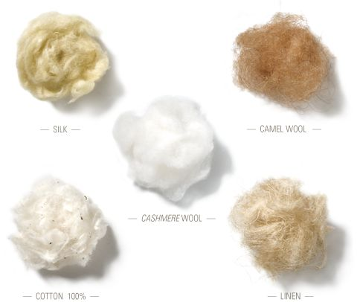
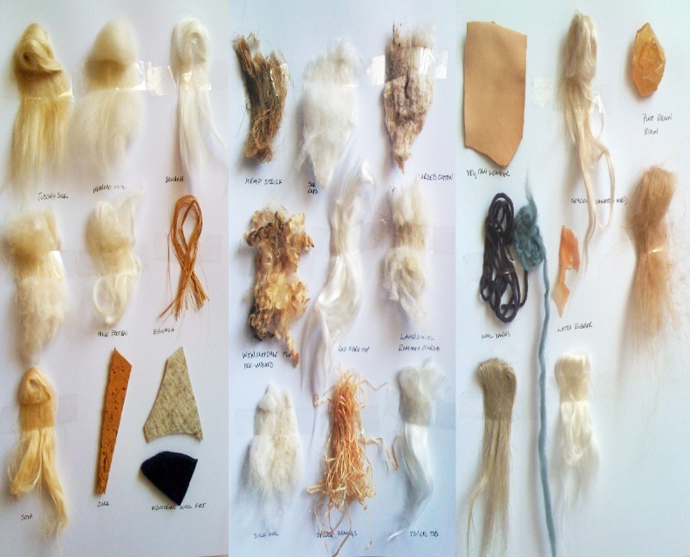
History and development of fishing gears
During the last 50 years, synthetic fibers, which are virtually rot-proof, gradually replaced natural materials in the fabrication of nets and lines.
These materials have greatly extended the useful life of fishing gear.
Developments in new synthetic materials and fabrication techniques are continuously improving fishing gear effectiveness and efficiency.
During the last 50 years, synthetic fibers, which are virtually rot-proof, gradually replaced natural materials in the fabrication of nets and lines.
These materials have greatly extended the useful life of fishing gear.
Developments in new synthetic materials and fabrication techniques are continuously improving fishing gear effectiveness and efficiency.

Slide 7
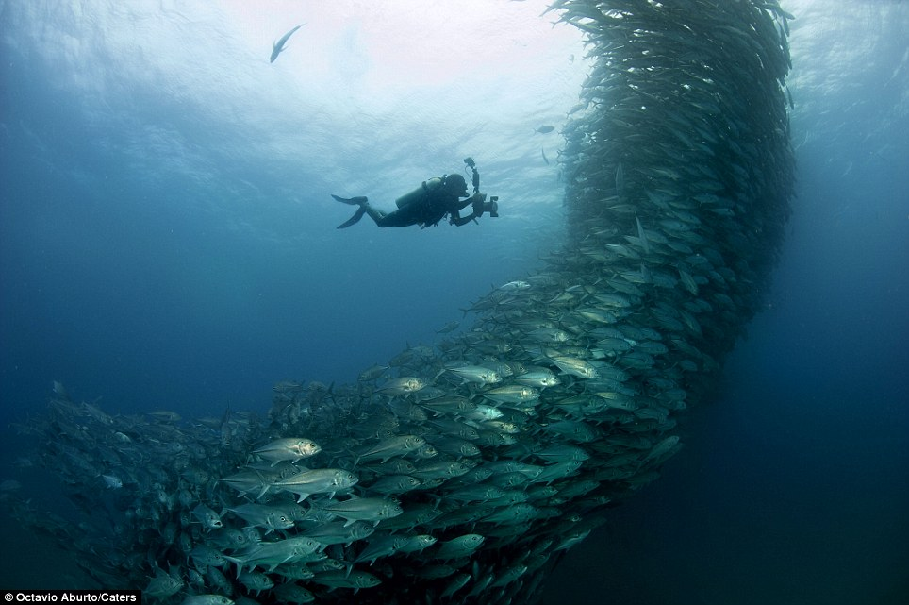
History and development of fishing gears
Traditionally fishermen detect fish through local knowledge, record keeping, observation of schools breaking to surface, and the behavior of birds and other sea creatures.
In deeper waters fishes were detected from the vibration of signal lines dropped from the vessel.

Slide 8
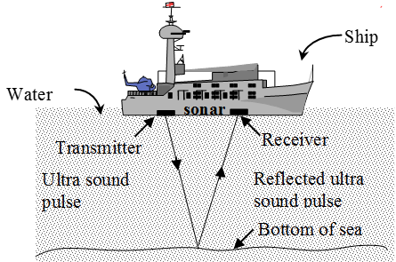
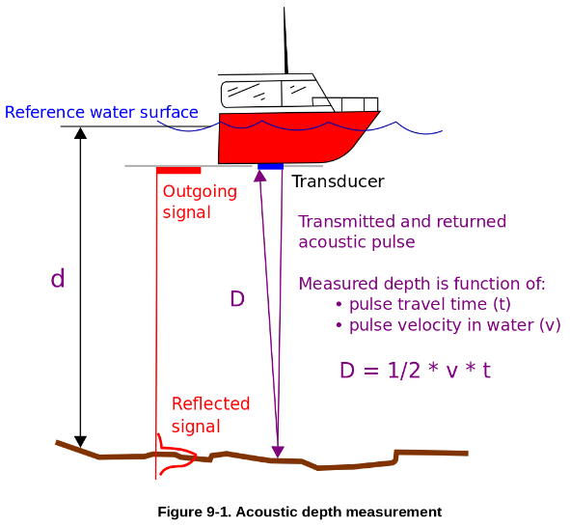
History and development of fishing gears
The introduction of electronic fish finding equipment a half century ago has revolutionized the process of finding fish to catch.
Aircraft enable much greater areas to be searched visually, while satellite and laser technology are being utilized as aids for identifying suitable environmental conditions.
Fish finding sonar and echo sounders rapidly analyse signals from high performance transducers and display detailed information to the fisherman.

Slide 9
Thank You

