Slide 1
Processing of Meat and Meat Products-I
Dr. Gargi Mahapatra
Asst. Prof. cum Jnr. Sc.
Dept. of Livestock Products Technology
Bihar Veterinary College
BASU, Patna

Slide 2
Processing
Any treatment which brings about a substantial physical and chemical changes in the natural state of meat.

Slide 3
Basic Processing Procedures
Comminution
Emulsification
Meat Extension
Pre-blending
Hot Processing
Fermentation
Cooking

Slide 4
Advanced Processing Procedures
Smoking
Curing/ Salting
Canning
Restructuring

Slide 5
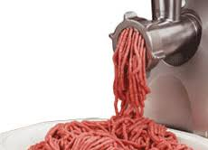
Comminution (size reduction)
Reduction of raw meat into smaller pieces or particles.
Size reduction improves uniformity and promotes uniform distribution of ingredients..
Instrument:
Knives and Meat Mincer

Slide 6
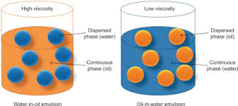
Emulsion (continuous phase + dispersed phase)
A mixture of two immiscible liquids where one liquid is dispersed in another as droplets.
Phases remain immiscible due to the existence of interfacial tension between them.
Stabilized by emulsifying agents which reduce the interfacial tension.
Diameter of dispersed fat droplets in a true emulsion ranges from 1-5 micrometer.

Slide 7
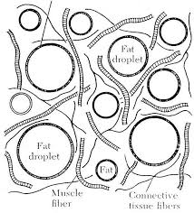
Meat Emulsion
Dispersed Phase solid or liquid fat droplets
+
Continuous Phase
water containing salt and proteins

Slide 8
Meat Emulsion cont.…
Meat emulsion is an oil-in water emulsion.
A multiphase system.
The continuous phase consists of water, salt and proteins hence referred to as matrix, in which fat droplets are dispersed.
Fat droplets are usually >50μm and remain coated with soluble proteins (myofibrillar or sarcoplasmic).
Low temperature maintained during emulsion formation.
Stable meat emulsion: Each fat droplet is coated with a thin layer of soluble protein which has been released into the aqueous medium from the muscle fibres.

Slide 9
Meat Emulsion cont.…
For meat emulsion meat samples having high myofibrillar content and minimal connective tissue are selected.
The process of emulsification is carried in a bowl chopper.
The entire process is carried out at low temperatures ranging from 3-13 °C, this achieved by addition of chilled water or ice-flakes.
Salt is added @ 4-4.5% of the lean meat and the chopping is initiated by keeping the temperature below 3 °C.
Excessive physical handling and long holding of the emulsion should be avoided.

Slide 10
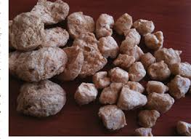
Meat Extension
Process of adding extenders to a meat product.
Meat extenders are non-meat substances with substantial protein content.
They increase bulk as well modify the nutritional quality of the end product.
Increases the Fe and Vit. B content of the product.
Reduces the price of the final product, making it affordable to larger masses.

Slide 11
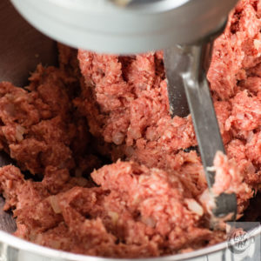
Preblending
Mixing of ingredients with ground meat in fixed proportions. This process allows better extraction of proteins which in turn stabilizes the emulsion. It also helps in achieving the desired fat content of the final product.

Slide 12
Hot-Processing & Hot-Boning
Earlier hot processing have been defined as processing of meat prior to the onset of rigor mortis. However, the term “hot processing” is defined as the processing of meat prior to chilling . Whereas removal of bones from fresh meat is known as hot-boning.

Slide 13
Hot-Processing
Advantages
Problems Associated
Reduced cooler space.
Reduced labor requirements, energy consumption and in-plant holding time.
Superior binding qualities
Reduced shrinkage.
Increased rendering efficiency.
Unavailability of inadequate chilling systems.
Inadequate tenderness of the end product.
Cut distortion, can be over-come by electric stimulation.
Unavailability of adequate packaging systems

Slide 14
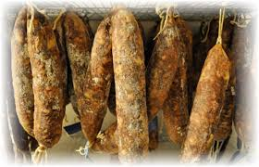
Fermentation Eg. Sucuk, Hungarian salami and Chorizo
A method of preparing and preserving meat. The bacteria, Lactobacillus, Staphylococcus and Micrococcus, play the most important role in this well known microbial process. Additionally, certain types of yeasts and molds are also used in production of some special fermented meat products. The process leads to development of organic acids(eg. lactic acid)

Slide 15
Fermentation Advantages
Improved organoleptic properties viz. appearance, color, flavor, aroma, taste texture and juiciness.
Enhanced nutritive value and digestibility.
Maintains keeping quality of the meat product by inhibiting the growth of food pathogens and spoilage organism by producing bacteriocins.

Slide 16
Cooking
Dry Heat Moist Heat Microwave Cooking

Slide 17
Dry Heat Cooking
Implied for tender cuts and comminuted meats.
Types: Broiling; Roasting and Frying.
Broiling: Meat held on a wire grill, is exposed to heat from above . Meat turned around for uniform cooking.
Roasting: Roast pieces at least 8 cm thick, placed fat side up and placed in a hot air oven at 115-150 °C. Imparts brown color to the end product and enhances flavor of the product.
Frying: Heating in pan with deep or shallow fat, suitable for thin cuts.

Slide 18
Moist Heat Cooking
Implied for relatively tough cuts of meat.
Types: Pressure Cooking; Stewing; Simmering and Braising.
Pressure Cooking: Meat cooked under high pressure and temperature. Facilitates the tenderization of tough cuts.
Stewing: Meat pieces are first browned in small amount of fat and then covered with water/curry stuff and simmered, while covering the container. Final product becomes tender with the curry

Slide 19
Moist Heat Cooking cont….
Simmering: Cooking in hot water at 70°C for considerable amounts of time.
Braising: It utilizes both dry heat as well as moist heat. The meat cuts are first fried and then put in a covered container along with water and seasoning, then cooked at 80-90°C.

Slide 20
Microwave Cooking
Relatively recent development.
Microwaves: High frequency, non-ionizing electromagnetic waves which are reflected by metals.
Microwaves penetrate the food from all directions up to a depth of 2-4 cm causing water, fat and sugar molecules to vibrate at very high speeds. Vibration of molecules causes friction which in turn produce heat.
Causes volume heating i.e. the heat in food spreads through three dimensional space.
No browning achieved and for uniform food needs to be turned frequently.

