Slide 1
Neuromuscular System Muscles

Slide 3
Types of muscle tissue:
There are 3 types of muscle tissue found in an animal body
However, they are the Biological motors that convert chemical energy into mechanical & translate the signals from the CNS into movements.
Smooth muscle (involuntary or striated) –
These muscle cells have no visible striations with a microscope & found in systems of the body that are automatic in their function
Thus, smooth muscles are major components of the digestive & uro-genital systems as well as of most blood vessels & respiratory system
Contraction of smooth muscle-
It is an intrinsic property of the fibres themselves
The contraction does not generally require stimulation by a nerve
The contractile activity is regulated by ANS which may be influenced by certain drugs

Slide 5
Structure of smooth muscle:
These are made up of narrow (<10µm) elongated (up to 500 µm) cells, tapering towards their ends
Each cell has a single centrally placed nucleus
These cells are arranged in bundles in the same direction
Although the cells are distinct to each other in that there is no protoplasmic continuity between them
Membrane of the adjacent cells are fused together into are k/a tight junction
These muscle cells contain actin & myosin filaments
However myosin is not arranged in thick filaments although the basic mechanism of contraction in smooth muscle will be found to be similar to that of skeletal muscle

Slide 6
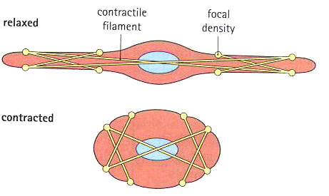

Slide 7
Cardiac muscle (in-voluantry and striated)-
These muscles characterized by fibres with visible striations
They contracts intrinsically & is not under voluntary control
These muscles are restricted to heart constituting myocardium & its rhythmic contraction for circulation of blood
They are also found in blood & lymphatic vessels in plenty
Skeletal muscle (voluntary and striated)-
The visible striated muscles tissue are grouped into distinct organs of variable size called muscles
They are attached to the bones of skeleton under voluntary control
The interior of the fibre is packed with elongated protein strands (myofibrils) & filling the clefts & spaces between these strands
It is an extensive network of smooth endoplasmic reticulum & associated tubular invaginations of surface plasma membrane (transverse or T-tubules)

Slide 8
A golgi apparatus & large no. of mitochondria as well as glycogen & fat inclusions are also found in muscle fibers
It has multinucleated cell made up of numerous muscle fibres ranging between 10 & 100 microns in diameter
Structures of skeletal muscle-
Muscle fibres are arranged in bundles surrounded by the fibrous CT
The CT between individual muscle fibres are called as endomysium
The sheath surrounding bundles of muscle fibres are called perimysium
CT around an entire muscle is k/a epimysium
Each muscle fibre contains several hundred myofibrils consists about 1500 myosin filaments & two times more actin filaments
These are polymerized protein molecules responsible for muscle contraction
Whereas thick filaments are myosin and thin filaments are actin filaments

Slide 9
These filaments interdigitate and thus the myofibril have alternate light & dark bends
The light bands contain only actin filaments called I bands and are isotropic to polarized light
The dark bands contain the myosin filaments as well as the end of actin filaments where they overlap the myosin are called A bands because they are anisotropic to polarized light
The combination of an A & I band is called a sarcomere
The actin filaments are attached to each other & so called Z line or Z membrane
It passes from one myofibril to another thus attaching them to each other and causing the respective sarcomeres

Slide 10
Contracted & relaxed sarcomere of skeletal muscle:

Slide 11
Structure of cardiac muscle:
It consists largely of sarcoplasm, myofibrils, a sarcoplasmic reticulum, transverse tubules, nuclei & a sarcolemma
The most striking difference is the tendency for CM fibers to join forming a network
Unique structures found in CM are inter-calated disk
These disks are interposed between segments of muscle & may cross the fiber in an irregular manner containing only one nucleus
These disks represent apposed cell membranes where gap junction occur (nexi)
Gap junctions are laterally oriented cell interfaces where two CM cells are within 10 nm of each other & permit electrical transmission from one to next
Action potentials can readily spread from cell to cell causing the atria & the ventricles to each act electrically & mechanically as a functional syncytium as if it were as single cell mass

Slide 12
Mechanism & process of Relaxation, Contraction & Excitation of muscles:
Smooth muscle-
It exhibits a special property called plasticity also referred to as stress relaxation
SM has the ability to adjust to being stretched without ↑^{ing} the final tension (pain) or the pressure exerted on the contents within a hollow viscous surrounded by SM even though it is still elongated
Plasticity allows expansion of stretch within physiologic limits without an ↑ in pressure & pain
The SM doesn’t lose its contractile ability & is believed due to changes in the arrangement of the myosin & actin molecules upon stretching or shortening
These are believed to be surrounded always by CT even though it may be only as small amount of reticular tissue (collagenous + elastic fibres) which makes the major part of the CT associated with SM

Slide 13
SM cells in the walls of hollow organs are arranged so that only a fraction of the cells is supplied by autonomic nerves
These can bring about contraction, but nerve stimulation is not required, since it has various pacemaker cell points for its own depolarization and contraction resulting from stimuli such as distention, chemical or hormonal influences or myogenic self excitation without any extrinsic stimulus
The contraction impulse (action potential) spreads across the tissue because of syncytial connections between the fibres
Thus SM cells can be linked electrically while remaining independent chemically
This direct transmission is called ephaptic conduction & current flows across readily & the membrane resistance is low
Hence SM contraction can be initiated by stretch, neural, hormones, chemical and mechanical stimuli

Slide 14
SM cells respond to nor-epinephrine released by sympathetic nerves and to acetylcholine released by parasympathetic nerves, the one being antagonistic to the other
Few SM consists of distinctly separated fibres that require nerve stimulation to contract called multiunit sm & includes pilomotor sm cells in the skin (iris & ciliary body of the eye)
Myogenic or self excitation is apparently the result of Na & Ca both leaking into the fiber, causes the resting potential to decay down toward threshold as a action potential is about -35mV while the resting potential is only -55 to -50 mV
However, the Na & Ca are pumped back out before threshold is reached, so the membrane resting potential is restored
This cycle is repeated continuously in a sinusoidal pattern (constantly oscillation forming pacemaker)

Slide 15
Ca²⁺ diffuses through the cytoplasm in 200 to 300 msecs & is an latent period (slower response) between the initial excitation & the beginning of contraction
Ca is responsible for delaying the sequence because of slow process being consumes only 25% of O₂ as compare to skeletal muscle
When action potentials depolarize the threshold, the transmitter substance is released & diffuses to the SM cell membranes where stimulation occurs
This innervation is usually conducted dual i.e., in both divisions of the ANS
In skin, the pilomotor fibres, sweat glands & cutaneous vessels receive only sympathetic innervation
Ach is released from the parasympathetic nerve fibers & nor-epinephrine from the sympathetic fibers. For eg. Ach enhances intestinal peristalsis, whereas NE inhibits peristalsis

Slide 16
Cardiac muscle-
CM does not require nerve stimulation. It has its own intrinsic or inherent ability to generate action potentials rhythmically
This is done by normal pacemaker, the SA node which depolarizes faster than any other part of the heart muscle
Although it is innervated by the sympathetic & parasympathetic nervous systems
But its function is limited to altering or regulating the heart rate which is set normally by pacemaker
The CM action potential is 150 msec in the atria & 300 msec in ventricles
Contraction time lasts as long is the action potential does
This extended period provides time for pumping the blood out of the ventricles & filling them again before the next beat
Hypertrophy (↑in cell size) occurs in CM when the heart has excessive work to do

Slide 17
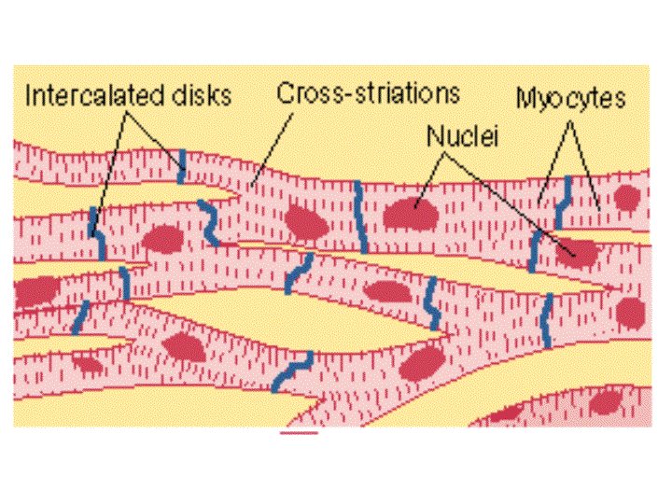
Also in man this condition is sometimes called athletes heart
Brisket disease (high mountain disease of cattle involves enlargement of the heart as well as edema of the brisket & involvement of the lungs)

Slide 18
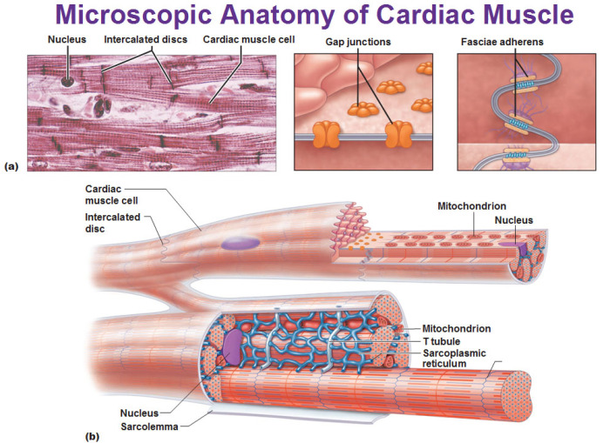

Slide 19
Skeletal muscles-
When an action potential generates along the muscle fibre (sarcolemma), the fibre begins to contract after an initial latent period of about 3 msec
The action potential is initiated by the firing of a motor neuron whose axon branch terminates at neuromuscular junction (t tubules) near the mid point of muscle fibre
T tubules causes current to flow in the longitudinal tubules
To complete the electrical circuit, the current then transverse the walls of the longitudinal tubules into the sarcoplasm & hence, back outward through cell membrane
A local circuit of ionic current flow occurs throughout the entire muscle fibre with each action potential
An electrical potential applied directly to the opening of a t tubule at the surface of a muscle fibre will cause contraction of that half of sarcomere supplied by the tubule

Slide 20
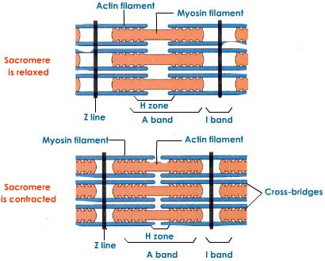

Slide 21
Therefore, the spread of electrical current inward through t tubules when an action potential passes has direct electrical effect on the interior of the muscle fibre to cause attraction between the actin & myosin filaments
Myosin & Actin filaments-
Each thick filament in a sarcomere is a bundle of about 200 myosin molecules having 2 parts
Light meromyosin (LMM)- It lies parallel to other LMM molecules making up the length of the thick filament
Heavy meromyosin (HMM)- It projects outward like an arm from the end of the LMM filaments
Arm projecting- it is flexible like a hinge, where it joins the LMM & also to the head
Head attached to the free end of the arm
These hinged HMM particles called cross-bridges, protrude from all around the thick filaments

Slide 22
They away from the centre in both directions, so there are no cross-bridges in the centre of the thick filament
Each thin filament is made up of 3 components; actin, tropomyosin & troponin
The base unit is the F-actin molecule consists 2 long strands around each other in spiral
Each strand is made up of hundreds of G-actin molecules
Lying in the grooves of 2 F-actin spiral chains are tropomyosin molecules attached together to form large strands
The 3rd protein, troponin is attached to each other tropomyosin molecule & together are called troponin-tropomyosin complex
The presence of ca²⁺ also causes the myosin molecules to develop an ATPase capability i.e., myosin has the capability of splitting ATP & liberating energy from this molecule

Slide 23
RATCHET theory for muscle contraction-
In resting state the -ve charges of the ATP bound with the cross bridges of the myosin filaments & the -ve charges of actin filament causes these two to remain in the uncombined state with no attractive forces both them
On the appearance of Ca⁺⁺ the following amounts occur:
The Ca⁺⁺ bind with -ve reactive sites of the ATP on the myosin cross bridges & at the same time with the -ve reactive sites on the actin filaments pulling these filament together
It is assured that the cross bridges having strong electronegativity in the resting state because of the presence of ATP normally project straight outward from the mysoin filaments because the shank of the filament is also -vely charged

Slide 24
When Ca⁺⁺ bind with the ATP on the cross bridges, the negativity of the cross bridge become neutralized. Therefore, the bridges now bend inward toward the axis of the myosin filament. This also pulls the axis of the myosin filament, thus shortening of the muscle
When the cross bridges fold in against the shank of the myosin filament causes the ATP to split immediately to ADP. This breaks the Ca linked connections between the myosin cross bridges & actin, but in mean time the actin filament has been pulled along the axis of the myosin filament
Subsequent similar reactions occurs at other cross bridges and the actin filament is pulled another step
Energy from other sources such as creatinin phosphate causes almost immediate reconstitution of the ADP to ATP. Therefore, the cross bridges that has folded inward now bend outward again & bind with other Ca⁺⁺ to pull the actin filament another step

Slide 25
Relaxation:
Muscle contraction will continue as long as there is an excess of Ca⁺⁺ ions present in the sarcoplasm, but when the effect of the current spread at the triads ends
The Ca⁺⁺ is then sequestered back into the longitudinal tubules
Ion pumps in the membrane of the sarcoplasmic reticulum use the energy of ATP to pump the Ca⁺⁺ from the sarcoplasmic fluid back into the tubules, ready for the next depolarization
Only a small amount of Ca⁺⁺ is left out in the sarcoplasm of the relaxed muscle not enough to act on the troponin tropomyosin complex
Therefore, during relaxation the thin & thick filaments are dissociated, allowing the elasticity of the muscle to return into its resting length, which pulls the Z line & thin filaments back to their original positions

Slide 26
Summary of Excitation and contraction:
Nerve impulse arrives at neuromuscular junction; ACh released from synaptic vesicles & diffuses across synaptic cleft to bind to receptors on muscle cell membrane
Binding of ACh leads to initiation of membrane action potential which spreads over entire muscle cell surface membrane & via T- tubules into the interior of cell
Action potential in T- tubules membrane inhibit the Ca⁺⁺ pump of the adjacent terminal cisterns of sarcoplasmic reticulum; Ca⁺⁺ rushes out of the terminal cisterns into the sarcoplasm
Ca⁺⁺ binds to the troponin component of the troponin tropomyosin complex, moving the complex away from its position blocking the binding sites on the actin chains
Myosin head (HMM) with attached ATP molecules bind to the new exposed actin chains
The ATP molecules are hydrolyzed to yield energy which derives the change in the angle of myosin heads & pulls the attached actin chain towards the middle of the sarcomere

Slide 27
New ATP molecules bind the vacant ATPase sites on the myosin heads; the myosin heads detach from the actin chains & return to their original angle & are attached to new binding sites on the still exposed actin chains. (This process repeats as long as Ca⁺⁺ is bound to the troponin tropomyosin complex
The Ca⁺⁺ pumps of the sarcoplasmic reticulum recover from the period of inhibition by the muscle cell membrane action potential; Ca⁺⁺ removed from the troponin molecules & pumped back into the sarcoplasmic reticulum
The troponin tropomyosin complex resumes its blocking positions on the actin chain; further binding of myosin heads to actin chains is presented & the muscle cell relaxes
Effect of Temperature:
Whenever environment temperature is much below the normal body temperature, heat production by muscles is a definite advantage
When air temperature is extremely low, muscles may undergo spasmodic contractions called shivering to produce enough heat to maintain normal body temperature.

Slide 28
Stimulus for muscle contraction:
Due to an ↑ed permeability of membrane, an electrical action potential is produced by change in the balance of ions on the inside & outside of the nerve fiber
However, it does not travel beyond the nerve endings
Instead the depolarization of the nerve ending releases a chemical neurotransmitter ACh from synaptic vesicles at the neuromuscular junction
The released ACh crosses the cleft between the nerve ending & the muscle fibre membrane to initiate a depolarization wave
This excitation wave reaches the sarcotubular system & initiates the contraction by subsequent release of Ca⁺⁺
The depolarization wave initiated by ACh is due to ↑ed permeability of the muscle fibre membrane to Na⁺ & the wave reaches the individual myofibrils by the way of triads, which are where the longitudinal sarcoplasmic reticulum lies in juxtaposition with the T tubules that pass all the way though a muscle fiber at the junction of the A & I bands

Slide 29
The T- tubules may pass through the Z line in some species
The sarcoplasmic reticulum is the longitudinal tubular network within the fiber contains Ca⁺⁺ stores which are released when the membrane depolarization is spread throughout the fiber preceding contraction of the whole muscle fiber
Ach initiates the impulse for muscle contraction & are inactivated by an enzyme called actelycholinesterase
Acetylcholinesterase in turn is irreversibly inhibited by certain alkyl-phosphates (insectisides) such as malathion, parathion, diazinon, thymen etc
When use any of the organic phosphates is improperly tends to extremely dangerous
Some of the symptoms like constriction of the pupil of the eye, Cramps, vomiting, diarrhea & weakness
The organophosphates are anti-cholinesterases and they inhibit the action of muscular spasm & asphyxiation
Neastigmine & physotigmins are commonly used as anti-cholinesterase drugs

Slide 30
Another group of drugs that affects the neuromuscular junction are the curariform drugs
These drugs act like curare which is the deadly poison that South Americans Indianas use on their arrowheads
It binds to the post-junctional membrane so that Ach cannot act on it to produce an end plate potential (EPP)
Also curare is not destroy by acetylcholinesterase (AchE); muscle contraction cannot be produced because of action potential is not elicited
Death can result from asphyxiation because the muscles needed for breathing are unable to contract
Gallamine will do this in varying degree depending on the concentration
Another group of drugs block the release of ACh from the nerve terminal is botulins toxin causes food poisoning as deadly
Flaccid paralysis results because Ach is blocked & no action potentials can be produced for muscle contraction. This condition gives rise to the term “limber neck” for poisoning with botulinus toxin

Slide 31
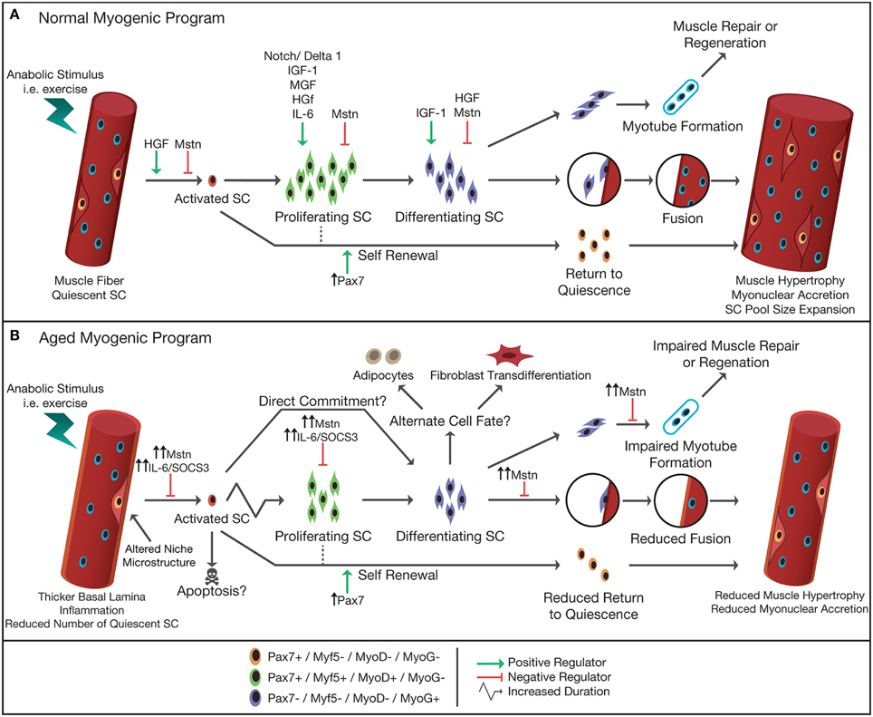

Slide 32
Isometric versus Isotonic Contraction:
Contraction is said to be isometric when muscle does not shortens during contraction & isotonic when it shortens but the tension on the muscle remains constant
Difference both isometric & isotonic contraction:
Isometric contraction does not require slidling of myofibrils among each other
Isotonic contraction, a load is moved which involves the phenomenon of inertia. Therefore, an isotonic contraction is likely to last considerably longer than an isometric contraction of the same muscle
Muscles can contract both isometric & isotonic, but most contract are actually a mixed of the two
When a person stand, he tenses his quadriceps to tighten the knee joints & to keep the legs stiff- Isometric condition
When a person lifts a weight using his biceps- Isotonic condition

Slide 33
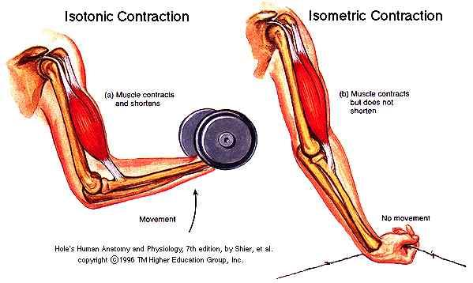

Slide 34
Contractions of leg muscles during running are a mixture of both to keep the limb stiff when the legs hit the ground & isotonic mainly to move the limb
All or None law: It states that when a muscle fibre is contract, the whole fibre contracts & it will contract to the maximum of its ability under the particular condition or it will not contract at all
A stimulus to a muscle fibre either causes an action potential to travel ones the entire fibre causing contraction or it fails to stimulate the muscle fibre at all
It applies to a single muscle fibre or motor unit
It doesn`t state that a muscle fibre will always contract to its maximum
However has a direct relationship to the strength of the contraction because the larger the stimulus the more motor units are caused to contract

Slide 35
Muscle twitch- It is a single brief response of a single motor unit & so twitch is the smallest quantum of contraction possible. It has 3 phases
A latent period- between the application of the stimulus & the beginning of the muscle
A period of contraction- during which the muscles shortens
A period of relaxation
Physiological properties of muscles: The primary function of muscle is to contract; develop tension & shortens (relaxation)
Concentric contraction- It is the usual form of contraction in which the muscle moves a bone or segment by shortening. Flexion of elbow by contraction of the biceps brachii

Slide 36
Isometric contraction- It occurs naturally whenever a limb or portion of the body is held stationary against equal resistance as gravity. To hold the head up in a fixed position, the dorsal neck muscle must contract isometric
Eccentric contraction- It occurs in the extensor muscles of the neck when an animal lowers its head gradually. Antagonistic muscles may also unsuccessfully opposing the actions of a prime mover
Isotonic contraction- It refers to a contraction in which the length of the muscle changes but the tension remains the same. This occurs primarily when a muscle lifts a given weight
Factors affecting contraction:
Summation-
Multiple motor unit (recruitment):- It occurs when more motor units are stimulated to contract simultaneously in

Slide 37
the gross muscle. Therefore, more muscle fibres & bundles are contracting & producing greater strength in the whole muscle
Wave summation- It occurs when the frequency of stimulation is ↑^{ed} to a motor unit. i.e., the frequency of stimulation is such that the 1st contraction is not over by the time, the 2nd contraction begins
Tetany- When the frequency of stimulation becomes so rapid that no further ↑ in frequency will ↑ the tension of contraction. Then the greatest force that muscle can develop will have been reached. It is caused by Clostridium tetani which produces spasm of the massester muscles
Fatigue- It is a ↓ in work capacity caused by work itself. The length of the muscle tension/contraction can be maintained depends on the ability to supply energy in the form of ATP & Ca to the contractile protein filaments. As ATP supply ↓^{ed}, the force of contraction ↓es & the muscle gets weaker and the prolonged period is k/a muscle fatigue.

Slide 38
Muscle contraction compresses the blood vessels in the muscle & thereby ↓ blood flow during prolonged contraction. This produces ischemia (lack of blood) which along with fatigue & the build up of lactic acid may cause muscle cramps.
Rigor- If most of the ATP becomes depleted in a muscle, the myosin heads can`t separate from the actin in the thin filament & the Ca can no longer be sequestered back into the sarcoplasmic reticulum by the Ca pump. Therefore, relaxation can`t occur because the actin & myosin filaments become bound in a continuous contracted state. This is the state of extreme fatigue i.e., rigor
Rigor mortis- It is essentially the same except that it occurs a few hours after death
Tone- It refers to the slight tension exhibited by all muscles at rest. Due to continuous transmission of impulses at very low frequency from the spinal cord to the muscles, it keeps

Slide 39
in a state that is receptive to the contraction-strength stimuli & prevents them from hanging flaccid as occurs in paralysis. When an animal becomes anxious, fearful or excited, the muscle tone becomes intensified. During sleep, muscle tone is low to allow for optimal relaxation.
Measurement of contraction- Abnormalities of contraction as well as normal function can be tested by a procedure called electromyography.

Slide 40
Nervous System

Slide 42
The system is divided into central & peripheral nervous system based on their location
Functionally they are divided into somatic & autonomic & autonomic is further sub-divided into enteric, sympathetic & parasympathetic
Ventricles & CSF:
The lateral ventricles (1&2) are present in the cerebral hemisphere
3rd in the diencephalon & 4th is continues with the central canal of the spinal cord
The ventricular system is filled with CSF; a clear, colorless fluid which is produced regularly in choroid plexus
Functions of CSF-
It gives much of the animal for support of the brain & spinal cord maintenance of intracranial pressure, chemical buffering & transporting of different neurotransmitters

Slide 43
Structure of nerve fibre:
The cell consists of a nucleus, E.R., ribosomes, golgi apparatus & mitochondria
It has a dendrite & an axon
At the end of axon distal end swellings are present k/a synaptic vesicles contain neurotransmitter filled vesicles & form chemical synapses with other neurons
Neurons communicate by the release of a neurotransmitter from the pre-synaptic neuron causing a change in the membrane potential called the postsynaptic potential
Resting potential-
The voltage across the neural membrane (inside & outside surface of the neural membrane) at rest is called resting potential

Slide 44
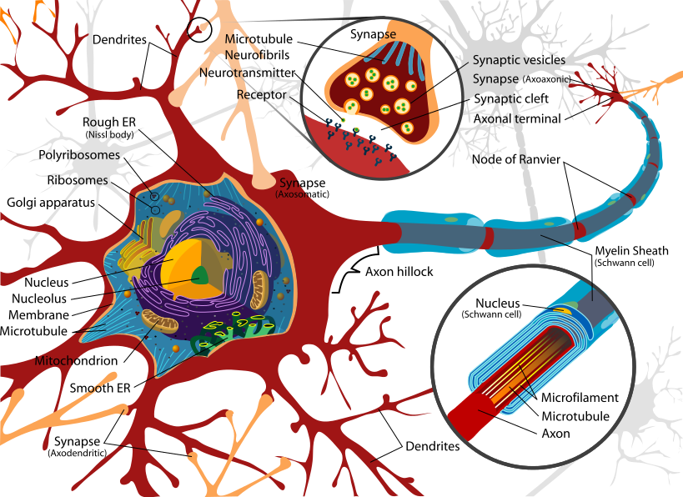

Slide 45
No. | Name | Brain division | Major functions
I | Olfactory | Telencephalon | Smell
II | Optic | Diencephalon | Vision
III | Occulomotor | Mesencephalon | Eye movement, papillary constriction
IV | Trochlear | Mesencephalon | Eye movement, papillary constriction
V | Trigeminal | Metencephalon | Sensory from face & head
VI | Abducens | Mylencephalon | Eye movement
VII | Facial | Mylencephalon | Motor of taste, face & some glands
VIII | Vestibulocochlear | Mylencephalon | Hearing & balance
IX | Glossopharyngeal | Mylencephalon | Motor to muscles of pharynx & taste
X | Vagus | Mylencephalon | Motor to muscles of larynx & glands
XI | Spinal accessory | Mylencephalon | Motor to muscles of neck
XIII | Hypoglossal | Mylencephalon | Motor to muscles of tongue

Slide 48
Equilibrium potential-
The concentration gradient attempts to move the ion across the membrane from a region of high to low concentration
The electrical gradient attempt to move cation across the membrane towards more –ve regions or an anion towards more +ve regions
The differential distribution of the ion across the membrane at dynamic equilibrium produces a voltage across the membrane called equilibrium potential for that specific ion
The difference between the resting potential & an ion `s equilibrium potential determines the magnitude of the driving force on the ion
While the ions charge determines the direction the ion will move in or out as it attempts to reach its equilibrium potential (E_{ion})

Slide 49
The opening or closing of different ion selected gated channels is responsible for changes in the relative permeability of the membrane to different ions
These are operated by the ATP concentration provided by the different ions for maintain the membrane equilibrium permeability
They are affected for the maintenance due to the difference in function, location, size, polarity, specific mechanism of initiation, mechanism of propagation & reliance on the magnitude of pre-synaptic input
Degeneration & Regeneration of nerve fibres:
Glia cells are classified as macroglia, microglia & ependyma present in CNS also k/a interstitial or neuroglia cells
They involved in k⁺ buffering & provide pathways for neuronal migration during development for axonal guidance during regeneration
They release cytokines in disease processes & proliferate or hypertrophy following injury.

Slide 50
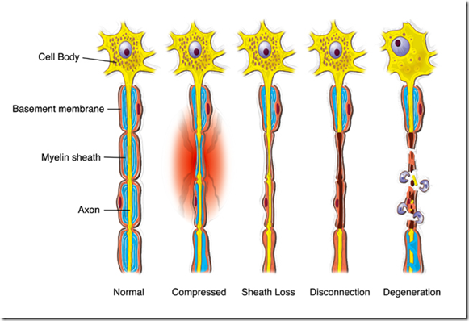

Slide 51
They just intimate contact with nerve cells & involved in Ca²⁺ buffering & neurotransmitter reuptake
They participate in the blood-brain barrier & are involved in CSF production
Ependymal cells unite with the pia mater & capillaries in the lateral, 3rd & 4th ventricles to form the choroid plexus for CSF production
It also serves as a selective barrier between the brain & CSF comportments
Regeneration of the nerve cells (neurons):
If a peripheral nerve crushed, the cell may undergo chromatolysis in response to the injury & characterized by swelling & displacement of the nucleus
Degenerating axons & mylein are phagocytised but not schwann cells
After few days, surviving axons begin to sprout & guided by the residual band of schwann cells
A lot of factors are responsible for regeneration like availability of neurotrophins (secreted by schwann cells)

Slide 52
If a CNS nerve injured, oligodendrocytes & vascular pericytes are reactive
The all phagocytised astrocyte (cell of macroglia) processes fill in the empty spaces forming dense glial scars & oligodendrocytes form mylein ensheatments around masses of cellular debris and regeneration may occur also possibly by releasing proteins that inhibit abnormal growth
Reflexes & pathway transmission of nerve to effectors tissue:
The PNS transmits sensory information from the body to the CNS & conveys motor commands from the brain & spinal cord to the periphery
Sensory neuron cell activated on stretching of the muscle via receptors
In response, action potentials are conducted centrally to synapse on motor neurons located in the grey matter of spinal cord
The reflex arc is completed by action potentials in motor neuron travelling to the neuromuscular junction in the periphery causing contraction of the stretched muscle

Slide 53
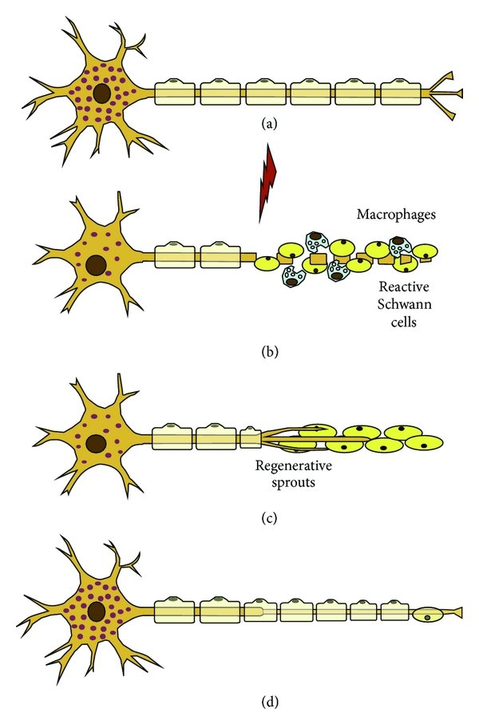
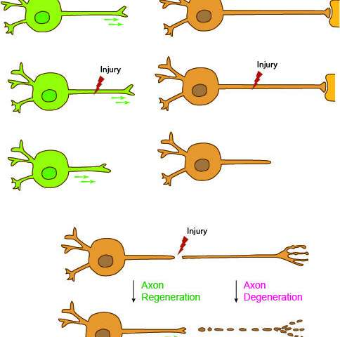

Slide 54
Variation on this reflex can include one or more inter neurons interposed both the sensory input & the motor input on both sides of the spinal cord
Autonomic Nervous System:
General Arrangement:
The ANS is also k/a vegetative visceral or involuntary nervous system & arranged as the SNS
It handles the body’s response to stress (fight or flight system)
The para-SNS responsible for homeostatic functions in the absences of stress & the enteric nervous system responsible for regulation of the G. I. system & modulated by SNS & PSNS
The SNS & PSNS home 2 efferent neuronal components

Slide 55
SNS:
Pre-ganglionic neurons- Cell bodies are located in the inter-mediolateral horn of the thoracic & lumbar region of the spinal cord
Postganglionic nerves- Cell bodies are located in the pre vertebral & para-vertebral ganglionic chains
sympathetic innervations of the upper thorax, neck & head arises from the top ganglia of the para-vertebral chain
PSNS:
Pre-ganglionic neurons- Cell bodies are in the brain stem & the sacral spinal cord whose axons innervate the various parasympathetic ganglions
Postganglionic neurons- Short axons innervate the tissue
Most tissue receive both SNS & PSNS innervations but the effects are antagonistic except in the sweat gland, piloreceptor muscles, uterus & most blood vessels
The quality of saliva produced differs as PSNS elicited profuse & watery while SNS elicited scant & viscous. Overall SNS & PSNS both innervate the salivary glands

Slide 56
Neurotransmitters:
The accomplishment of ANS is performed through the release of neurotransmitters, chemicals that act on membrane bound transmitter receptors & accomplished by local synaptic transmission as adrenal gland to act on remote receptors. These are
Under SNS-
Cholinergic →Acetylcholine
Adrenergic →N.E, epinephrine, Dopamine
Noradrenergic →cholecystokinin, Dynorphin, EnKephalin, neuropeptide ϒ, serotonin, somatostatin, substance P Under PSNS-
Cholinergic →acetylcholine
Noradrenergic → Neuropeptide ϒ, nitric oxide, substance P.
Under ENS-
Cholinergic → Acetylcholine
Noradrenergic → Bombesin, Dynorphin, serotonin, substance P, γ- amino butyric acid, neuropeptide ϒ

