Slide 1
Examination of urinary system Unit -2
By- Dr Sonam Bhatt
Assistant Professor
VMD
BVC Patna

Slide 2
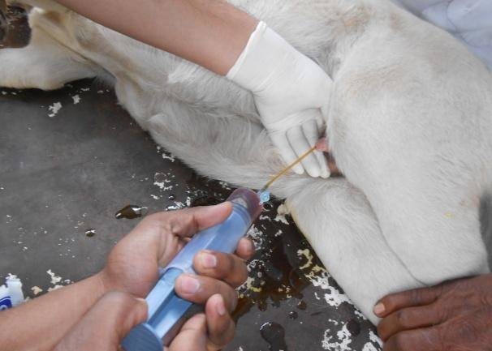
COLLECTION OF Urine
Free catch (mid stream voided)
Catheterisation
Cystocentesis
Should be analysed as rapidly as possible after collection, ideally within 30 min
If this is not possible, samples should be refrigerated immediately & stored preferably for more than 6 – 12 hours after collection
Preservatives:
Toluene
Thymol
Formalin

Slide 3
Analysis
Physical Examination of Urine:
Urine Volume
Color & transparency: Recorded while observing it in a test tube or in a urinometer cylinder
Normal : yellow to light amber & it depends primarily on the concentration of urochromes
Interpretation :
Yellow to amber- normal
Colorless to pale yellow – dilute urine with low specific gravity & polyuria
End stage renal disease
Excessive intake of water
Diabetes insipidus
Pyometra

Slide 4
Interpretation :
Dark yellow to yellow –brown: concentrated urine with high specific gravity & small quantity
1. Acute nephritis
2. Diminished intake of fluids
3. Dehydration – prolonged vomiting or diarrhea
4. Fever
Red, wine or brown:
Hematuria
Hemoglobinuria
Porphyrins
Brown to brownish black: hemoglobin
Myoglobin in azoturia
Horse: Normal color is yellow when voided, turns deep brown color upon standing (pyrocatechin)

Slide 5
Transparency: Clear, cloudy and flocculent
Interpretation:
Clear : normal urine, except in horse where it is thick & cloudy due to calcium carbonate crystals & mucus
Cloudy : not necessarily pathological
Epithelial cells
Blood
Leucocytes
Bacteria
Mucus
Crystals

Slide 6
Specific gravity:
Directly proportional to urine osmolality, solute concentration and urine density, or the ability of kidney to concentrate or dilute the urine over that of plasma
Valuable test, as concentrating ability of the kidneys is among the first sign of renal tubule
Recorded either using urinometer method or by a refractometer in cases when the urine quantity is very small
NORMAL: 1.015-1.050

Slide 7
Decreased specific gravity
Non pathologic:
Excessive water consumption –most common cause
Diuretics
Parentral fluids
Pathologic:
End stage renal disease
Diabetes insipidus
Pyometra
Increased specific gravity
Non pathologic:
Decreased water consumption –most common cause
High environmental temperature
Excessive panting
Pathologic:
Dehydration
Fever
Diabetes mellitus
Disease state in which abnormal solids are present in urine (protein, glucose)

Slide 8
Chemical examination
Urinary pH:
Alkaline: horse, cattle, sheep
Acid- dog, cat
Acid or alkaline : pig
Acid-
Excess protein
Starvation
Prolonged muscular activity
Acidosis
Alkaline-
Cystitis
Urine retention
Alkalosis

Slide 9
Urinary proteins:
Tests
Robert’s test
Sulfosalicylic acid test
Non pathological causes of proteinuria- high protein meal, exercise and stress
Pathological causes include renal disease, glomerular leakage of proteins occur, pyelonephritis, Bence- Jones proteinuria

Slide 10
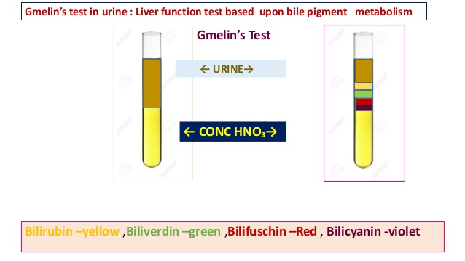
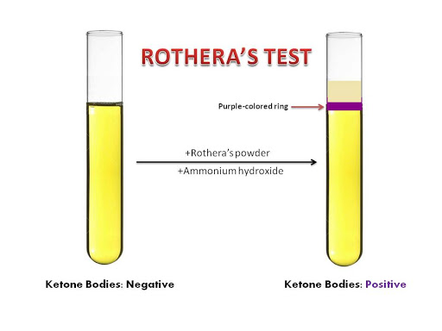
Glucose: Benedicts test
Acetone: Ross test (REAGENT : sodium nitroprusside; ammonium sulfate )
Bilirubin: Gmelin test (nitric acid ): bile duct obstruction, hepatic necrosis caused by infectious canine hepatitis, leptospirosis and other infectious diseases haemolytic diseases such as immune-mediatedhaemolytic anaemia

Slide 11
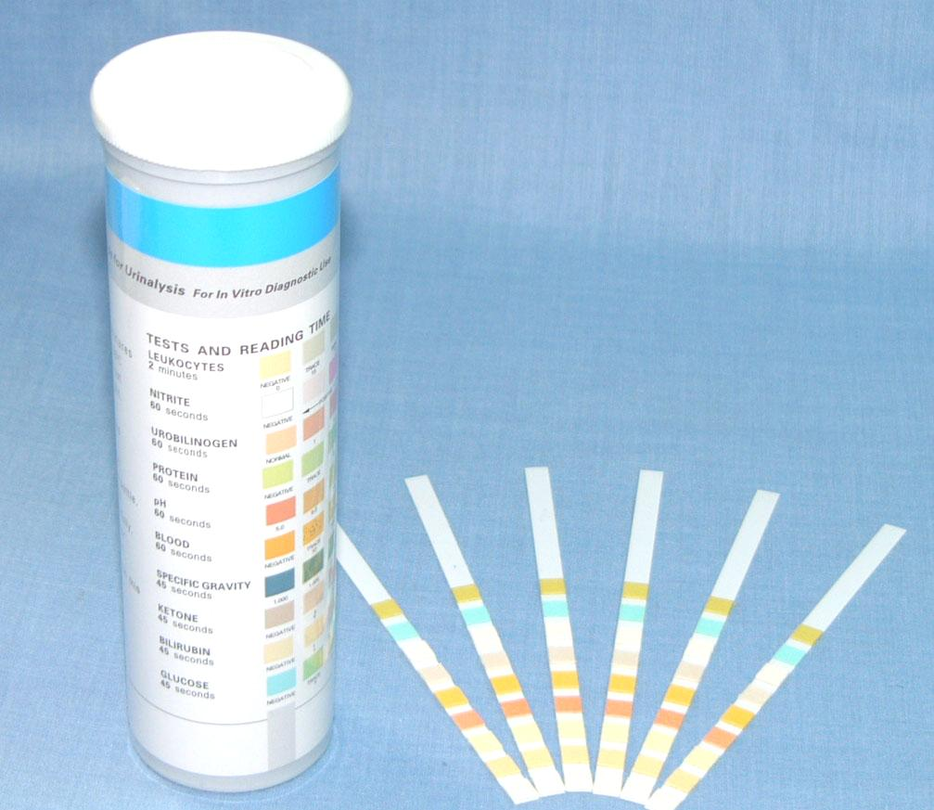
Dipstick method

Slide 12
Microscopic examination
Method:
Centrifugation
Put a sediment on the glass slide
Cover with a coverglass
Low power microscopy then high power
Organic sediments:
Epithelial cells: squamous epithelial cell; transitional epithelial cells; renal epithelial cells
Squamous epithelial cells: largest cell appearing in urine sediment
Irregular outline & occur singly or in sheets
Derived from urethra & vagina

Slide 13
Significance:
Certain number of epithelial cells in urine id normal
Squamous epi cells may appear in large number especially in voided samples from female animals
Pathologic condition : cystitis, pyelonephritis
Erythrocytes : round
Leucocyte or pus cells : appear as granular cell that are larger than erythrocyte & smaller than epithelial cells
Indications: contamination from genital tract
Urethritis
Cystitis, pyelitis, nephritis

Slide 14
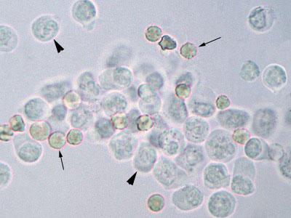
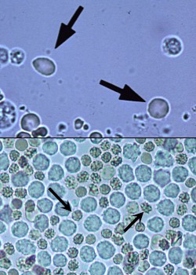
WBC; RBC
Upper: RBC in fresh urine are red with a smooth texture. Lower: RBCs in stored urine can crenate taking on a spiky appearance (arrows)

Slide 15
B. Casts: cylindrical bodies appearing in urinary sediments
Formed principally in the lumen of distal tubules & collecting tubules of kidney
When cells & cellular debris are present in the tubules, they are included in hyaline matrix at time of formation
Types of casts:
Hyaline cast: made of protein alone
Colorless, homogenous, semitransparent, cylindrical structures with parallel sides & usually rounded ends
Indicates mildest form of renal irritation

Slide 16
Granular cast: hyaline cast containing fine or coarse granules ; chiefly derived from disintegration of tubular epithelial cells
Most common type of cast seen in domestic animals
Indicates a more severe type of renal disease than hyaline cast, represent integration of renal tubular epithelium
Large numbers are usually associated with more severe renal disease involving necrosis of tubular cells
Epithelial cast:, waxy cast, fatty, blood, leucocytic, mucus & mucus thread
Significance:
Generally indicates degree of renal changes – renal irritation. Renal inflammation, renal degeneration
Microorganisms: bacteria, yeast, fungi, parasite

Slide 17
Unorganised sediment:
Crystals: Depends on pH
Normal: Acid urine: amorphous urates & uric acid
Alkaline urine: triple & amorphous phophates, calcium carbonate
Abnormal: minor significance; except in case of urolithiasis & few metabolic disturbance

Slide 18
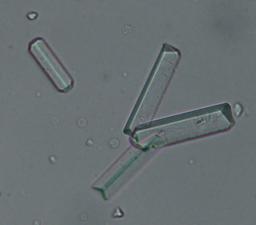
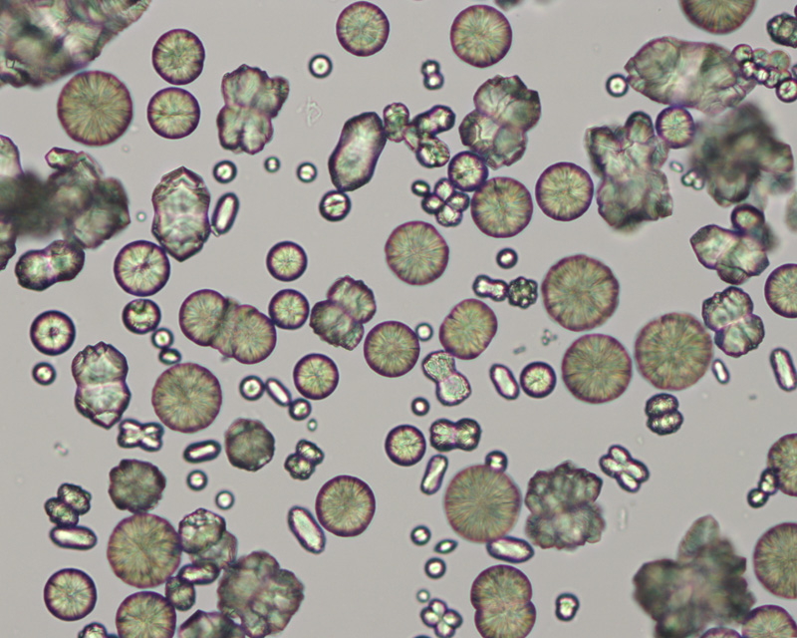
Struvite (coffin shaped)
Calcium carbonate

Slide 19
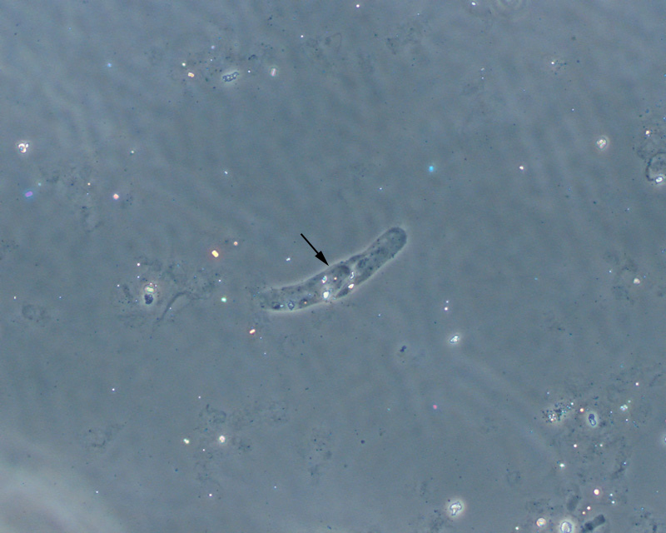
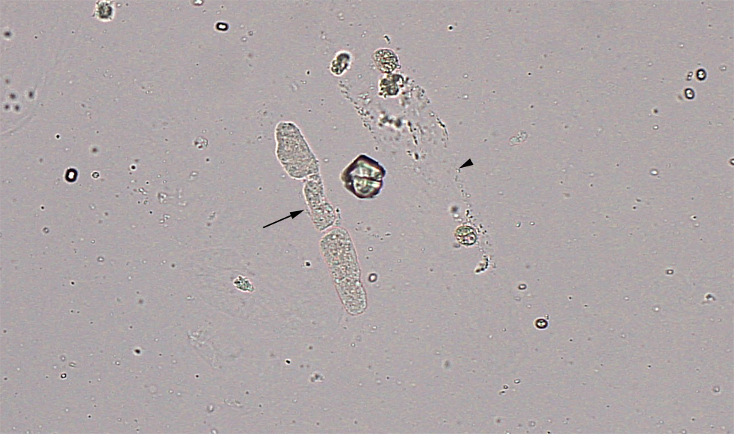
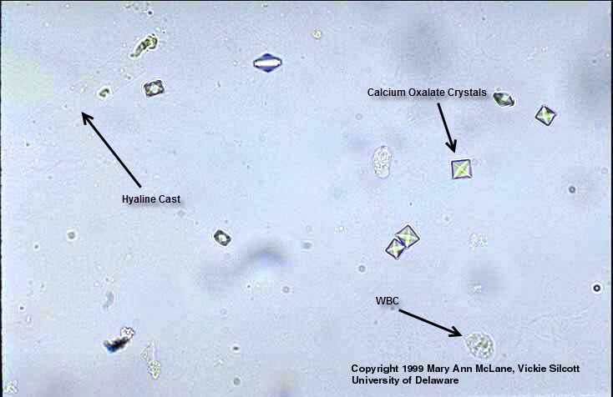
Hyaline cast
Granular cast

