Slide 1
SURGICAL SITE IN ANIMAL
UNIT-5 (REGIONAL SURGERY – II)
DR. MITHILESH KUMAR
Assistant Professor cum Jr. Scientist
Veterinary Surgery and Radiology
Bihar Veterinary College,
Patna-800014

Slide 2
INCISION SITES IN CATTLE:-
Right and Left flank incision remains most popular sites in ruminants.
Median, Paramedian and ventrolateral incision also used.
Extreme paramedian incision parallel and lateral to the Subcutaneous abdominal vein routinely used in for cs in large animal ruminants.

Slide 3
FLANK INCISION:-
Upper left flank laparotomy- Exploratory laparotomy, Rumenotomy, left flank abomasopexy and repair of ruptured UB.
Occasionally left flank incision used to remove a macerated or mummified fetus from uterus.
Lower left flank used for CS in sheep, goat, buffalo and cattle.

Slide 4
Upper right flank laparotomy include
Exploratory laparotomy, abomasopexy, omentopexy, surgical correction of intestinal obstruction and caecal dilatation.
UPPER FLANK INCISION:-
Middle of left paralumbar fossa.
Incision parallel to last rib to retrieve foreign body from reticulum.
Slightly oblique incision below the tubercoxae to approach to approach UB.

Slide 5
The skin is incised with smooth but firm pressure.
Dissection of the subcutaneous fossa and oblique muscle explore transverse abdominis muscle.
Transverse abdominis muscle and attached peritoneum incised altogether.
Avoid separation of transverse muscle and peritoneum.

Slide 6
Flank laparotomy incision sutured in two layer transverse muscle and peritoneum in one layer and obliquus muscle in other layer.
Skin sutured with simple interrupted or horizontal mattress.
In lower flank incision include the combined aponeurosis of the two obliquus muscle, rectus abdominis muscle and peritoneum.

Slide 7
Ventrolateral oblique incision
The incision is placed in front of the stifle and extends cranioventrally in a slightly oblique direction
Include skin, subcutaneous fascia and aponeurosis of the two oblique muscle, which form external sheath of rectus abdominis muscle, transverse abdominis muscle and peritoneum.

Slide 8
PARAMEDIAN INCISION :-
Region between linea alba and subcutaneous abdominal milk vein.
Used in cattle and buffalo.
Chance of dehiscence is not more if suture placed carefully and avoid contamination.
Ventrally placed incision are avoided due to requirement of assistance and control in dorsal recumbency.

Slide 9
Incision cranial to umbilicus and to the xiphoid process-Abomasopexy.
CS – lateral incision behind the umbilicus to the udder.
Structure include skin, external rectus sheath, rectus abdominis muscle and peritoneum.
Suturing of the subcutaneous tissue before closure of skin prevent seroma formation.

Slide 10
EXTREME PARAMEDIAN INCISION:-
Lateral to subcutaneous abdominal vein
Used for CS in buffalo and cattle.
Interlocking suture pattern for closure of muscle.
MEDIAN INCISION:
Midline incision over lenea alba in small ruminants.

Slide 11
Peritoneum and linea alba sutured together either simple interrupted or continuous lock stich pattern
POST XIPHOID INCISION:-
Crescent shaped incision for DH in cattle and buffalo
Incise the reticular abscess.
Interrupted horizontal mattress suture are used to close muscle and peritoneum with thick non absorbable suture.
Skin – horizontal mattress suture.

Slide 12
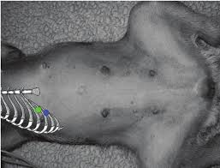

Slide 13
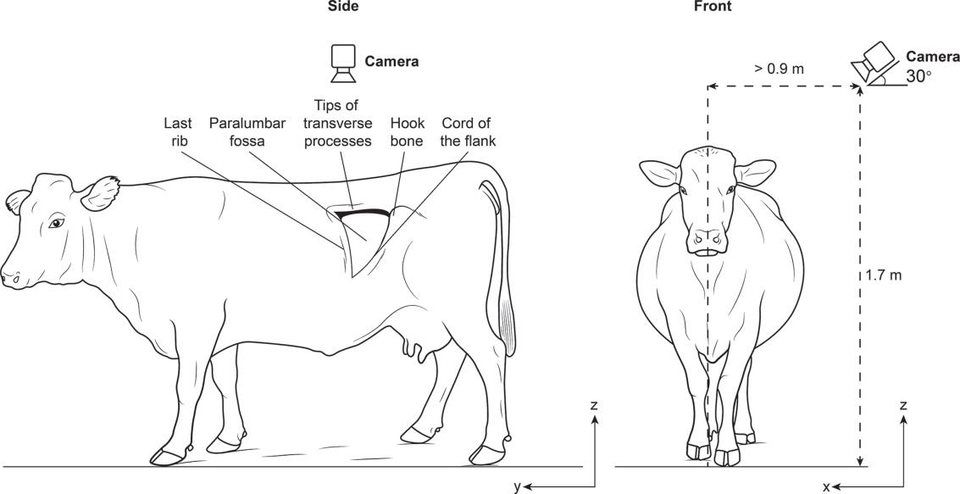

Slide 14
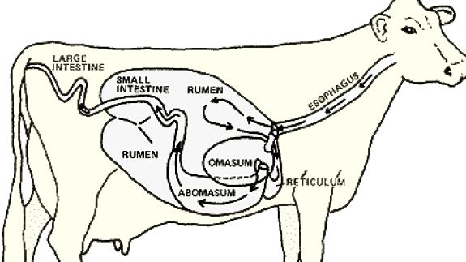

Slide 15
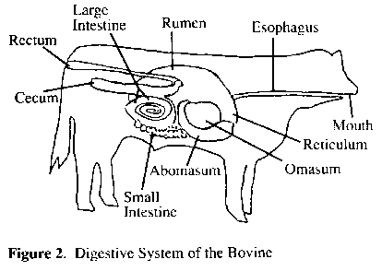

Slide 16
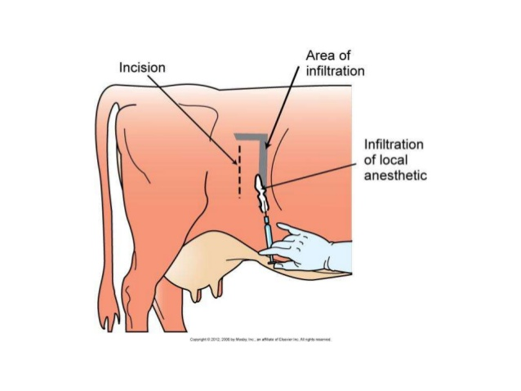
Inverted L – SHAPED INFILTRATION OF LA

Slide 17
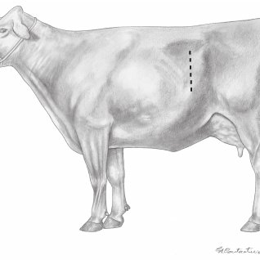
SURGICAL APPROACHES FOR CS.

Slide 18
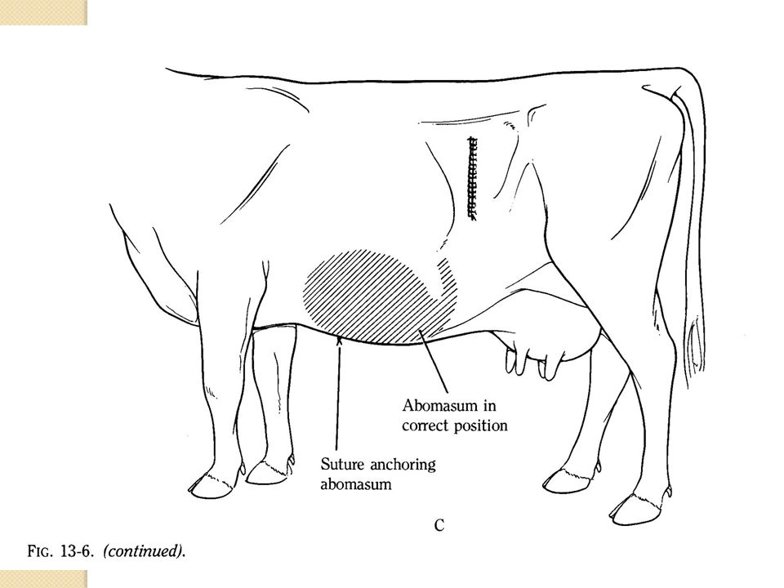

Slide 20
ABDOMINAL INCISION IN DOG
CS and Intussusception in dog – Midline incision.
Gastrotomy – Midline incision near post xiphoid.
Cystotomy- Midline incision behind umbilicus

Slide 21
THANKS

