Slide 1
CLASSIFICATION OF FRACTIRE
DR. MITHILESH KUMAR
ASSISTANT PROFESSOR CUM JR. SCIENTIST
VETERINARY SURGERY AND RADIOLOGY
BIHAR VETERINARY COLLEGE, PATNA

Slide 2
Fracture – Break continuity of bone and cartilage.
EXTENT OF BONE DAMAGE
1. Complete fracture:- Completely broken in two fragments
2. Incomplete fracture: - Partial loss of continuity observed in young
dog.

Slide 3
Complete fracture of bone

Slide 4
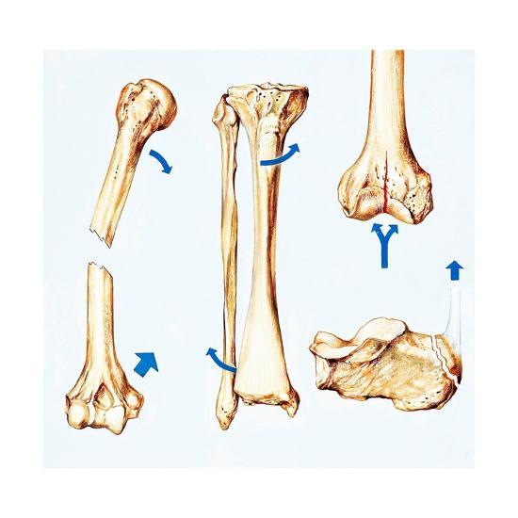
According to displacement of fractured bone
Impacted fracture –
driven into other bone
Distracted fracture –
gap due muscular pull
Depression fracture –
ex. Fracture of skull bone

Slide 5
According to severity of fracture
Simple fracture:- does not communicate with exterior of body.
Compound fracture or open: Fracture sites communicates with the exterior of body.
ACCORDING TO DIRECTION OF FRACTURE
1. Transverse fracture: Right angle to the long axis of bone.
2. Oblique : diagonal to the long axis of bone.

Slide 6
3. Spiral fracture- Spiral along the long axis of bone.
4. Comminuted – at least three fracture lines meet at common point.
5. Multiple – Three or more fragments do not communicate at a point.
6. Avulsion: Fragment of bone detached due to forceful muscular pull.

Slide 9
According to stability of fractured fragments
Stable fracture: - Interlock after reduction maintain their length.
Unstable fracture:- unstable after reduction e.g. comminuted fracture
ACCORDING TO LOCATION OF FRACTURE:
1. Diaphyseal fracture:- at mid shaft.
2. Metaphyseal fracture:- at metaphysis of long bone

Slide 10
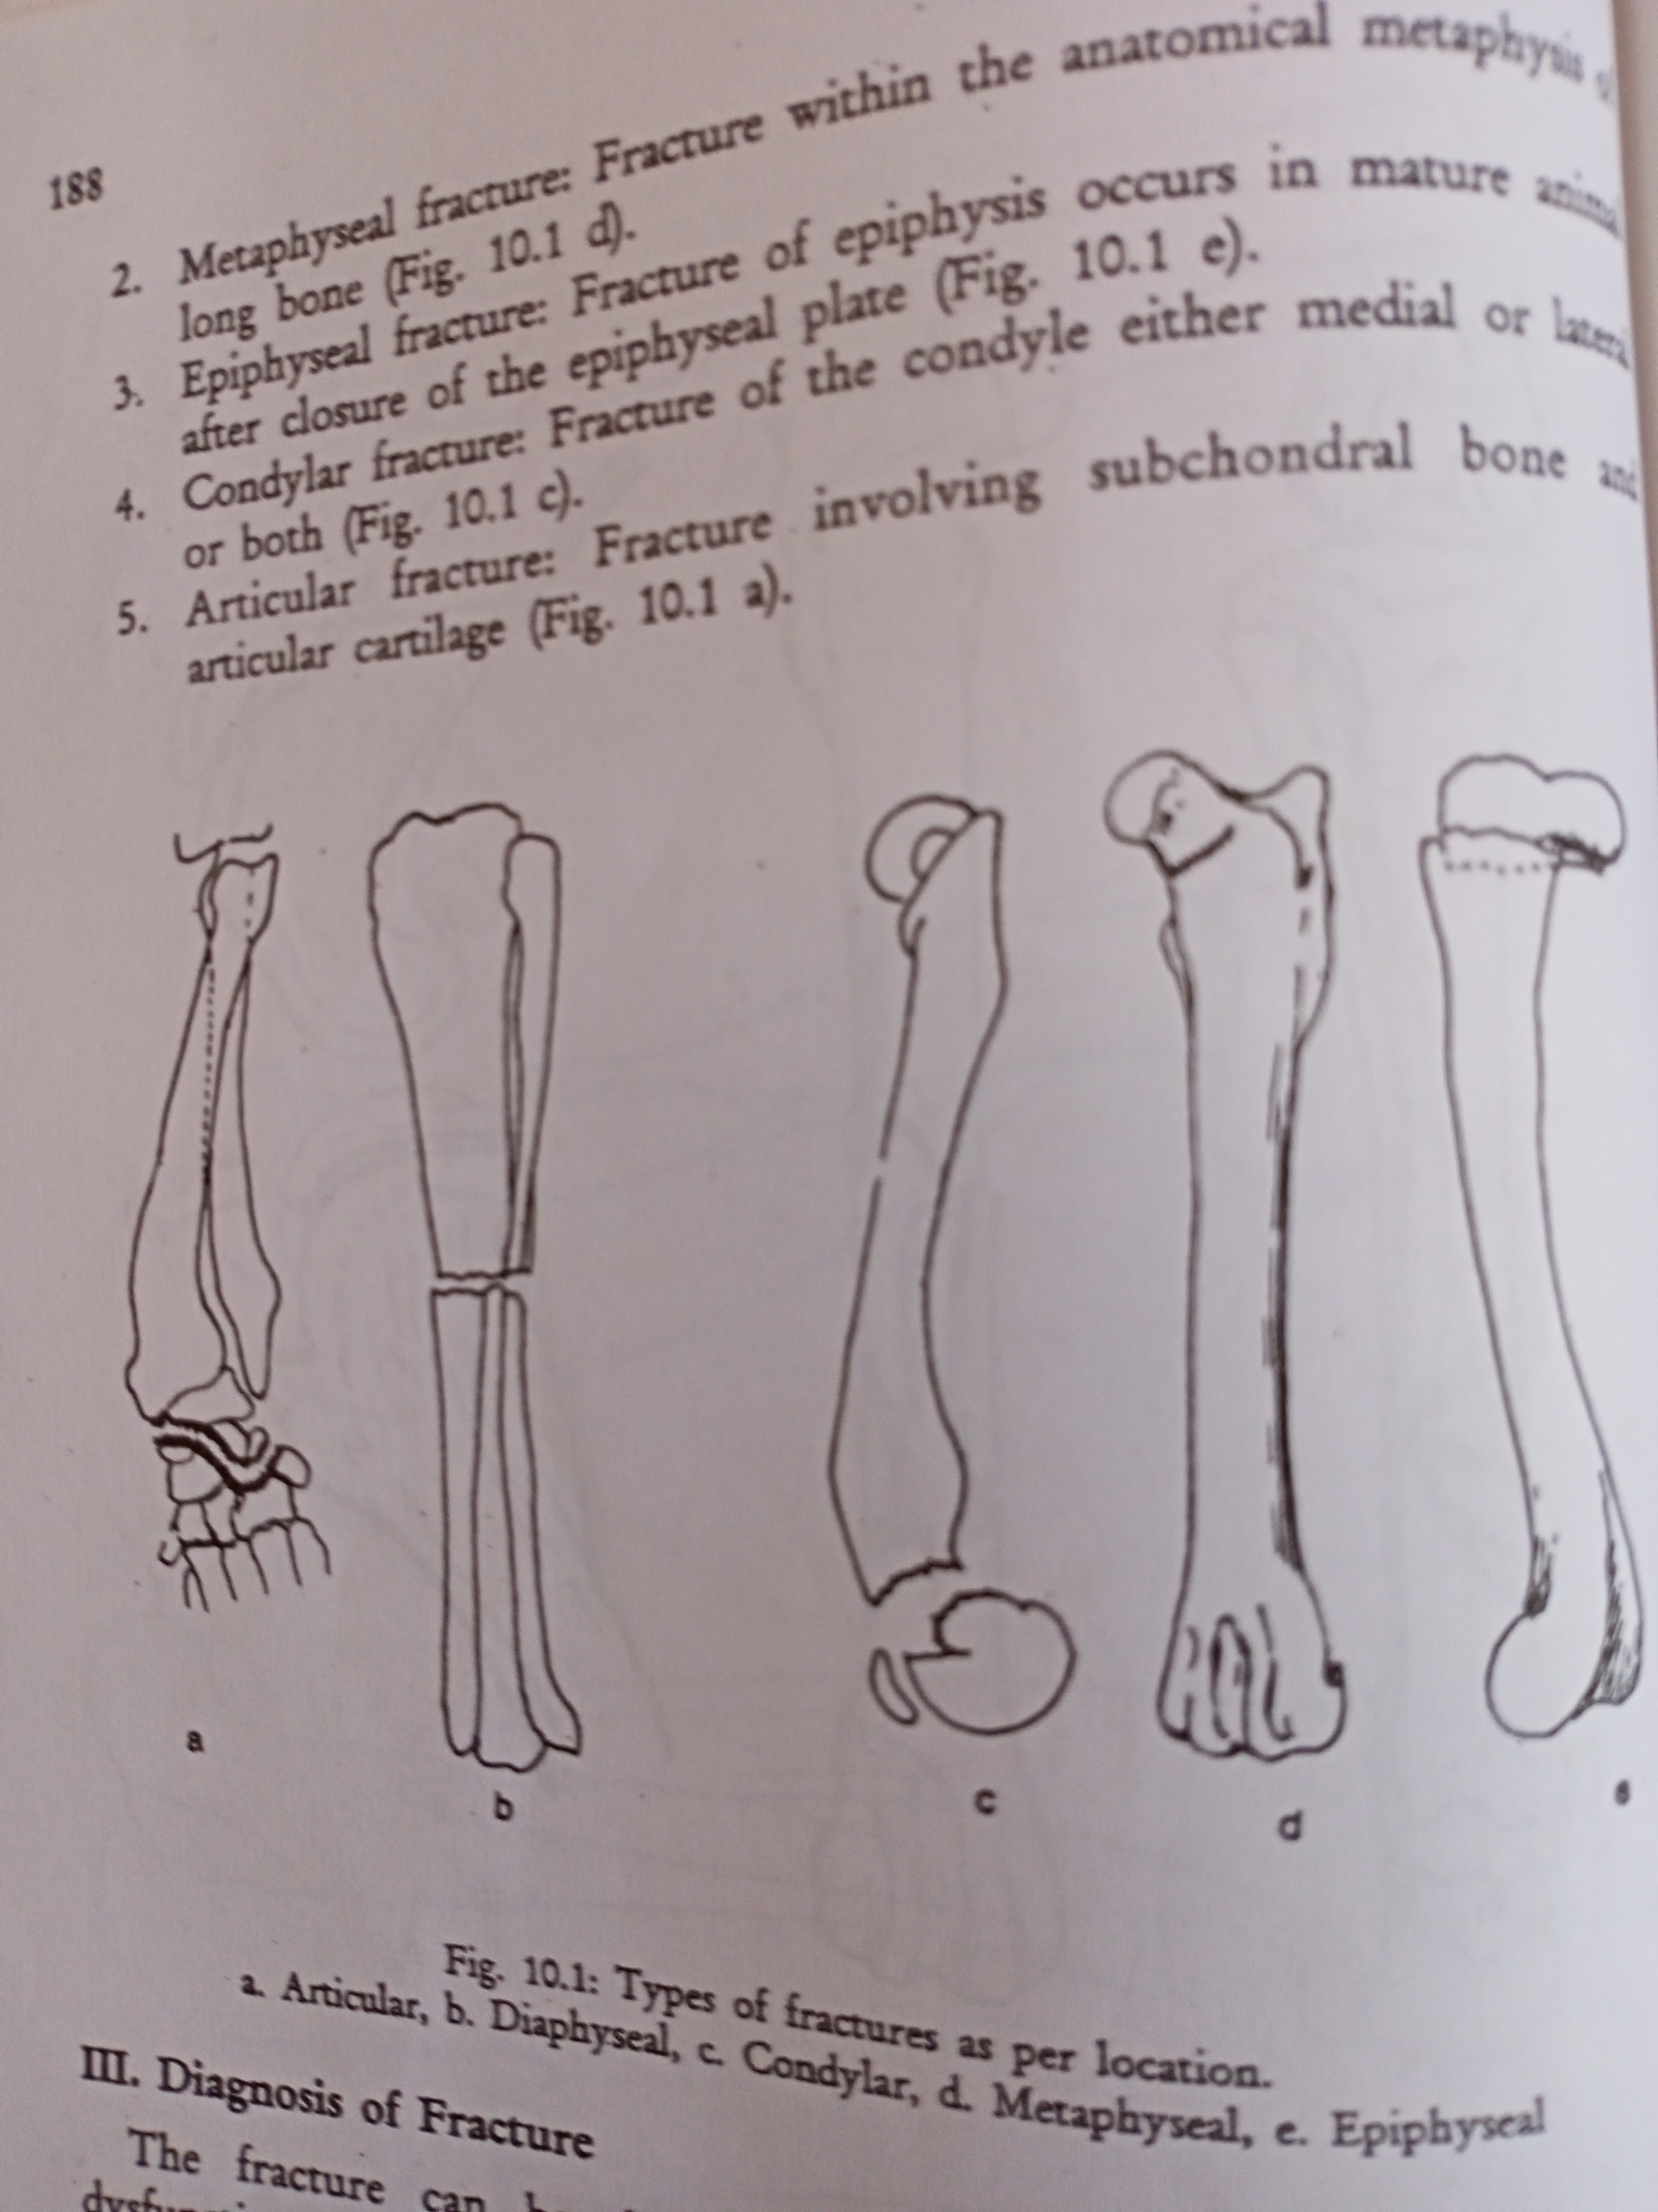
Epiphyseal fracture:- at epiphysis of mature animal
Condylar fracture:- at condyle
Articular fracture:- at subchondral bone and articular cartilage

Slide 11
DIAGNOSIS OF FRACTURE
Pain
Dysfunction
Local trauma
Abnormal posture
Crepitus
Radiographic signs

