Slide 1
Fluroquinolones
By: Rashmi Rekha kumari
Assistant Professor, BVC,Patna

Slide 2
Ouinolones
These are synthetic antimicrobials having a quinolone structure that are active primarily against gram-ve bacteria.
The first member Nalidixic acid was introduced in mid 1960s
Usefulness is usually limited to urinary and GIT infection
Have low potency, Modest blood and tissue level,
Limited spectrum of activity ( only gram-ve) and high frequency of bacterial resistance

Slide 3
Fluroquinolones
The carboxyl group at position 3 and ketone at position 4 are necessary for the antibacterial activity.
The Fluorine at position 6 differentiates the quinolones from fluoroquinolones and accounts for the improved gram –ve and gram+ve activity over nonfluoronated quinolones, increased potency and increased entry into bacteria.
Additiom of piperazine at position 7, as demonstrated for ciprofloxacine and enrofloxacine improves spectrum of activity to include pseudomonads group, among other gram –ve bacteria.

Slide 4
Newer generation of quinolones have a bicyclic substitution at position 7, insteade of piperazine. This increases the activity to include wider range of bacteria.
A substitution at 8 position on the ring enhances the bactericidal effect and improves the spectrum of activity to include more gram positive bacteria and anaerobes( Moxifloxacin, pradofloxacin)

Slide 5
First generation (Original quinolones): Nalidixic acid ,oxolinic acid ,cinoxacin, and resoxacin: These are primarly active against Gram negative bacteria specially coliforms but not against Pseudomonas .Their use is restricted only for the treatment of urinary and GI tract infections because of their CNS toxicity, low potency ,moderate blood and tissue levels ,limited spectrum and high incidence of bacterial resistance.
Second generation (Fluoroquinolones: FQs): Ciprofloxacin, enrofloxacin ,norfloxacin, difloxacin, ofloxacin, danofloxacin, marbofloxacin and flumequine : Additional of one or fluorine atoms and other substitutions in the quinolone molecule yield fluoroquinolones with enhanced antibacterial potency, expended spectrum , better tissue penetrability ,reduced toxicity and retard development of bacterial resistance.

Slide 6
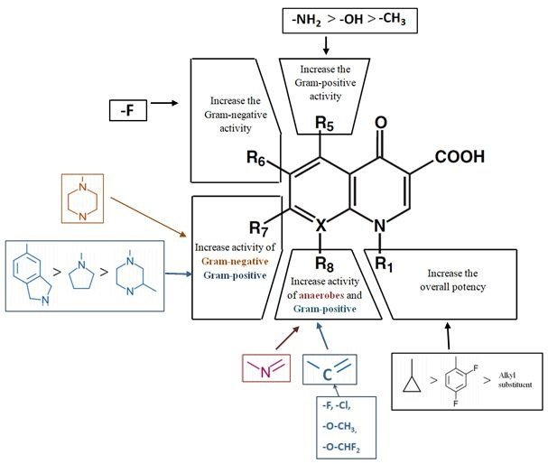

Slide 7
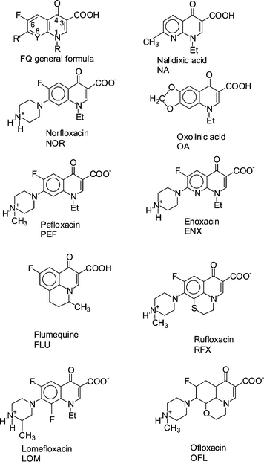

Slide 8
Generations Used In Vety. Medicine)
1st | Nalidixic acid
2nd | Ciprofloxacin, enrofloxacin ,norfloxacin, difloxacin, ofloxacin, danofloxacin, marbofloxacin, orbifloxacin and flumequine
Used In Medical practice

Slide 10
Spectrum of Activity
Fluroquinolones are highly active against a broad range of aerobic Gram negative and Gram positive bacteria.
The most susceptible ones are the aerobic Gram negative bacilli (MIC˂ 0.1 ug/ml) especially the Enterobacteriaceae (E. coli, klebsiella spp.Proteus spp., Salmonella spp.,enterobactor spp., and Neisseria. Pseudomonas aeruginosa is variably susceptible. (But high MIC, CIPROFLOXACIN)
GRAM+VE bacteria are variably susceptible, (staphylococcus aureus and other staph spp., But MIC value is higher)
They are also effective against several intracellular pathogens (Brucella spp) and have significant activity against Mycoplasma and chlamydia spp.
Some are also active against Mycobacteria (ciprofloxacin, olfloxacin)

Slide 11
Mechanism of action
Bactericidal
Inhibit bacterial replication and transcription
The separation of double stranded DNA is essential for replication or transcription
However, anything that separates the strands results in over winding or excessive positive supercoiling of the DNA in front of the point of separation and damage of DNA .
To prevent this, the bacterial enzyme DNA gyrase nicks the double stranded DNA and introduces negative supercoil and then reseals nicked ends.

Slide 12
The DNA gyrase enzyme consist of two A subunit and two B subunits.
During DNA transcription or replication the A subunit nicks the DNA, B subunits introduces a negative supercoil and then A subunit again reseals the strands.
Fluoroquinolones bind to A subunit of DNA gyrase enzyme with high affinity, inhibit it, interfere with DNA replication or transcription and ultimately cause DNA damage
The bactericidal action results from digestion of DNA by exonucleases whose production is singled by damaged DNA.

Slide 14
In gram+ve bacteria the major target of FQ action is a similar enzyme topoisomerase IV which nicks and separate daughter DNA strand after DNA replication.
The mammalian cells possess an enzyme topoisomerase II (analogus to bacterial DNA gyrase which also removes positive supercoils) which has very low affinity for fluoroquinoles and hence are less toxic to the host cell.
Quinolones are synergistic with beta-lactam, aminoglycosides and metronidazole

Slide 15
The mammalian cells possess an enzyme topoisomerase II (analogus to bacterial DNA gyrase which also removes positive supercoils) which has very low affinity for fluoroquinoles and hence are less toxic to the host cell.
Quinolones are synergistic with beta-lactam, aminoglycosides and metronidazole

Slide 16
Pharmacokinetics: Quinolones are commonly administered orally, IM, SC, IV and also topically.
Oral bioavailability in Monogastric animal is about 80% (food delays absorption ) for most quinolones but in adult ruminant it is low.
FQs have high tissue penetrability and wide distribution to the tissues and fluids .Some members also cross the blood-brain barrier and attain high concentration in CSF (prefloxacin).

Slide 17
Some are eliminated unchanged (ofloxacin) and some are metabolized in liver and the metabolites (sometimes active ;enrofloxacin to ciprofloxacin) undergoes glucronidation and are mainly excreted by kidneys ,both by glomerular filtration and tubular secretion,
In some cases (ciprofloxacin, pefloxacin) the parent drug as well as metabolites are mainly eliminated in bile.
Quinolones also appear in milk when administered to lactating animals. Nitrofurantion (bacteriostatic) interferes with efficacy of quinolones (bactericidal).

Slide 18
Clinical uses
FQs have broad spectrum of activity, oral as well as parenteral efficacy, high tissue penetrability and good tolerability.
FQs are extensively used for blind therapy,
They should not be used for minor infections or where Gram positive organisms are primarily suspected.
In severe infections, the treatment should be started parenterally.
They are particularly good for deep seated infections and for intracellular pathogens.
They are used in Gram negative septicaemias; respiratory tract ,GI tract ,urinary tract, skin and eye infection ,also in meningoencephalitis,bacterial prostitis, osteomyelitis, arthritis and mastitis .

Slide 19
In human, some members are also used in the treatment of typhoid (ciprofloxacin; drug of choice) and tuberculosis.
Doses of fluoroquinolones:
Norfloxacin: Dog & cat; 10-20 mg/kg, orally twice a day.
Ciprofloxacin: dog 5-15 mg/kg, orally twice a days.
Enrofloxacin; Dog & cat: 5 mg/kg orally, once a day, 2.5 mg /kg SC.
Cattle, calves & pig: 2.5-5 mg /kg IM or SC once in a day.
Marbofloxacin: Cat & Dog: 2.5 -5 mg/kg orally once in a .day
Orbifloxacin: Cat & dog: 2.5- 7.5 mg/kg orally once in a day.

Slide 20
Toxicity of quinolones
GI disturbances (vomiting, diarrhea etc.) neurotoxicity (convulsions, GABA antagonism) at high doses. Causes.
Fluoroquinolones are relatively safer than older quinolones.
FQs cause arthopathic toxicity (erosion of cartilage in weight bearing joint).
Dogs are the most susceptible species (mainly in pups/growing dogs), but also occurs in young foals.

