Slide 1
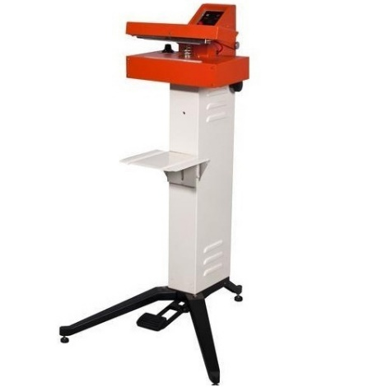
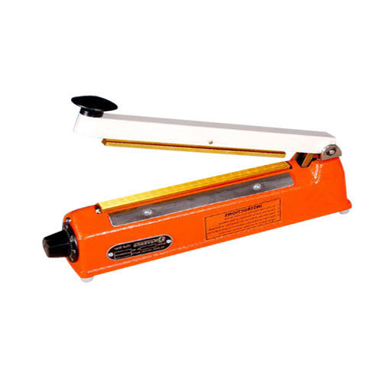
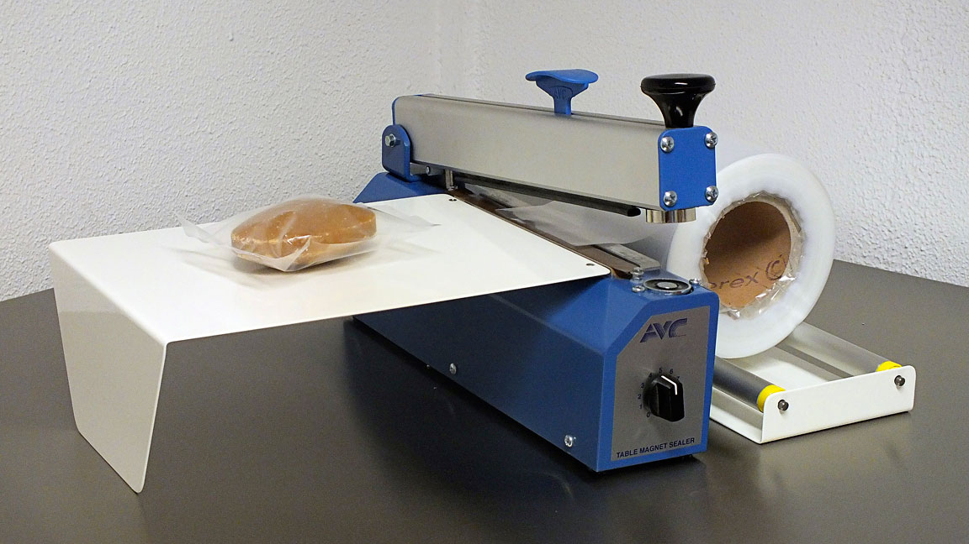
Heat & Impulse Sealing
Subject: Fish Packaging Technology
Date of Lecture: 20.05.2020
By
Dr. Abhishek Thakur
(Assistant Professor)
College of Fisheries, Kishanganj
BASU, Patna

Slide 2
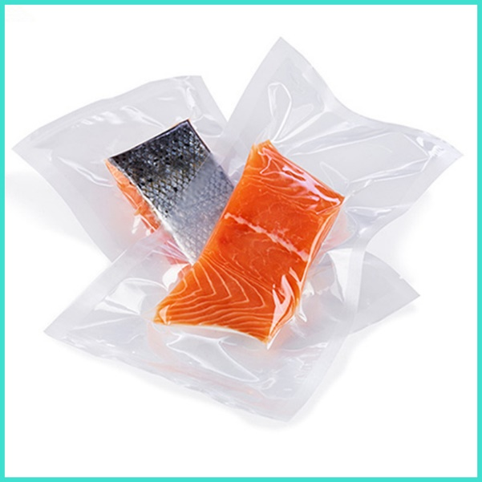
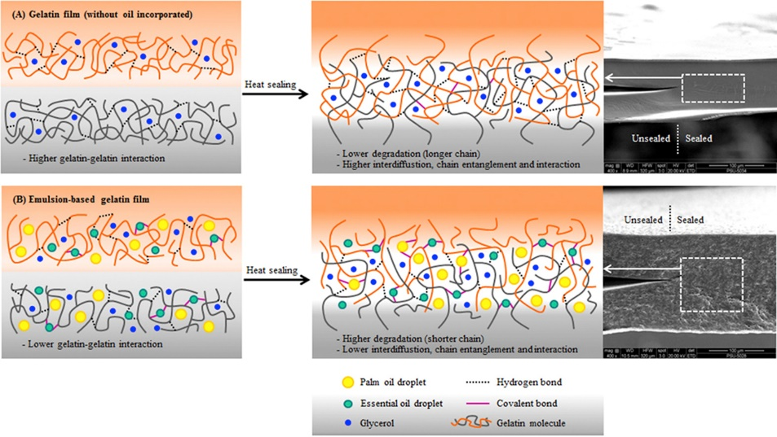
Heat sealing
It is an effective way of closing packages.
Any material which is to be sealable by heat welding must either be fully thermoplastic (that is the plastic becomes fluid when heated and solidify again on cooling) or should have a layer of a thermoplastic.
During heat sealing, two layers of thermoplastic films are held together under pressure, melt on heating, fuse into one another and seal together on cooling.

Slide 3
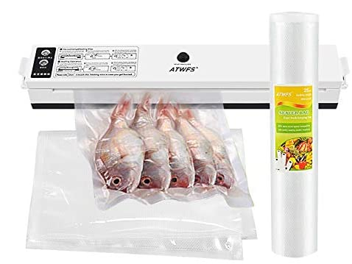
Factors affecting Sealing
Three factors that control the effectiveness of a heat seal:
Pressure,
Temperature &
Dwell time
The dwell time is usually taken to mean the time during which the sealing jaws are closed.
Hot bar sealing: same as time for which the heat is applied
Impulse sealing: it also includes the cooling time.

Slide 4
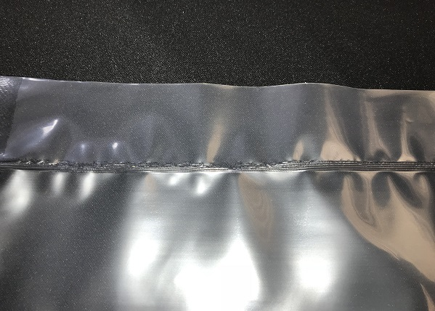
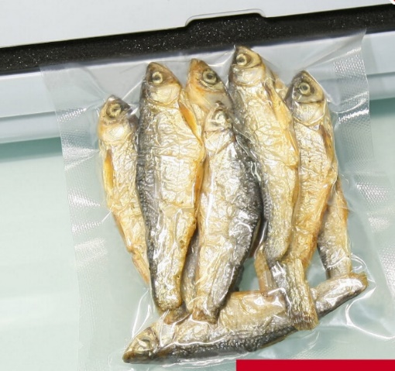
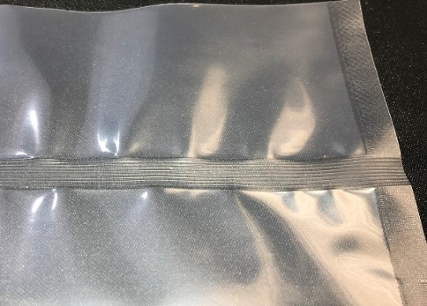
Formation of Good Seal
Each thermoplastic material has its own particular range of sealing pressure, temperature and time over which it will form a good heat seal.
Immediately after the heat sealing, the process joints are soft and don’t have much mechanical strength.
The original strength returns only after cooling (setting) to about room temperature and stresses should not be applied during this coating period.

Slide 5
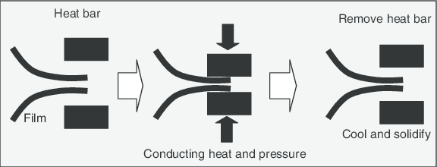
Hot plate/hot bar/continuously heated hot jaw sealing

Slide 6
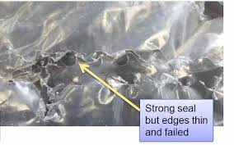
Hot plate/hot bar/continuously heated hot jaw sealing
Two films to be sealed are placed between the two bars that form the jaw. Either one or both the jaws may be heated and one moves to clamp the two films together.
The films now in contact melt into one another at the adjacent surfaces. The heating time may vary from 1/20th of a second to several seconds and is controlled by the time/during which the jaws remain closed.

Slide 7
Hot wire sealing
This gives a bead seal. A hot wire contacts the two films placed between it and the opposing unheated surface.
The wire is raised to red hot temperature electrically which seals and cuts the film at the same time.
Heat sealers use a low volatage electric current to generate heat in the sealing wires.

Slide 8
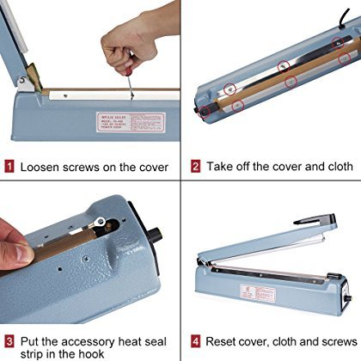
Hot wire sealing

Slide 9
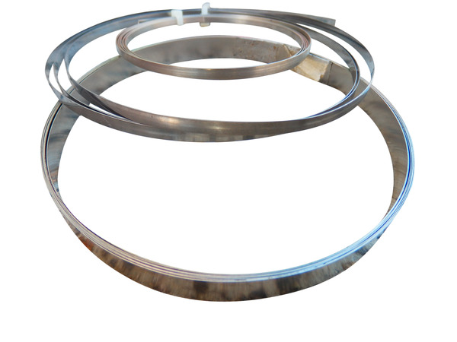
Hot wire sealing
Sealing wire can be a ribbon material and is typically made from nickel chrome material which is flat in 2mm, 3mm, 5mm or even 10mm, while a round wire is used for cuting and sealing on a Shrink a Pack Shrink wrapper or on Impulse sealers when excess film is requires to be cut of.

Slide 10
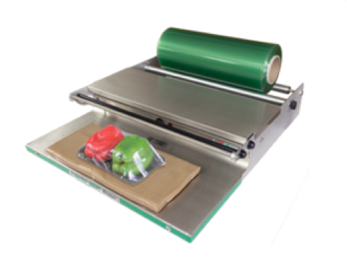
Hot wire sealing
This method can be used on homogeneous thermoplastic materials which can tolerate high temperatures for atleast a short time and which have a low viscosity in the fused state.
This method is mainly used for the manufacture of bags and pouches from polyethylene film in tubular form.
This method is particularly suitable for cutting PVC cling films or shrink wrap film.

Slide 11
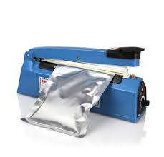
Impulse sealing
In this method, both the jaws are initially cold and on closing an electric current passes for a short time through a resistance heater placed in one jaw which gets heated rapidly and the films melt together (The jaws are covered with a special film of Teflon to prevent sticking).
The jaws remain closed during heating and till the seal is cooled and the seal sets.
Impulse sealing is used for homogeneous thermoplastic films, e.g. polyethylene, polypropylene and for films, in which shrinkage does not take place during sealing.

Slide 13
High frequency heat sealing
The sealing metal bars, or the jaws connected to a high frequency alternating electrical supply.
When the electric current is passed, an alternating electric field is generated, causing the molecules to vibrate and generate heat within the material.

Slide 14
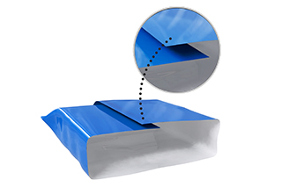
Type of heat seals
Lap seal: In a lap seal, opposite surface of a sheet film are sealed together. Therefore for this type of seal, both the surfaces need thermoplastic coatings.

Slide 15
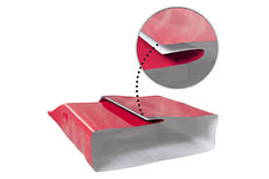
Type of heat seals
Fin seal: In this type the same surface of the sheet is sealed together, therefore such seals can be made using one side coated material. Since fin seals protrude from the pack, no pressure is exerted on the contents during sealing. The fin seal may be crimped or corrugated along the seal for better strength.

Slide 16
Type of heat seals

Slide 17
Type of heat seals
Bead seal: At the end of the pack, the edges are melted together to form a narrow weld. Bead seal can only be made using homogeneous thermo plastic film.

Slide 18
Criteria for proper heat sealing and to produce a reliable seal
Fusion is a necessary requirement for formation of an acceptable heat seal. It occurs when the opposing seal surfaces are welded together so that is not possible to distinguish visually sealing surfaces at the inner seal junction.
Fusion sometimes does not occur as a result of contamination of the sealing area with water, grease or particulate matter. Hence contamination of seal area should be avoided.
Clouding due to decrease in time of sealing. This is due to structural reorganization of polymers.
Wrinkles in the sealing are occur due to slightly differing amounts of plastic material on the two sides of the seal. This can also be due to slippage of sealing bars.
Blisters in the heat seal area are due to entrapment of water, grease or food particles.

Slide 19
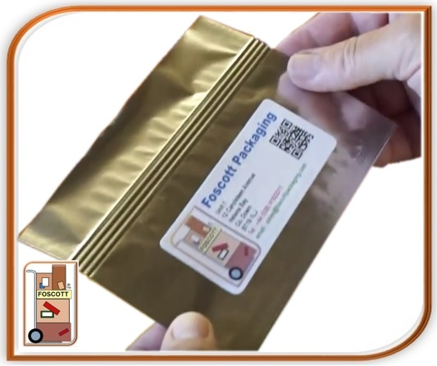
Crimping in heat seals
To understand why crimping of heat seals are done, it is necessary to study the stresses acting on the heat seal. The air stresses and pack stress act on the heat seal as shown in the figure.

Slide 20
Cold Seal
For packaging of heat sensitive materials like creams, chocolates (which melt at higher temperature in flexible packages) usually cold seals are made.
Cold seals both the surfaces involved in sealing must be coated with natural rubber compounds at the sealing area and sealing is achieved by applying only pressure.
Rubber is the only material which attaches to itself just by applying pressure.

Slide 21
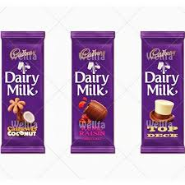
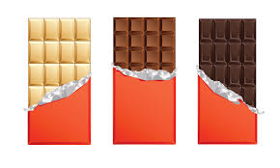
Cold Seal

Slide 22
https://www.youtube.com/watch?v=n8q-vMnze2A
https://www.youtube.com/watch?v=xbQg-LaHDdg&list=PLnL0T2ZTs-OXyOD_4q_h0eCiFqzOGnyoz
https://www.youtube.com/watch?v=jti5aF9BI5Q&list=PLnL0T2ZTs-OXyOD_4q_h0eCiFqzOGnyoz&index=6

Slide 23
Thank You

